Slide 1
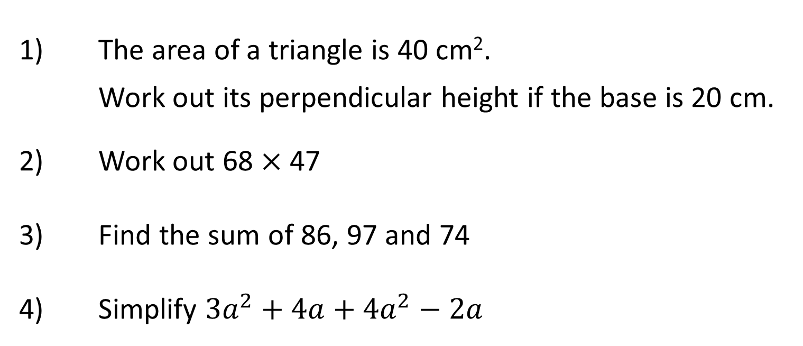
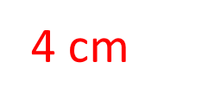
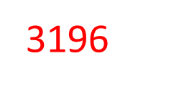
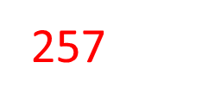
Which is Larger?

Slide 2
What is this diagram showing?
What can you tell me about number lines?
What is different about this number line? What is the same?
-8
-7
-6
-5
-4
-3
-2
-1
0
1
2
3
4
5
6
7
8
Notes:
Use “negative 3” instead of “minus 3” – discuss with students how the use of the word minus can be confusing as it has two meanings

Slide 3
Which is larger 3 or 5?
Which is larger _3 or _5?
How do you know?
Notes:
Use “negative 3” instead of “minus 3” – discuss with students how the use of the word minus can be confusing as it has two meanings

Slide 4
-8
-7
-6
-5
-4
-3
-2
-1
0
1
2
3
4
5
6
7
8
Which is the bigger number?
5 or −2?

Slide 5
Which is the bigger number?
5 or −2?

Slide 6
-8
-7
-6
-5
-4
-3
-2
-1
0
1
2
3
4
5
6
7
8
Which is the bigger number?
−5 or −2?

Slide 7
Which is the bigger number?
−5 or −2?

Slide 8
-8
-7
-6
-5
-4
-3
-2
-1
0
1
2
3
4
5
6
7
8
Which is the bigger number?
−7 or −1?

Slide 9
-8
-7
-6
-5
-4
-3
-2
-1
0
1
2
3
4
5
6
7
8
Which is the bigger number?
0 or −6?

Slide 10
-8
-7
-6
-5
-4
-3
-2
-1
0
1
2
3
4
5
6
7
8
Which is the bigger number?
−3 or −4?

Slide 11
-8
-7
-6
-5
-4
-3
-2
-1
0
1
2
3
4
5
6
7
8
Order these numbers from smallest to biggest.
0, −6, 7
−6, 0, 7

Slide 12
-8
-7
-6
-5
-4
-3
-2
-1
0
1
2
3
4
5
6
7
8
Order these numbers from smallest to biggest.
−3, 3, −5
−5, −3, 3

Slide 13
Order these numbers from smallest to biggest.
−3, −4, −2
−4, −3, −2

Slide 14
Order these numbers from smallest to biggest.
−1, −6, −4
−6, −4, −1

Slide 15
Order these numbers from smallest to biggest.
−4, −2, 1, −7, −13
−13, −7, −4, −2, 1

Slide 16
Put these numbers in ascending order:
45, 9, −23, −17
−23, −17, 9, 45
Answer

Slide 17
Put these numbers in descending order:
−17, −23, 25, −16
25, −16, −17, −23,
Answer

Slide 18
1. For each question,
circle the biggest number:
a) 5 & −5
b) −10 & −5
c) 0 & −10
d) −7 & −8
e) −9 & −18
f) −25, −50, & 30
2. Put these sets of
numbers in order,
from smallest to biggest.
a) 6, −5, 8, −4
b) −13, −15, 17, 0, −8
c) 3.5, −4, 7, −9, −22
d) 0, −5.5, −8, 5, −3, −6
3. If you start at −5 and increase the number by 8, where on the number line are you now?
4. If you start at 4 and decrease the number by 10, where on the number line are you now?

Slide 19
1. For each question,
circle the biggest number:
a) 5 & −5
b) −10 & −5
c) 0 & −10
d) −7 & −8
e) −9 & −18
f) −25, −50, & 30
2. Put these sets of
numbers in order,
from smallest to biggest.
a) 6, −5, 8, −4
−5, −4, 6, 8
b) −13, −15, 17, 0, −8
−15, −13, −8, 0, 17
c) 3.5, −4, 7, −9, −22
−22, −9, −4, 3.5, 7
d) 0, −5.5, −8, 5, −3, −6
−8 , −6, −5.5, −3, 0, 5
3. If you start at −5 & increase the number by 8, where on the number line are you now?
3
4. If you start at 4 & decrease the number by 10, where on the number line are you now?
−6

Slide 20
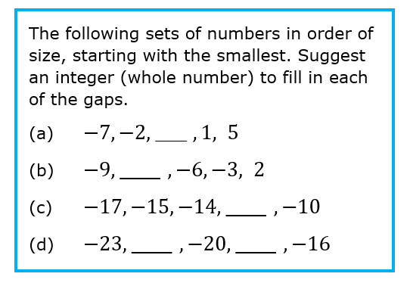
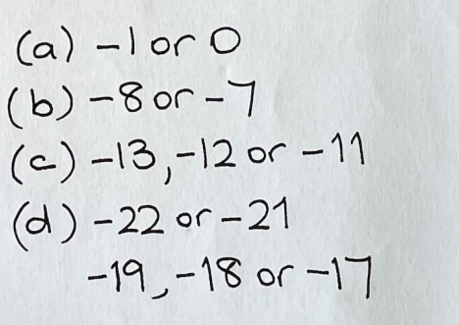

Slide 21
Greater than or less than? Fill in the correct inequality sign
?
$$−3<−2$$
$$−13>−21$$
$$−3.5<−3.4$$
?
?

Slide 22
