Slide 1
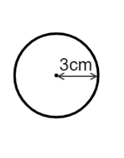
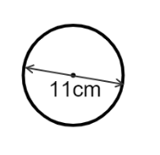
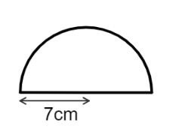
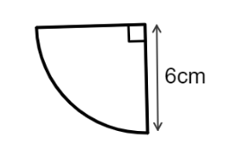
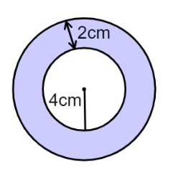
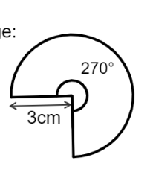
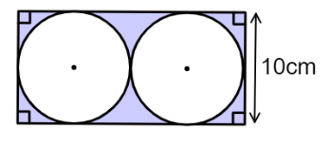
Draw these shapes in your book accurately

Slide 2
Circle
Loci
The locus of a point is the path traced out by the point as it moves through 2D or 3D space.
The locus of a point that moves so that it remains a constant distance from a fixed point p?
Draw the locus of a point that moves so that it is always 4cm from the fixed point p.
p
p
4 cm
A circle

Slide 3
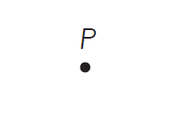
On your mini whiteboard…
Sketch the locus of point 3cm from point P
Notes:
This set of questions encourage students to think about what the locus will look like before accurately drawing these later in the lesson.

Slide 4
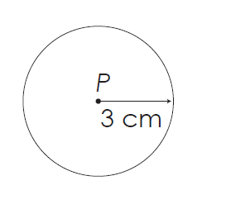
The locus of point 3cm from point P

Slide 5
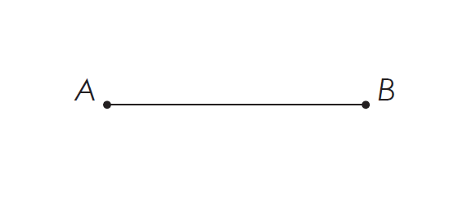
On your mini whiteboard…
Sketch the locus of points that are 3cm from line AB

Slide 6
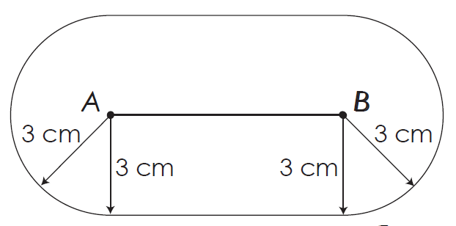
The locus of points that are 3cm from line AB

Slide 7
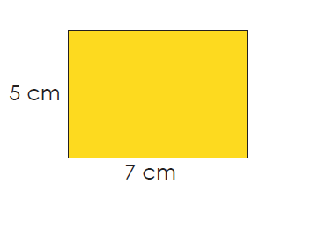
On your mini whiteboard…
Sketch the locus of points that are 3 cm from the perimeter of the rectangle.

Slide 8
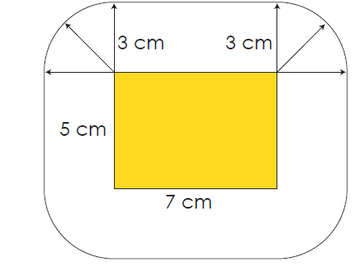
The locus of points that are 3 cm from the perimeter of the rectangle.

Slide 9
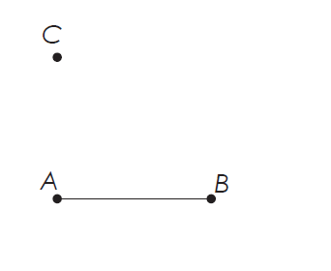
On your mini whiteboard…
Show on the diagram the region which is less than 3 cm from both the line AB and point C.
AC > 3cm

Slide 10
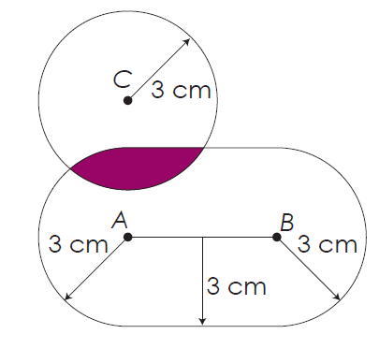
The region which is less than 3 cm from both the line AB and point C.
AC > 3cm

Slide 11
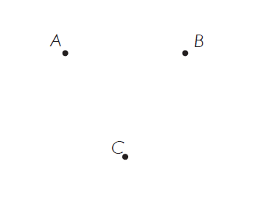
On your mini whiteboard…
Shade the region that is less than 4 cm from all points.

Slide 12
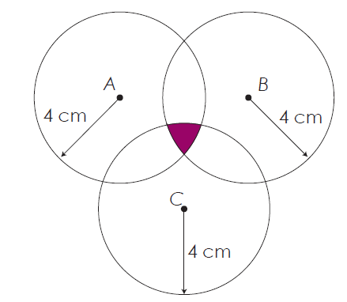
The region that is less than 4 cm from all points.

Slide 13




Loci
With a pair of compasses and ruler draw:
The locus of points 3cm from a point.
The locus of points that are 3cm from a line AB, where AB = 4cm
The locus of points that are 3 cm from the perimeter of the 5 cm by 7cm rectangle.
4. Show on the diagram the region which is less than 3 cm from both the line AB and point C. AC = 4 cm
5. Shade the region that is less than 4 cm from all points.

Slide 14
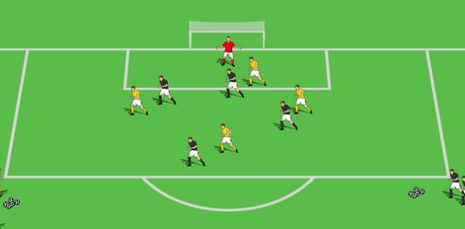
Problem 1
Invention of the penalty area
Football began in the 1870s and the goal kick was formalised.
The goal was 8 yards wide, and the goal kick had to be taken from within 6 yards of the nearest post. Sketch what the six yard area used to look like.

Slide 15
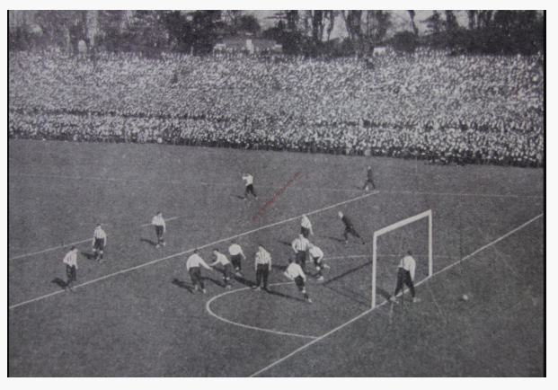
Take a look at the photo below, taken at the 1901 FA Cup final between Tottenham Hotspur and Sheffield United. You can clearly make out the line of the bulging six yard area.
Notes:
https://robeastaway.com/blog/six-yard-box

Slide 16
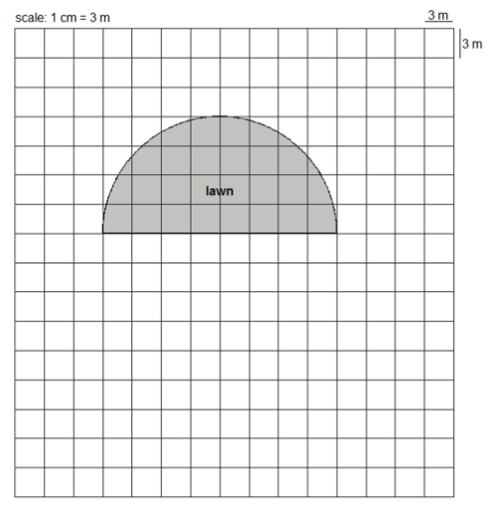
Problem 2
In this scale drawing the shaded area is a semi-circular lawn
There is a fence all around this lawn.
The shortest distance from the fence to the edge of the lawn is always 6m.
Draw the fence accurately.
Notes:
Not to scale – students will need to draw this in their books

