Slide 1
300,000 + 400,000
These calculations are quick to answer because the units that you are counting are the same in each term of the calculation.
400,000 - 300,000
4 million – 3 million
0.4 + 0.3
0.004 + 0.003
What do you notice?
What is the same? What is different about these calculations?
PRACTISE
SECURE

Slide 2
300,000 + 400,000
3 lots of 100,000 + 4 lots of 100,000
400,000 - 300,000
4 lots of 100,000 - 3 lots of 100,000
4million – 3million
4 lots of 1million - 3 lots of 1million
0.4 + 0.3
4 lots of 0.1 + 3 lots of 0.1
RETRIEVE
PRACTISE
SECURE

Slide 3
Applying the same idea to very big numbers:
$3×{10}^{9}+4×{10}^{9}$
3 lots of ${10}^{9}$ + 4 lots of ${10}^{9}$
RETRIEVE
PRACTISE
SECURE

Slide 4
Why does this work?
$${10}^{4}$$
$${10}^{4}$$
$${10}^{4}$$
$${10}^{4}$$
$${10}^{4}$$
=
$${10}^{4}$$
+
$${10}^{4}$$
$${10}^{4}$$
$${10}^{4}$$
$${10}^{4}$$
$$3×{10}^{4}+2×{10}^{4}=5 ×{10}^{4}$$
RETRIEVE
PRACTISE
SECURE

Slide 5
I DO:
WE DO:
Calculate the following and leave your answers in standard form
$$3×{10}^{14}+2×{10}^{14}$$
$$7×{10}^{13}+2×{10}^{13}$$
RETRIEVE
INSTRUCT
SECURE

Slide 6
I DO:
WE DO:
Calculate the following and leave your answers in standard form
$$3.4×{10}^{40}+2.1×{10}^{40}$$
$$1.7×{10}^{13}+2.2×{10}^{13}$$
RETRIEVE
INSTRUCT
SECURE

Slide 7
I DO:
WE DO:
Calculate the following and leave your answers in standard form
$$3×{10}^{4}−2×{10}^{4}$$
$$7×{10}^{13}−2×{10}^{13}$$
RETRIEVE
SECURE

Slide 8
Independent:
$8×{10}^{2}+1×{10}^{2}$
$3×{10}^{42}+5×{10}^{42}$
$8×{10}^{5}−3×{10}^{5}$
$7×{10}^{30}−5×{10}^{30}$
$2.4×{10}^{15}+1.2×{10}^{15}$
$5.5×{10}^{53}−1.5×{10}^{53}$
$4.6×{10}^{100}+2.4×{10}^{100}$
$5.6×{10}^{9}−2.18×{10}^{9}$
$8×{10}^{9}+2×{10}^{9}−3×{10}^{9}$
$8.3×{10}^{9}+2.1×{10}^{9}−5.3×{10}^{9}$
$8.1×{10}^{12}−2.5×{10}^{12}−1.62×{10}^{9}$
d) Work out the perimeter of the rectangle
$$2.8×{10}^{40}$$
$$5.2×{10}^{40}$$
RETRIEVE
INSTRUCT
SECURE

Slide 9
$200×3=600$
$20×30=600$
$2×300=600$

Slide 10
$200×1=200$
$20×10=200$
$2×100=200$
$0.2×1000=200$
$0.02×10000=200$

Slide 11
$200×1=200$
$20×{10}^{1}=200$
$2×{10}^{2}=200$
$0.2×{10}^{3}=200$
$0.02×{10}^{4}=200$

Slide 12
$6×{10}^{2}=600$
$×{10}^{3}=600$

Slide 13
$6×{10}^{6}=6000000$
$×{10}^{7}=6000000$

Slide 14
$6×{10}^{6}=600$
$×{10}^{8}=600$

Slide 15
Previously we looked at adding standard form by collecting the same powers of ten.
We could have used this less efficient method instead:
$$5×{10}^{5}+4×{10}^{5}=$$
$500,000+400,000=900,000$
$900, 000=9×{10}^{5}$
RETRIEVE
PRACTISE
SECURE

Slide 16
Lets look at some calculations with different powers of ten and see what we can notice.
$$5×{10}^{5}+4×{10}^{4}=$$
$500,000+40,000=540,000$
$540, 000=5.4×{10}^{5}$
RETRIEVE
PRACTISE
SECURE

Slide 17
Lets look at some calculations with different powers of ten and see what we can notice.
$$5×{10}^{6}+4×{10}^{4}=$$
$5,000,000+40,000=5,040,000$
$5,040, 000=5.04×{10}^{6}$
RETRIEVE
PRACTISE
SECURE

Slide 18
Lets look at some calculations with different powers of ten and see what we can notice.
$$5×{10}^{6}+4×{10}^{5}=$$
$5,000,000+400,000=5,400,000$
$5,400, 000=5.4×{10}^{6}$
RETRIEVE
PRACTISE
SECURE

Slide 19
Lets look at some calculations with different powers of ten and see what we can notice.
$$5×{10}^{4}+4×{10}^{5}=$$
$50,000+400,000=450,000$
$450, 000=4.5×{10}^{5}$
RETRIEVE
PRACTISE
SECURE

Slide 20
This would be easy if the powers of ten were the same…
$$5×{10}^{6}+4×{10}^{5}=$$
$×{10}^{6}$
RETRIEVE
PRACTISE
SECURE

Slide 21
I DO:
WE DO:
$$2×{10}^{8}+4×{10}^{9}=$$
$$8×{10}^{5}+4×{10}^{4}=$$
$×{10}^{5}$
RETRIEVE
INSTRUCT
SECURE

Slide 22
I DO:
WE DO:
$$2×{10}^{8}−4×{10}^{7}=$$
$$8×{10}^{5}−4×{10}^{4}=$$
$×{10}^{5}$
RETRIEVE
INSTRUCT
SECURE

Slide 23
$6×{10}^{7}+1×{10}^{6}$
$3×{10}^{9}+5×{10}^{10}$
$8×{10}^{6}−3×{10}^{5}$
$7×{10}^{30}−5×{10}^{29}$
$2.4×{10}^{15}+1.2×{10}^{14}$
$2.4×{10}^{250}+1×{10}^{249}$
Independent:
RETRIEVE
INSTRUCT
PRACTISE

Slide 24
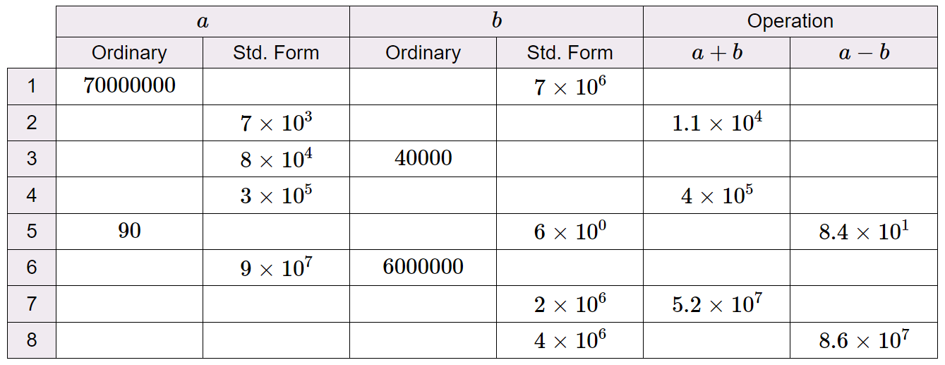
Depth:
RETRIEVE
INSTRUCT
PRACTISE

