Slide 1
Dual coding symbols:
Practise
Explain
Organise
Big Question
Reflect
Present
Compare
Evaluate
Activate
Discuss
Predict
Connect
Summarise
Recall
Vocabulary

Slide 2
Editable reading ruler
Every child in an Archway school will become a fluent reader
 | RETRIEVE the words or phrases you need from the text | DECODE the words or phrase to address a breakdown | CONNECT with words or phrases you know from the text or your memory | VISUALISE the images in as much detail as possible | SUMMARISE the main ideas of the text in a few words | INFER meanings that might be within the text | PREDICT what might happen next using details from the text | EXAMINE how the writer uses words to construct meaning
 | ASK THOUGHTFUL QUESTIONS TO HELP YOU UNDERSTAND THE TEXT

Slide 3
A
B

Slide 4
Circumference of a Circle Problems

Slide 5
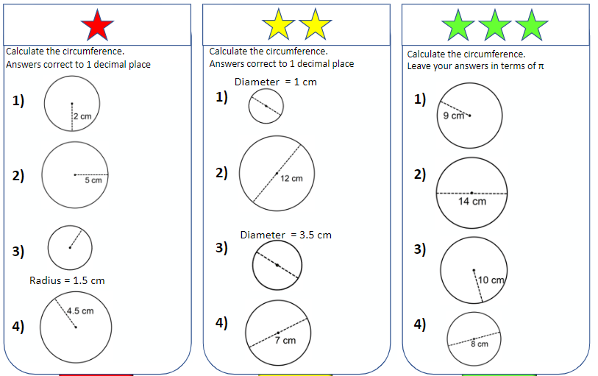
$$C= πd$$

Slide 6
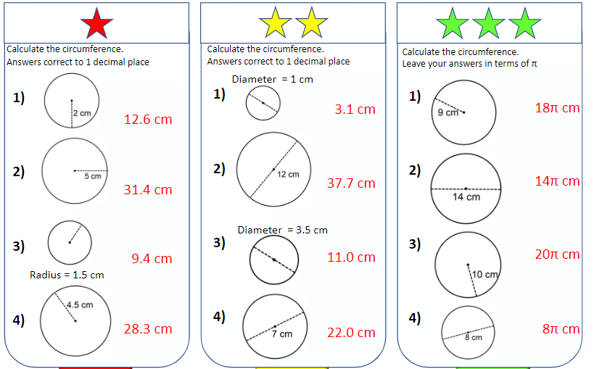

Slide 7
Key vocabulary:
Decode the word
Definition
.
Circumference
Examples
Non-examples

Slide 8
From Year 8…
and a bit
So if we were to take the diameter…
1 time
3 times
and bend it around the circumference of the circle, we could fit it around the circle…
diameter
The circumference is 3.1415 times longer than the diameter.
There is a special constant in mathematics which has this value:
2 times
This is the Greek letter “pi”.
$$π=3.1415926535…$$

Slide 9
Circumference of a circle
! Circumference of circle
$$=πd or 2πr$$
$$d$$
?
$$r$$
where $d$ is the diameter.
Noting that the diameter is twice the radius.

Slide 10
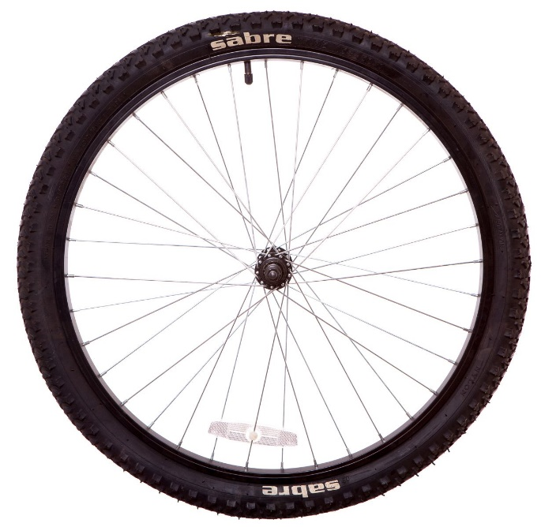
I DO:
WE DO:
Calculate the circumference to 1 decimal place
How far does the bike move with one full rotation of the wheel?
40 cm
40 cm

Slide 11
How far does the bike move with each full rotation of the wheel?
62cm

Slide 12
How far does the bike move with each full rotation of the wheel?
5cm
62cm

Slide 13
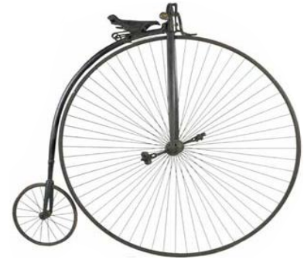
How far does the Penny Farthing move with each full rotation of the wheel?
55 inches
30 rotations?
100 rotations?

Slide 14
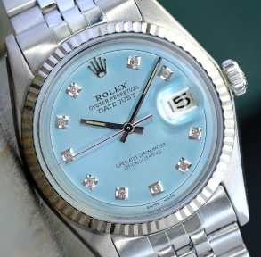
The minute hand is the radius and is 1.5cm in length.
How far does it move in an hour?
55 inches
In a day?
In a week?
In a year?

Slide 15
Notes:
Acknowledgements: Don Steward

Slide 17
