Slide 1
Dual coding symbols:
Practise
Explain
Organise
Big Question
Reflect
Present
Compare
Evaluate
Activate
Discuss
Predict
Connect
Summarise
Recall
Vocabulary

Slide 2
Editable reading ruler
Every child in an Archway school will become a fluent reader
 | RETRIEVE the words or phrases you need from the text | DECODE the words or phrase to address a breakdown | CONNECT with words or phrases you know from the text or your memory | VISUALISE the images in as much detail as possible | SUMMARISE the main ideas of the text in a few words | INFER meanings that might be within the text | PREDICT what might happen next using details from the text | EXAMINE how the writer uses words to construct meaning
 | ASK THOUGHTFUL QUESTIONS TO HELP YOU UNDERSTAND THE TEXT

Slide 3
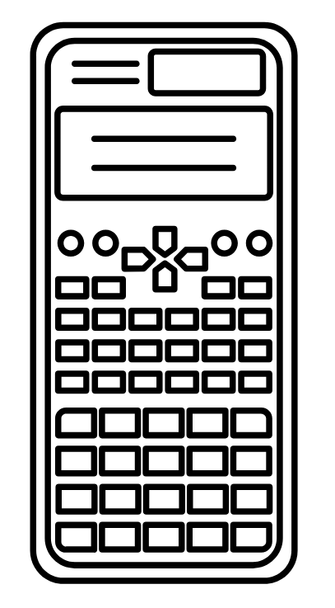
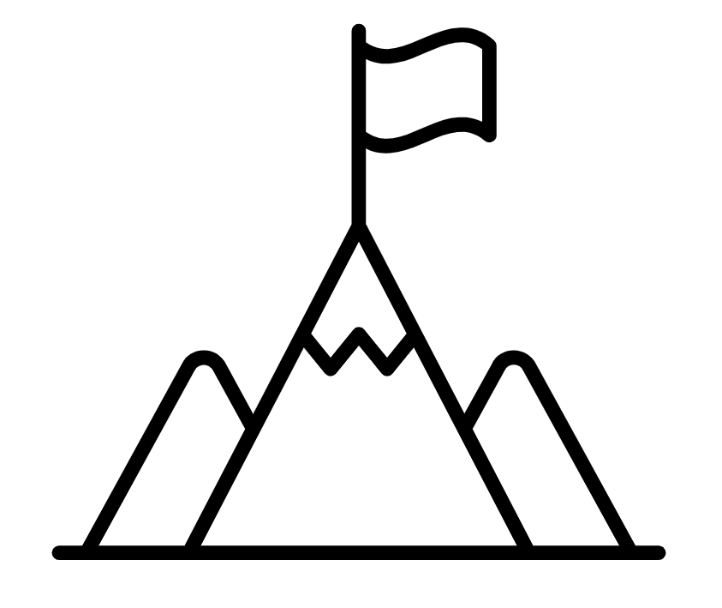
A
B

Slide 4
Area of a Sector

Slide 5
Based on the information given for the circle.
Label the missing measurements of the sectors.
10cm
6cm
a
d
b
c
e

Slide 6
How do I know this area is roughly 30?
Area ≈ 60
Roughly what would this area be?

Slide 7
I DO:
WE DO:
Find the area of the sector
Find the area of the sector
6cm
$${90}^{o}$$
6 cm
Notes:
No calculator

Slide 8
I DO:
WE DO:
Find the area of the sector
Find the area of the sector
$${120}^{o}$$
$${36}^{o}$$
8cm
8cm
Notes:
No calculator

Slide 9
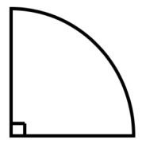
6cm
12cm
$${120}^{o}$$
6cm
3cm
3cm
6cm
$${120}^{o}$$
$${45}^{o}$$
$${240}^{o}$$
RETRIEVE
INSTRUCT

Slide 10
12cm
8cm
4cm
$${135}^{o}$$
$${15}^{o}$$
$${300}^{o}$$
9cm
10cm
$${72}^{o}$$
$${144}^{o}$$
RETRIEVE
INSTRUCT

Slide 11
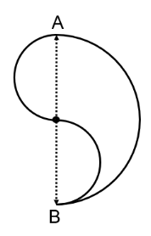
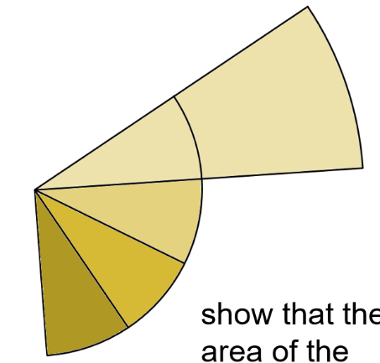
Depth:
If distance AB is 12cm what is the area of the compound shape shown above?
The radius of the big sector is twice that of the radius of the smaller congruent sectors. Show that the area of the 4 small sectors is equal to that of the large sector. Can you use algebra to show this will always be true?
Find some values of radii for the two circles which would make the shaded area equal to the unshaded area.
RETRIEVE
INSTRUCT
PRACTISE
Notes:
Provide answers

Slide 12
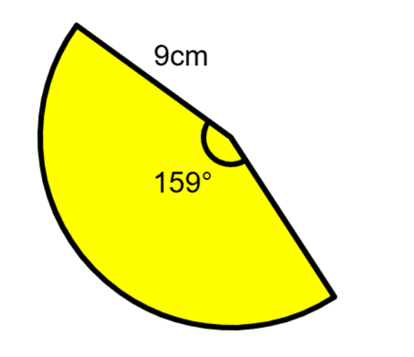
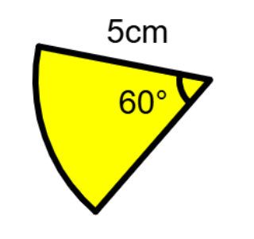
I DO:
WE DO:
Find the area of the sector to 1 decimal place
Find the area of the sector to 1 decimal place
Notes:
You model clearly. Use agreed upon representations and approaches.
Students do working on sheet/on whiteboards
ANSWER shown to you on WBS unless inappropriate ie constructions/graphs
Add in more of these as appropriate.

Slide 13
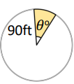
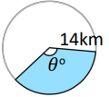
I DO:
WE DO:
Area = 675$π$ square feet.
Area = 205.3$km^{2}$
Notes:
You model clearly. Use agreed upon representations and approaches.
Students do working on sheet/on whiteboards
ANSWER shown to you on WBS unless inappropriate ie constructions/graphs
Add in more of these as appropriate.

Slide 14
I DO:
WE DO:
Area = $81.3cm^{2}$
Area = $100cm^{2}$
Notes:
You model clearly. Use agreed upon representations and approaches.
Students do working on sheet/on whiteboards
ANSWER shown to you on WBS unless inappropriate ie constructions/graphs
Add in more of these as appropriate.

Slide 15
RETRIEVE
INSTRUCT

Slide 16
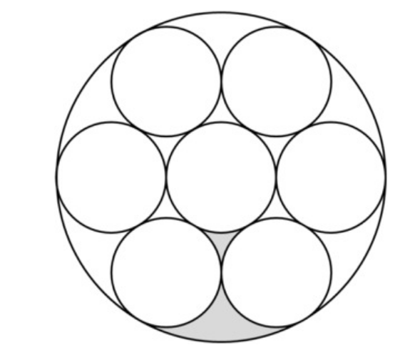
Depth:
The base of this isosceles triangle is 6cm.
Find the shaded area.
The rectangle is 16cm by 10cm.
Find the shaded area.
r
The large circle has a diameter of 30cm.
Find the shaded area.
r is 4cm. Use this to find the shaded area of the parallelogram.
RETRIEVE
INSTRUCT
PRACTISE
Notes:
Provide answers

Slide 17
4r
3r
?
r
$${240}^{o}$$
$${240}^{o}$$
Find the ratio of the areas of the two sectors.
The area of shape A is 9 times the size of shape B. Find the radius of shape A in terms of r.
RETRIEVE
INSTRUCT
PRACTISE
Notes:
Provide answers

