Slide 2
DO NOW
20% >> $\frac{20}{100}=\frac{2}{10}=0.2$
30%
13%
3
333%
300%
33.3%
0.033
3%
303%
0.003
0.03
0.3
3.3%
0.003
300
0.333

Slide 3
3%
0.03
0.003
13%
3.3%
0.033
300
333%
30%
0.3
0.003
303%
33.3%
0.333
300%
3

Slide 4
In our previous lesson we learnt …….
ADD SLIDE FROM LESSON 2 (% AMOUNT NON-CALC)

Slide 5
How would you work out this problem?
450 people were surveyed about their pets.
73% of them owned a cat.
100 %
450
$$× 0.1$$
$$× 0.1$$
How could using a calculator make this calculation easier?
73% of 450
10 %
45
$$×7$$
$$×7$$
$$× 0.1$$
70 %
315
$$× 0.1$$
1 %
4.5
$$×3$$
$$×3$$
3 %
13.5
315 + 13.5 = 328.5

Slide 6
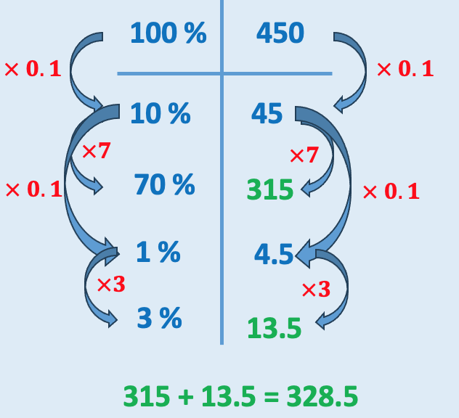
450 people were surveyed about their pets.
73% of them owned a cat.
How could using a calculator make this calculation easier?
73% of 450
Think back to your retrieval task!
0.73 x 450
100%
450
$$×0.73$$
$$×0.73$$
73%
328.5

Slide 7
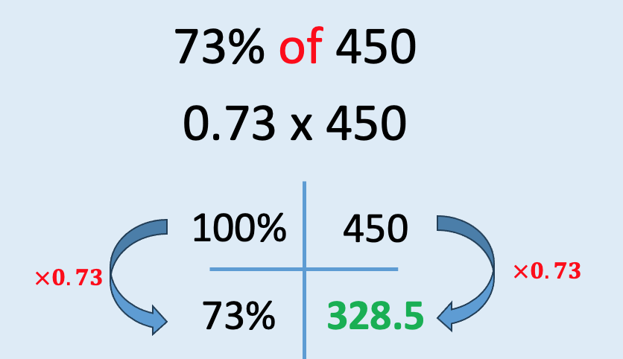
Mini Whiteboards
Copy and complete
100%
42
$$×0.16$$
$$×0.16$$
16%
6.72

Slide 8
Mini Whiteboards
Copy and complete
100%
55
$$×0.14$$
$$×0.14$$
14%
7.7

Slide 9
Mini Whiteboards
Copy and complete
100%
17
$$×0.03$$
$$×0.03$$
3%
0.51

Slide 10
Mini Whiteboards
Copy and complete
100%
55
$$×0.82$$
$$×0.82$$
82%
45.1

Slide 11
Mini Whiteboards
Copy and complete
100%
72
$$×0.05$$
$$×0.05$$
5%
3.6

Slide 12
Mini Whiteboards
Copy and complete
100%
231
$$×0.63$$
$$×0.63$$
63%
145.53

Slide 13
Mini Whiteboards
Copy and complete
100%
770
$$×0.3$$
$$×0.3$$
30%
231

Slide 14
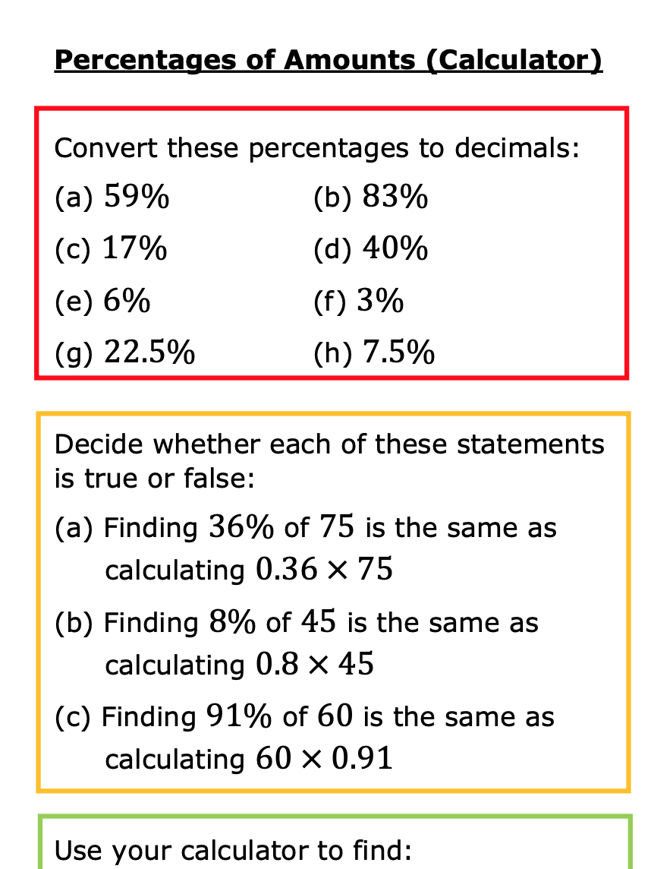
Challenge
*Remember to use your Ratio tables if you get stuck!

Slide 16
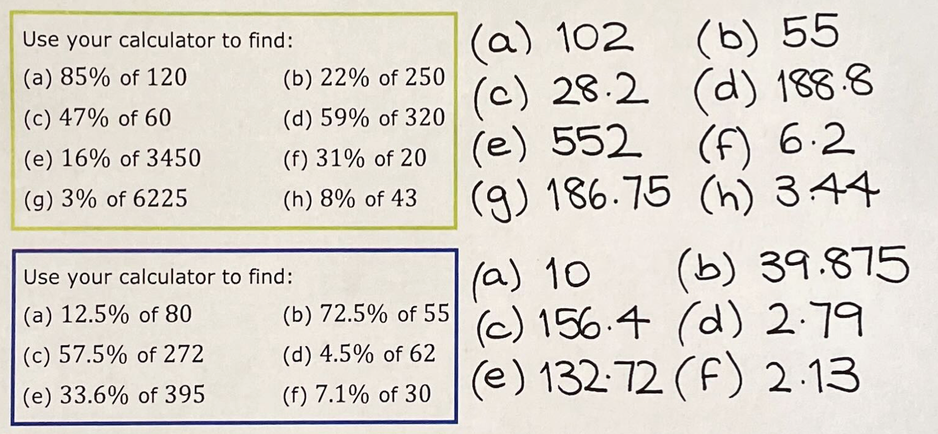

Slide 17
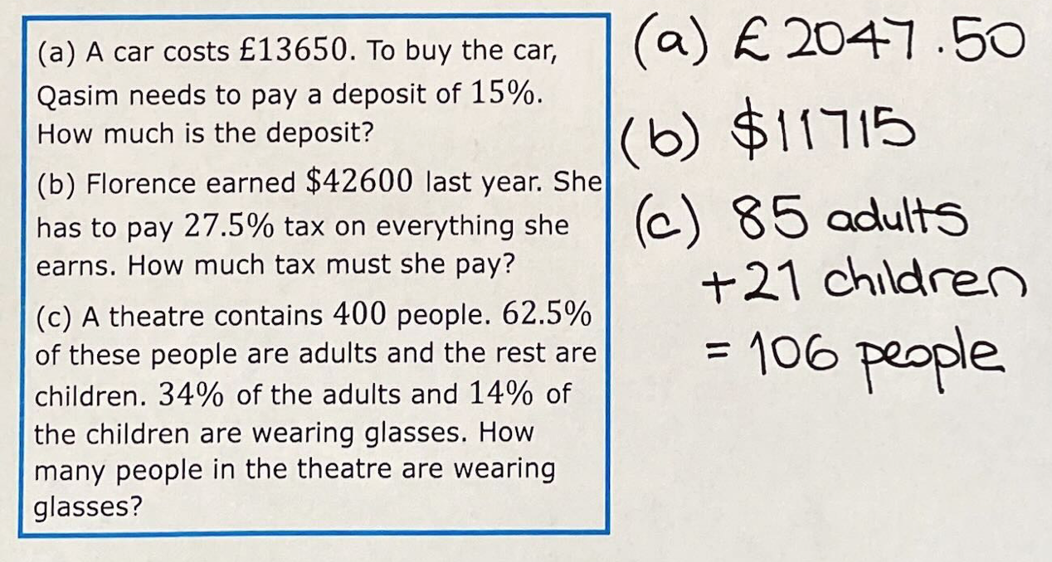

Slide 18
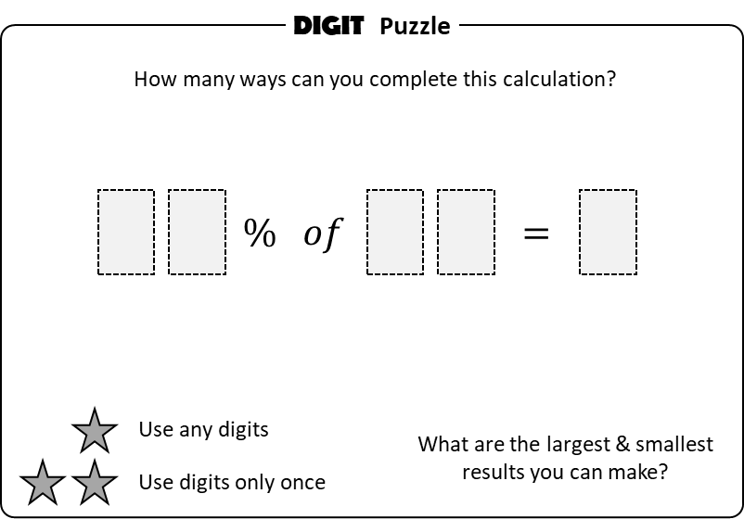
To Finish

Slide 19
DIGIT Puzzle
How many ways can you complete this calculation?
$$20\% of 35=7$$
$$20\% of 45=9$$
$$\%$$
$$of$$
$$=$$
$$20\% of 15=3$$
$$25\% of 36=9$$
Use any digits
What are the largest & smallest
results you can make?
Use digits only once
$$25\% of 04=1$$
$$50\% of 16=8$$
Some Answers
$$50\% of 18=9$$
$$75\% of 04=3$$
$$75\% of 12=9$$

Slide 21
DIGIT Puzzle
$$80\% of 90=72$$
How many ways can you complete this calculation?
$$40\% of 85=34$$
$$\%$$
$$of$$
$$=$$
$$25\% of 32=08$$
$$25\% of 36=09$$
Use any digits
What are the largest & smallest
results you can make?
$$50\% of 46=23$$
Use digits only once
$$50\% of 92=46$$
$$60\% of 35=21$$
Some Answers
$$75\% of 48=36$$
$$80\% of 95=76$$
$$95\% of 80=76$$
$$80\% of 45=36$$

