Slide 2
TITLE: Expressing change as a percentage
What does a multiplier of 1.34 mean?
Decrease £45 by 68%
Fill in the blank multiplier
45 x = 61.2

Slide 3
TITLE: Expressing change as a percentage
What does a multiplier of 1.34 mean?
Decrease £45 by 68%
Fill in the blank multiplier
45 x = 61.2
Increase of 34%
45x0.32 = £14.40
1.36

Slide 4
Amna scored 40/100 on her science test.
She revised for the next test and scored 70/100
How much better is this result?
30%
75%

Slide 5
Amna scored 40/100 on her science test.
She revised for the next test and scored 70/100
How much better is this result?
100% | 40
 | 70
X1.75
70÷40
X1.75
175%
Amna improved her result by 75%

Slide 6
Tom scored 40 on his science test.
He didn’t revise for the next test and scored 22
What is his percentage improvement?
100% | 40
 | 22
X0.55
22÷40
X0.55
55%
Tom’s result decreased by 45%

Slide 7
On Monday it was sunny for 25 minutes.
On Tuesday it was sunny for 45 minutes.
Express this as a percentage change.
100% | 25
 | 45
X1.8
45÷25
X1.8
180%
This represents an 80% increase in the time it was sunny on Tuesday

Slide 8
Jack invested £150 for a year.
He gained interest and withdrew £165.
What is this as a percentage change?
100% | 150
 | 165
X1.1
165÷150
X1.1
110%
This represents a 10% increase in Jacks money when he withdrew

Slide 9
A burger cost £3.50
The restaurant puts it on sale for £2.80
What percentage sale is this?
100% | 3.50
 | 2.80
X0.8
2.8÷3.5
X0.8
80%
This represents a 20% decrease in the original price.

Slide 10
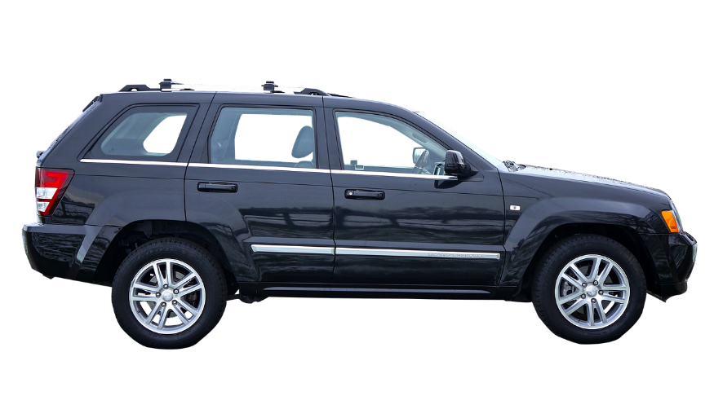
A car cost £25,000 last year.
This year it is worth £22,500.
Express this as a percentage change.
100% | 25,000
 | 22,500
X0.9
22500÷25000
X0.9
90%
The percentage change is 10% meaning the car lost 10% of it’s original value.

Slide 11
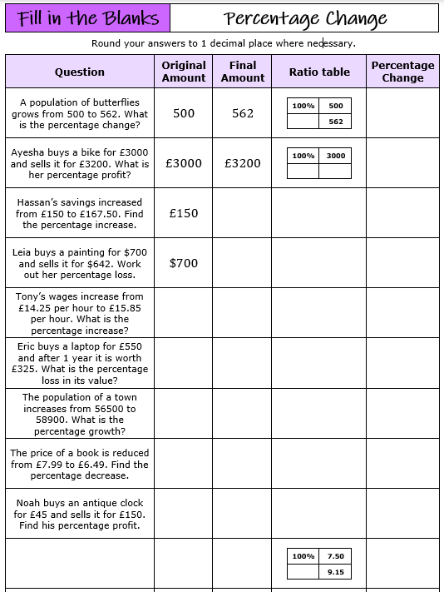
Kamile sells sandwiches. In May, she sold 400 sandwiches. In June, Kamile sold 20% more sandwiches than in May. In July, Kamile sold 15% fewer sandwiches than in June.
Calculate the percentage change in her sales from May to July.

Slide 12
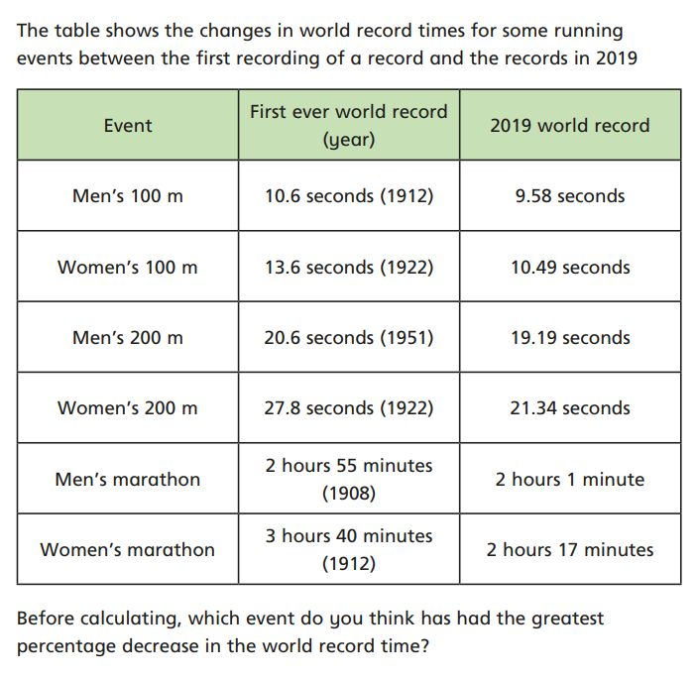
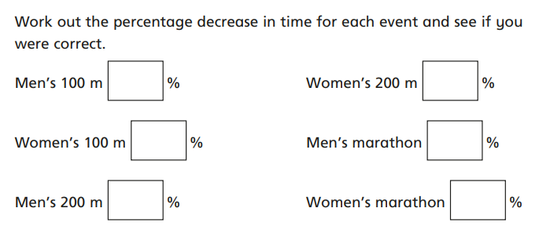

Slide 13
Answers

