Slide 1
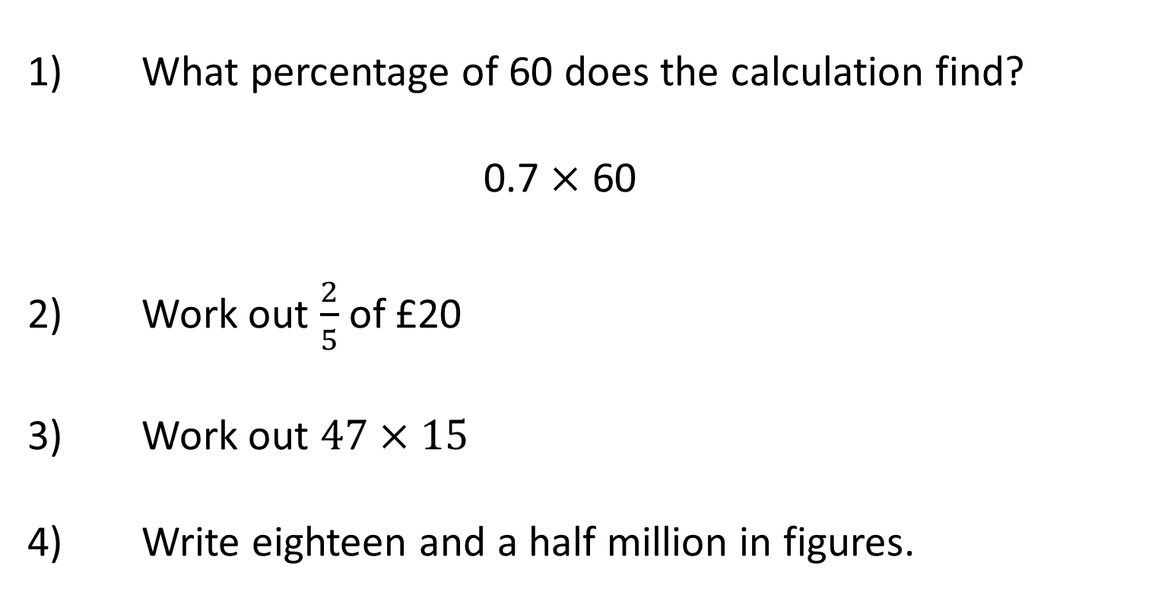
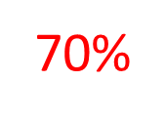
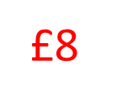
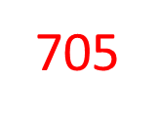
Comparing Temperatures

Slide 2
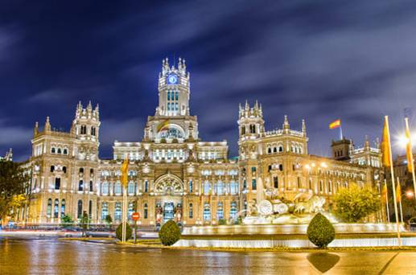
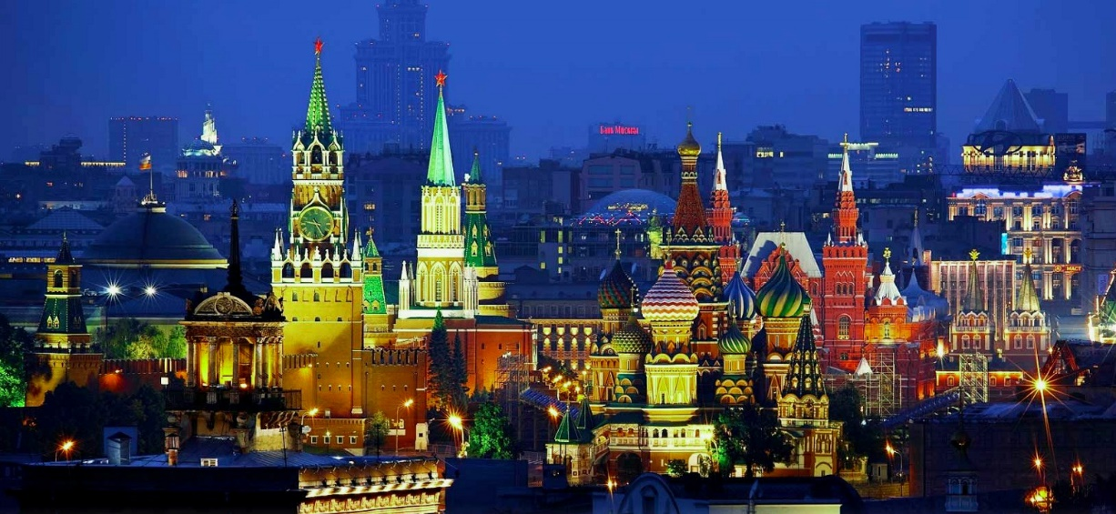
Order the cities from coldest to hottest

Slide 3
Which country is colder?
9
9
8
8
7
7
6
6
5
5
4
4
3
3
Russia!!
2
France
2
Russia
1
1
0
0
-1
-1
-2
-2
-3
-3
-4
-4
-5
-5
-6
-6
-7
-7
-8
-8

Slide 4
How much warmer is France?
9
9
8
8
7
7
6
6
5
5
5
4
4
3
3
2
6
France
2
Russia
1
1
0
0
-1
-1
-1
-2
-2
-3
-3
-4
-4
-5
-5
-6
-6
-7
-7
-8
-8

Slide 5
Which country is warmer?
9
9
8
8
7
7
6
6
5
5
USA!!
4
4
3
3
2
UK
2
USA
1
1
0
0
-1
-1
-2
-2
-3
-3
-4
-4
-5
-5
-6
-6
-7
-7
-8
-8

Slide 6
How much warmer is the USA?
9
9
8
8
8
7
7
6
6
5
5
4
9
4
3
3
2
UK
2
USA
1
1
0
0
-1
-1
-1
-2
-2
-3
-3
-4
-4
-5
-5
-6
-6
-7
-7
-8
-8

Slide 7
Which country is warmer?
9
9
8
8
Germany!
7
7
6
6
5
5
4
4
3
3
2
Germany
2
Canada
1
1
0
0
-1
-1
-2
-2
-3
-3
-4
-4
-5
-5
-6
-6
-7
-7
-8
-8

Slide 8
How much warmer is Germany?
9
9
8
8
7
7
6
6
5
5
4
4
3
3
2
Germany
2
Canada
1
1
0
0
-1
-1
-2
-2
-2
-3
2
-3
-4
-4
-4
-5
-5
-6
-6
-7
-7
-8
-8

Slide 9
Which country is colder?
9
9
8
8
7
7
6
6
5
5
Norway!
4
4
3
3
2
Norway
2
Egypt
1
1
0
0
-1
-1
-2
-2
-3
-3
-4
-4
-5
-5
-6
-6
-7
-7
-8
-8

Slide 10
How much warmer is Egypt?
9
9
8
8
7
7
6
6
6
5
5
4
4
3
3
2
Norway
2
Egypt
1
1
0
13
0
-1
-1
-2
-2
-3
-3
-4
-4
-5
-5
-6
-6
-7
-7
-7
-8
-8

Slide 11
Which country is warmer?
9
9
8
8
7
7
Sweden!
6
6
5
5
4
4
3
3
2
Sweden
2
Finland
1
1
0
0
-1
-1
-2
-2
-3
-3
-4
-4
-5
-5
-6
-6
-7
-7
-8
-8

Slide 12
How much warmer is Sweden?
9
9
8
8
7
7
6
6
5
5
4
4
3
3
2
Sweden
2
Finland
1
1
0
2°C
0
-1
-1
-2
-2
-3
-3
-4
-4
-5
-5
-6
-6
-7
-7
-8
-8

Slide 13
Which country is warmer and by how much?
9
9
8
8
7
7
6
6
5
5
4
4
3
Netherlands
3
2
Netherlands 1°C
2
Estonia
1
1
0
0
-1
-1
-2
-2
-3
-3
-4
-4
-5
-5
-6
-6
-7
-7
-8
-8

Slide 14
Which country is warmer and by how much?
Denmark
-5°C
Italy
4°C
Italy 9°C

Slide 15
Which city is warmer and by how much?
Nottingham
-3°C
Birmingham
-4°C
Nottingham 1°C

Slide 16
Which city is warmer and by how much?
Glasgow
-4°C
Birmingham
6°C
Birmingham 10°C

Slide 17
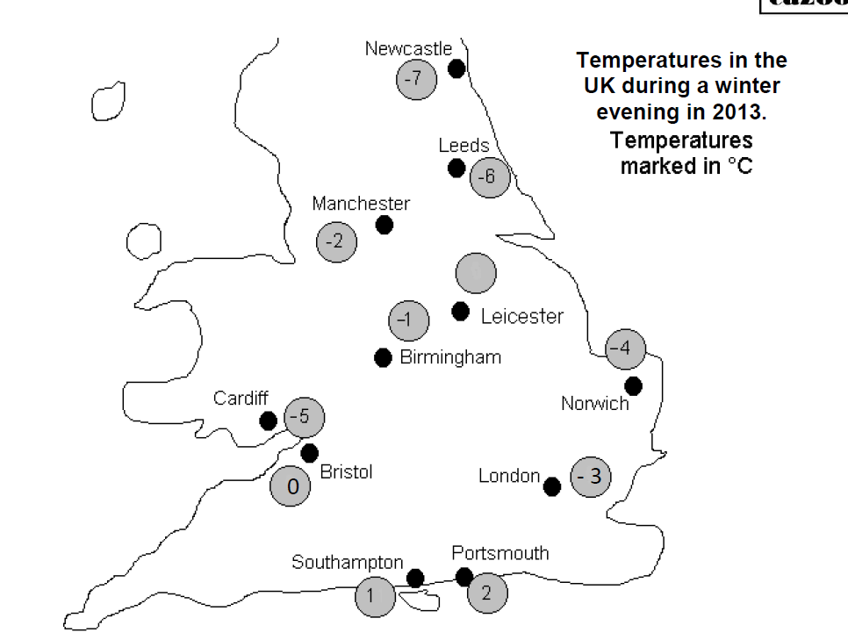
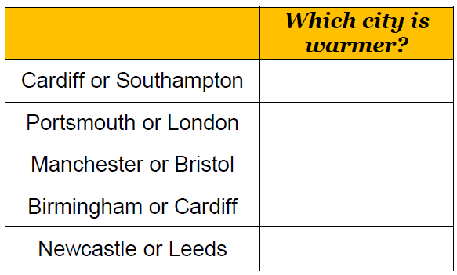
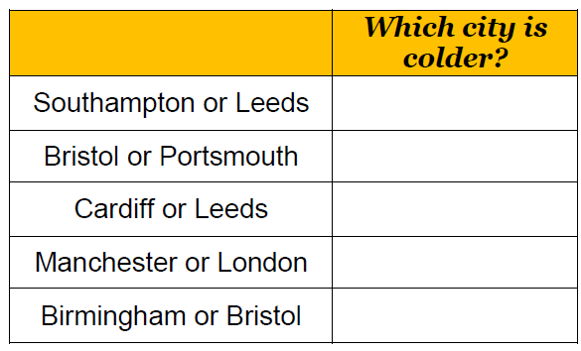

Slide 18
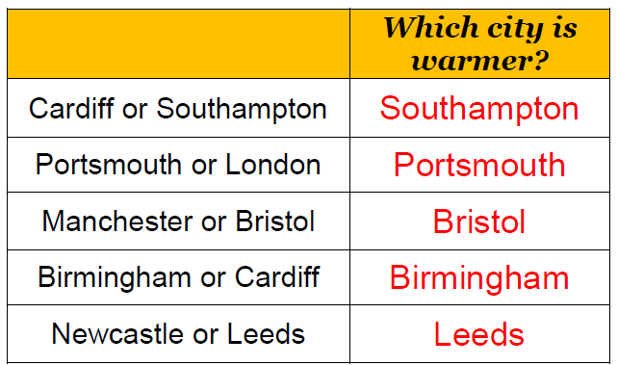
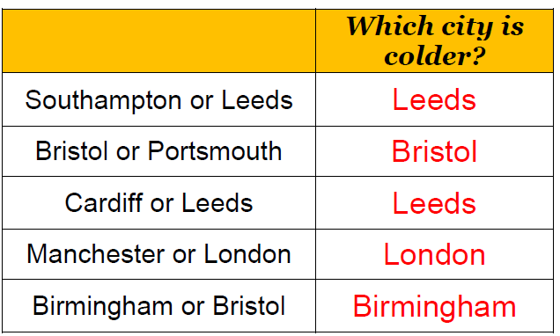

Slide 19
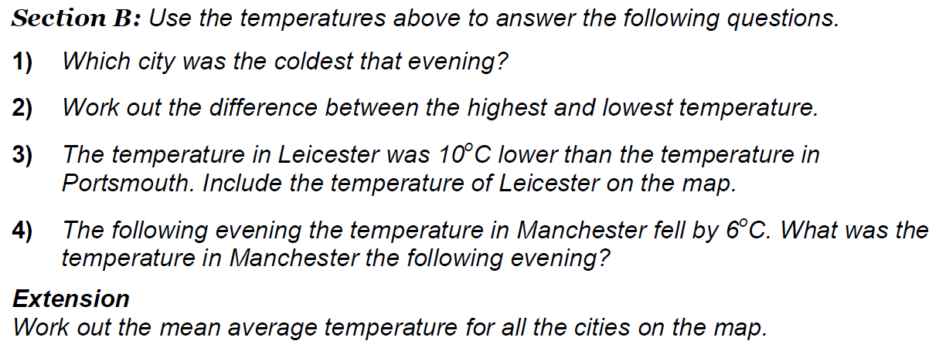

Slide 20
