Slide 1
Retrieve
Vocabulary check:
sum

Slide 2
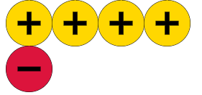
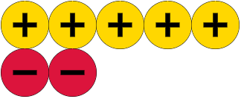
Use your counters to show me three
Notes:
Mathsbot counters: https://mathsbot.com/manipulatives/twoColourCounters

Slide 3
These are examples of “zero pairs”
Make your own zero pair
Get your partner to check it
Notes:
The zero pair is very powerful idea when adding and subtraction with directed numbers. Understanding this concept is absolutely crucial for the calculations we will explore when we use a combination of negative and positive numbers.
I would spend a bit of time showing them different zero pairs so that they are able to recognise them. I tend to arrange the counters as above as I don’t want mistakes from miscounting. It also models a nice technique for students to follow by arranging the counters in a way to spot zero pairs without having to physically count them.
At some point I may ask the students to make their own zero pair and have their partner check it - or draw one on their mini whiteboard to hold up for me to check.

Slide 4
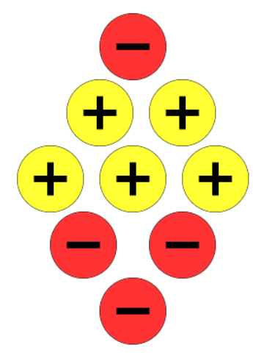
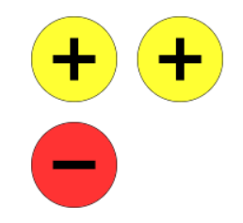
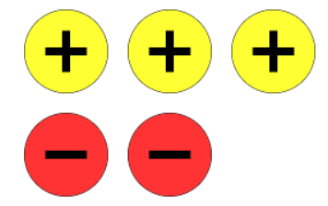
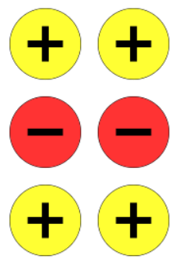
Which one is the odd one out?
Notes:
Once confident that students are able to spot zero pairs I would look to represent the same number using different amounts of coloured counters. This again reinforces the idea of zero pairs and develops their understanding of using the counters. What I want the students to notice is that we can represent the number one in a variety of ways.
I would ask questions such as:
What is the same about the representations of the number one? Hopefully, they will notice that there is always ONE more positive counter than negative
What is different about the representations of the number one? This is mainly to hammer home the point that we can use an infinite amount of counters to represent the number one. As before I may ask students to create the number one with their own counters or draw me a picture of a different representation again to check to see if students have understood this idea.
So we are are now comfortable with the idea of zero pairs and different representations of the same number, where do I go from here? Well time to take some baby steps to see if they can see the effect of adding and subtracting counters.
I would now zero in on the odd one out.

Slide 5
Draw counters to answer the following questions with your partner.
On your whiteboards…
What would I need to add to make the number one?
What would I need to add to make a zero pair?
What would happen if I subtracted one negative counter?
What would happen if I added one negative counter?
What would happen if I added three positive counters?
What would happen if I subtracted three positive counters?
Can I subtract three negative counters?
Notes:
The idea of the questions is to elicit some more information about what students know, their intuitive feel for the model so far and to flush out any unanticipated misconceptions.
The last questions will also allow me to see how much I will need to model subtracting negative numbers if the model does not have sufficient negative counters to subtract.
I would ask students to carry out the addition and subtractions using their own counters so that they get used to using the counters and can see the maths. This is also a great way to see which students may be ready for a more difficult challenge and to see who can do these without using counters.

Slide 6
How will we say…?
$$−2+−4$$
Addend
Addend
Notes:
Avoid the use of the word “minus” – it refers to both the position of a number below zero and the operation of subtraction.
Negative two is the minuend
Negative four is the subtrahend
Negative two subtract negative four

Slide 7
Work out $−2+4$
Work out $−6+7$
Notes:
I do, we do

Slide 8
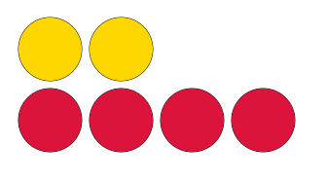
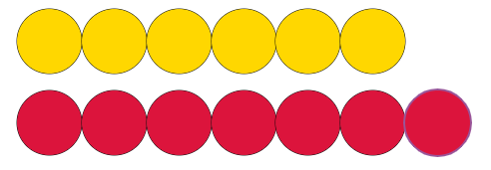
Work out $6+−7$
Work out $2+−4$
Notes:
I do, we do

Slide 9
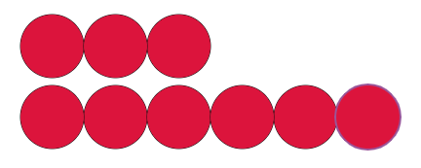
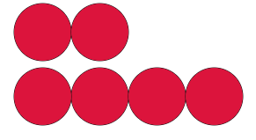
Work out $−2+−4$
Work out $−3+−6$
Notes:
I do, we do

Slide 10
3 + 5
5 + 3
3 + -5
-3 + 5
-3 + -5
- 5 + -3
-5 + 3
On your whiteboards…
Which questions have the same answers?
Would this be true for different amounts?
Can you generalise?
Notes:
We do

Slide 11
In your books…
7) $−19 + −13$
8) $24 + −36$
9) $−0.8 + −1 .5$
10) $4.8 + −5.2$
11) $−4 + 2.6$
$−3 + 27$
$−5 + −7$
$0 + −2$
$−4 + 4$
$−15 + −8$
$−40 + 12$
Notes:
Ask students to copy and complete these in their Maths books.

Slide 12
Mark your work
7) $−19 + −13=−32$
8) $24 + −36=−12$
9) $−0.8 + −1 .5 =−2.3$
10) $4.8 + −5.2 =−0.4$
11) $−4 + 2.6 =−1.4$
$−3 + 27 =24$
$−5 + −7 =−12$
$0 + −2 =−2$
$−4 + 4 =0$
$−15 + −8=23$
$−40 + 12=−28$
Notes:
Ask students to copy and complete these in their Maths books.

Slide 13
On your whiteboards…
Challenge 1:

Slide 14
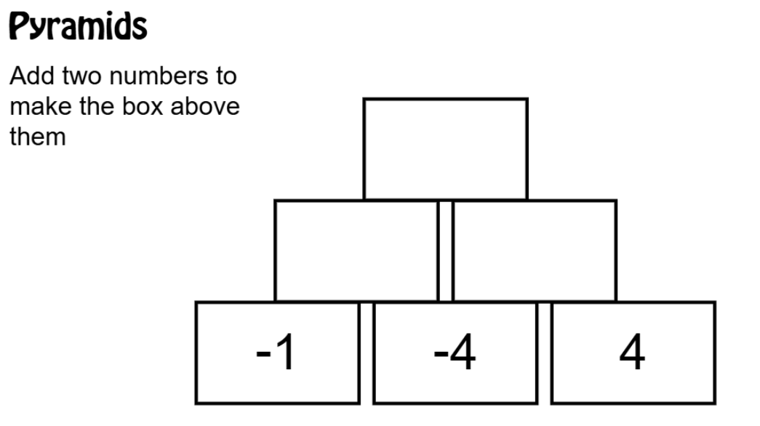
On your whiteboards…
Challenge 2:
-5
-5
0

Slide 15
On your whiteboards…
Challenge 3:
What is the value of…
5$a$
$$0$$
4$a$
$$12a+ −7a=$$
$$−{5y}^{2}+ −5y^{2}=$$
$$6a+ −2a+b+ −b=$$
Notes:
From the IMC
Answer is 4

Slide 16
Exit ticket:
Answer the following on the post note:
1) 8 + -3 =
2) -10 + - -5 =
3) 1.5 + -0.7 =

Slide 17
In each square, the rows, columns and
diagonals all total the same MAGIC number!
Can you complete the squares?
In each square, the rows, columns and
diagonals all total the same MAGIC number!
Can you complete the squares?
A
B
C
A
B
C
1 | 0 | 5
 |  | −2
−3
 | 1 | −2
 |  | 5
−6 | −1 | 4
3
1 | 0 | 5
 |  | −2
−3
 | 1 | −2
 |  | 5
−6 | −1 | 4
3
MAGIC No. = 6
MAGIC No. =
MAGIC No. =
MAGIC No. = 6
MAGIC No. =
MAGIC No. =
D
E
F
D
E
F
−7
−4 | 3
−6
 | −5
 | −1
 |  | −3
 |  | −5
1
−7
−4 | 3
−6
 | −5
 | −1
 |  | −3
 |  | −5
1
MAGIC No. = −9
MAGIC No. = −15
MAGIC No. = −3
MAGIC No. = −9
MAGIC No. = −15
MAGIC No. = −3
G
H
G
H
 |  |  | 4
−4 |  | 1 | −1
0
−5 | 5 | 6 | −8
−18 | −3 |  | 18
 | −9 | 3 | −24
 | −12 |  | −21
 |  |  | 4
−4 |  | 1 | −1
0
−5 | 5 | 6 | −8
−18 | −3 |  | 18
 | −9 | 3 | −24
 | −12 |  | −21
1
MAGIC No. =
MAGIC No. = −18
1
MAGIC No. =
MAGIC No. = −18
Notes:
Additional consolidation activity From GoTeachMaths

Slide 18
In each square, the rows, columns and
diagonals all total the same MAGIC number!
Can you complete the squares?
A
B
C
1 | 0 | 5
6 | 2 | −2
−1 | 4 | 3
−3 | 6 | 0
4 | 1 | −2
2 | −4 | 5
0 | 2 | −5
−6 | −1 | 4
3 | −4 | −2
MAGIC No. = 6
MAGIC No. = 3
MAGIC No. = −3
D
E
F
Answers
2 | −9 | −2
−7 | -3 | 1
−4 | 3 | −8
−6 | −9 | 0
1 | −5 | −11
−10 | −1 | −4
−7 | 7 | −3
3 | −1 | −5
1 | −9 | 5
MAGIC No. = −9
MAGIC No. = −15
MAGIC No. = −3
G
H
7 | −7 | −6 | 4
−4 | 2 | 1 | −1
0 | -2 | −3 | 3
−5 | 5 | 6 | −8
−18 | −3 | −15 | 18
12 | -9 | 3 | −24
15 | −12 | 0 | −21
−27 | 6 | −6 | 9
1
MAGIC No. = −2
MAGIC No. = −18

Slide 19
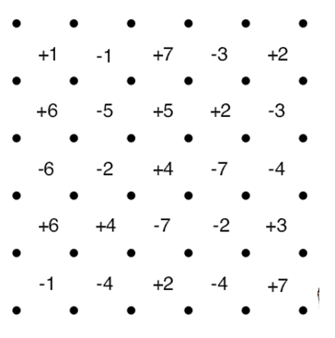
SQUARES GAME
This is a two player game.
Each player takes it in turn to join two dots next to each other, in a straight line – No diagonals allowed.
If a player completes a square they mark the square with their initials and gets the value written inside the square.
They then get another go.
The winner is the player with the highest score when all boxes are completed/time is up!
Notes:
Acknowledgements:
East Midlands East Maths Hub
Nottingham Emmanuel School

