Slide 2
Show me…
a simple addition question that gives the answer 0
a simple subtraction question that gives the answer -3
can you show me a harder example?
a simple addition question that gives the answer -12
can you show me a harder example?
a simple subtraction question that gives the answer -4
can you show me a harder example?

Slide 3
(+5) + (-4) =
Don’t work it out yet. What does this actually say?
Why are there brackets?
Do we need them?
Is that any different to
+5 + -4 =
Why are there some big spaces?
Is that any different to
+5+ -4 =
Why is there a ‘+’ at the beginning?
Is that any different to
5+ -4 =
Why is there a ‘+’ and ‘-’ together in the middle?
Is that any different to
5 - 4 =

Slide 4
(+5) + (-4) =
Important: 5 + -4 has the same answer to 5 – 4, but a different meaning.
Just like 10 – 5 has the same answer to 7 – 2, but has a different meaning.

Slide 5
In pairs, you will soon cut out and arrange your cards in following three piles:
Negative Number Statements
Always
True
Sometimes True
Never
True
You will then make a poster with the cards, explaining in detail why each card is Always, Sometimes or Never true.

Slide 6
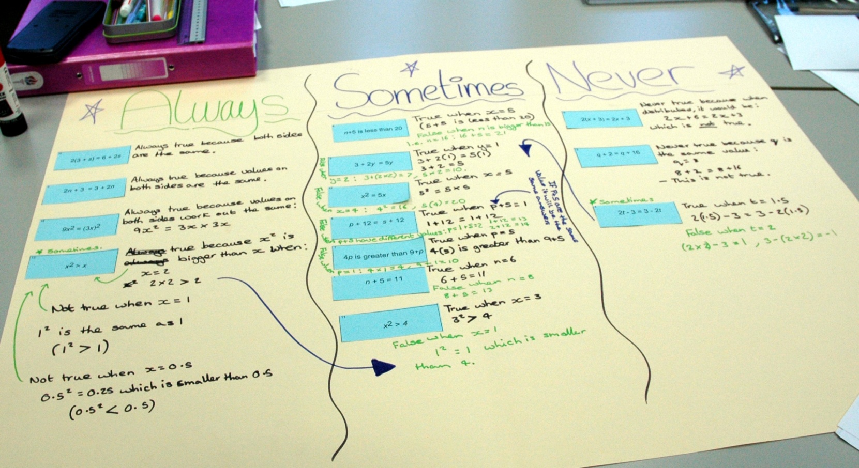
Negative Number Statements
Posters will look something like this…

Slide 7
Negative Number Statements
Important…
Each card only contains an example calculation.
But you need to decide if the statement is:
ALWAYS true SOMETIMES true NEVER true
Think of examples with large and small numbers.
Try to think of examples with decimals or fractions too.

Slide 8
Negative Number Statements
What your posters should show:
If it’s ALWAYS true:
Give a variety of examples showing it’s true
If it’s SOMETIMES true:
Give some examples showing when it’s true, and some when it’s not.
If it’s NEVER true:
Explain why you are sure it CANNOT be true.

Slide 9
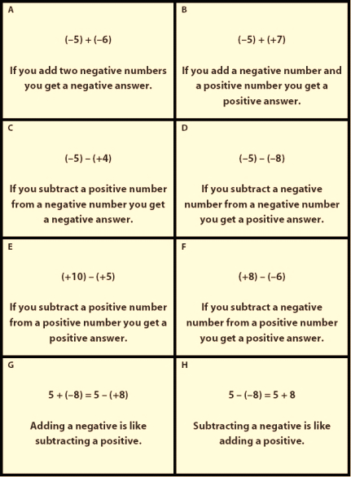
Negative Number Statements
Let’s check…
What are you going to do?
Step 1. Cut and sort statements into:
Always, Sometimes, Never true
Step 2. Create poster explaining why.
If it’s ALWAYS true:
Give a variety of examples showing it’s true
If it’s SOMETIMES true:
Give examples of true and false.
If it’s NEVER true:
Explain why it CANNOT be true.

Slide 10
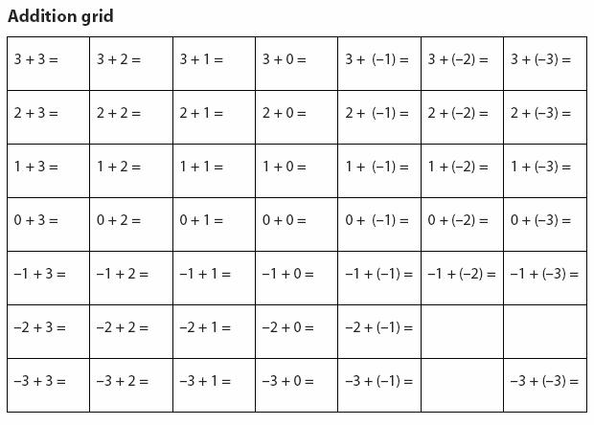
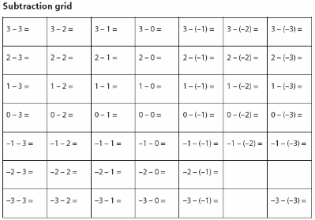
Negative Number Statements
PAUSE… Progress check
Further tips to help you:
Tip #1: Complete these simple worksheets
Cut and stick these worksheets onto your poster too.

Slide 11
Negative Number Statements
Continue…
What you should have done:
Step 1. Cut and sort statements into:
Always, Sometimes, Never true
What you should be doing now:
Step 2. Create poster explaining why.
If it’s ALWAYS true:
Give a variety of examples showing it’s true
If it’s SOMETIMES true:
Give examples of true and false.
If it’s NEVER true:
Explain why it CANNOT be true.

Slide 12
Negative Number Statements
PAUSE… Progress check
Further tips to help you:
Tip #2: Use a calculator to help check your answers.
Subtraction button.
(-5) + (+7)
Positive/Negative button.
-5 + +7 =
Type in calculator as:

Slide 13
Check that you have…
Written your names on your poster
Step 2. Created poster explaining why.
If it’s ALWAYS true:
Give a variety of examples showing it’s true
If it’s SOMETIMES true:
Give examples of true and false.
If it’s NEVER true:
Explain why it CANNOT be true.
Done this?
Given examples of lots of types of numbers…large/small/zero/decimals…

Slide 14
Negative Number Statements
Quickly & neatly clear up all equipment

Slide 15
Negative Number Statements
So, which statements are ALWAYS true?

