Slide 1
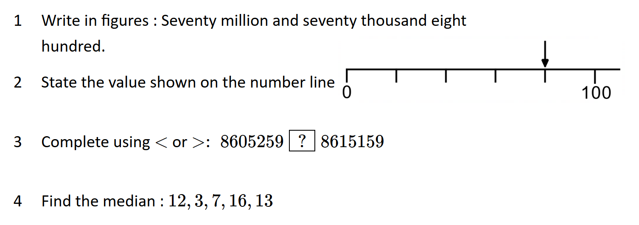
Multiplying Negative Numbers
Complete in silence
Vocab Check: Product

Slide 2

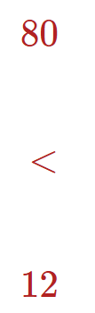
Multiplying Negative Numbers
Complete in silence
Vocab Check: Product

Slide 3
Multiplication is repeated addition.
How can we describe these calculations?
3 × 4 =
‘the sum of 3 lots of 4’
4 + 4 + 4 = 12
8 × 5 =
‘the sum of 8 lots of 5’
5 + 5 + 5 + 5 + 5 + 5 + 5 + 5 = 40
4 × −5 =
‘the sum of 4 lots of −5’
(−5) + (−5) + (−5) + (−5) = −20

Slide 4
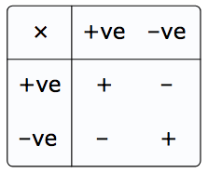
+
-
+
+
-
-
-
+
+
-
+
-

Slide 5
Model Solution – With counters we can show the following:
2 x 4
= 8
“2 lots of 4”
“2 lots of ”
+
+
+
+
+
+
+
+
+
+
+
+

Slide 6
Model Solution – With counters we could show the following:
5 x -2
= -10
“5 lots of -2”
“5 lots of ”

Slide 7
Your Turn – Use your counters to solve:
3 x (-2) = -6
2 x -1 = -2
2 x (-4) = -8
4 x -3 = -12
-1 x 5 = -5
Hint: Is -1 x 5 the same question as 5 x -1?

Slide 8

Can you describe these statements mathematically?
+
+
I will do my homework.
= positive
−
+
I won’t do my homework
= negative
+
−
I will not do my homework.
= negative
−
−
I won’t not do my homework.
= positive

Slide 9


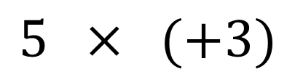









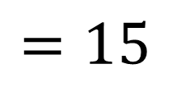
Using a number line
Multiplication involves a magnitude (size) & a direction.
$$5 × (+3)$$
$$=15$$
Three times the size
in the same (+) direction
$$−25$$
$$−20$$
$$−15$$
$$−10$$
$$−5$$
$$0$$
$$5$$
$$10$$
$$15$$
$$20$$
$$25$$

Slide 10


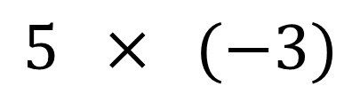









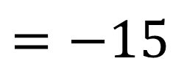
Using a number line
Multiplication involves a magnitude (size) & a direction.
$$5 × (−3)$$
$$=−15$$
Three times the size
in the opposite (−) direction
$$−25$$
$$−20$$
$$−15$$
$$−10$$
$$−5$$
$$0$$
$$5$$
$$10$$
$$15$$
$$20$$
$$25$$

Slide 11
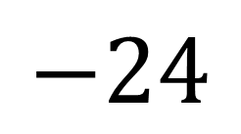
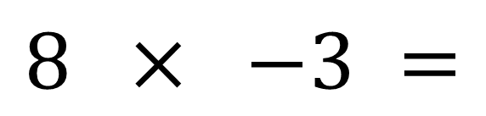
Multiplying Negative Numbers
positive × positive = positive
4 × 5 = 20
positive × negative = negative
4 × −5 = −20
−4 × 5 = −20
negative × negative = positive
−4 × −5 = 20
$$8 × −3 =$$
$$−24$$

Slide 12
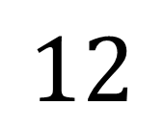
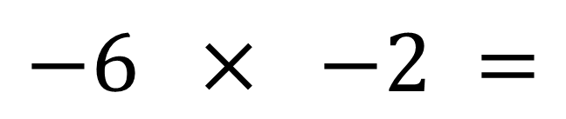
Multiplying Negative Numbers
positive × positive = positive
4 × 5 = 20
positive × negative = negative
4 × −5 = −20
−4 × 5 = −20
negative × negative = positive
−4 × −5 = 20
$$−6 × −2 =$$
$$12$$

Slide 13
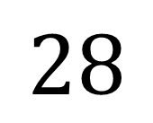
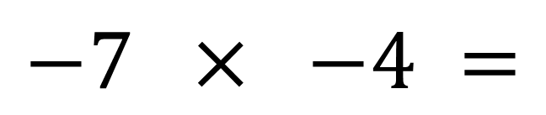
Multiplying Negative Numbers
positive × positive = positive
4 × 5 = 20
positive × negative = negative
4 × −5 = −20
−4 × 5 = −20
negative × negative = positive
−4 × −5 = 20
$$−7 × −4 =$$
$$28$$

Slide 14
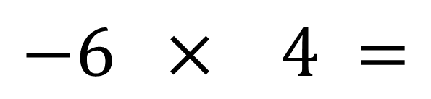
Multiplying Negative Numbers
positive × positive = positive
4 × 5 = 20
positive × negative = negative
4 × −5 = −20
−4 × 5 = −20
negative × negative = positive
−4 × −5 = 20
$$−6 × 4 =$$
$$−24$$

Slide 15
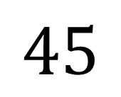
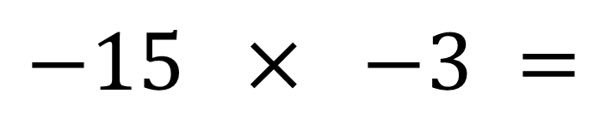
Multiplying Negative Numbers
positive × positive = positive
4 × 5 = 20
positive × negative = negative
4 × −5 = −20
−4 × 5 = −20
negative × negative = positive
−4 × −5 = 20
$$−15 × −3 =$$
$$45$$

Slide 16


On your whiteboards…
… a multiplication with a result of 16.

Slide 17
On your whiteboards…
… a multiplication with a result of −16.

Slide 18
On your whiteboards…
… two numbers with a positive product.

Slide 19
On your whiteboards…
… two numbers with a negative product.

Slide 20
On your whiteboards…
… two numbers with a product of 0.

Slide 21
On your whiteboards…
… two numbers with a product of −12.

Slide 22
On your whiteboards…
… two numbers with a product of −24.

Slide 23
On your whiteboards…
… two negative numbers and
their positive product.

Slide 24
On your whiteboards…
… three numbers with a positive product.

Slide 25
On your whiteboards…
… three numbers with a negative product.

Slide 26
On your whiteboards…
… three numbers with a zero product.

Slide 27
On your whiteboards…
… the product of a
positive number and a
negative number.

Slide 28
On your whiteboards…
… the product of two negative numbers.

Slide 29
On your whiteboards…
… a calculation (including negative
numbers) with a result of 24.

Slide 30
On your whiteboards…
… a calculation (including negative
numbers) with a result of −36.

Slide 31
On your whiteboards…
… the negative factor pairs for 24.

Slide 32
On your whiteboards…
… the negative factor pairs for
a positive number.

Slide 33
On your whiteboards…
… the factor pairs for
a negative number.

Slide 34
On your whiteboards…
… a calculation (including negative
numbers) that needs BIDMAS.

Slide 35
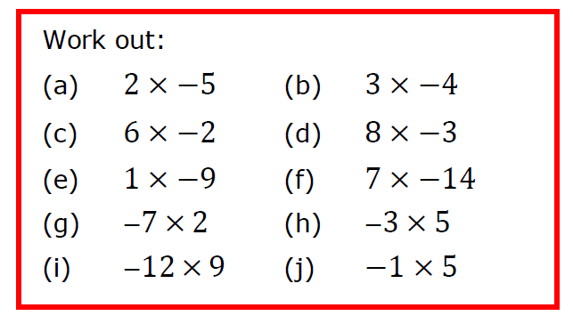
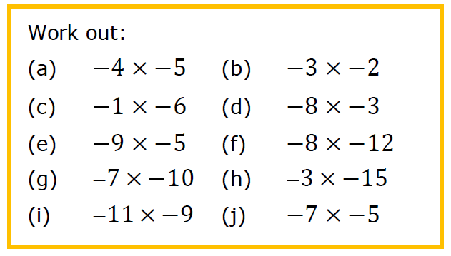
In your
books
× | 1 | −2 | 3 | −4
2 |  |  | 6 | −8
−3 | −3 |  |  | 12
−5
× | 2 | −3 | 4 | −5
4 |  |  | 16
−6 | −12
−7 |  |  |  | 35
× | 8 | −8 | 9 | −10
0.5
−12
−15

Slide 36
× | 1 | −2 | 3 | −4
2 |  |  | 6 | −8
−3 | −3 |  |  | 12
−5
2
-4
6
-9
-5
10
-15
20
× | 2 | −3 | 4 | −5
4 |  |  | 16
−6 | −12
−7 |  |  |  | 35
8
-12
-20
18
-24
30
-14
21
-28
× | 8 | −8 | 9 | −10
0.5
−12
−15
4
-4
4.5
-5
-96
96
-108
120
-120
120
-135
150

Slide 37
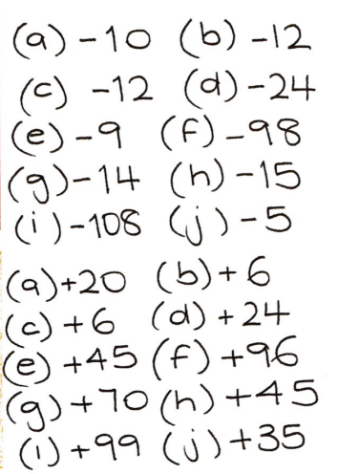

Slide 38
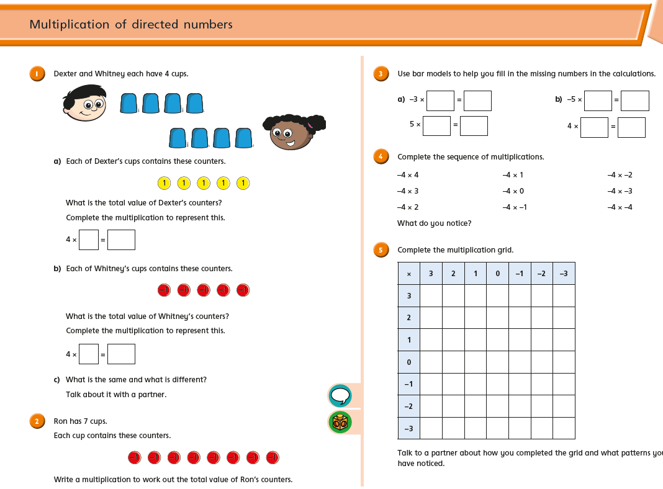
Worksheet

Slide 39
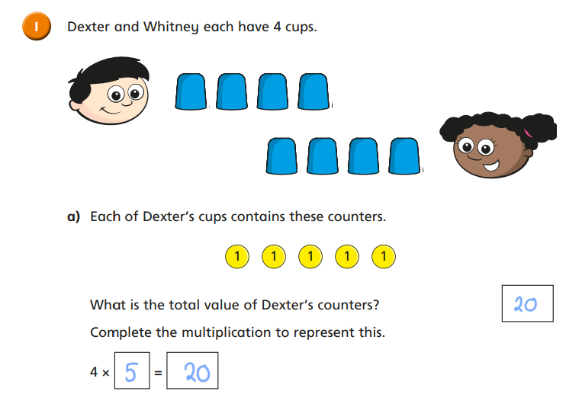
Mark in green pen

Slide 40
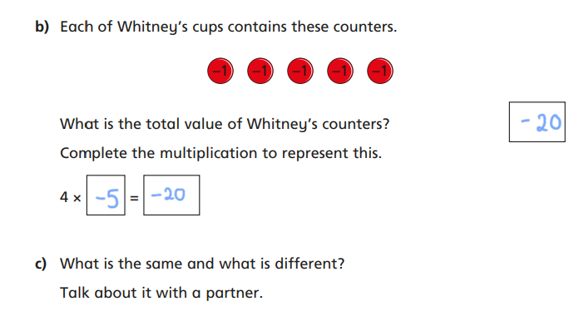
Mark in green pen

Slide 41
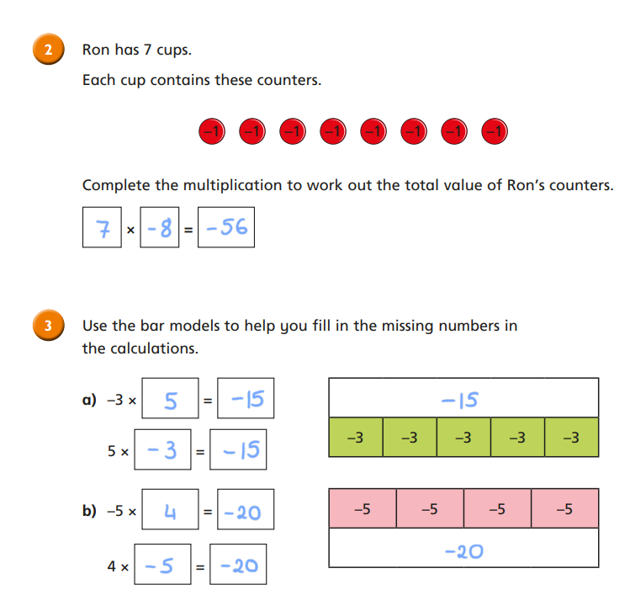
Mark in green pen

Slide 42
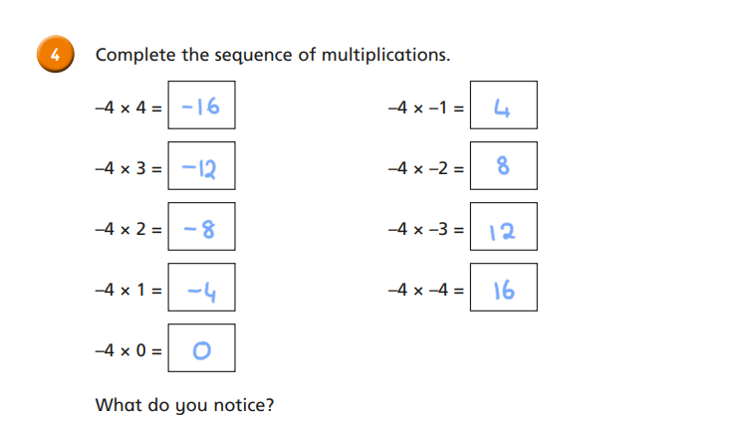
Mark in green pen

Slide 43
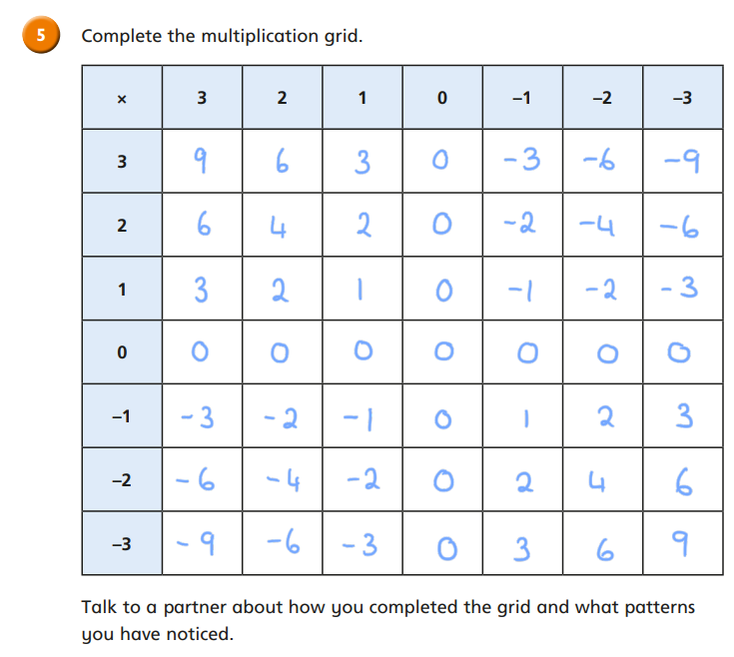
Mark in green pen

Slide 44
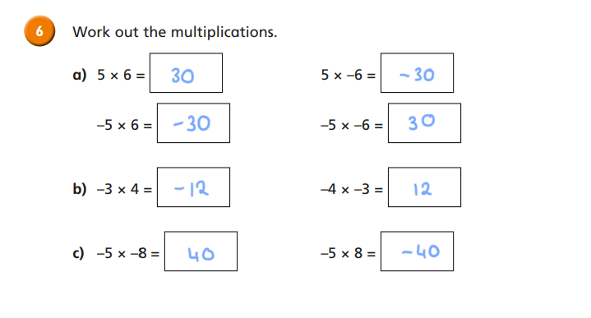
Mark in green pen

Slide 45
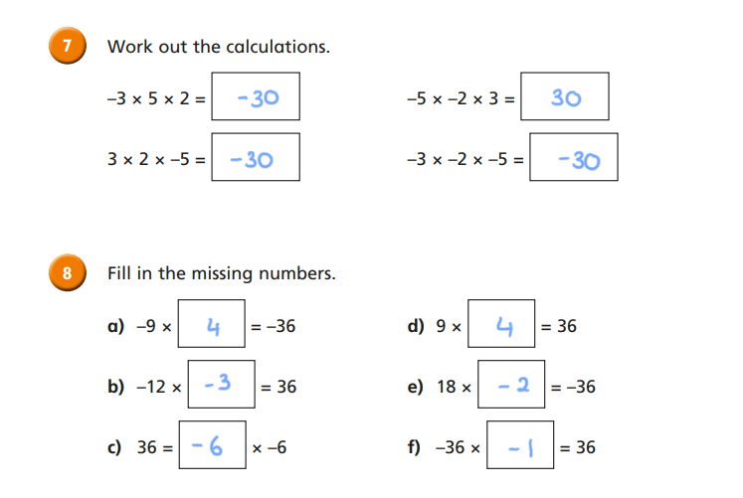
Mark in green pen

Slide 46
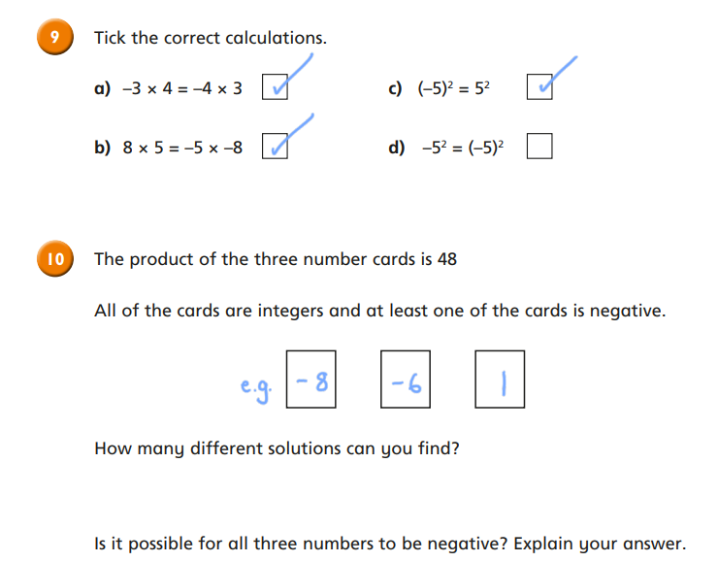
Mark in green pen

Slide 47

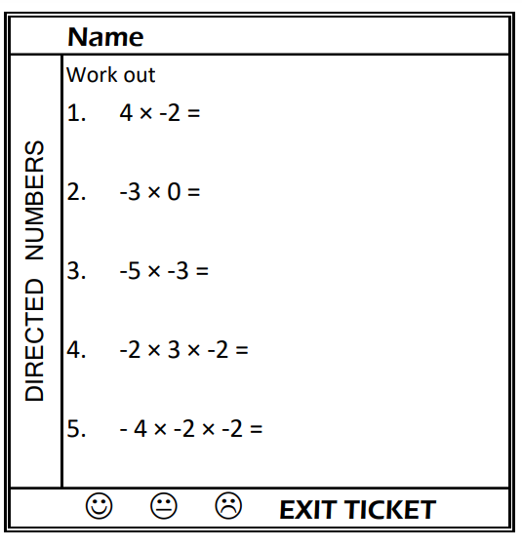
Exit Ticket

