Slide 2
Percentage Increase and Decrease

Slide 3
Checkpoint 4: 110%
Kathryn is an Olympic rower. Kathryn’s coach tells her she needs to give 110% effort in her race.
Is this possible? Why or why not?
Is 110% possible or not possible in each of these situations?
Scoring 110% on an exam.
Paying 110% of a debt back.
The cost of a house increasing by 110%.
A baby being 110% of its birth weight.
Being 110% older than when you started school.
Eating 110% of a cake.
Is it possible to decrease by 110% in any situation? Why or why not?
Notes:
This slide is animated. Each question, and each statement describing a situation, will appear separately so you can choose the pace at which to work with your class.
Answers
a) No, it is not possible: the most effort you can give is 100% (i.e. all of your effort) although it’s a common phrase used in sports coaching. What 100% effort looks like can, of course, vary each day.
b) Scoring 110% on an exam: not possible, as the maximum score is 100%.
Paying 110% of a debt back: possible. In fact, it is usual to pay back more than you borrowed in interest.
The cost of a house increasing by 110%: possible. If a house cost £200 000, then it would have increased by 110% if it was valued at £420 000. Note the phrasing here: if the statement said, ‘A house costing 110% of its original cost’, then it would be if it was valued at £220 000.
A baby gaining 110% of its birth weight: possible. If a baby weights 3 kg when it is born, then it will be 110% of its birth weight when it is 3.3 kg. Note the phrasing here: if the statement said, ‘A baby gaining 110% of its birth weight’, then it would be when it reached 6.3 kg.
Being 110% older than when you started school: possible. If you start school aged four then you’ll be 110% older when you are 8.4 years old. Note the phrasing here: if the statement said, ‘Being 110% of the age you were when you started school’, then it would be when you were 4.4 years old.
Eating 110% of a cake: not possible, as 100% would be all of the cake.
? This is only possible if a negative value makes sense in the context. For example, your bank balance can decrease by 110% if you have an overdraft.
Suggested questioning
What does 100% mean in this situation? Can you have more than that?
How might you represent this using a diagram?
Can you think of an example for this?
Things to think about
Many of the Checkpoints are discussion based, to learn about students’ understanding through their explanations and reasoning. Some of these situations may lead to disagreement! This is desirable, but think ahead about how to manage this in the classroom. Will you ask students to vote first? How will you ensure that students feel confident enough to give arguments and counter-arguments, even if they might ultimately be disproved? Will you ask students to vote again, to see if anyone has changed their mind? Activities like this are most effective within a classroom environment where all students’ voices can be heard, and where all students feel comfortable with being wrong.

Slide 4
We can use bars to represent percentage changes:
0%
100%
88%
What percentage is left when 12% is removed?
88%

Slide 5
0%
100%
88%
£0
£320
So finding a 12% reduction is the same as finding
88%.

Slide 6
We can use bars to represent percentage changes:
0%
100%
12%
What percentage is there in total when 12% is added?
112%

Slide 7
We can use bars to represent percentage changes:
0%
100%
12%
So finding a 12% increase is the same as finding
112%.

Slide 8
DEMO
Increasing & Decreasing by a Percentage
Increase 260 by 10%
100% + 10% = 110%
100% | 260
10%
110%
100% | 260
10%
110%
÷ 10
÷ 10
x 11
260 + 26 =
286
26 x 11 =
286
Notes:
Add arrows alongside tables showing multiplication and addition

Slide 9
DEMO
Increasing & Decreasing by a Percentage
Increase 250 by 20%
Could we do this another way?
100% + 20% = 120%
100% | 250
20%
120%
100% | 250
20%
120%
÷ 5
÷ 5
x 6
250 + 25 =
285
25 x 6 =
285
Notes:
Add arrows alongside tables showing multiplication and addition

Slide 10
DEMO
Increasing & Decreasing by a Percentage
Increase 250 by 20%
100% + 20% = 120%
100% | 250
10% | 25
120% | 275
100% | 250
1% | 2.5
120% | 275
100% | 250
5% | 12.5
120% | 275
÷ 10
÷ 100
÷ 20
x 120
x 24
x 12
Which method do you prefer and why?
Notes:
Add arrows alongside tables showing multiplication

Slide 11
DEMO
Increasing & Decreasing by a Percentage
What different about this question?
Decrease 250 by 20%
Could we do this another way?
100% - 20% = 80%
100% | 250
20%
80%
100% | 250
20%
80%
÷ 5
÷ 5
x 4
250 - 50 =
200
50 x 4 =
200
Notes:
Add arrows alongside tables showing multiplication and addition

Slide 12
DEMO
Increasing & Decreasing by a Percentage
Decrease 250 by 20%
100% - 20% = 80%
100% | 250
10% | 25
80% | 200
100% | 250
1% | 2.5
80% | 200
100% | 250
5% | 12.5
80% | 200
÷ 10
÷ 100
÷ 20
x 80
x 16
x 8
Which method do you prefer and why?
Notes:
Add arrows alongside tables showing multiplication

Slide 13
DEMO
Increasing & Decreasing by a Percentage
Increase 80 by 50% in as many ways as you can think of…
100% + 50% = 150%
100% | 50
150%
Notes:
Collect mwbs compare methods

Slide 14
DEMO
Increasing & Decreasing by a Percentage
Increase 50 by 80% in as many ways as you can think of…
100% + 80% = 180%
100% | 50
180%
Notes:
Collect mwbs compare methods

Slide 15
DEMO
Increasing & Decreasing by a Percentage
Decrease 80 by 30% in as many ways as you can think of…
100% - 30% = 70%
100% | 80
70%
Notes:
Collect mwbs compare methods

Slide 16
DEMO
Increasing & Decreasing by a Percentage
Increase 90 by 40% in as many ways as you can think of…
100% + 40% = 140%
100% | 90
140%
Notes:
Collect mwbs compare methods

Slide 17
DEMO
Increasing & Decreasing by a Percentage
Decrease 90 by 60% in as many ways as you can think of…
100% - 60% = 40%
100% | 90
40%
Notes:
Collect mwbs compare methods

Slide 18
DEMO
Increasing & Decreasing by a Percentage
Increase 140 by 5% in as many ways as you can think of…
100% + 5% = 105%
100% | 140
105%
Notes:
Collect mwbs compare methods

Slide 19
DEMO
Increasing & Decreasing by a Percentage
Decrease 140 by 15% in as many ways as you can think of…
100% - 15% = 85%
100% | 140
85%
Notes:
Collect mwbs compare methods

Slide 20
DEMO
Increasing & Decreasing by a Percentage
Increase 120 by 15% in as many ways as you can think of…
100% + 15% = 115%
100% | 120
115%
Notes:
Collect mwbs compare methods

Slide 21
DEMO
Increasing & Decreasing by a Percentage
Decrease 120 by 45% in as many ways as you can think of…
100% - 45% = 55%
100% | 120
55%
Notes:
Collect mwbs compare methods

Slide 22
100% - 20% = 80%
100% + 10% = 110%
100% + 20% = 120%
100% - 10% =
100% | 980
10%
80%
100% | 950
10%
110%
100% | 660
110%
100% | 460
Notes:
Worksheet to print

Slide 23
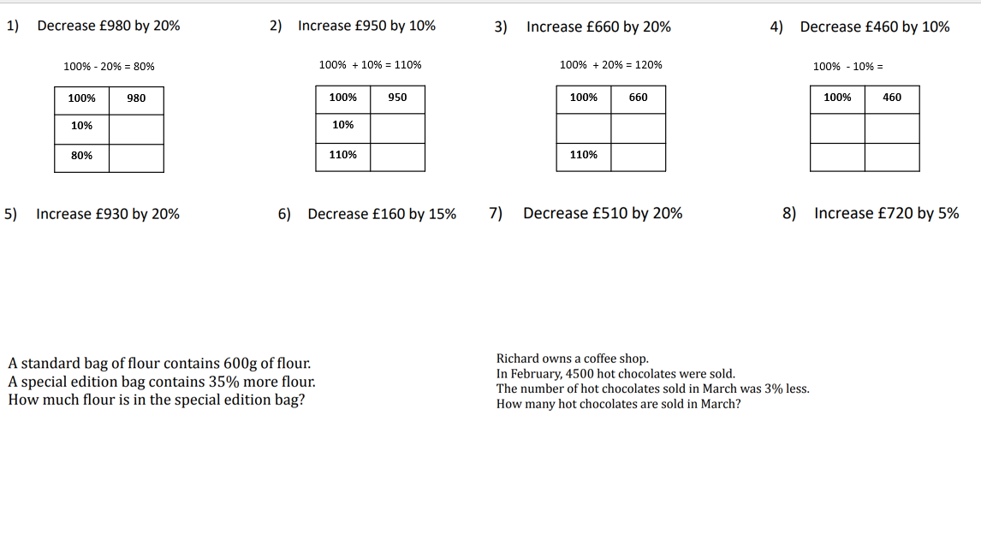
Title:
Increasing and Decreasing by a Percentage

Slide 24
Challenge:

Slide 26
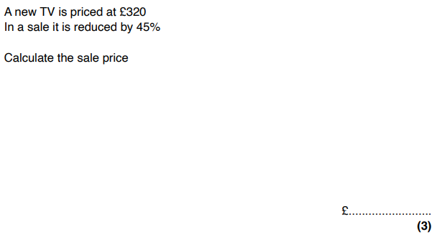
Exit ticket

