Slide 1
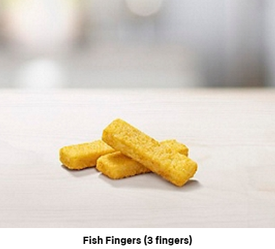
Happy Meals consists of fours choices of main course:
And a side:

Slide 2
Discuss:
How many different Happy Meals are possible?
Notes:
Allow students to work in pairs using a method of their choice.
Compare and share ideas.

Slide 3
How many different Happy Meals are possible?
If we use abbreviations like:
Cheeseburger (C), Hamburger (H), Nuggets (N) and Fish Fingers (F)
Grape Bag (G), Fries (P) and Cucumber Sticks (S)
We could list all the possible combinations like this:
CG, CP, CS
HG, HP, HS
NG, NP, NS
FG, FP, FS
Notes:
Allow students to work in pairs using a method of their choice.
Compare and share ideas.

Slide 4
Or we could use a mapping diagram like this…
Notes:
Allow students to work in pairs using a method of their choice.
Compare and share ideas.

Slide 5
Or we could use a two-way table like this…

Slide 6
With this menu there are 12 different combinations of Happy Meals.

Slide 7
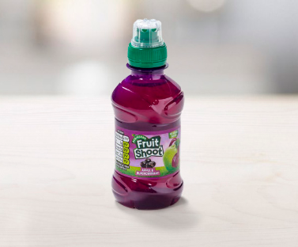
However, Happy Meals also come with a drink:
Discuss: How many different combinations of Happy Meals are there if drinks are also included?

Slide 8
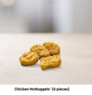
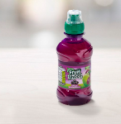
There are 36 different combinations
How can we calculate this without using a two-way table or a listing strategy?

Slide 9
Since there are 4 choices of main course,
3 choices of side and 4 choices of drink
the number of different possible combinations can be calculated by:
$$4×3×4$$

Slide 10
A
B
C
How many different ways can you arrange these 3 cards?
1st Card
3 options
2nd Card
2 options
3rd Card
1 option
3 × 2 × 1 =
6 total possibilities
ABC
ACB
BAC
BCA
CAB
CBA
This is 3 factorial.
3!

Slide 11
A
B
C
D
E
F
How many different ways can you arrange these 6 cards?
1st Card
6 options
2nd Card
5 options
3rd Card
4 options
4th Card
3 options
5th Card
2 options
6th Card
1 option
6 × 5 × 4 × 3 × 2 × 1 =
720 total possibilities
This is 6 factorial.
6!

Slide 12
A
B
C
D
E
F
How many different ways can you arrange these 6 cards?
6 × 5 × 4 × 3 × 2 × 1 =
720 total possibilities
This is 6 factorial.
6!
We have lots of combinations of cards, this is because order matters.
ADEFCB is counted as well as BCEFDA.
Sometimes when we are counting order doesn’t matter,
we only care about what is picked, not how.
If we don’t care about order things happen in, the possibilities must decrease.

Slide 13
A
B
C
D
Mark picks 2 cards at random.
How many different combinations of cards could he pick?
4 × 3 =
12 different ways to pick
But! Order doesn’t matter, we only care about which cards he gets:
AB are the same cards as BA.
 |  | 1ST Choice
 |  | A | B | C | D
2nd Choice | A |  | AB | AC | AD
 | B | BA |  | BC | BD
 | C | CA | CB |  | CD
 | D | DA | DB | DC
2 cards can be arranged in 2! ways.
total ways to pick
12
12
=
=
= 6
duplicate arrangements
2!
2
There are only 6 unique combinations he could get.

Slide 14
A
B
C
D
E
F
If you pick 3 cards,
how many different combinations could you get?
Different ways to pick 3 from 6 = 6 × 5 × 4 = 120
But, these possibilities include the same 3 cards selected:
it counts DCF, DFC, CFD etc…
We need to eliminate duplicates: how many ways can 3 cards be arranged?
3!
Each set of 3 cards has 6 duplicate arrangements.
total ways to pick
120
=
= 20 unique combinations of cards
duplicate arrangements
3 × 2 × 1

Slide 15
Anna
Beth
Charlie
Dawn
Elle
Fran
Grace
We want to pick a 5 person running team.
How many possible combinations of 5 students are there?
Different ways to pick 5 students from 7 = 7 × 6 × 5 × 4 × 3 = 2,520
But! We don’t care about order: ACDEG are the same 5 runners as DGCAE
We need to divide by the duplicates.
different ways to pick
2520
=
= 21 unique combinations of players
duplicate arrangements
5!

Slide 16
From 11 students, Mr Hedges wants to pick 5 for the athletics squad.
How many possible combinations of 5 students are there?
Different ways to pick 5 students from 11 = 11 × 10 × 9 × 8 × 7 = 55,440
How many duplicates are there in each set of 5?
different ways to pick
55440
=
= 462 unique combinations of students
duplicate arrangements
5!

Slide 17
A pizza place has 6 toppings available.
You pick 4 different toppings.
How many unique pizzas are available?
Total ways to pick 4 from 6 = 6 × 5 × 4 × 3 = 360
Duplicate ways to arrange 4 items = 4! = 4 × 3 × 2 × 1 = 24
total ways to pick
360
=
= 15 unique combinations of toppings
duplicate arrangements
4!

Slide 19
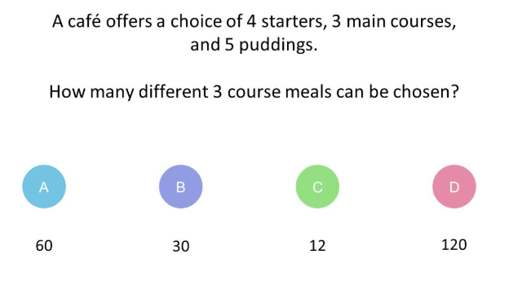

Slide 24
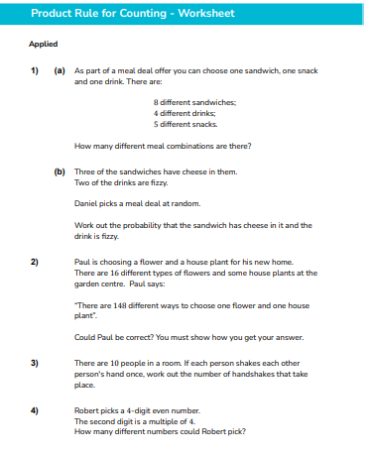
Practice Worksheet

Slide 26
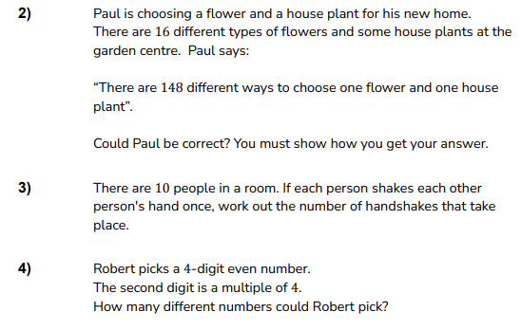

Slide 27
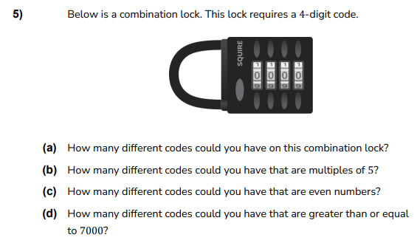

Slide 28
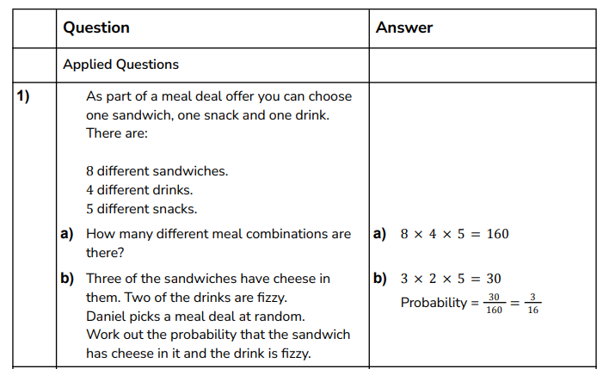

Slide 29
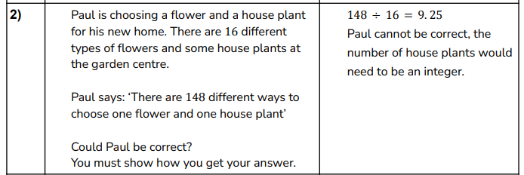

Slide 32
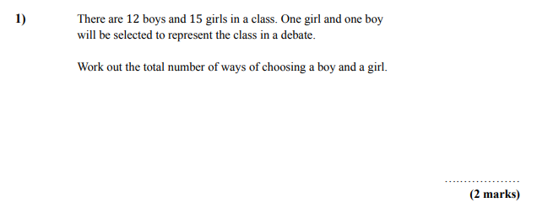

Slide 33
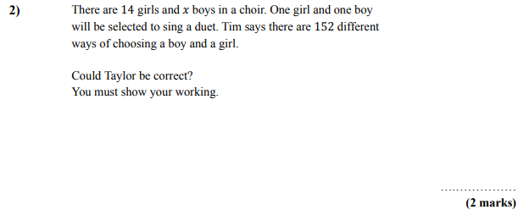

Slide 34
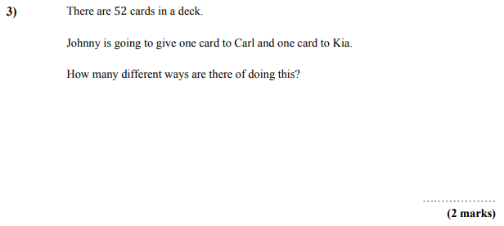

Slide 36
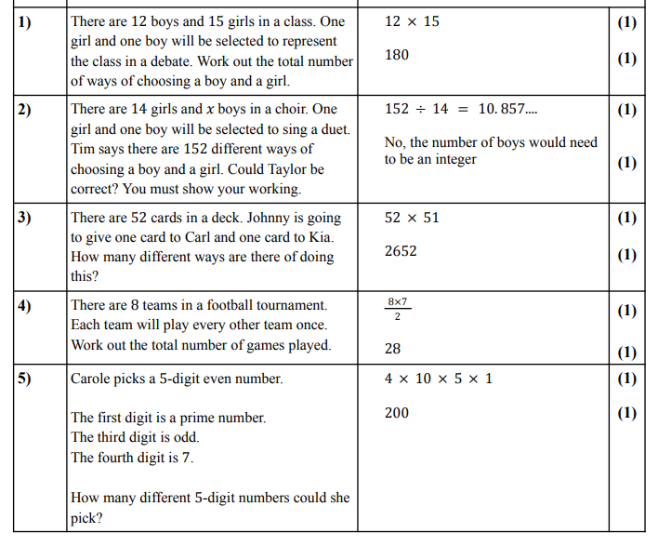

Slide 37
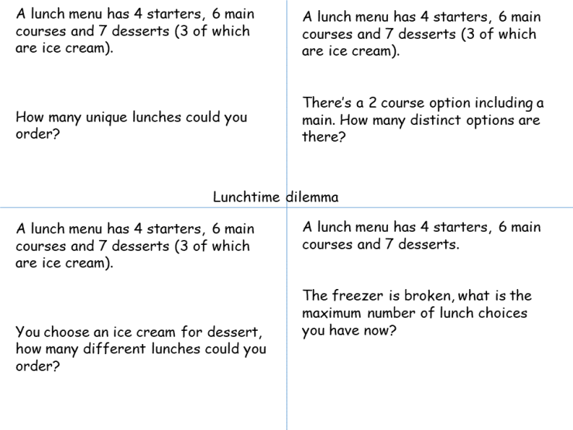
Notes:
50 x 49 x 48 x 47 x 46 x 12 x 11

Slide 38
