Slide 1
Dual coding symbols:
Practise
Explain
Organise
Big Question
Reflect
Present
Compare
Evaluate
Activate
Discuss
Predict
Connect
Summarise
Recall
Vocabulary

Slide 2
Editable reading ruler
Every child in an Archway school will become a fluent reader
 | RETRIEVE the words or phrases you need from the text | DECODE the words or phrase to address a breakdown | CONNECT with words or phrases you know from the text or your memory | VISUALISE the images in as much detail as possible | SUMMARISE the main ideas of the text in a few words | INFER meanings that might be within the text | PREDICT what might happen next using details from the text | EXAMINE how the writer uses words to construct meaning
 | ASK THOUGHTFUL QUESTIONS TO HELP YOU UNDERSTAND THE TEXT

Slide 3
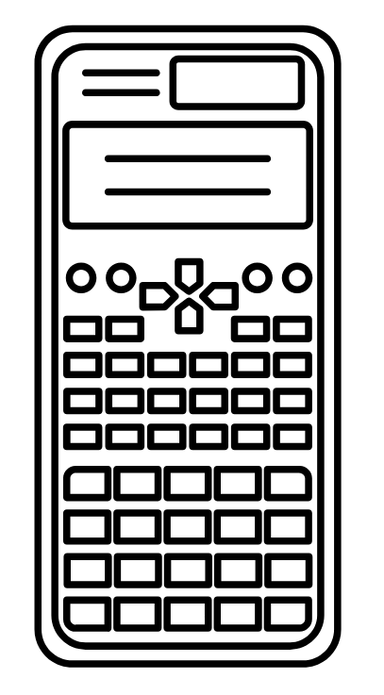
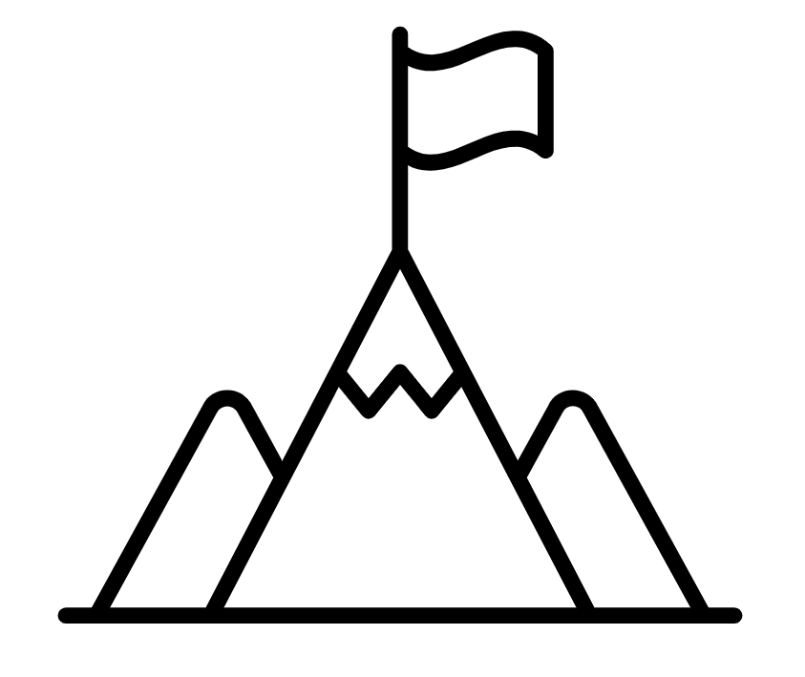
A
B

Slide 4
LESSON TITLE: Dividing Fractions

Slide 5
What do you notice about the following pairs of questions?
2 ÷ $\frac{1}{3}$ = 6 2 x 3 = 6
3 ÷ $\frac{1}{4}$ = 12 3 x 4 = 12
4 ÷ $\frac{1}{2}=8$ 4 x 2 = 8
5 ÷ $\frac{2}{5}=12.5$ 5 x 2.5 = 12.5

Slide 6
Any division can be rewritten as a multiplication of the reciprocal.
E.g.
$5÷2=\frac{5}{2}$ $5×\frac{1}{2}=\frac{5}{2}$

Slide 7
What would you replace the question mark with in each of the following ?
2 ÷ ? = 6 2 x 3 = 6
3 ÷ $\frac{1}{5}$ = 15 3 x ? = 15
4 ÷ ? = 5 4 x $1\frac{1}{4}$ = 5
5 ÷ $\frac{4}{5}$ 5 x ? = 6.25

Slide 8
When dividing fractions its easier to multiply by the reciprocal, rather than complete the division
$\frac{3}{8}$ ÷ $\frac{7}{11}$ = $\frac{3÷7}{8÷11}$ = $\frac{0.428571…}{0.727272…}$
We can divide these numerator and denominators, however if we multiply by the reciprocal the calculation is easier to complete
$\frac{3}{8}$ x $\frac{11}{7}$ = $\frac{3 ×11}{8 × 7}$ = $\frac{33}{56}$

Slide 9
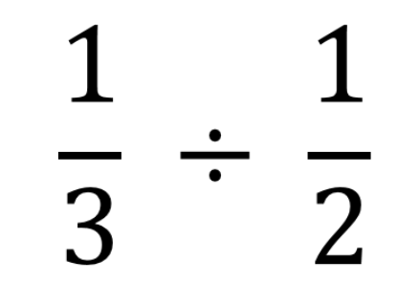
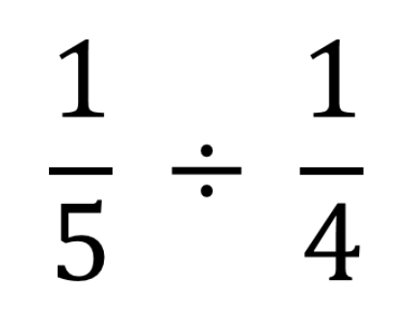
I DO:
WE DO:

Slide 10
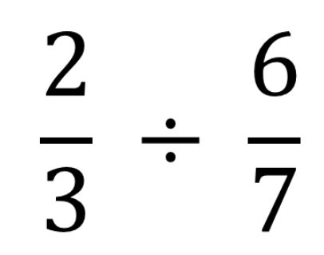
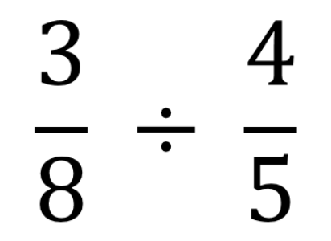
I DO:
WE DO:

Slide 11
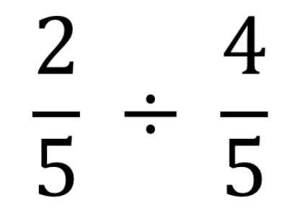
I DO:
YOU DO:

Slide 12
I DO:
YOU DO:
$$\frac{4}{8}$$
$$\frac{5}{9}$$
$$\frac{2}{3}$$
$$\frac{4}{6}$$
÷
÷

Slide 13
Mini WBs:

Slide 14
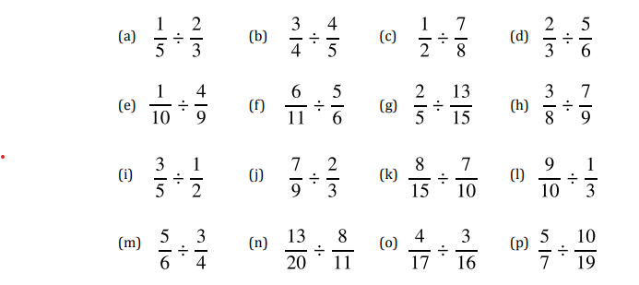
Calculate the following divisions

Slide 15
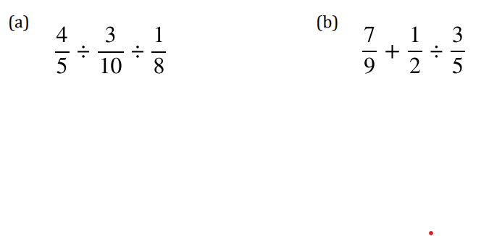
Depth:
Calculate the following
$\frac{5}{6}$ x $\frac{3}{7}$ ÷ $\frac{5}{8}$
$\frac{5}{6}$ ÷ $\frac{2}{5}$ x $\frac{3}{2}$
($\frac{2}{5}$ + $\frac{1}{3}$ )÷ $\frac{2}{3}$
($\frac{5}{6}$ - $\frac{1}{4}$ )÷ $\frac{3}{4}$

Slide 16
Depth:
Using the digits 1 – 9, how close can you make the following calculation to 1
$×\frac{}{}$ ÷

