Slide 1
Dual coding symbols:
Practise
Explain
Organise
Big Question
Reflect
Present
Compare
Evaluate
Activate
Discuss
Predict
Connect
Summarise
Recall
Vocabulary

Slide 2
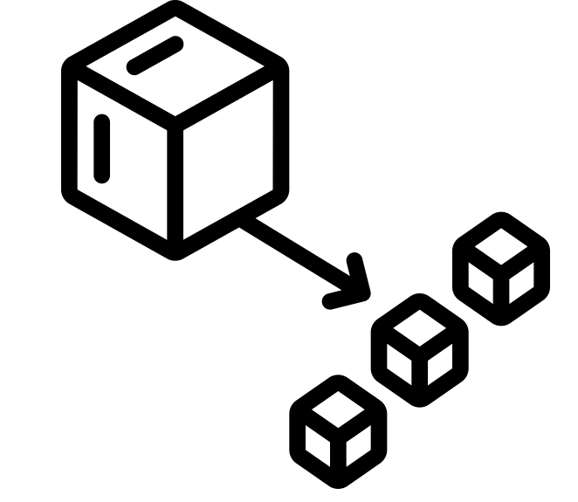
Editable reading ruler
Every child in an Archway school will become a fluent reader
 | RETRIEVE the words or phrases you need from the text | DECODE the words or phrase to address a breakdown | CONNECT with words or phrases you know from the text or your memory | VISUALISE the images in as much detail as possible | SUMMARISE the main ideas of the text in a few words | INFER meanings that might be within the text | PREDICT what might happen next using details from the text | EXAMINE how the writer uses words to construct meaning
 | ASK THOUGHTFUL QUESTIONS TO HELP YOU UNDERSTAND THE TEXT

Slide 3
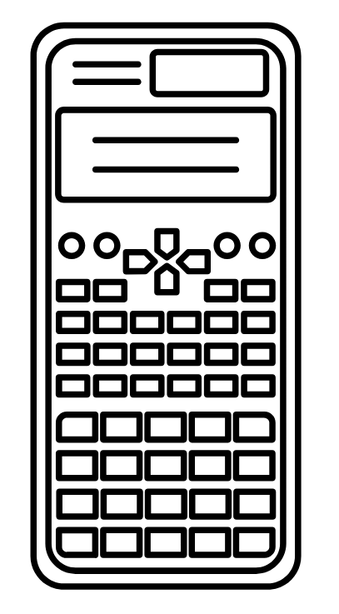
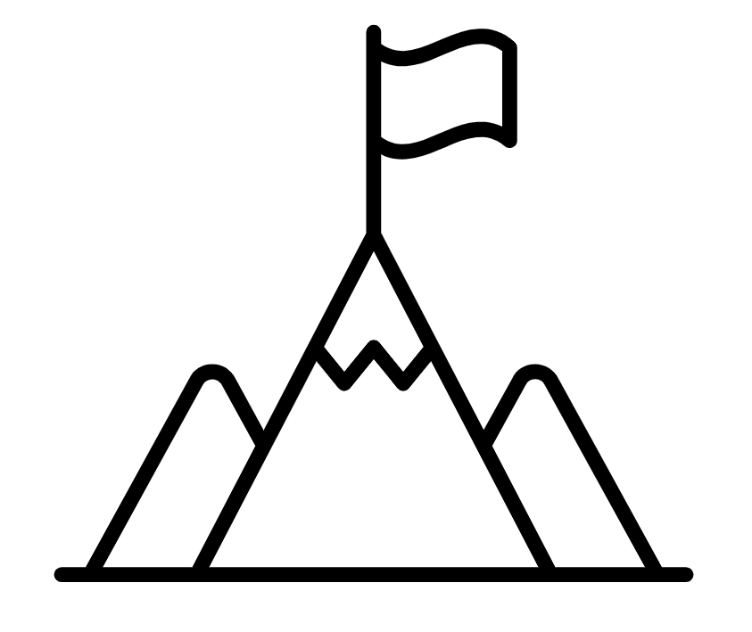
A
B

Slide 4
LESSON TITLE: Dividing Mixed Numbers

Slide 5
I have $4\frac{1}{2}$ pizzas if I split it up into portions of $\frac{1}{2}$ a pizza how many portions can I make?
If I split it instead into portions of $1\frac{1}{2}$ pizzas how many portions can I make?
Notes:
$$÷÷$$

Slide 6
I have $4\frac{1}{2}$ pizzas if I split it up into portions of $1\frac{1}{3}$ a pizza how many portions can I make?
This is more challenging.
Lets look at a method for solving this problem.
Notes:
$$÷÷$$

Slide 7
I DO:
WE DO:
$$2\frac{1 }{2 } ÷ \frac{3}{4}$$
$$1\frac{3 }{5 }÷ \frac{2}{3}$$

Slide 8
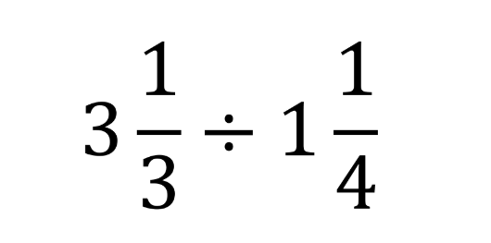
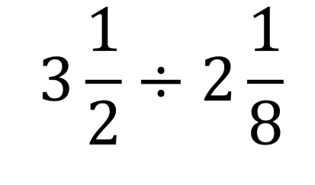
I DO:
WE DO:

Slide 9
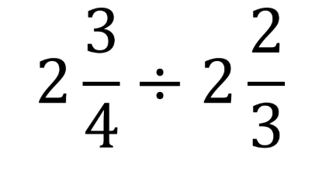
I DO:
WE DO:

Slide 10
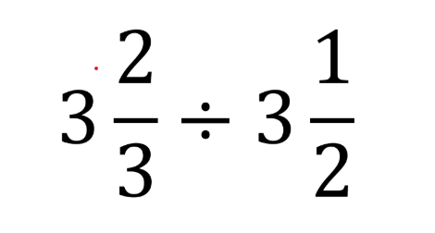
I DO:
YOUI DO:

Slide 11
Mini WBs:

Slide 12
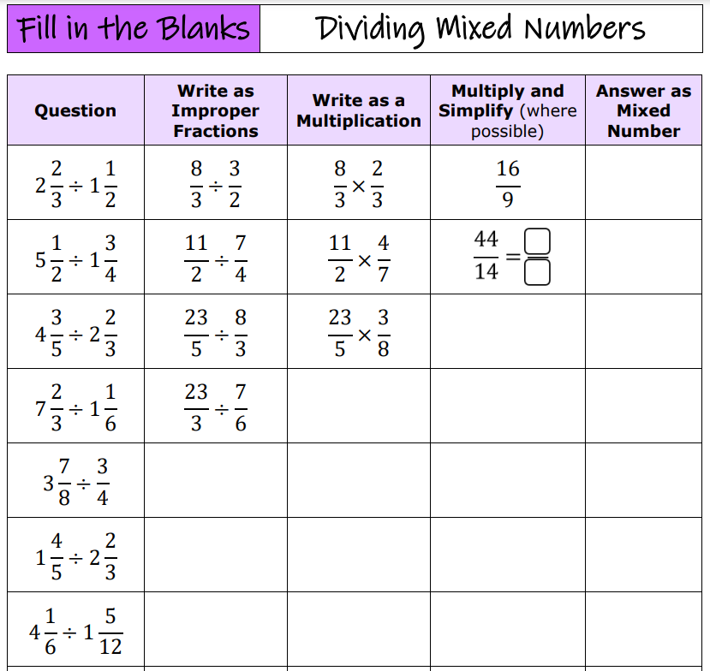
https://www.draustinmaths.com/_files/ugd/7ac124_c6bcd3641dbd4620b77da0c2160a2e36.pdf

Slide 13
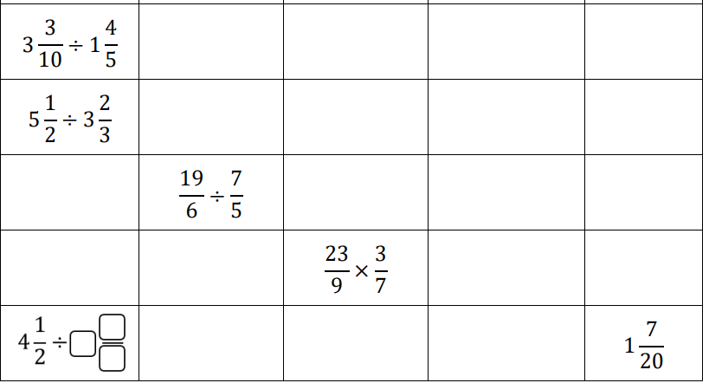

Slide 14
x
( )
${\left(4\frac{2}{3}\right)}^{2}÷1\frac{2}{3}$
-
$$3\frac{1}{3}$$
Calculate the missing length of the rectangle?
Area = 8 $\frac{1}{2}{cm}^{2}$
?

Slide 15
Depth:
Using the digits 1 – 9, how close can you make the following calculation to 5
$× \frac{}{}$ ÷

