Slide 1
Dual coding symbols:
Practise
Explain
Organise
Big Question
Reflect
Present
Compare
Evaluate
Activate
Discuss
Predict
Connect
Summarise
Recall
Vocabulary

Slide 2
Editable reading ruler
Every child in an Archway school will become a fluent reader
 | RETRIEVE the words or phrases you need from the text | DECODE the words or phrase to address a breakdown | CONNECT with words or phrases you know from the text or your memory | VISUALISE the images in as much detail as possible | SUMMARISE the main ideas of the text in a few words | INFER meanings that might be within the text | PREDICT what might happen next using details from the text | EXAMINE how the writer uses words to construct meaning
 | ASK THOUGHTFUL QUESTIONS TO HELP YOU UNDERSTAND THE TEXT

Slide 3
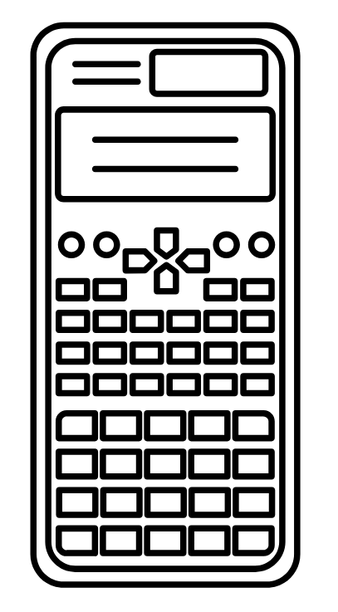
A
B

Slide 4
LESSON TITLE: Division of integers

Slide 5
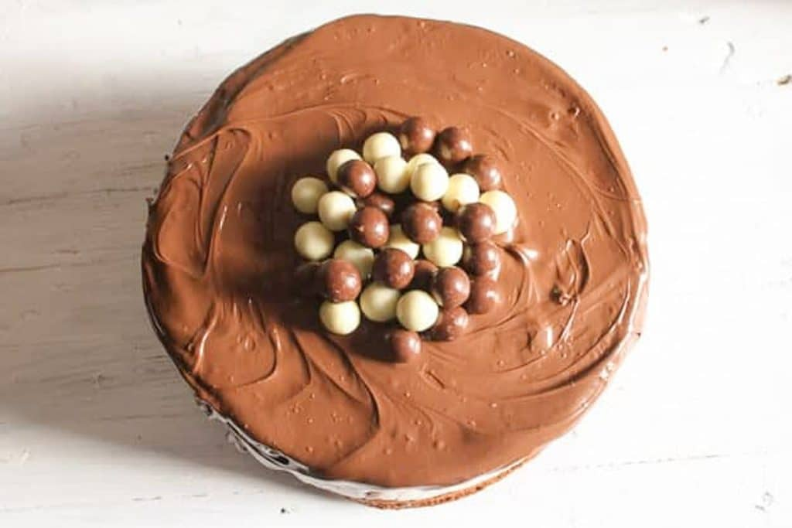
James buys 3 cakes for a party
How many slices will James have if he cuts the cakes into:
Halves
Quarters
Eighths

Slide 6
$3÷\frac{1}{2}=$
How many halves fit into 3 wholes?

Slide 7
$2÷\frac{2}{5}$
How many two-fifths fit into 2 wholes?

Slide 8
I DO:
WE DO:
$2÷\frac{1}{4}$
$3÷\frac{1}{3}$

Slide 9
I DO:
WE DO:
$3÷\frac{3}{4}$
$2÷\frac{2}{3}$

Slide 10
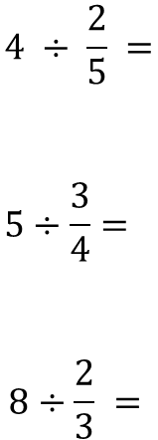
Mini WBs:

Slide 11
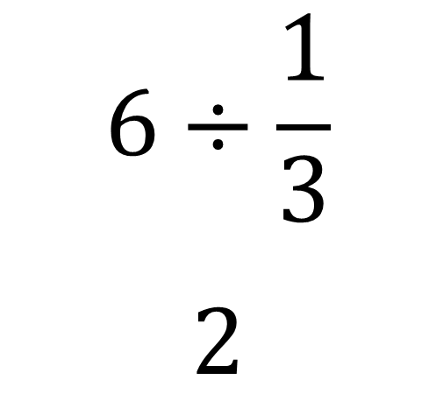
Mini WBs:
Spot the mistake:

Slide 12
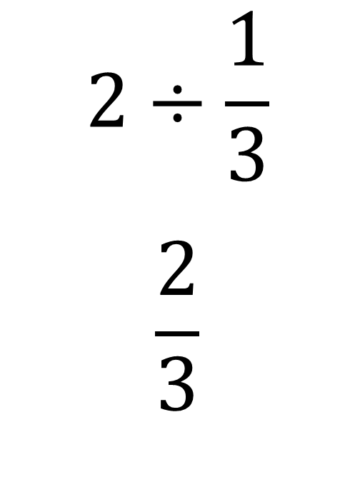
Mini WBs:
Spot the mistake:

Slide 13
$2÷\frac{1}{3}$
$3÷\frac{1}{3}$
$3÷\frac{1}{2}$
$1÷\frac{1}{5}$
$5÷\frac{1}{2}$
$3÷\frac{3}{4}$
$4÷\frac{2}{5}$
$2÷\frac{2}{5}$

Slide 14
$\frac{1}{4}÷3=\frac{1}{12}$

Slide 16
$\frac{2}{5}÷3=$

Slide 17
I DO:
WE DO:
$\frac{1}{4}÷2$
$\frac{1}{4}÷3$

Slide 18
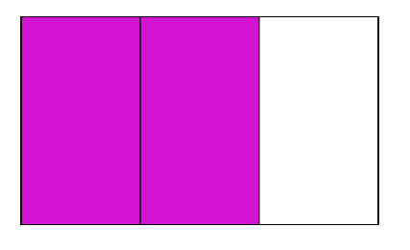
I DO:
WE DO:
$\frac{3}{4}÷2$
$\frac{2}{3}÷3$

Slide 19
Mini WBs:

Slide 20
$\frac{1}{2}÷3$
$\frac{1}{3}÷2$
$\frac{1}{4}÷3$
$\frac{1}{10}÷2$
$\frac{2}{3}÷3$
$\frac{3}{5}÷2$
$\frac{3}{4}÷3$
$\frac{7}{10}÷2$

