Slide 1
Systematic Listing
When listing systematically, the outcomes are listed in such a way that all outcomes are recorded.

Slide 2
At an ice cream stall you can choose…
one flavour of ice cream & one topping.
Flavours
Vanilla
Chocolate
Banana
Toppings
Flake
Sprinkles
Nuts
How many different ice creams could be ordered?
Vanilla & Flake
Chocolate & Flake
Banana & Flake
Vanilla & Sprinkles
Chocolate & Sprinkles
Banana & Sprinkles
Vanilla & Nuts
Chocolate & Nuts
Banana & Nuts
There are 9 choices in total.
How can we make these choices easier to list?

Slide 3
At the ice cream stall you can choose…
one flavour of ice cream & one topping.
Flavours
Vanilla
Chocolate
Banana
Toppings
Flake
Sprinkles
Nuts
We can use letters to make it easier to list:
VF
CF
BF
VS
CS
BS
VN
CN
BN

Slide 4
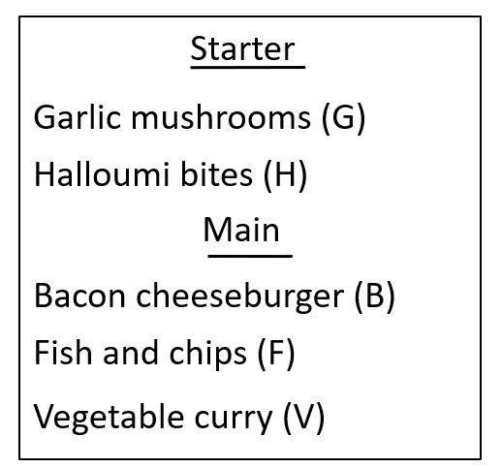
A restaurant has a two course set menu. You select one from the starters and one from the main course section.
What are the possible two course meals?
GB, HV, HB, GF, HF, GV
Andeep
GB, GF, GV, HB, HF, HV
Sofia
GB, HB, GF, HF, GV, HV
Alex
Whose list is the least systematic?

Slide 5
A restaurant has a two course set menu. You select one from the starters and one from the main course section.
What are the possible two course meals?
GB, HV, HB, GF, HF, GV
Andeep
Andeep’s list is not systematic. It jumps between the different starters and main courses.
It could lead to missed outcomes or duplications.

Slide 6
A restaurant has a two course set menu. You select one from the starters and one from the main course section.
Why are Sofia’s and Alex’s lists better?
GB, GF, GV, HB, HF, HV
Sofia
Sophia has systematically found the outcomes for each starter.
GB, HB, GF, HF, GV, HV
Alex has systematically found the outcomes with each main.
Alex

Slide 7
WHITEBOARDS READY

Slide 8
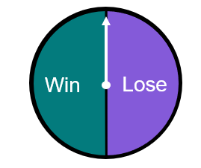
WHITEBOARDS:
A spinner is spun twice.
List all the possible outcomes
Win, Win
Win, Lose
Lose, Lose
Lose, Win
Win
Lose

Slide 9
WHITEBOARDS:
A spinner is spun twice. The possible outcomes are {AA, BA, AB, BB}. Which of these spinners could it have been?
A
B
B
B
B
A
A
A
A
B
A
A
B
B
A
B
a
b
c
All of them!
Each spinner has two possible outcomes of A or B - so when a trial of 2 spins is carried out, there are only four possible combinations.

Slide 10
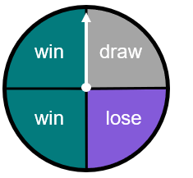
WHITEBOARDS:
If we were to spin this spinner twice, what are the possible outcomes?
Let win be W, lose be L and draw be D.
Possible outcomes are {WW, LL, DD, WD, LW, DL, WL, DW, LD}.
So this spinner is different in terms of its outcomes?
Yes, there will be more possible outcomes in the sample space too.
Aisha
Laura

Slide 11
WHITEBOARDS:
When spun twice, which of the following spinners do not have a sample space of:
{win/win, lose/lose, win/lose, lose/win}?
Each spin has three possible outcomes rather than two.
win
draw
win
win
win
lose
lose
win
lose
a
b
c

Slide 12
WHITEBOARDS:
Spinner A and Spinner B are both spun:
spinner A
spinner B
D
A
B
A
C
B
List all the possible outcomes:
BA, BB, BC, BD, AA, AB, AC, AD

Slide 13
WHITEBOARDS:
Two spinners are going to be spun.
The possible outcomes are {A1, A2, A3, B1, B2, B3, C1, C2, C3}.
Complete the spinners.

Slide 14
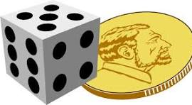
WHITEBOARDS:
A fair dice is rolled and a coin flipped.
List all the possible outcomes
H, 1
T, 1
H, 2
T, 2
H, 3
T, 3
H, 4
T, 4
H, 5
T, 5
H, 6
T, 6

Slide 15
WHITEBOARDS:
A set menu at a restaurant costs £15.
You can choose one main meal & one dessert.
List all the different choices for the set menu.
(Use letters instead of the full words.)
Main Meal
Lasagne
Pizza
Curry
Dessert
Toffee Pudding
Ice Cream
Mousse
L
T
P
T
C
T
L
I
P
I
C
I
L
M
P
M
C
M
= 9 choices in total.

Slide 16
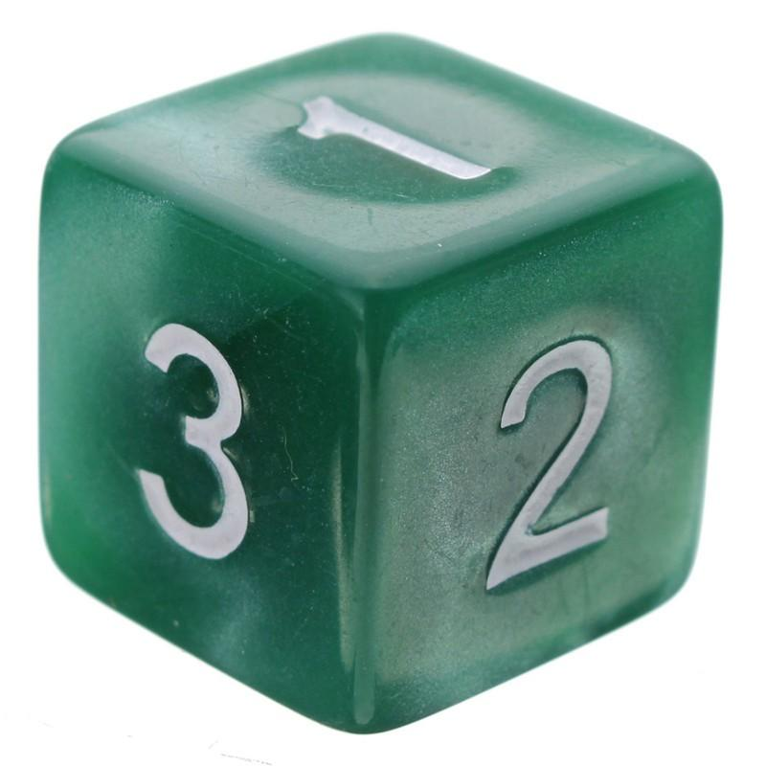
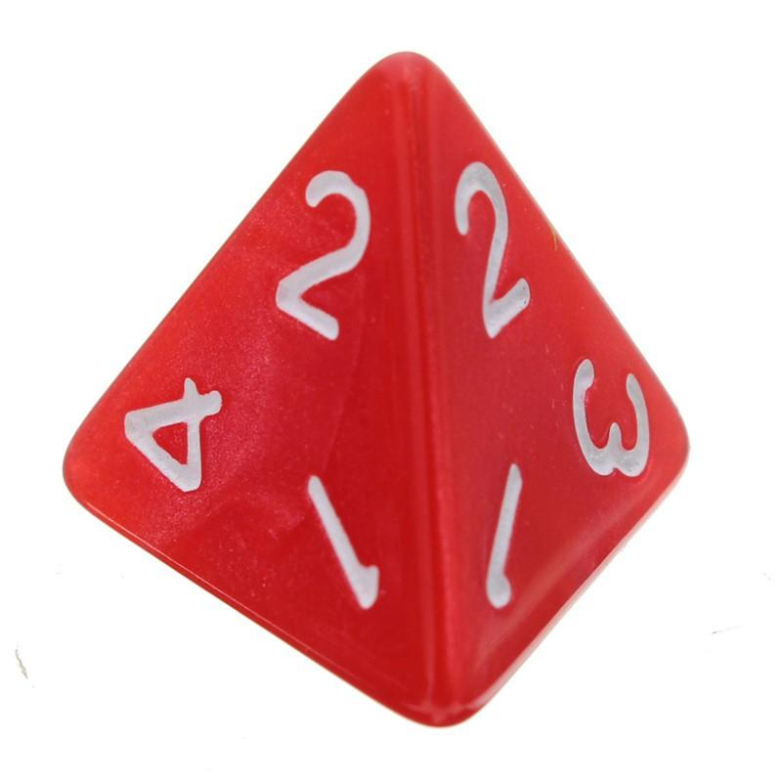
These 3 cards all have a
letter on them.
At a clothes store you can
design your own jacket.
Size:
Small, Medium, Large
Outside Colour:
Red, Yellow, Green
Inside Colour:
Black, Yellow
1)
3 fair 6-sided dice are rolled
and their scores are added.
E
A
T
List all the ways we can
score less than 5.
1)
How many different
ways can the cards be
ordered?
Your Turn:
Complete the Worksheet
2)
Use a code to list all the
possible types of jackets
you can buy.
A fair 4-sided dice is
rolled twice & the
scores are multiplied.
What is the probability we
score more than 7?
2)
If the cards are
randomly ordered,
what is the probability
they spell TEA?

Slide 17
These 3 cards all have a
letter on them.
At a clothes store you can
design your own jacket.
Size:
Small, Medium, Large
Outside Colour:
Red, Yellow, Green
Inside Colour:
Black, Yellow
1)
3 fair 6-sided dice are rolled
and their scores are added.
E
A
T
List all the ways we can
score less than 5.
1)
How many different
ways can the cards be
ordered?
2)
Use a code to list all the
possible types of jackets
you can buy.
A fair 4-sided dice is
rolled twice & the
scores are multiplied.
What is the probability we
score more than 7?
2)
If the cards are
randomly ordered,
what is the probability
they spell TEA?

Slide 18
These 3 cards all have a
letter on them.
At a clothes store you can
design your own jacket.
Size:
Small, Medium, Large
Outside Colour:
Red, Yellow, Green
Inside Colour:
Black, Yellow
1)
3 fair 6-sided dice are rolled
and their scores are added.
E
A
T
List all the ways we can
score less than 5.
1)
How many different
ways can the cards be
ordered?
1,1,1 1,1,2
1,2,1 2,1,1
6
2)
EAT
ETA
ATE
AET
TEA
TAE
Use a code to list all the
possible types of jackets
you can buy.
A fair 4-sided dice is
rolled twice & the
scores are multiplied.
What is the probability we
score more than 7?
18
2)
If the cards are
randomly ordered,
what is the probability
they spell TEA?
SRB
SRY
SYB
SYY
SGB
SGY
MRB
MRY
MYB
MYY
MGB
MGY
LRB
LRY
LYB
LYY
LGB
LGY
 | 1 | 2 | 3 | 4
1 | 1 | 2 | 3 | 4
2 | 2 | 4 | 6 | 8
3 | 3 | 6 | 9 | 12
4 | 4 | 8 | 12 | 16
$$\frac{1}{6}$$
$$\frac{6}{16}=\frac{3}{8}$$

Slide 19
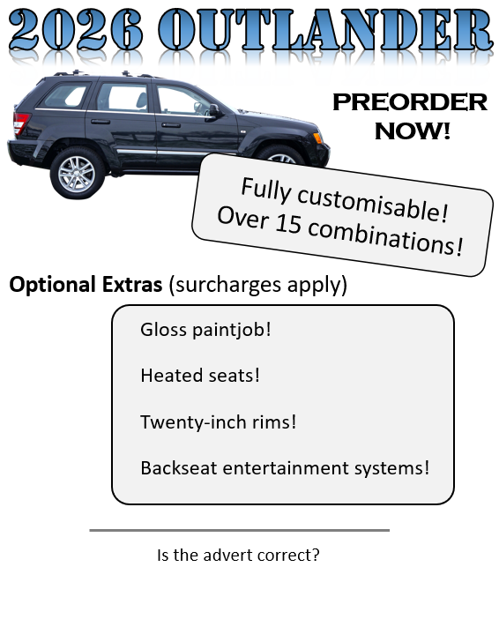
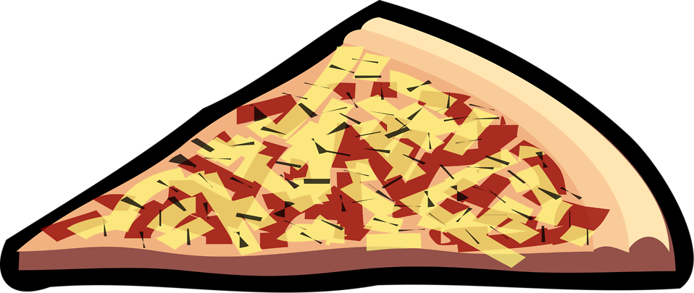
Pete’s Perfect
Veggie Pizza!
Over 15 different types of pizza!
Only £8.99 for a
double-topping* medium pizza!!
mushrooms
peppers
extra-cheese
spinach
fried broccoli
olives
*Choose two different toppings
Is the advert correct?

Slide 20
Pete’s Perfect
Veggie Pizza!
Is the advert correct?
Over 15 different types of pizza!
MP
ME
MS
MF
MO
PE
PS
PF
PO
ES
EF
EO
SF
SO
FO
Only £8.99 for a
double-topping* medium pizza!!
mushrooms
peppers
extra-cheese
spinach
fried broccoli
olives
Exactly 15, not “over 15”
*Choose two different toppings
How does it change if we can choose
the same topping twice?

Slide 21
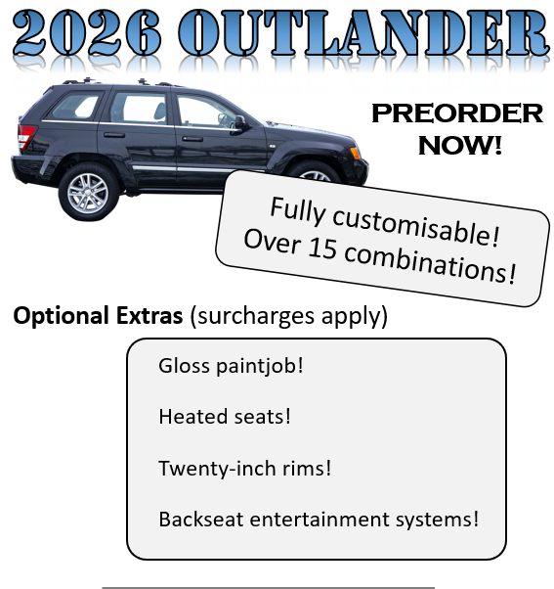
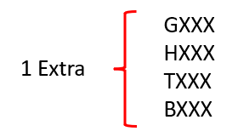
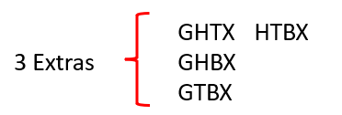
Is the advert correct?
Yes, 16 combinations.

Slide 22
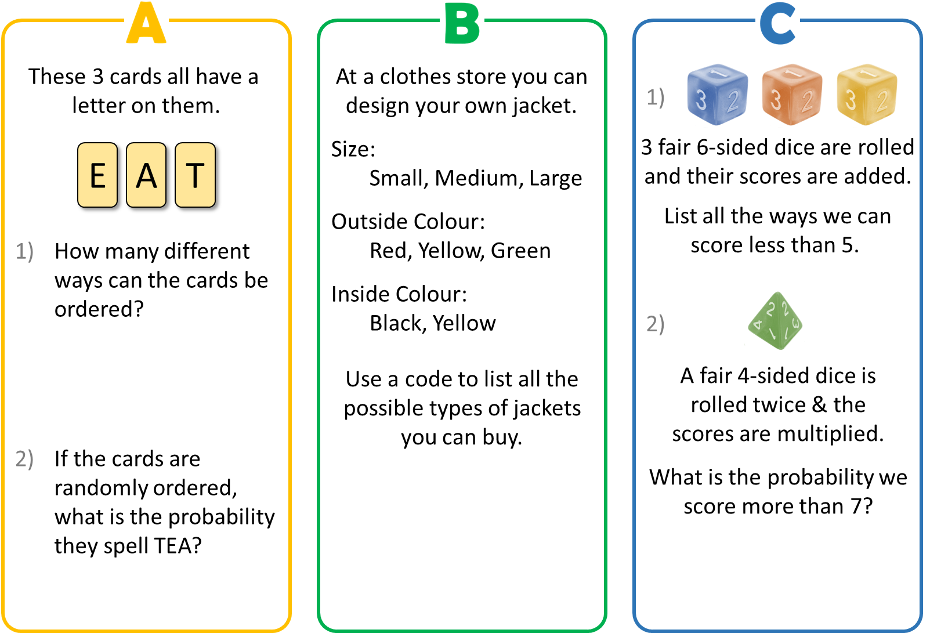

Slide 23
Systematic listing
1) A fair six-sided dice and the spinner shown are to be rolled and spun simultaneously.
a) List the possible outcomes systematically
b) How many possible outcomes are there?
C
A
{1A, 1B, 1C, 2A, 2B, 2C, 3A, 3B, 3C, 4A, 4B, 4C, 5A, 5B, 5C, 6A, 6B, 6C}
or {A1, A2, A3, A4, A5, A6, B1, B2, B3, B4, B5, B6, C1, C2, C3, C4, C5, C6}
B
18. 6 different outcomes from the dice and 3 different outcomes from the spinner

Slide 24
Systematic listing
2) A fair coin and a fair six-sided dice are flipped and rolled simultaneously.
a) List the possible outcomes systematically
b) How many possible outcomes are there?
{1H, 1T, 2H, 2T, 3H, 3T, 4H, 4T, 5H, 5T, 6H, 6T}
or {H1, H2, H3, H4, H5, H6, T1, T2, T3, T4, T5, T6}
12: 6 different outcomes from the dice and 2 different outcomes from the coin

Slide 25
3) Two spinners are going to be spun.
The possible outcomes are {A1, A2, A3, B1, B2, B3, C1, C2, C3}.
Complete the spinners.
e.g.
A
C
2
1
3
Either 1, 2 or 3
B

Slide 26
Here are the menus from 2 different restaurants.
Customers can choose one main meal & one dessert.
List all the meals you can have at each restaurant.
Main Meal
Pasta
Roast
Dessert
Cheesecake
Fondue
Brownie
Shortcake
Main Meal
Noodles
Pie
BBQ
Dessert
Ice Cream
Custard
Flan
Milkshake
Tiramisu
NI | PI | BI
NC | PC | BC
NF | PF | BF
NM | PM | BM
NT | PT | BT
PC | RC
PF | RF
PB | RB
PS | RS
What is the connection between the options & the total number of choices?

Slide 27
How many different ways
can you arrange the letters AB?
How many different ways
can you arrange the letters ABCD?
AB | BA
ABCD | BACD | CABD | DABC
ABDC | BADC | CADB | DACB
ACBD | BCAD | CBAD | DBAC
ACDB | BCDA | CBDA | DBCA
ADBC | BDAC | CDAB | DCAB
ADCB | BDCA | CDBA | DCBA
How many different ways
can you arrange the letters ABC?
ABC | BAC | CAB
ACB | BCA | CBA
How can you approach this systematically?
Do you notice a pattern?

Slide 28
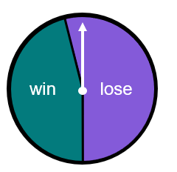
If we were to spin this spinner twice, what are the possible outcomes?
win, win
lose, lose
lose, win
win, lose
The spinner has the same outcomes, but the probability of the outcomes has changed.
The spinner is different,
So why are the outcomes the same?
Laura
Aisha
Laura

Slide 29
WHITEBOARDS:
This spinner is spun twice.
List all the possible outcomes.
Let win be W, lose be L and draw be D.
{WW, LL, DD, WD, LW, DL, WL, DW, LD}
Does it matter that there are two ‘win’ sectors of the spinner?
Not for the possible outcomes, but it just means that outcomes with ‘win’ are more likely to be landed on.
Aisha
Laura

