Slide 1
Dual coding symbols:
Practise
Explain
Organise
Big Question
Reflect
Present
Compare
Evaluate
Activate
Discuss
Predict
Connect
Summarise
Recall
Vocabulary

Slide 2
Editable reading ruler
Every child in an Archway school will become a fluent reader
 | RETRIEVE the words or phrases you need from the text | DECODE the words or phrase to address a breakdown | CONNECT with words or phrases you know from the text or your memory | VISUALISE the images in as much detail as possible | SUMMARISE the main ideas of the text in a few words | INFER meanings that might be within the text | PREDICT what might happen next using details from the text | EXAMINE how the writer uses words to construct meaning
 | ASK THOUGHTFUL QUESTIONS TO HELP YOU UNDERSTAND THE TEXT

Slide 3
A
B

Slide 4
LESSON TITLE: Product of Two Fractions

Slide 5
Key vocabulary:
Decode the word
Definition
.
Product
Examples
Non-examples

Slide 6
$$\frac{1}{3}×\frac{1}{2}=$$
RETRIEVE
INSTRUCT
PRACTISE
SECURE

Slide 7
$\frac{1}{4}$
$$\frac{1}{3}$$
$$\frac{1}{4}× \frac{1}{3}=$$
RETRIEVE
INSTRUCT
PRACTISE
SECURE

Slide 8
$$\frac{2}{4}$$
Using this area model
$$\frac{1}{3}$$
$$\frac{2}{4}×\frac{1}{3}=$$
RETRIEVE
INSTRUCT
PRACTISE
SECURE

Slide 9
Using this area model
$$\frac{2}{5}$$
$$\frac{2}{3}$$
$$\frac{2}{5}×\frac{2}{3}=$$
RETRIEVE
INSTRUCT
PRACTISE
SECURE

Slide 10
When multiplying fractions,
the numerator is the product of the numerators
the denominator is the product of the denominators
$\frac{3}{5}×$ $\frac{1}{4}=\frac{3×1}{5×4}=\frac{3}{20}$
RETRIEVE
INSTRUCT
PRACTISE
SECURE

Slide 11
I DO:
WE DO:
$\frac{1}{7}×$ $\frac{2}{3}=$
$$\frac{2}{3}×\frac{1}{4}=$$
RETRIEVE
INSTRUCT
PRACTISE
SECURE

Slide 12
I DO:
WE DO:
$$\frac{3}{8}×\frac{2}{10}=$$
$$\frac{5}{6}×\frac{2}{3}=$$
RETRIEVE
INSTRUCT
PRACTISE
SECURE

Slide 13
I DO:
WE DO:
$$\frac{1}{5}×\frac{1}{10}=$$
$$\frac{1}{3}×\frac{2}{3}=$$
RETRIEVE
INSTRUCT
PRACTISE
SECURE

Slide 14
I DO:
WE DO:
$$\frac{3}{5}×\frac{1}{6}=$$
$$\frac{4}{5}×\frac{2}{4}=$$
RETRIEVE
INSTRUCT
PRACTISE
SECURE

Slide 15
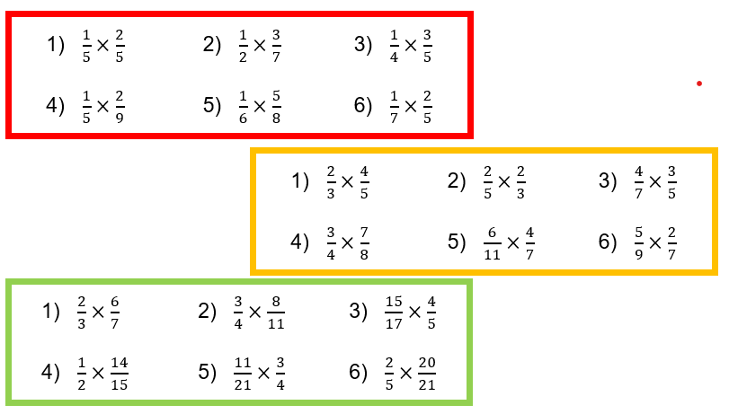
YOU DO
RETRIEVE
INSTRUCT
PRACTISE
SECURE

Slide 16
RETRIEVE
INSTRUCT
PRACTISE
SECURE

