Slide 1
Dual coding symbols:
Practise
Explain
Organise
Big Question
Reflect
Present
Compare
Evaluate
Activate
Discuss
Predict
Connect
Summarise
Recall
Vocabulary

Slide 2
Editable reading ruler
Every child in an Archway school will become a fluent reader
 | RETRIEVE the words or phrases you need from the text | DECODE the words or phrase to address a breakdown | CONNECT with words or phrases you know from the text or your memory | VISUALISE the images in as much detail as possible | SUMMARISE the main ideas of the text in a few words | INFER meanings that might be within the text | PREDICT what might happen next using details from the text | EXAMINE how the writer uses words to construct meaning
 | ASK THOUGHTFUL QUESTIONS TO HELP YOU UNDERSTAND THE TEXT

Slide 3
A
B

Slide 4
LESSON TITLE: Multiplying Mixed Numbers

Slide 5
Key vocabulary:
Decode the word
Definition
.
Mixed Number
Examples
Non-examples

Slide 6
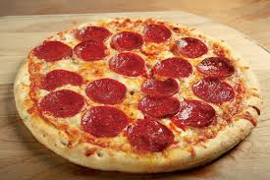
What is a mixed number?
Express as a fraction, how many pizzas are there below:
Mixed number is made up of whole numbers and a part of whole.
RETRIEVE
PRACTISE
SECURE

Slide 7
If I multiply the amount of pizzas below by 3, how much pizza do I now have?
Express your answer as a mixed number
RETRIEVE
PRACTISE
SECURE

Slide 8
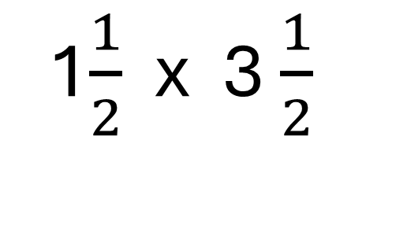
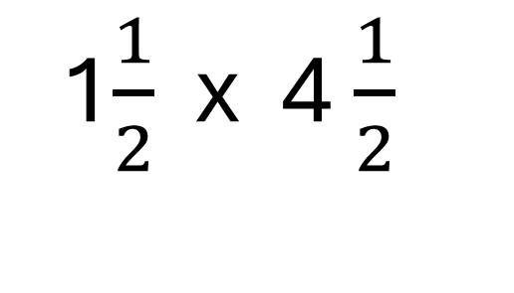
I DO:
WE DO:
Calculate
Calculate
SECURE

Slide 9
I DO:
WE DO:
Calculate
Calculate

Slide 10
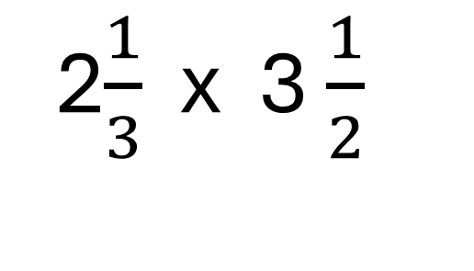
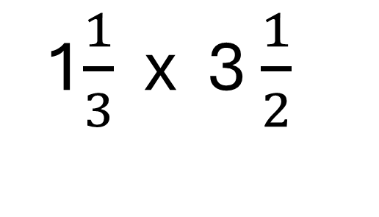
I DO:
WE DO:
Calculate
Calculate

Slide 11
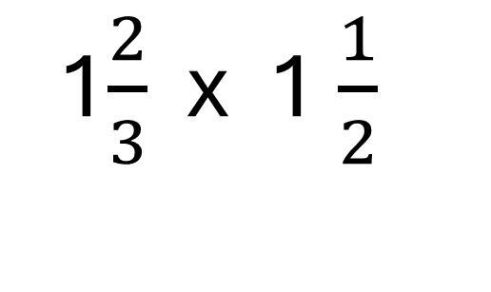
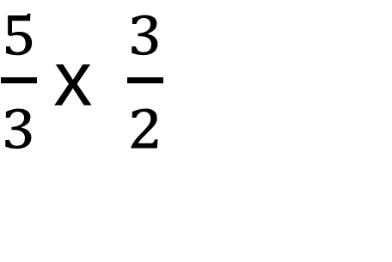
Mini WBs:
What's missing?

Slide 12
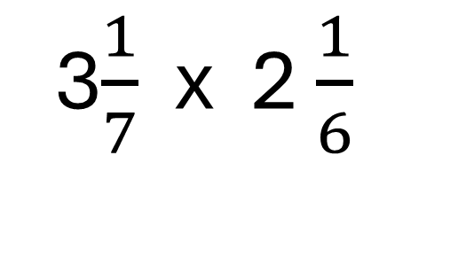
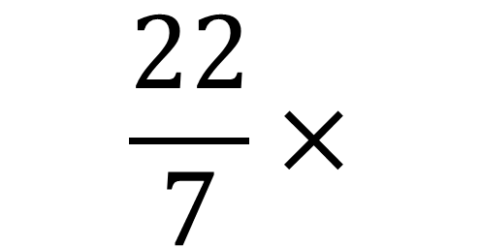
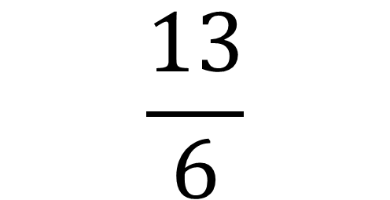
Mini WBs:
What's missing?

Slide 13
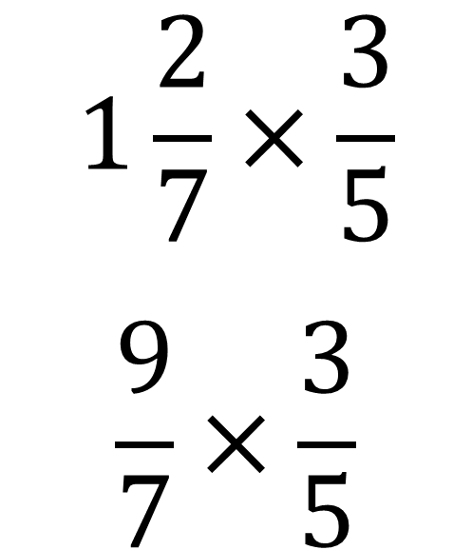
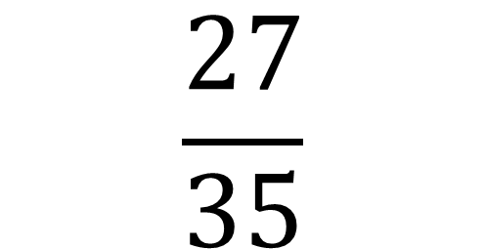
Mini WBs:
What's missing?

Slide 14
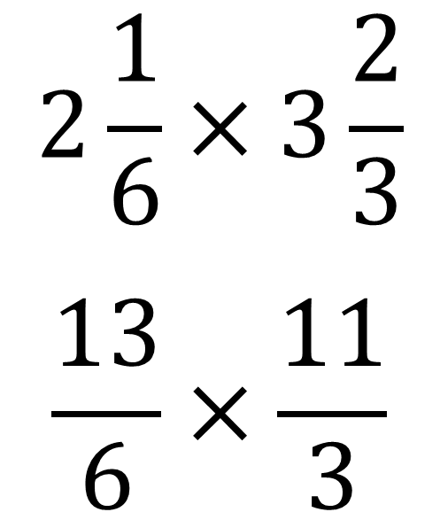
Mini WBs:
Spot the mistake?

Slide 15
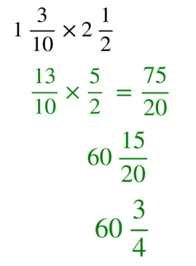
Mini WBs:
Spot the mistake?

Slide 16
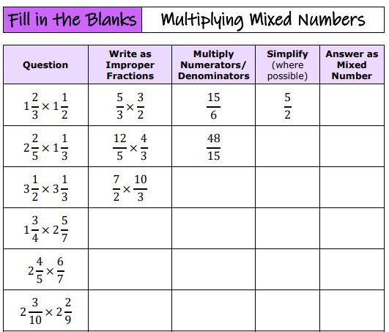
Independent task:
7ac124_f588f7a9e11440b3848452f3cd7dc33b.pdf

Slide 17
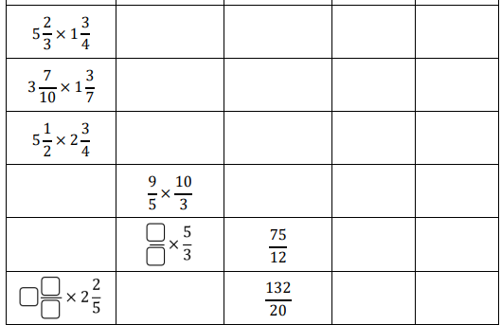
Independent task:

Slide 18
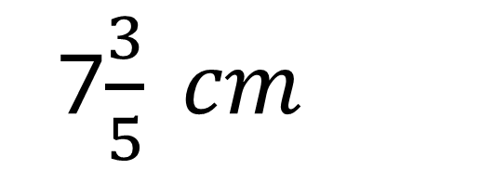
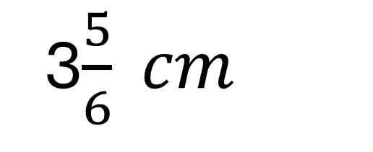
Calculate the area of the shape below:

Slide 19
$$×$$
$$×$$
Using the numbers 1 – 9 each exactly once what are the largest and smallest products you can make?

