Slide 1
Dual coding symbols:
Practise
Explain
Organise
Big Question
Reflect
Present
Compare
Evaluate
Activate
Discuss
Predict
Connect
Summarise
Recall
Vocabulary

Slide 2
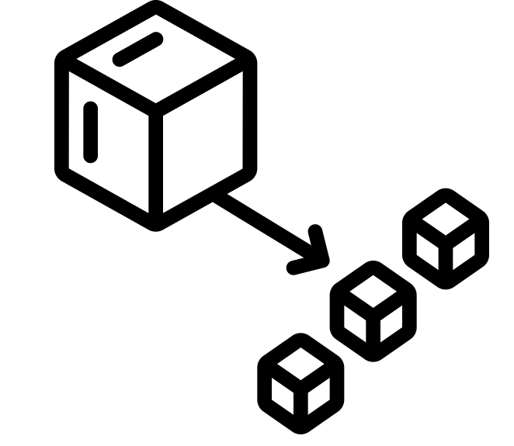
Editable reading ruler
Every child in an Archway school will become a fluent reader
 | RETRIEVE the words or phrases you need from the text | DECODE the words or phrase to address a breakdown | CONNECT with words or phrases you know from the text or your memory | VISUALISE the images in as much detail as possible | SUMMARISE the main ideas of the text in a few words | INFER meanings that might be within the text | PREDICT what might happen next using details from the text | EXAMINE how the writer uses words to construct meaning
 | ASK THOUGHTFUL QUESTIONS TO HELP YOU UNDERSTAND THE TEXT

Slide 3
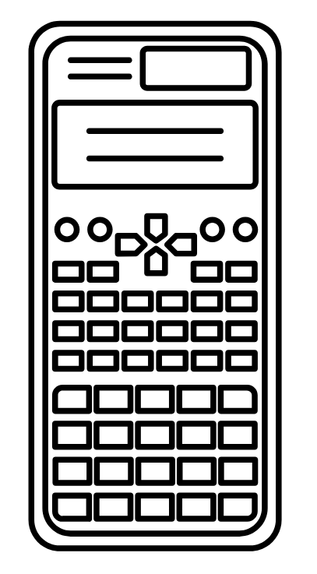
A
B

Slide 4
LO: To be able to multiply a fraction by an integer
Key vocabulary:
Word | Definition
Integer | a number that is not a fraction; a whole number.
Retrieve from memory without prompts or discussion. You must write something for each.
RETRIEVE
INSTRUCT
PRACTISE
SECURE

Slide 5
LESSON TITLE: Multiplying an integer by a fraction

Slide 6
Key vocabulary:
Decode the word
Definition
.
Integer
Examples
Non-examples

Slide 7
PRE REQUISITES:
Adding fractions with the same denominator
PRACTISE
SECURE

Slide 8
Multiplication is just repeated addition
$$3×2 = 2+2+2=6$$
$$4×5= 5+5+5+5 =$$
$$5×3 = 3+3+3+3+3 =$$
PRACTISE
SECURE

Slide 9
$$3×\frac{1}{2} = \frac{1}{2}+\frac{1}{2}+\frac{1}{2}=$$
$$4×\frac{1}{5} = \frac{1}{5}+\frac{1}{5}+\frac{1}{5}+\frac{1}{5} =$$
$$5×\frac{1}{3} = \frac{1}{3}+\frac{1}{3}+\frac{1}{3}+\frac{1}{3}+\frac{1}{3} =$$
RETRIEVE
INSTRUCT
PRACTISE
SECURE

Slide 10
$$3×\frac{1}{2}= \frac{1}{2}+\frac{1}{2}+\frac{1}{2}=\frac{3}{2}$$
$4×\frac{1}{5}=\frac{1}{5}+\frac{1}{5}+\frac{1}{5}+\frac{1}{5}=\frac{4}{5}$
Can you spot the link between the multiplication and the answer?
RETRIEVE
INSTRUCT
PRACTISE
SECURE

Slide 11
I DO:
WE DO:
$$5×\frac{1}{2}=$$
$$3×\frac{1}{4}=$$
RETRIEVE
INSTRUCT
PRACTISE
SECURE

Slide 12
I DO:
WE DO:
$$\frac{1}{2}×4=$$
$$\frac{1}{3}×8=$$
RETRIEVE
INSTRUCT
PRACTISE
SECURE

Slide 13
Mini WBs:
RETRIEVE
INSTRUCT
PRACTISE
SECURE

Slide 14
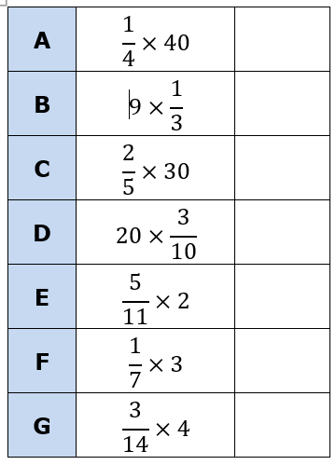
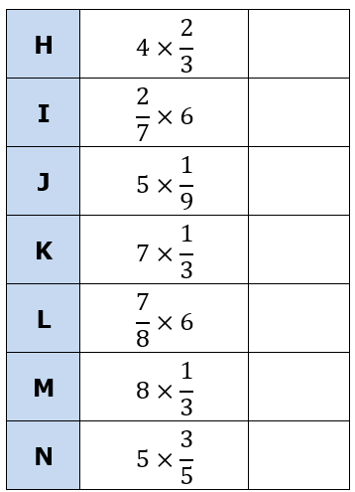
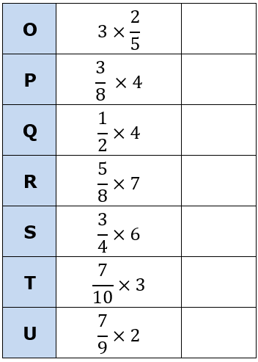
Independent task:
RETRIEVE
INSTRUCT
PRACTISE
SECURE

Slide 15
$x×\frac{7}{6}$
$\frac{5x}{8}×7$
$\frac{x}{9}×3$
$\frac{4x}{7}×3x$
$\left(x+3\right)×\frac{12}{5}$
$\frac{3}{5}×(x+5)$
$\frac{6x}{5}×(x+2)$
$\frac{4}{5y}×x$
$\frac{y}{3}×x$
$\frac{(y+3)}{4}×5$
$\frac{(x+2)}{4}×(x+6)$
$(x+3)×\frac{(x−3)}{7}$
$m) x×\frac{2}{3}$
$n) 4x×\frac{4}{7}$
$o) (6+3)×\frac{1}{2}$
$p) \left(\frac{2}{7}+\frac{3}{7}\right)×6$
$q) 5×\frac{(3+2x)}{4x+2}$
RETRIEVE
INSTRUCT
PRACTISE
SECURE

Slide 18
A
B
C
.
A because…
B because…

