Slide 1
On your whiteboards:
Write these improper fractions as mixed numbers
$1) \frac{5}{2} 2) \frac{9}{4}$ 3) $\frac{6}{5}$ 4) $\frac{8}{3}$
$2\frac{1}{2}$ 2$\frac{1}{4}$ 1$\frac{1}{5}$ 2$\frac{2}{3}$

Slide 2
On your whiteboards:
Write these mixed numbers as improper fractions
$1) 3\frac{1}{2} 2) 2\frac{3}{4}$ 3) 3$\frac{2}{5}$ 4) $4\frac{2}{3}$
$\frac{7}{2}$ $\frac{11}{4}$ $\frac{17}{5}$ $\frac{14}{3}$

Slide 3
Calculate:
$$\frac{1}{4}+\frac{2}{4}$$
$$\frac{1}{4}$$
$$+$$
$$\frac{2}{4}$$
How many parts should we shade?
$$\frac{3}{4}$$
$$\frac{1}{4}+\frac{2}{4}=\frac{3}{4}$$
Copy and complete the sentence.
! When we add fractions with the same denominator, the denominator stays the same and we add the numerators.
?
?
?

Slide 4
I DO:
WE DO:
$\frac{1}{5}+\frac{1}{5}$
$\frac{2}{7}+ \frac{5}{7}$
$\frac{3}{5}+ \frac{4}{5}$
$\frac{1}{6}+\frac{1}{6}$
$\frac{3}{4}+ \frac{1}{4}$
$\frac{5}{6}+ \frac{4}{6}$
Notes:
No calculator

Slide 5
Subtracting Fractions
Calculate:
$$\frac{5}{7}−\frac{3}{7}$$
$$\frac{5}{7}$$
$$\frac{5}{7}−\frac{3}{7}=\frac{2}{7}$$
$$\frac{3}{7}$$
We subtract the numerators and keep the denominator the same.
$$\frac{2}{7}$$
drfrost.org/s/
56a
56b
56d
Notes:
Recap of equivalent fractions with bar models and numerically.
May be skipped if not identified as an area of weakness in the prerequisite check.
Click to animate.
TYU answers reveal on click of green boxes.

Slide 6
I DO:
WE DO:
$$\frac{6}{9}−\frac{2}{9}$$
$$\frac{13}{15}−\frac{7}{15}$$
$$\frac{4}{9}$$
$$\frac{6}{15}$$

Slide 7
I DO:
WE DO:
$$\frac{6}{9}−\frac{2}{9}$$
$$\frac{13}{15}−\frac{13}{15}$$
$$\frac{4}{9}$$
$$0$$

Slide 8
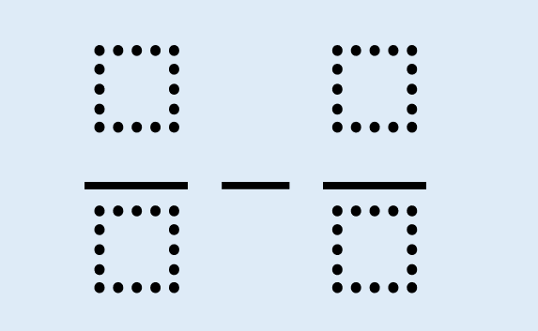
I DO:
WE DO:
$$\frac{6}{9}−\frac{2}{9}$$
$$\frac{4}{9}$$

Slide 9
2 Minutes
Test Your Understanding
a
$$\frac{4}{9}+\frac{1}{9}=\frac{5}{9}$$
?
b
$$\frac{6}{10}−\frac{3}{10}=\frac{3}{10}$$
?
c
$$\frac{17}{21}−\frac{9}{21}=\frac{8}{21}$$
?
d
?
e
$$\frac{5}{12}+\frac{4}{12}=\frac{9}{12}=\frac{3}{4}$$
?
f
$$\frac{8}{15}−\frac{3}{15}=\frac{5}{15}=\frac{1}{3}$$
$$\frac{5}{8}+\frac{3}{8}=\frac{8}{8}=1$$
?
Extension: $\frac{5}{8}−\frac{2}{4}$

Slide 10
Notes:
No calculator

Slide 11
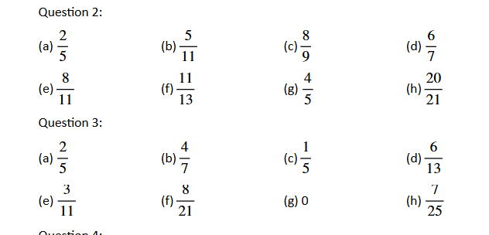
Notes:
No calculator

Slide 12
Notes:
No calculator

Slide 13
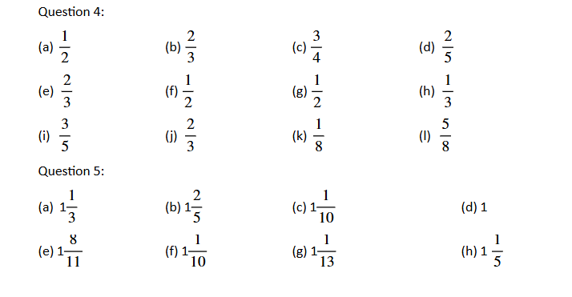
Notes:
No calculator

Slide 14
Add the fractions;
$\frac{2}{9}$ + $\frac{5}{9}$
$$\frac{7}{18}$$
$$\frac{10}{18}$$
$$\frac{7}{9}$$
$$\frac{10}{18}$$
A B C D
Notes:
C is correct
A added both numerator and denominator
B multiplied numerator, added denominator
D multiplied numerator, added denominator

Slide 15
Subtract the fractions;
$\frac{6}{7}$ - $\frac{1}{7}$
$$\frac{6}{7}$$
$$\frac{5}{0}$$
$$\frac{5}{14}$$
$$\frac{5}{7}$$
A B C D
Notes:
D is correct
A multiplied numerator
B subtracted both numerator and denominator
C added denominator

