Slide 1
Retrieval: On your whiteboards:
1) $\frac{1}{3}+\frac{1}{3}$ 2) $\frac{2}{5}+\frac{3}{5}$ 3) $\frac{6}{5}+\frac{7}{5} 4) \frac{8}{7}+\frac{6}{7}$
Write your answers as mixed numbers
Describe the error in the calculation below, then find the correct answer.

Slide 2
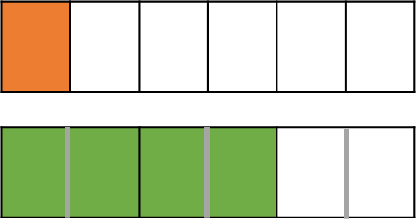
How can I add these together?
$$\frac{1}{6}$$
$$\frac{2}{3}$$
$$\frac{4}{6}$$
Notes:
Introduction to adding fractions where one denominator is a multiple of the other using bar models.
Click to animate.

Slide 3
Calculate:
$$\frac{4}{9}+\frac{1}{3}$$
Calculate:
$$\frac{4}{5}+\frac{1}{10}$$
$$\frac{4}{9}$$
$$\frac{4}{5}$$
$$\frac{1}{3}$$
$$=\frac{3}{9}$$
To be able to add both bar models they must have an equal number of parts.
$$\frac{1}{10}$$
$$=\frac{7}{9}$$
$$=\frac{9}{10}$$
$$\frac{4}{9}+\frac{3}{9}$$
$$=\frac{7}{9}$$
$$\frac{8}{10}+\frac{1}{10}$$
$$=\frac{9}{10}$$
$\frac{1}{3}$ can be written as $\frac{3}{9}$

Slide 4
I DO:
WE DO:
$\frac{1}{2}+\frac{1}{4}$
$\frac{2}{3}+ \frac{1}{4}$
$\frac{3}{4}+ \frac{4}{5}$
$\frac{1}{3}+\frac{1}{6}$
$\frac{1}{2}+ \frac{2}{5}$
$\frac{3}{5}+ \frac{5}{6}$
Notes:
No calculator

Slide 5
I DO:
WE DO:
$\frac{1}{2}−\frac{1}{4}$
$\frac{2}{3}− \frac{1}{4}$
$\frac{3}{4}− \frac{4}{5}$
$\frac{1}{3}−\frac{1}{6}$
$\frac{1}{2}− \frac{2}{5}$
$\frac{3}{5}−\frac{5}{6}$
Notes:
No calculator

Slide 6
I DO:
WE DO:
Notes:
No calculator

Slide 7
Question | Rewritten Question | Answer | Answer in Simplest Form
$$\frac{1}{4}+\frac{1}{12}$$ | $$\frac{3}{12}+\frac{1}{12}$$ | $$\frac{4}{12}$$
$$\frac{2}{5}+\frac{7}{10}$$ | $$\frac{}{10}+\frac{7}{10}$$ | $$\frac{}{10}$$ | $$\frac{}{10}$$
$$\frac{2}{15}+\frac{ 2 }{3}$$ | $$\frac{}{15}+\frac{}{15}$$ | $$\frac{}{15}$$
$$\frac{5}{33}+\frac{2}{11}$$ | $$\frac{}{}+\frac{}{}$$
$$\frac{}{}+\frac{}{}$$ | $$\frac{}{}+\frac{8}{27}$$ | $$\frac{23}{27}$$ | $$\frac{23}{27}$$
Notes:
Printable version of gap fill task.

Slide 8
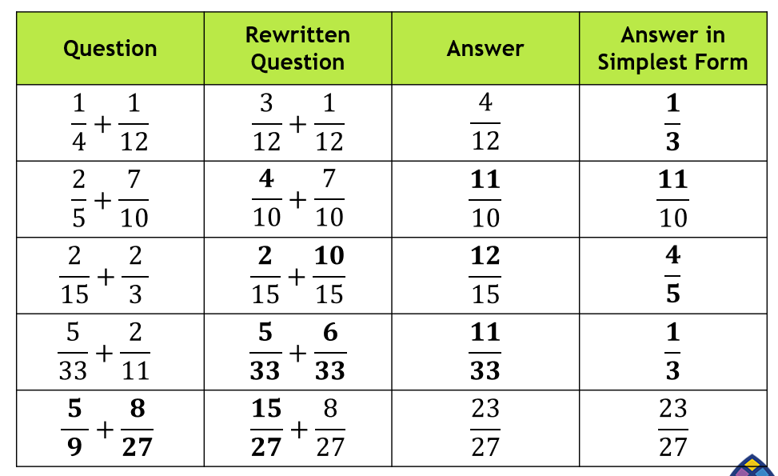

Slide 10
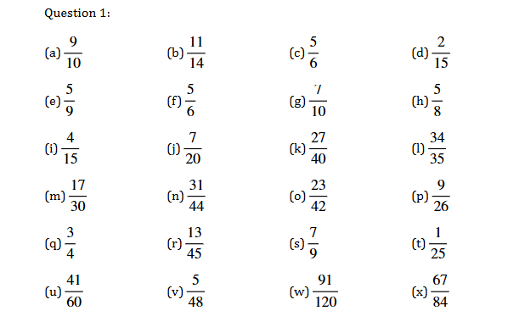

Slide 12
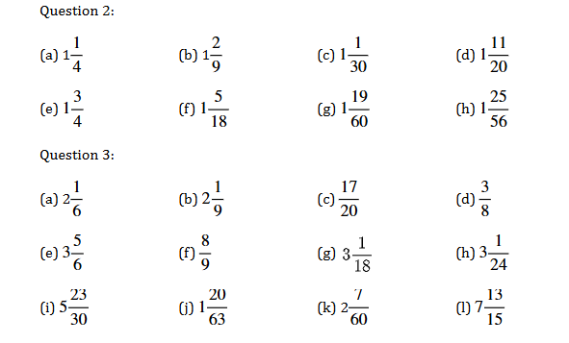

Slide 13
Add the fractions;
$\frac{2}{15}$ + $\frac{4}{5}$
$$\frac{6}{20}$$
$$\frac{10}{15}$$
$$\frac{6}{15}$$
$$\frac{14}{15}$$
A B C D
Notes:
D is correct
A added both numerator and denominator
B multiplied numerator by wrong number
C added numerator without multiplying

Slide 14
Subtract the fractions;
$\frac{6}{7}$ - $\frac{1}{6}$
$$\frac{5}{42}$$
$$\frac{4}{1}$$
$$\frac{29}{42}$$
$$\frac{5}{1}$$
A B C D
Notes:
C is correct

