Slide 1
Dual coding symbols:
Practise
Explain
Organise
Big Question
Reflect
Present
Compare
Evaluate
Activate
Discuss
Predict
Connect
Summarise
Recall
Vocabulary

Slide 2
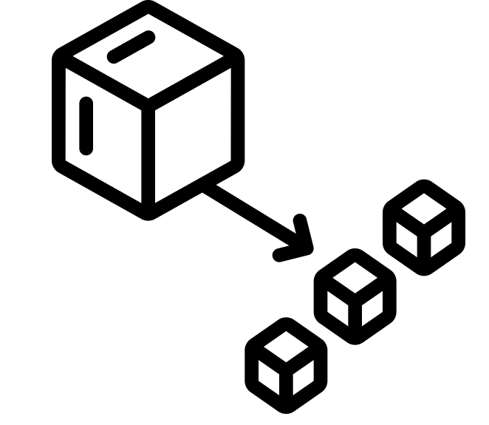
Editable reading ruler
Every child in an Archway school will become a fluent reader
 | RETRIEVE the words or phrases you need from the text | DECODE the words or phrase to address a breakdown | CONNECT with words or phrases you know from the text or your memory | VISUALISE the images in as much detail as possible | SUMMARISE the main ideas of the text in a few words | INFER meanings that might be within the text | PREDICT what might happen next using details from the text | EXAMINE how the writer uses words to construct meaning
 | ASK THOUGHTFUL QUESTIONS TO HELP YOU UNDERSTAND THE TEXT

Slide 3
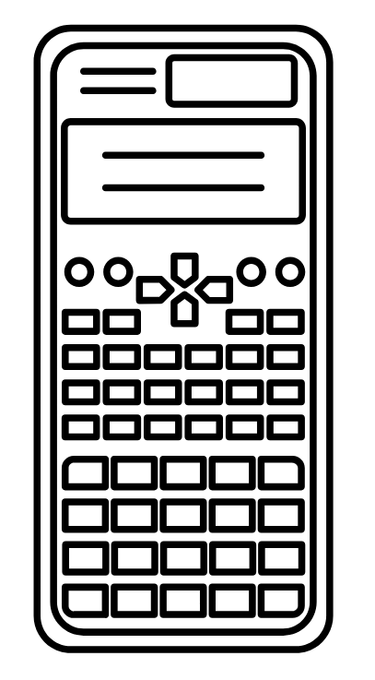
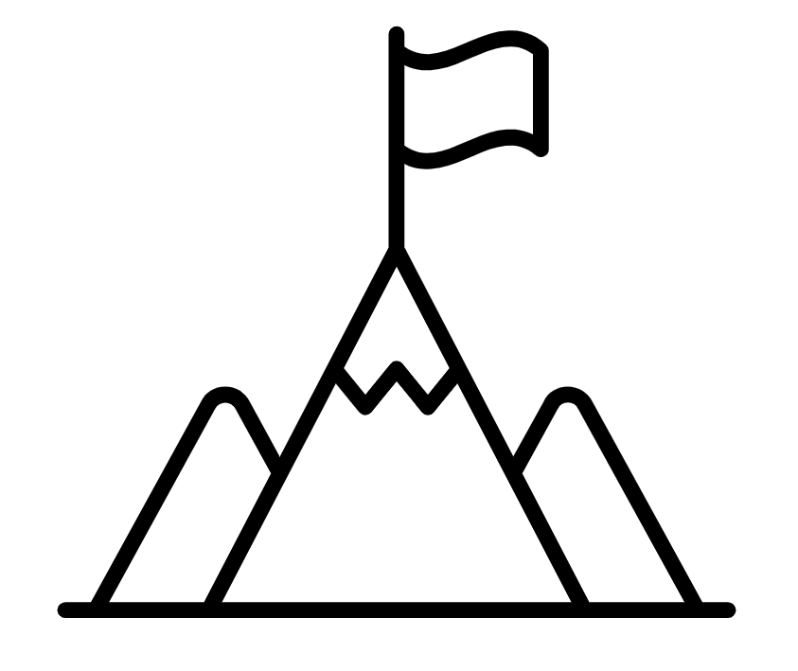
A
B

Slide 5
LESSON TITLE:

Slide 6
If you share 6 baguettes between 3 people, they each get $\frac{6}{3}$ baguettes each
Show this by using diagrams in the space below.

Slide 7
If you share 2 baguettes between 3 people, they each get $\frac{2}{3}$ of a baguette.
Show this by using diagrams in the space below.

Slide 8
We know that…
Dividing p by q can be expressed as a fraction by:

Slide 9
Discuss: Which group is the odd one out and why?

Slide 10
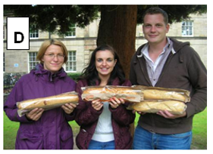
Group D had 4 baguettes between 3 people
This is the only group with more baguettes than people.
What division calculation is this?
What fraction is this?
How else could we represent this fraction?

Slide 11
An improper fraction is a fraction where the numerator is greater than or equal to the denominator.
Example
Example
Non example
We also know when the numerator is equal to the denominator this is 1.

Slide 12
Key vocabulary:
Decode the word
Definition
.
Improper Fraction
Examples
Non-examples

Slide 13
Can you explain the improper fraction represented here if each bar is worth 1 whole?
because a whole is represented as 4 equal parts
We have 3 whole bars, so it is

Slide 14
Match the improper fraction with the correct integer.

Slide 15
Fill in the gaps to evaluate the answer to 4.
4

Slide 16
Improper Fraction:
a fraction with a numerator
larger than the denominator
Mixed Number:
an integer with a fraction
$$\frac{3}{2}$$
$$1\frac{1}{2}$$
$$\frac{7}{4}$$
$$1\frac{3}{4}$$
$$\frac{9}{4}$$
$$2\frac{1}{4}$$
$$\frac{19}{8}$$
$$2\frac{3}{8}$$

Slide 17
On your whiteboards: Convert each diagram into a Mixed Number & an Improper Fraction.Can you think of a quick method instead of counting pieces?
a)
$$2\frac{1}{4}=\frac{9}{4}$$
b)
$$1\frac{1}{3}=\frac{4}{3}$$
c)
$$1\frac{2}{5}=\frac{7}{5}$$
d)
$$2\frac{4}{5}=\frac{14}{5}$$
e)
$$2\frac{5}{6}=\frac{17}{6}$$
f)
$$2\frac{5}{8}=\frac{21}{8}$$
g)
$$3\frac{1}{6}=\frac{19}{6}$$
h)
$$4\frac{7}{10}=\frac{47}{10}$$

Slide 18
A mixed number is an improper fraction written as its integer part plus the fractional part, where the fractional part is a proper fraction.
Example
This means we have 3 whole ones and a half
It is important to recognise the denominator indicates how many equal parts make a whole.

Slide 19
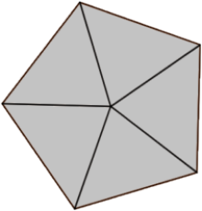
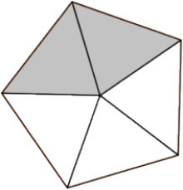
Fraction
Example diagram
Number line
0
1
2
3

Slide 20
Changing improper fractions to mixed numbers
For example,
Drawing diagrams or number lines are methods to visually represent the mixed number, but using knowledge that the denominator identifies how many parts are a whole is a quicker and easier way.
Fraction

Slide 21
Changing improper fractions to mixed numbers
For example,
Consider multiples of the denominator to make this more efficient.
Fraction

Slide 22
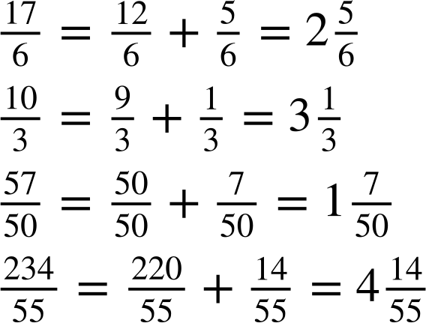
Changing improper fractions to mixed numbers
By filling in the gaps, show the conversion from an improper fraction to a mixed number.
a)
b)
c)
d)

Slide 23
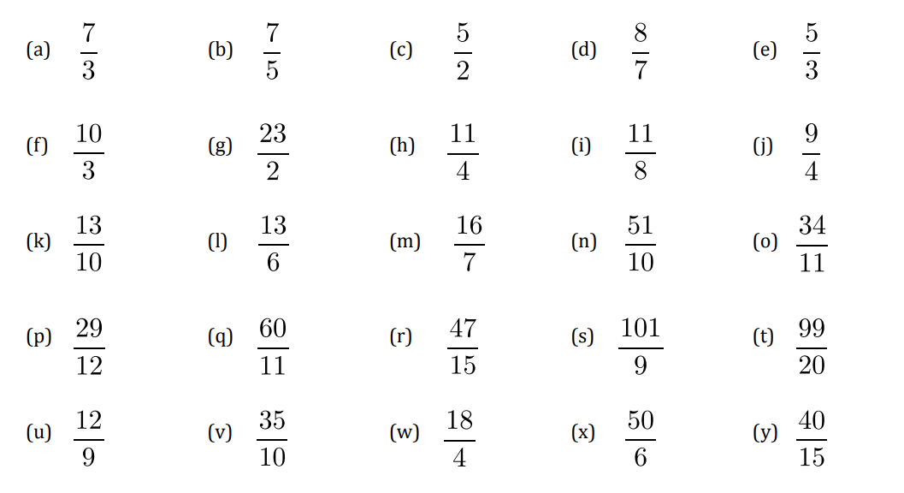
Convert these improper fractions to mixed numbers

Slide 24
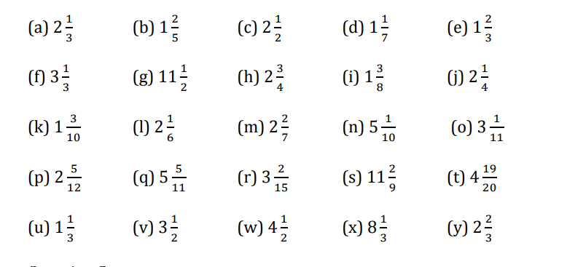
Answers

Slide 25
Now try these
Put the following numbers in ascending order (smallest to largest). Converting to a mixed number may help.
a)
b)

Slide 26
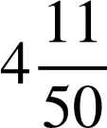
Answers
Put the following numbers in ascending order (smallest to largest). Converting to a mixed number may help.
a)
b)

