Slide 1
Dual coding symbols:
Practise
Explain
Organise
Big Question
Reflect
Present
Compare
Evaluate
Activate
Discuss
Predict
Connect
Summarise
Recall
Vocabulary

Slide 2
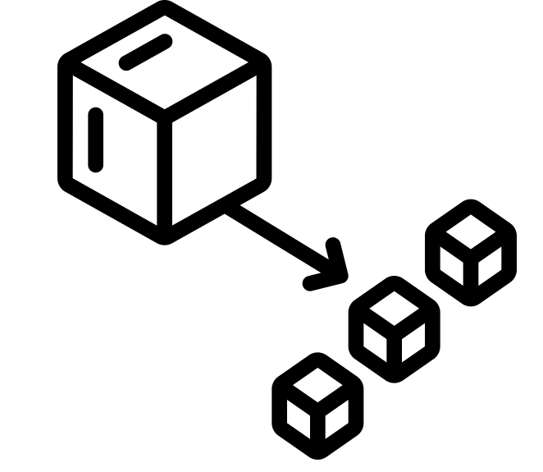
Editable reading ruler
Every child in an Archway school will become a fluent reader
 | RETRIEVE the words or phrases you need from the text | DECODE the words or phrase to address a breakdown | CONNECT with words or phrases you know from the text or your memory | VISUALISE the images in as much detail as possible | SUMMARISE the main ideas of the text in a few words | INFER meanings that might be within the text | PREDICT what might happen next using details from the text | EXAMINE how the writer uses words to construct meaning
 | ASK THOUGHTFUL QUESTIONS TO HELP YOU UNDERSTAND THE TEXT

Slide 3
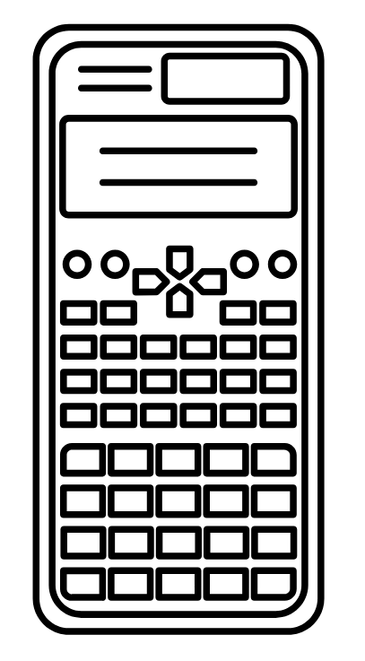
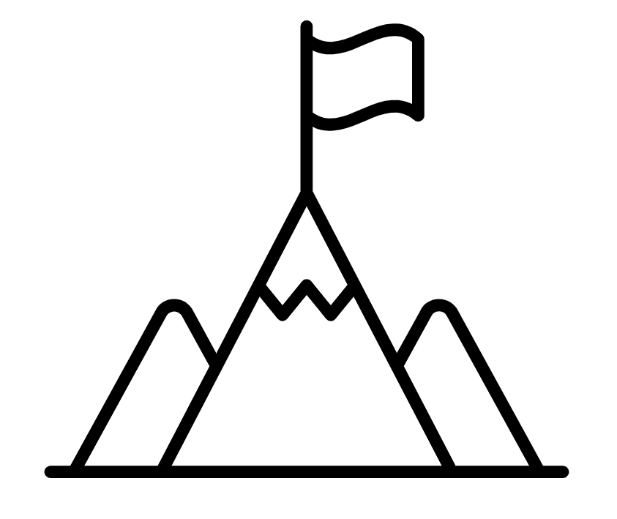
A
B

Slide 4
Sharing ideas from last lesson
If you share baguettes between people, they each get of a baguette.
Fill in the gaps to give an answer that is an improper fraction
Show this by using diagrams below.

Slide 5
A different representation.

Slide 6
How else could we write C and D?
C is $\frac{4}{3}$ (four thirds)
This is as an improper fraction
C is 1$\frac{1}{3}$ (one and one third)
This is as a
mixed number

Slide 7
How else could we write C and D?
D is $\frac{5}{3}$ (five thirds)
This is as an improper fraction
D is 1$\frac{2}{3}$ (one and two thirds)
This is as a
mixed number

Slide 8
Summary
A mixed number is the sum of an integer and a proper fraction.
What are the integers and the proper fraction of each of the following mixed number fractions.

Slide 9
Key vocabulary:
Decode the word
Definition
.
Mixed Number
Examples
Non-examples

Slide 10
How would we write this mixed number as an improper fraction?
$$= \frac{11}{4}$$
2$\frac{3}{4}$
Let’s use a representation to help
0
1
2
How many quarters in total? How would we write this?

Slide 11
How would we write this mixed number as an improper fraction?
$$=\frac{10}{3}$$
3$\frac{1}{3}$
Let’s use a representation to help
0
1
2
3
How many thirds in total? How would we write this?

Slide 12
Your Turn
Write the following mixed numbers as improper fractions
1. 1$\frac{4}{5}$
4. 1$\frac{3}{7}$
2. 2$\frac{4}{5}$
5. 1$\frac{4}{7}$
3. 3$\frac{4}{5}$
6. 1$\frac{5}{7}$
4. 4$\frac{4}{5}$
7. 1$\frac{6}{7}$
What do you notice about the answers in each column?
Can you explain why the patterns occur in this way?

Slide 13
On your whiteboards…
10 $\frac{1}{6}$
Challenge:
What about this one?
8 $\frac{6}{7}$
a$\frac{b}{c}$
9 $\frac{3}{5}$

Slide 14
It is important to understand what the mixed number means.
Example
How can we write 5 whole ones as an improper fraction using a denominator of 7?
an improper fraction with a denominator of 7

Slide 15
It is important to understand what the mixed number means.
Example
So we have now converted our mixed number into an improper fraction

Slide 16
I DO:
WE DO:
Convert to an improper fraction, showing working out if you need.
Convert to an improper fraction, showing working out if you need.
Notes:
No calculator

Slide 17
Fill in the blanks to show the working out and the conversion from a mixed number to an improper fraction.
a)
b)
c)

Slide 18
Fill in the blanks to show the working out and conversion from a mixed number to an improper fraction.
a)
b)

Slide 19
Fill in the blanks to show the working out and conversion from a mixed number to an improper fraction.
a)
b)

Slide 20
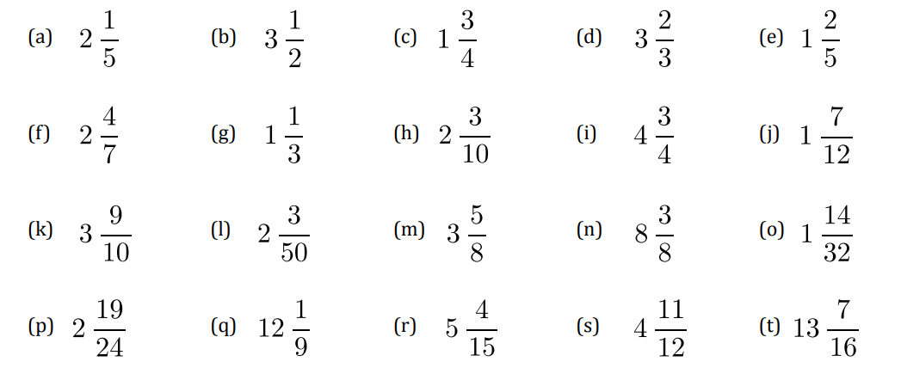
Convert the following to improper fractions, showing working out if you need.
Notes:
Answers

Slide 21
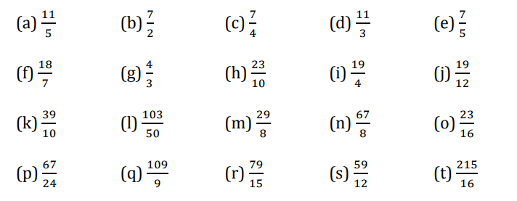
Answers
Notes:
Answers

Slide 22
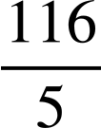
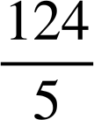
Can you work out the mixed number given the clues for the integer and proper fraction?
Write your own mixed number with clues.
The integer is even.
The numerator and denominator of the proper fraction are both odd and prime numbers.
The integer is even.
As an improper fraction the numerator is 173.
The denominator is odd.
The mixed number is
The mixed number is
between
and
between
and 10.7
Notes:
Answers 10 3/7 and 24 5/7

