Slide 1
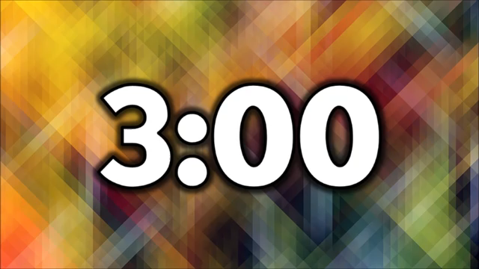
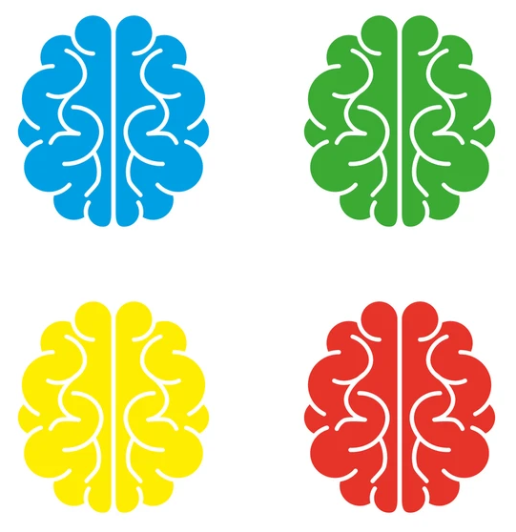

Sample space diagrams
14/02/2025
1) Work out the missing values
in the two-way table.
2) The table shows the ages of people in a golf club.
How many people are aged 50 or over?
3) $y=5x.$ Find $y$ when $x=$ 40
4) Work out the square of 16
1
 | Left-handed | Right-handed | Total
Girls | 25 | 160 | 185
Boys | 85 |  | 205
Total |  | 280
120
110
390
2
Age | 18 – 29 | 30 – 49 | 50 – 69 | 70 +
Number of people | 28 | 47 | 59 | 82
141
3
200
4
256
Vocabulary check: Significant figures

Slide 2
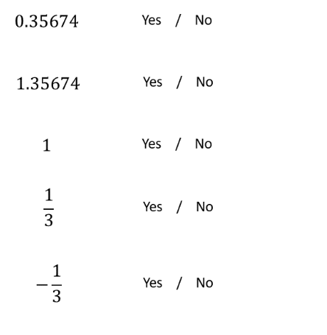
Could it be a probability?

Slide 3
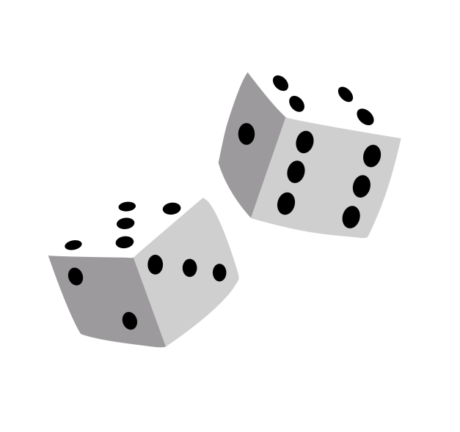
Dice Horse Race
Two dice are going to be rolled.
The two scores will added
The horse that has that number on its saddle will move forward
Choose your horse…..
Notes:
Whole class game

Slide 4

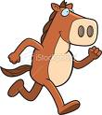


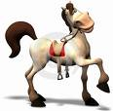



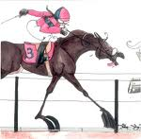



Horse 3
Horse 4
Horse 2
Horse 5
Horse 1
Horse 6
Speedy Sam
Fast Fiona
Brisk Barry
Gradual Gary
Racing Ryan
5
1
2
Idle Ian
4
3
Choose your horse
Horse 7
Horse 12
Horse 11
Horse 8
Horse 9
Horse 10
Lazy Luke
Quick Quintin
Slow Simon
Rapid Roy
Hypersonic Harry
Pronto Paul

Slide 5
Dice Horse Race
Score | Tally | Frequency
2
3
4
5
6
7
8
9
10
11
12
As we work through the game, tally the scores we get on your grid!
Notes:
Record the outcomes as you go here.

Slide 6







Racing Ryan
1
Speedy Sam
2
Fast Fiona
3
Brisk Barry
4
Gradual Gary
5
Idle Ian
6
Lazy Luke
7
Slow Simon
8
Pronto Paul
9
Hypersonic
Harry -10
Rapid Roy
11
Quick
Quentin -12

Slide 7
Dice Horse Race
Score | Tally | Frequency
2
3
4
5
6
7
8
9
10
11
12
What proportion of rolls resulted in a score of 7?
This proportion is known as the relative frequency.
Notes:
Record the outcomes as you go here.

Slide 8
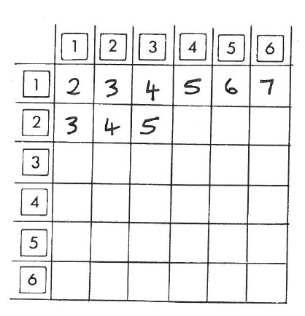
Dice Horse Race
A sample space diagram (a type of two-way table) is a way to list all possible outcomes.

Slide 9
 | 1 | 2 | 3 | 4 | 5 | 6
1 | 2 | 3 | 4 | 5 | 6 | 7
2 | 3 | 4 | 5 | 6 | 7 | 8
3 | 4 | 5 | 6 | 7 | 8 | 9
4 | 5 | 6 | 7 | 8 | 9 | 10
5 | 6 | 7 | 8 | 9 | 10 | 11
6 | 7 | 8 | 9 | 10 | 11 | 12
What number would we have expected to occur the most? Why?

Slide 10
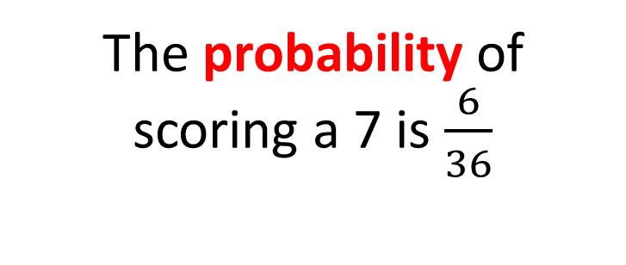
Dice Horse Race
The probability of scoring a 7 is $\frac{6}{36}$
The relative frequency of scoring a 7 from our bingo game was:
Discuss: Why are these proportions different?
Notes:
Talk about the difference between theoretical and experimental probability.

Slide 11
Sample Space: Rolling a dice and finding the product
 | 1 | 2 | 3 | 4 | 5 | 6
1 | 1 | 2 | 3 | 4 | 5 | 6
2 | 2 | 4 | 6 | 8 | 10 | 12
3 | 3 | 6 | 9 | 12 | 15 | 18
4 | 4 | 8 | 12 | 16 | 20 | 24
5 | 5 | 10 | 15 | 20 | 25 | 30
6 | 6 | 12 | 18 | 24 | 30 | 36

Slide 12
A fair coin is flipped twice
List all the possible outcomes
What is the probability of flipping two heads?
 | H | T
H | H, H | T, H
T | H, T | T, T

Slide 13
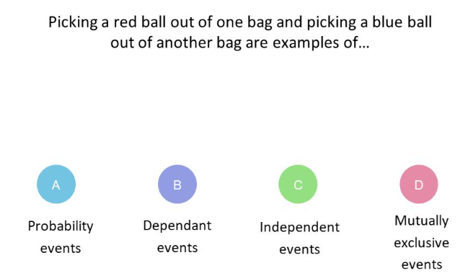

Slide 14
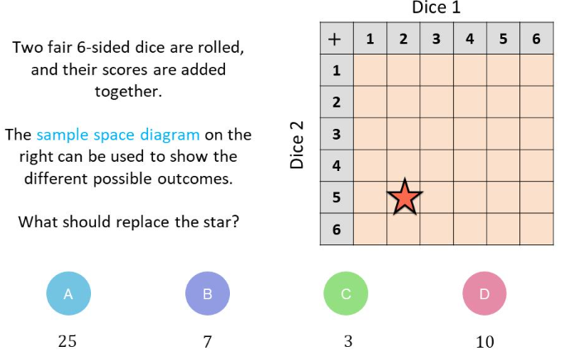

Slide 15
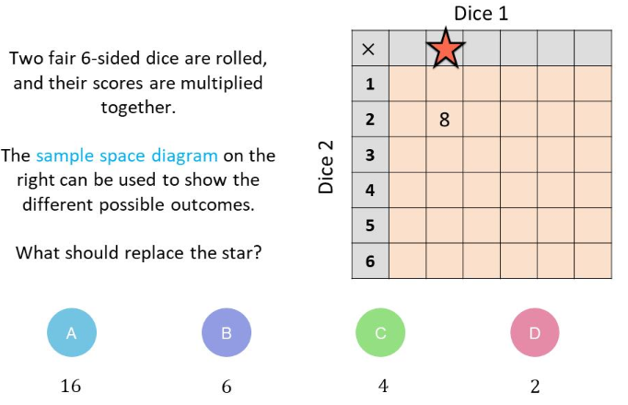

Slide 16
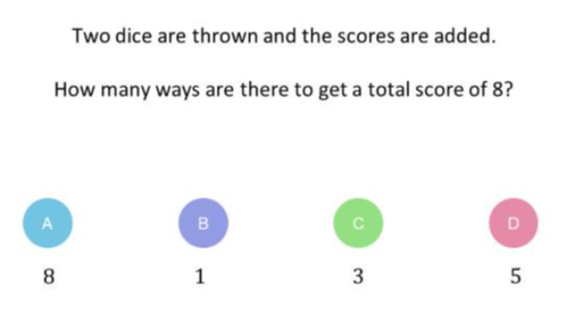

Slide 17
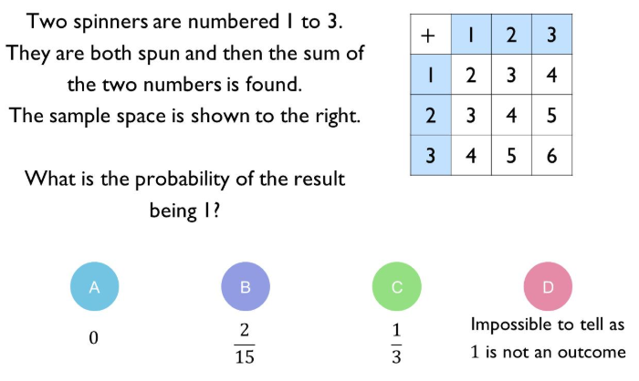

Slide 18
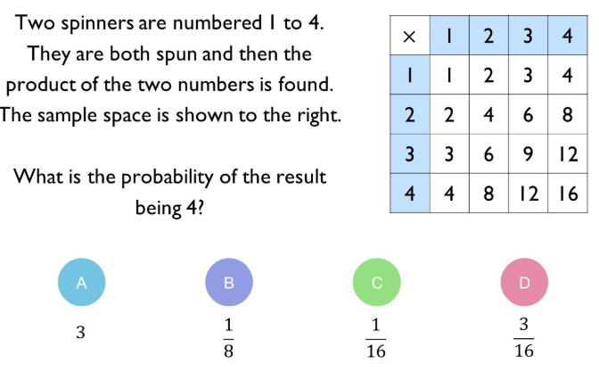

Slide 19
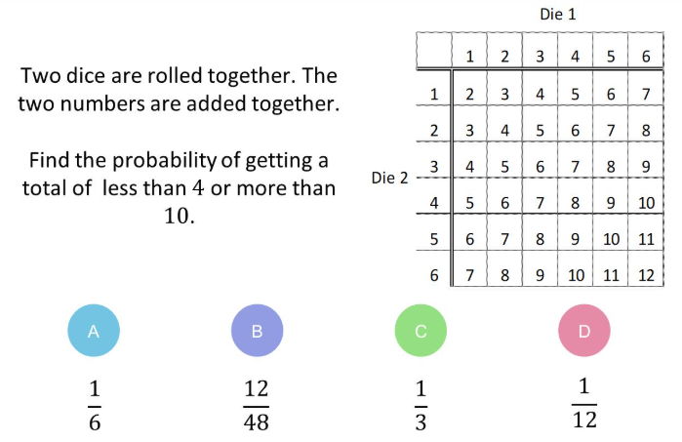

Slide 20
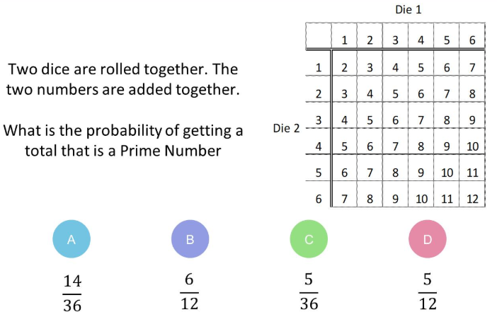

Slide 21
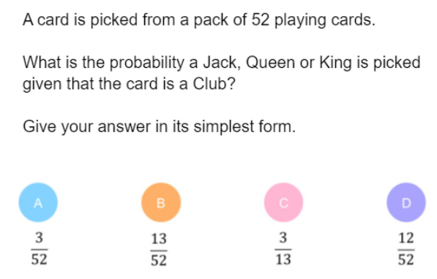

Slide 22
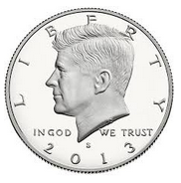
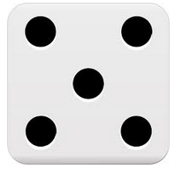
A dice and a coin are thrown at the same time.
a) Complete the Sample Space Diagram.
Dice
1
2
3
4
5
6
Head
H, 1
 |  |  |  | T, 5
Coin
Tail
b) Calculate the probability of scoring a 4 on the dice and a heads on the coin.
c) Calculate the probability of scoring tails and an odd number on the dice.
d) P(Heads and a number greater than 2) =
e) P(NOT a 5 and NOT Heads) =

Slide 23
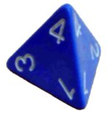






A 6-sided and a 4-sided die are thrown and
the product of their results recorded.
a) Complete a Sample Space Diagram.
 | 1 | 2 | 3 | 4 | 5 | 6
1 | 1 | 2 | 3 | 4 | 5 | 6
2 | 2 | 4 | 6 | 8 | 10 | 12
3 | 3 | 6 | 9 | 12 | 15 | 18
4 | 4 | 8 | 12 | 16 | 20 | 24
b) P(Even number) =
$$\frac{18}{24}$$
e) P(NOT a prime number) =
$$\frac{19}{24}$$
c) P(less than 10) =
$$\frac{15}{24}$$
f) P(NOT a square number) =
$$\frac{20}{24}$$
d) P(NOT more than 2) =
$$\frac{3}{24}$$
g) P(11) =
$$0$$

Slide 24
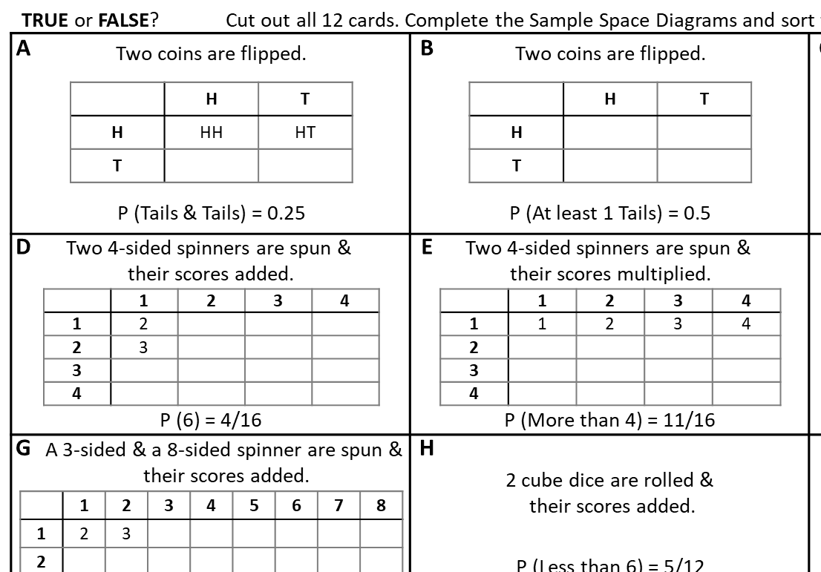

Slide 25
TRUE or FALSE?
Copy out each card and complete the Sample Space Diagrams and mark them TRUE & FALSE
A
Two coins are flipped.
B
Two coins are flipped.
C
A coin is flipped & a dice is thrown.
 | H | T
H | HH | HT
T
 | H | T
H
T
 | 1 | 2 | 3 | 4 | 5 | 6
H | H, 1
T | T, 1
P (Tails & Tails) = 0.25
P (At least 1 Tails) = 0.5
P (Tails & Odd) = 1/4
D
Two 4-sided spinners are spun &
their scores added.
E
Two 4-sided spinners are spun &
their scores multiplied.
F
A 6-sided dice and a 4-sided spinner:
scores added.
 | 1 | 2 | 3 | 4
1 | 2
2 | 3
3
4
 | 1 | 2 | 3 | 4
1 | 1 | 2 | 3 | 4
2
3
4
 | 1 | 2 | 3 | 4 | 5 | 6
1 | 2 | 3
2 | 3 | 4
3
4
Fill in the sample space diagrams and decide whether the statements are true or false
P (6) = 4/16
P (More than 4) = 11/16
P (7 or less) = 0.75
G
A 3-sided & a 8-sided spinner are spun &
their scores added.
H
I
2 cube dice are rolled &
their scores added.
A 6-sided dice & a tetrahedron dice
are rolled &
their scores are multiplied.
 | 1 | 2 | 3 | 4 | 5 | 6 | 7 | 8
1 | 2 | 3
2
3
P (Less than 6) = 5/12
P (More than 8) = 0.5
P (4 or 9) = 1/4
J
Two 5-sided spinners: scores added.
K
Two 5-sided spinners: scores multiplied.
L
 | 1 | 2 | 3 | 4 | 5
1 | 2 | 3
2 | 3 | 4
3
4
5
 | 1 | 2 | 3 | 4 | 5
1 |  |  |  |  | 5
2 |  |  |  |  | 10
3 |  |  |  |  | 15
4 |  |  |  |  | 20
5 | 5 | 10 | 15 | 20 | 25
An octahedron & a cube dice
are rolled &
their scores are added.
P (9 or more) = 7/16
P (3 or 6) = 0.15
P (Less than 3 or exactly 20) = 0.2

Slide 26


TRUE or FALSE?
Cut out all 12 cards. Complete the Sample Space Diagrams and sort them into two piles: TRUE & FALSE
A
Two coins are flipped.
B
Two coins are flipped.
C
A coin is flipped & a dice is thrown.
 | H | T
H | HH | HT
T | HT | TT
 | H | T
H | HH | HT
T | HT | TT
 | 1 | 2 | 3 | 4 | 5 | 6
H | H, 1 | H, 2 | H, 3 | H, 4 | H, 5 | H, 6
T | T, 1 | T, 2 | T, 3 | T, 4 | T, 5 | T, 6
P (Tails & Tails) = 0.25
P (At least 1 Tails) = 0.5
P (Tails & Odd) = 1/4
D
Two 4-sided spinners are spun &
their scores added.
E
Two 4-sided spinners are spun &
their scores multiplied.
F
A 6-sided dice and a 4-sided spinner:
scores added.
 | 1 | 2 | 3 | 4
1 | 2 | 3 | 4 | 5
2 | 3 | 4 | 5 | 6
3 | 4 | 5 | 6 | 7
4 | 5 | 6 | 7 | 8
 | 1 | 2 | 3 | 4
1 | 1 | 2 | 3 | 4
2 | 2 | 4 | 6 | 8
3 | 3 | 6 | 9 | 12
4 | 4 | 8 | 12 | 16
 | 1 | 2 | 3 | 4 | 5 | 6
1 | 2 | 3 | 4 | 5 | 6 | 7
2 | 3 | 4 | 5 | 6 | 7 | 8
3 | 4 | 5 | 6 | 7 | 8 | 9
4 | 5 | 6 | 7 | 8 | 9 | 10
P (6) = 4/16
P (More than 4) = 11/16
P (7 or less) = 0.75
G
A 3-sided & a 8-sided spinner are spun &
their scores added.
H
I
2 cube dice are rolled &
their scores added.
A 6-sided dice & a tetrahedron dice
are rolled &
their scores are multiplied.
 | 1 | 2 | 3 | 4 | 5 | 6 | 7 | 8
1 | 2 | 3 | 4 | 5 | 6 | 7 | 8 | 9
2 | 3 | 4 | 5 | 6 | 7 | 8 | 9 | 10
3 | 4 | 5 | 6 | 7 | 8 | 9 | 10 | 11
P (Less than 6) = 5/12
P (More than 8) = 0.5
P (4 or 9) = 1/4
J
Two 5-sided spinners: scores added.
K
Two 5-sided spinners: scores multiplied.
L
 | 1 | 2 | 3 | 4 | 5
1 | 2 | 3 | 4 | 5 | 6
2 | 3 | 4 | 5 | 6 | 7
3 | 4 | 5 | 6 | 7 | 8
4 | 5 | 6 | 7 | 8 | 9
5 | 6 | 7 | 8 | 9 | 10
 | 1 | 2 | 3 | 4 | 5
1 | 1 | 2 | 3 | 4 | 5
2 | 2 | 4 | 6 | 8 | 10
3 | 3 | 6 | 9 | 12 | 15
4 | 4 | 8 | 12 | 16 | 20
5 | 5 | 10 | 15 | 20 | 25
An octahedron & a cube dice
are rolled &
their scores are added.
P (9 or more) = 7/16
P (3 or 6) = 0.15
P (Less than 3 or exactly 20) = 0.2

Slide 27
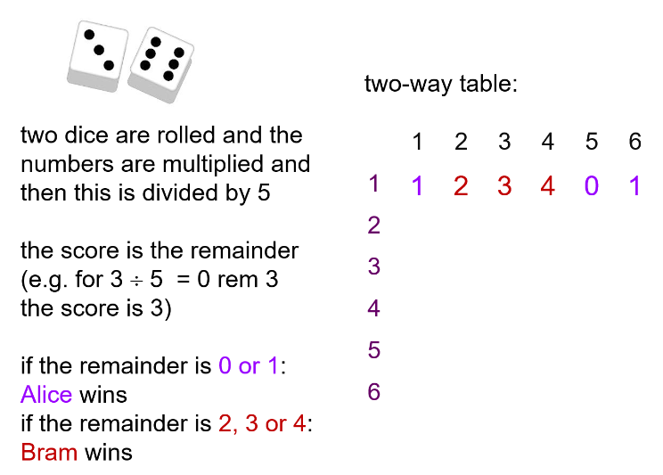
Is this game fair?
Notes:
Acknowledgements: Don Steward

Slide 28
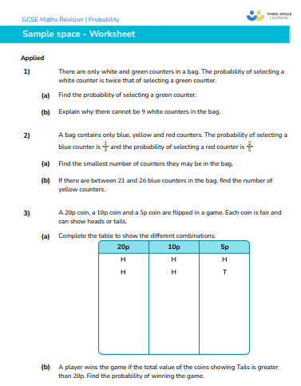
Practice Worksheet

Slide 29
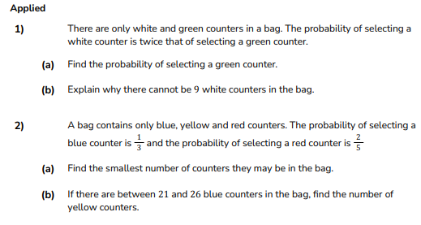

Slide 30
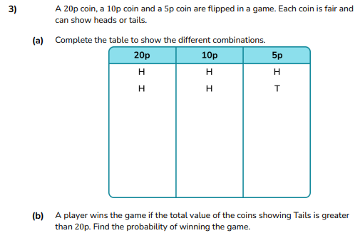

Slide 31
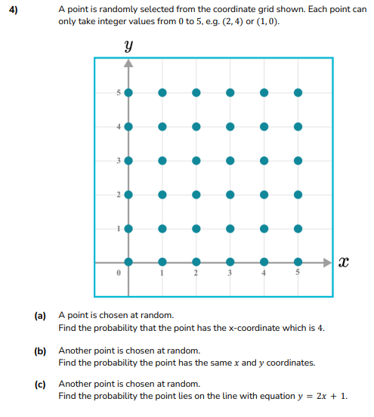

Slide 32
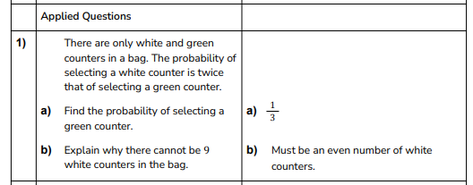

Slide 33
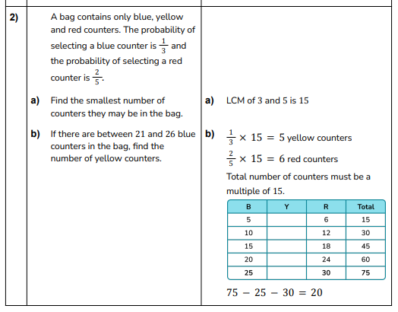

Slide 34
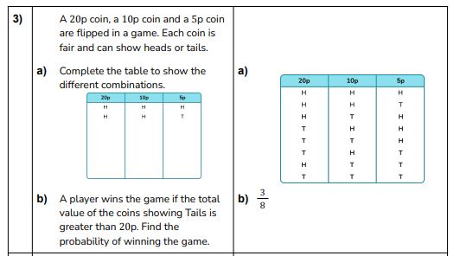

Slide 35
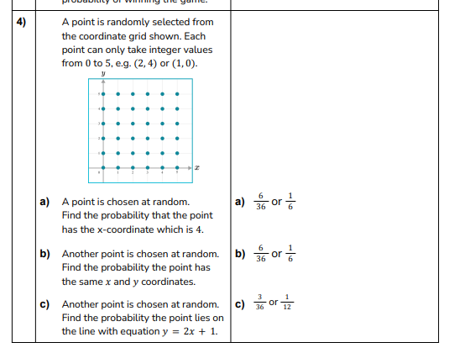

Slide 36
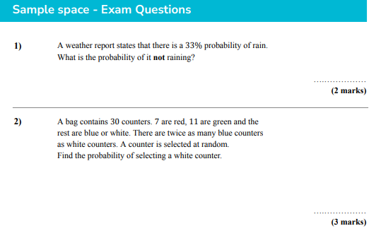

Slide 37
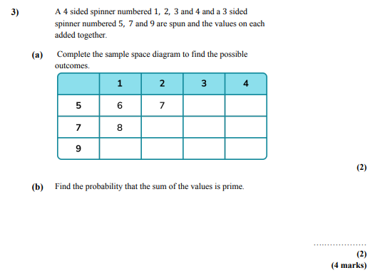

Slide 38
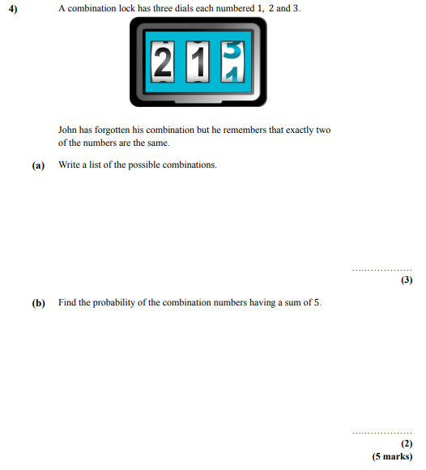

Slide 39
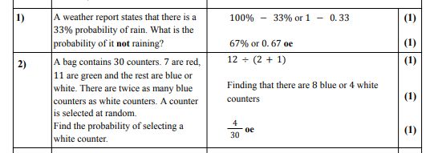

Slide 40
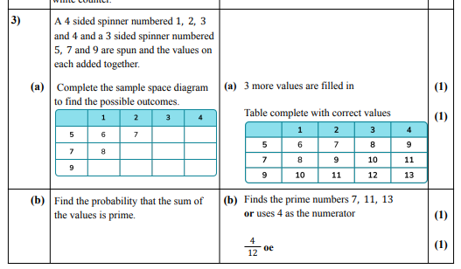

Slide 41
