Slide 1
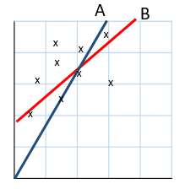
Two-way tables
14/02/2025
1) The table shows the responses to a survey question.
How many people took part in the survey?
2) Which is the better line of best fit?
3) $y=5x$
Find $y$ when $x=−$3
4) Sketch a rhombus.
1
Question | Yes | No | Don’t know
Number of responses | 42 | 40 | 11
2
3
4
Vocabulary check: Numerator

Slide 4
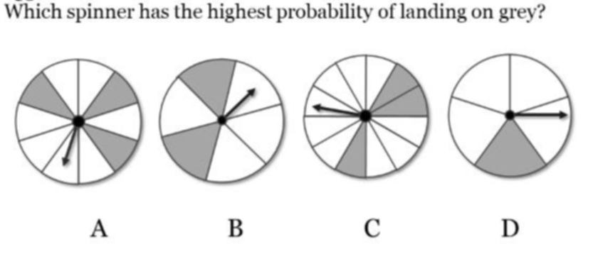

Slide 5
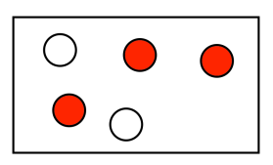

Slide 6
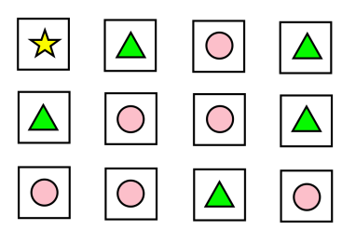
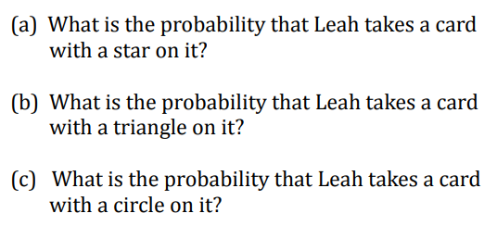

Slide 7
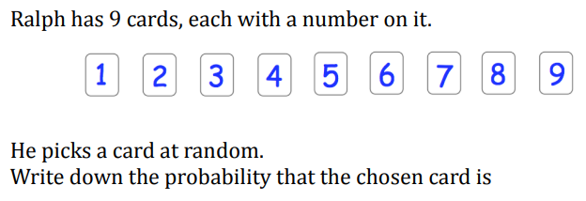

Slide 8
Problem
138 pupils were asked which subject they would like to study
95 pupils chose French
23 pupils in Year 11 chose Spanish
There are 80 students in Year 10
How many Year 10 students chose French?

Slide 9
A Two-Way table can help us solve problems like this
138 pupils were asked which subject they would like to study
95 pupils chose French
23 pupils in Year 11 chose Spanish
There are 80 students in Year 10
How many Year 10 students chose French?
 | French | Spanish | Total
Year 10 | 60 | 20 | 80
Year 11 | 35 | 23 | 58
Total | 95 | 43 | 138
?
?
?
?
?
?
?
?
?

Slide 10
Year 8, 9 and 10 students were asked about the subject they
do best in (English, Maths or Science).
Complete the two-way table.
 | English | Maths | Science | Total
Year 8 | 7 | 8 | 5 | 20
Year 9 | 3 | 9 | 8 | 20
Year 10 | 12 | 4 | 4 | 20
Total | 22 | 21 | 17 | 60
A) What subject do Year 8 students do best at?
Maths
B) What subject do Year 10 students do best at?
English
$$\frac{12}{20}=\frac{3}{5}$$
C) What fraction of Year 10 students do best in English?

Slide 11
Students were surveyed about their hair colour & eye colour.
Complete the two-way table.
 |  | Eye Colour
 |  | Blue | Green | Brown | Total
Hair Colour | Black / Brown | 7 | 2 | 4 | 13
 | Blonde | 8 | 5 | 2 | 15
 | Red | 5 | 0 | 7 | 12
 | Total | 20 | 7 | 13 | 40
$$\frac{7}{40}$$
A) What fraction of students had green eyes?
$$\frac{8}{40}=\frac{1}{5}=20\%$$
B) What percentage of students had blue eyes and blonde hair?
$$\frac{7}{13}$$
C) From students with brown eyes, what fraction had red hair?

Slide 12
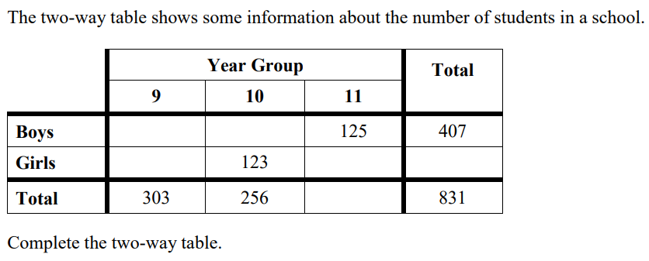

Slide 13
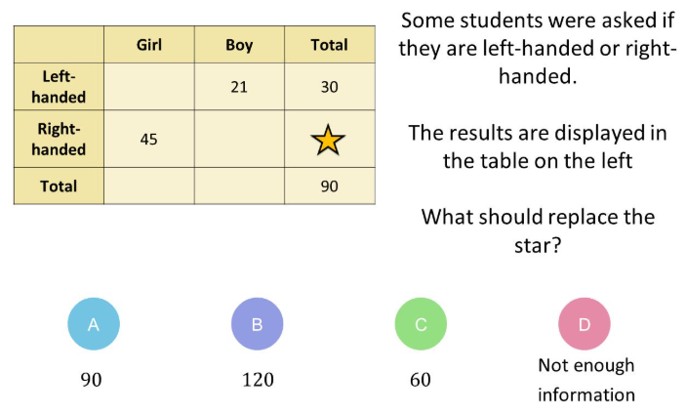

Slide 14
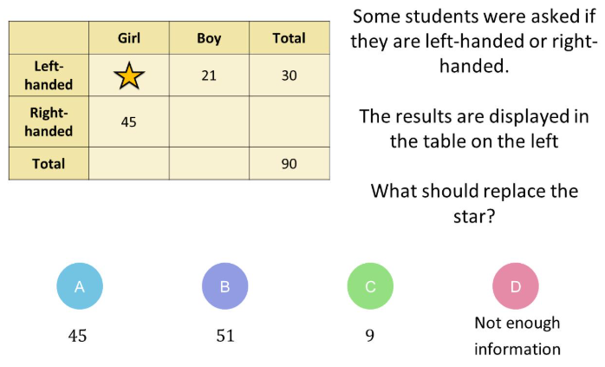

Slide 15
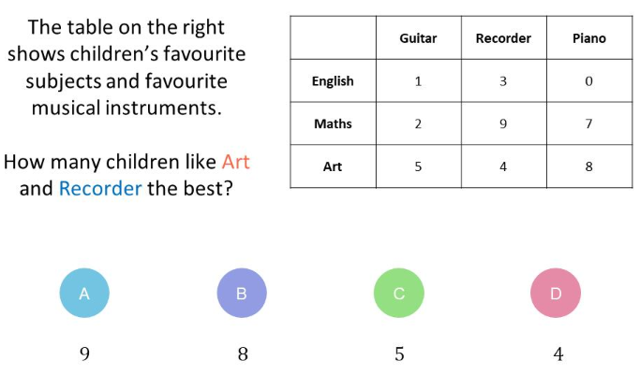

Slide 16
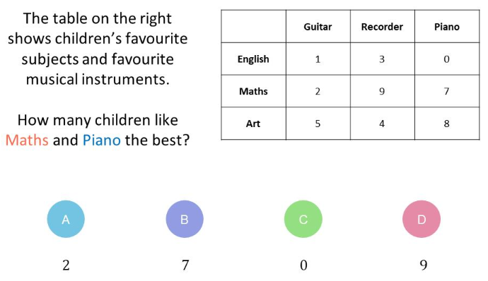

Slide 17
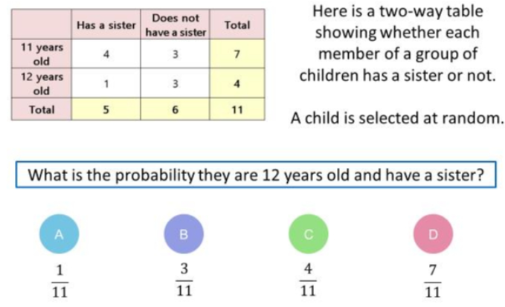

Slide 18
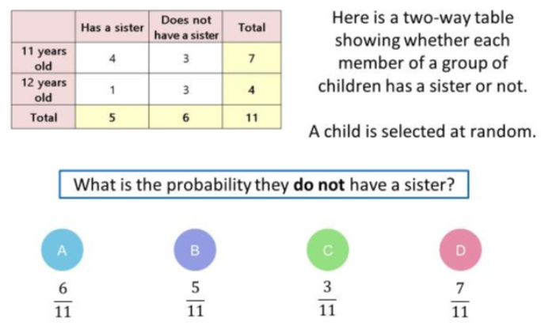

Slide 19
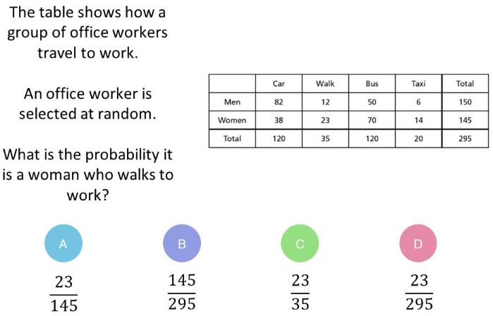

Slide 20
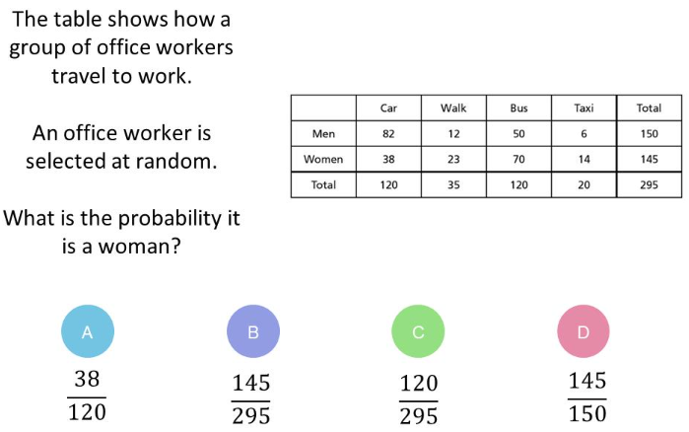

Slide 21
An electronics factory checks how many laptops
& how many desktops have faults.
Danesh recorded the health of trees in two areas.
 | Urban | Rural
Healthy | 21 | 14
Unhealthy | 7 | 3
 | OK | Fault | Total
Laptop | 63 | 4 | 67
Desktop | 58 | 3 | 61
Total | 121 | 7 | 128
What fraction of the trees were healthy?
How many laptops had a fault?
What percentage of the trees in the
urban area were unhealthy?
How many desktops were checked?
①
②
How People Keep Fit:
Cinema popcorn sales over the weekend:
 | Sport | Gym | Run | Total
Child | 10 |  | 1
Adult |  | 12
Total | 17 |  | 7 | 45
 | Sat. | Sun. | Total
Small £1 | 28 |  | 42
Medium £2 |  |  | 33
Large £4 |  | 9
Total | 64 |  | 99
Show that, compared to children,
proportionally more adults kept healthy by
going to the gym.
What fraction of customers on Saturday bought
a medium or large popcorn?
How much income was made on Sunday?
③
④

Slide 22
An electronics factory checks how many laptops
& how many desktops have faults.
Danesh recorded the health of trees in two areas.
 | Urban | Rural
Healthy | 21 | 14
Unhealthy | 7 | 3
 | Urban | Rural
Healthy | 21 | 14 | 35
Unhealthy | 7 | 3 | 10
 | 28 | 17 | 45
 | OK | Fault | Total
Laptop | 63 | 4 | 67
Desktop | 58 | 3 | 61
Total | 121 | 7 | 128
What fraction of the trees were healthy?
$$\frac{35}{45}=\frac{7}{9}$$
How many laptops had a fault?
4
What percentage of the trees in the
urban area were unhealthy?
How many desktops were checked?
61
$$\frac{7}{28}=\frac{1}{4}=25\%$$
①
②
How People Keep Fit:
Cinema popcorn sales over the weekend:
 | Sport | Gym | Run | Total
Child | 10 |  | 1
Adult |  | 12
Total | 17 |  | 7 | 45
 | Sport | Gym | Run | Total
Child | 10 | 9 | 1 | 20
Adult | 7 | 12 | 6 | 25
Total | 17 | 21 | 7 | 45
 | Sat. | Sun. | Total
Small £1 | 28 |  | 42
Medium £2 |  |  | 33
Large £4 |  | 9
Total | 64 |  | 99
 | Sat. | Sun. | Total
Small £1 | 28 | 14 | 42
Medium £2 | 21 | 12 | 33
Large £4 | 15 | 9 | 24
Total | 64 | 35 | 99
Show that, compared to children,
proportionally more adults kept healthy by
going to the gym.
$$\frac{36}{64}=\frac{9}{16}$$
What fraction of customers on Saturday bought
a medium or large popcorn?
Adult: $\frac{12}{25}=48\%$
Child: $\frac{9}{20}=36\%$
How much income was made on Sunday?
③
④
(14 × 1) + (12 × 2) + (9 × 4) = £74

Slide 23
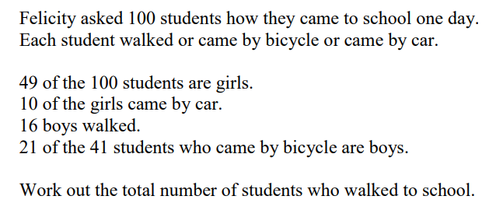

Slide 25
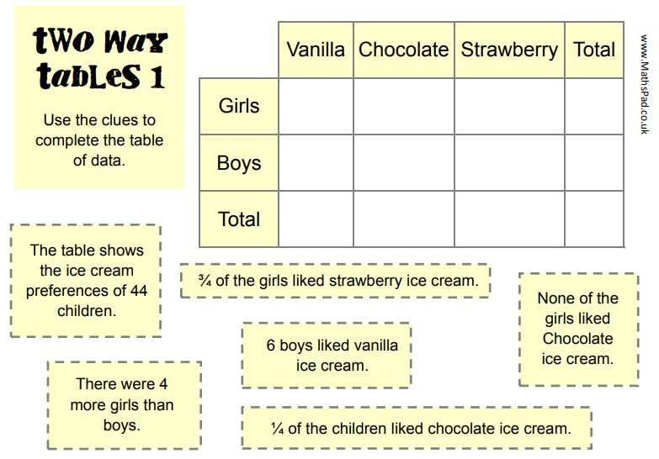

Slide 26
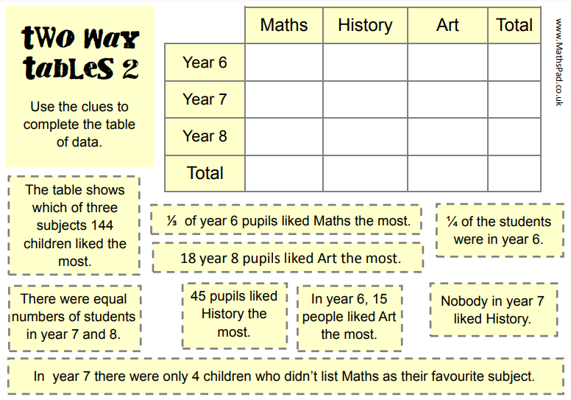

Slide 27
