Slide 1
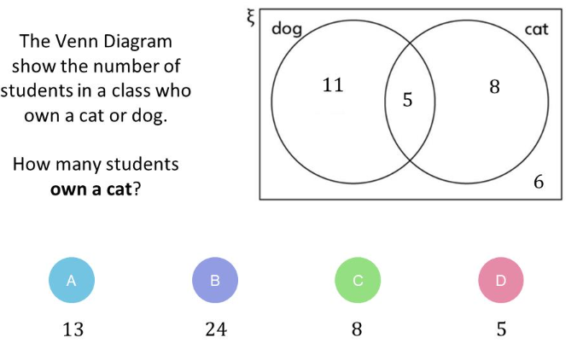

Slide 2

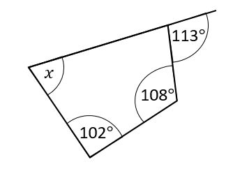
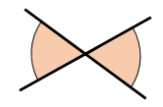
Title – Venn diagrams
14/02/2025
1
2
3
4

Slide 3

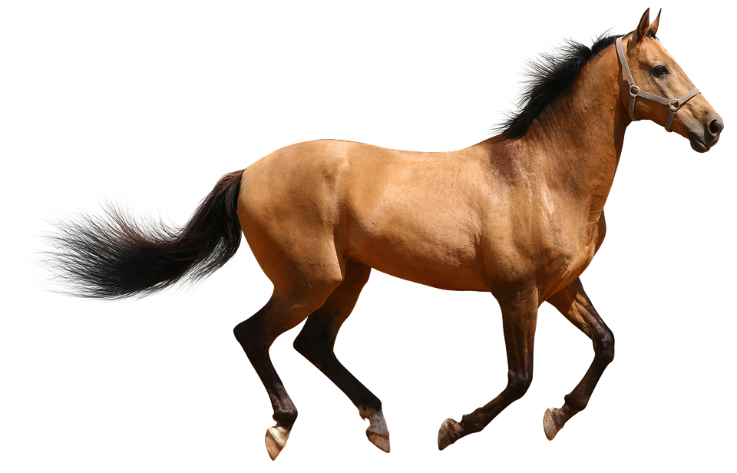
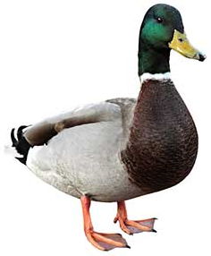
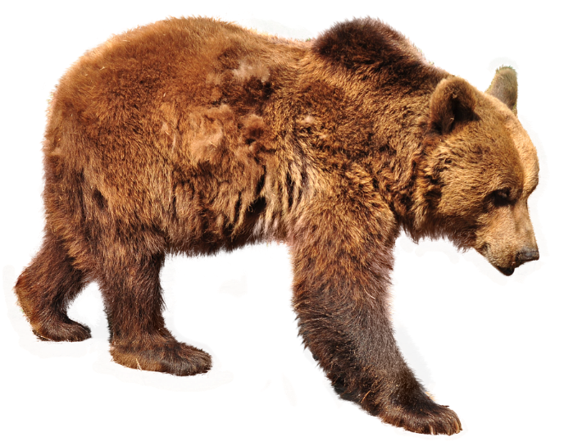
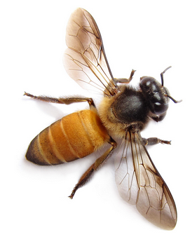
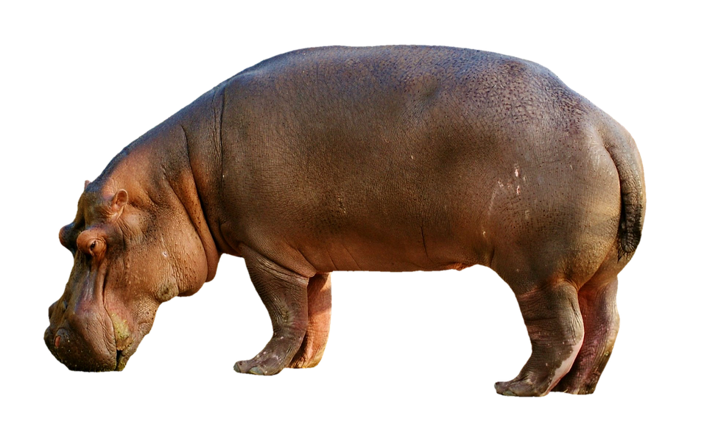
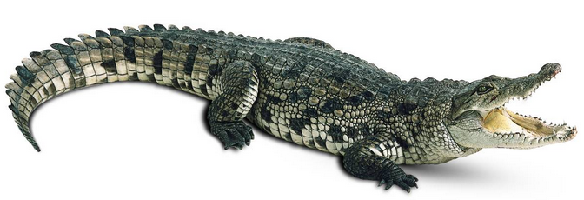
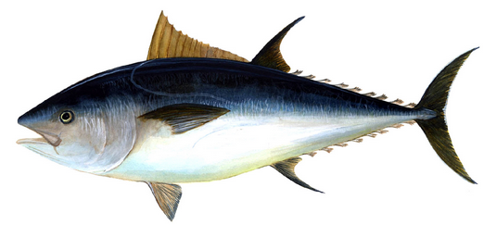

How could we
group these animals?
List at least 3 different ways…

Slide 4

How have they been organised?
Dangerous
Not dangerous

Slide 5
How have they been organised?
2 legs
No legs
4 legs
6 legs

Slide 6
Live on land
Live in water
Which group would these animals go into?

Slide 7

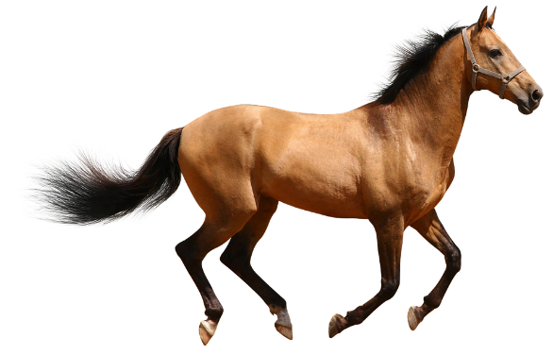

Live on land
and
in water
Live on land
Live in water
This is called a Venn diagram.
They help organise data and compare groups.
They are very useful when some things are in both groups

Slide 8
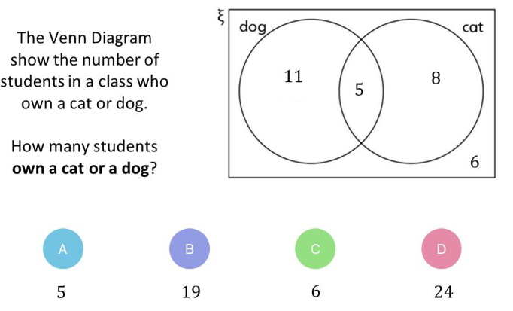

Slide 9
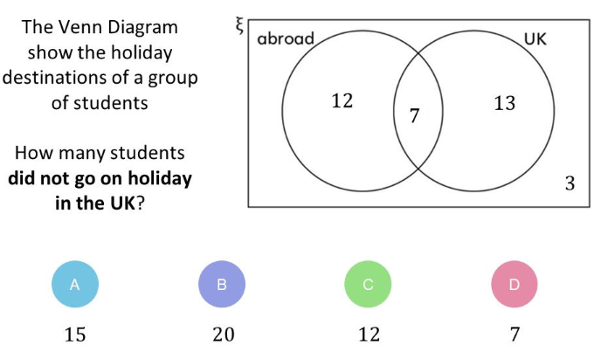

Slide 10
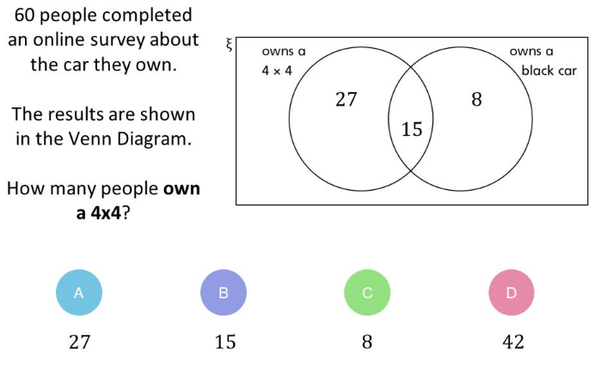

Slide 11
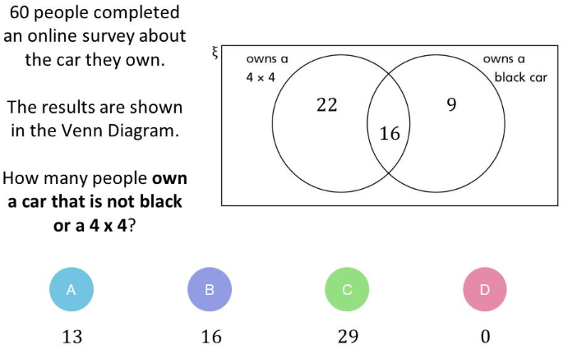

Slide 12
List types of data that could be collected from the class that would work in a Venn diagram:
Notes:
Pick 2 categories to collect data from the class for

Slide 13
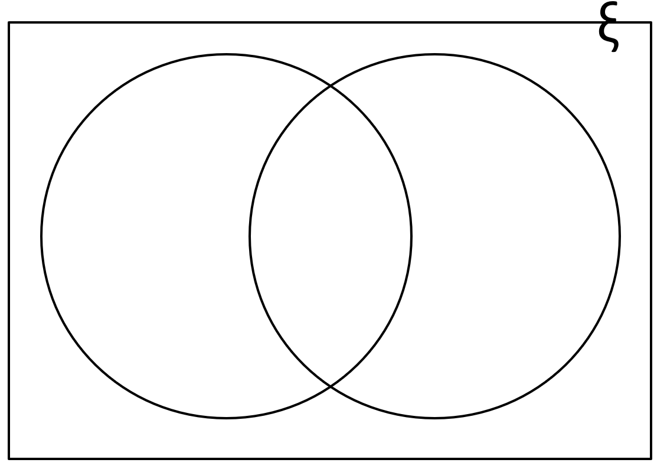
Notes:
Put data collected from the class into a Venn diagram

Slide 14
Set Notation
Let’s think about the set of integers that are less than 20 – what would they be?
{1, 2, 3, 4, 5, 6, 7, 8, 9, 10, 11, 12, 13, 14, 15, 16, 17, 18, 19}
ξ = Xi, the universal set (that means everything in the set you are given) in this case, the numbers 1 to 20
{ } curly brackets are used to show what is in the set
ξ
A
B
Notes:
“The elements of the universal set are…”
A subset includes the even numbers, a subset includes the odd numbers, another subset includes numbers that are odd and multiples of 3 etc..

Slide 15
Let’s think about the set of integers that are less than 20
{1, 2, 3, 4, 5, 6, 7, 8, 9, 10, 11, 12, 13, 14, 15, 16, 17, 18, 19}
a) How many numbers are even?
b) How many numbers are odd and a multiple of 3?
c) How many numbers are not a multiple of 3 and even?
ξ
A
B
ξ = Numbers below 20
A = Odd Numbers
B = Multiples of 3
Notes:
“The elements of the universal set are…”
A subset includes the even numbers, a subset includes the odd numbers, another subset includes numbers that are odd and multiples of 3 etc..

Slide 16
Let’s think about the set of integers that are less than 20
{1, 2, 3, 4, 5, 6, 7, 8, 9, 10, 11, 12, 13, 14, 15, 16, 17, 18, 19}
a) How many numbers are even?
b) How many numbers are odd and a multiple of 3?
c) How many numbers are not a multiple of 3 and even?
ξ
A
B
ξ = Numbers below 20
A = Odd Numbers
B = Multiples of 3

Slide 17
The numbers would go into the Venn diagram like this…
ξ
A
B
ξ = Numbers below 20
7
9
2
A = Odd Numbers
12
19
11
4
B = Multiples of 3
15
8
5
3
18
6
10
17
14
13
16
Notes:
Previous knowledge check to see whether students can already complete the learning objective. If they can’t, this provides an excellent opportunity to show progress at the end of the lesson.

Slide 18
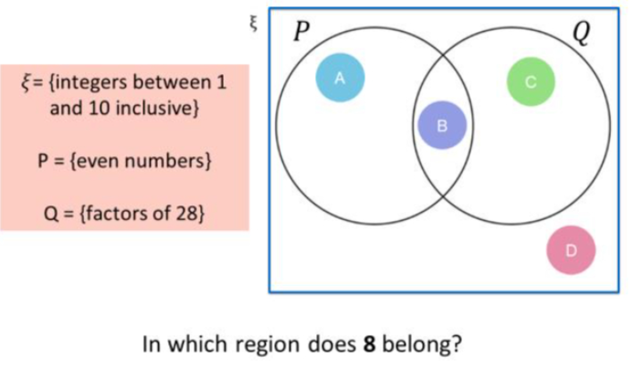

Slide 19
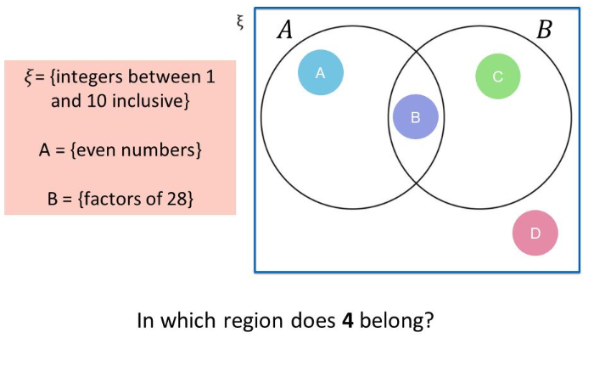

Slide 20
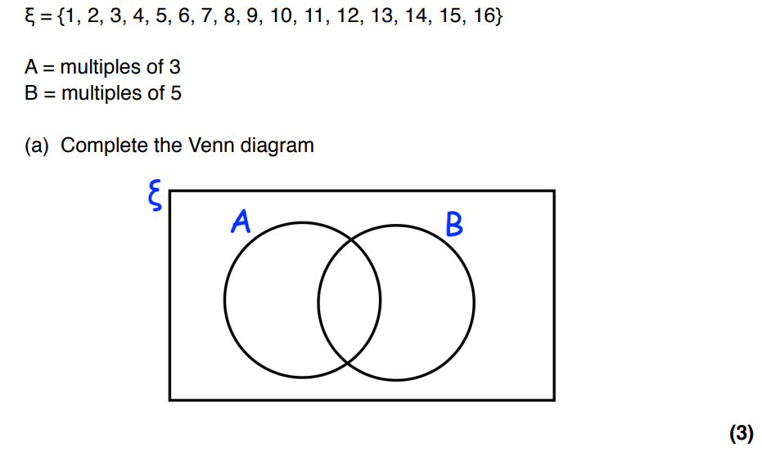

Slide 21
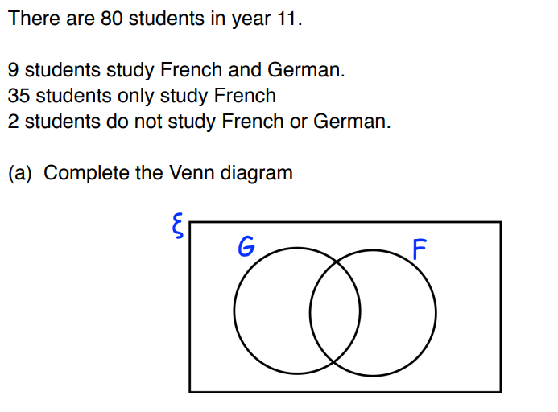

Slide 22
These possibilities are known as mutually exclusive
What’s wrong with these
Venn Diagrams?
ξ
Human
Insect
What should these Venn diagrams look like?

Slide 23
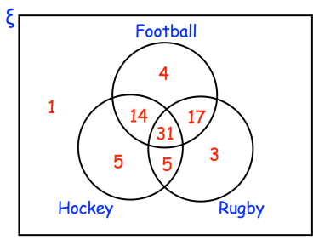
How many people enjoy all three sports?
(b) How many people enjoy football and hockey but not rugby?
(c) How many people enjoy football and rugby but not hockey?
(d) Work out which sport is enjoyed by the most number of people.

Slide 24
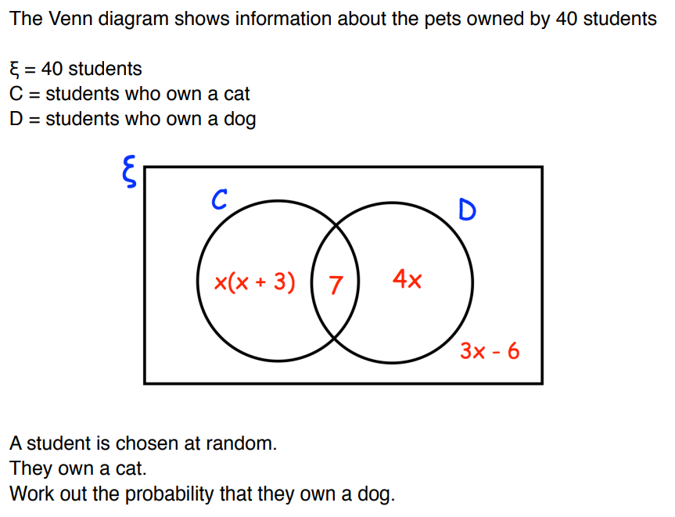

Slide 25
