Slide 2
What fraction of these shapes are red?
$$\frac{3}{7}$$

Slide 3
What fraction of these shapes are circles?
$$\frac{4}{7}$$

Slide 4
What fraction of the circles are red?
$$\frac{1}{4}$$

Slide 5
What fraction of the squares are yellow?
$$\frac{1}{3}$$

Slide 6
What fraction of the red shapes are squares?
$$\frac{2}{3}$$

Slide 7
What fraction of the yellow shapes are circles?
$$\frac{3}{4}$$

Slide 8
$$\frac{3}{7}$$
What fraction of these shapes are red?
$$\frac{4}{7}$$
What fraction of these shapes are circles?
$$\frac{1}{4}$$
What fraction of the circles are red?
$$\frac{1}{3}$$
What fraction of the squares are yellow?
$$\frac{2}{3}$$
What fraction of the red shapes are squares?
$$\frac{3}{4}$$
What fraction of the yellow shapes are circles?

Slide 9
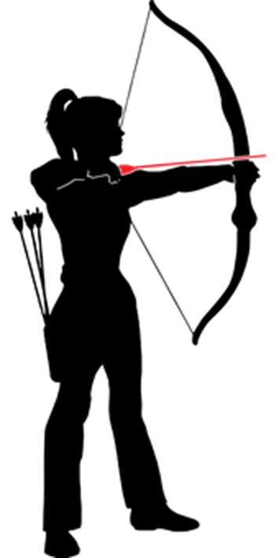
Jen & Tim were on the
same team in an archery contest.
5
6
5
11
$$\frac{6}{11}$$
What fraction of the team total did Jen score?
$$\frac{5}{6}$$
What fraction of Jen’s score, did Tim score?

Slide 10
Jen & Tim were on the
same team in an archery contest.
6
6
8
14
$$\frac{8}{14}$$
$$=\frac{4}{7}$$
What fraction of the team total did Tim score?
$$\frac{6}{8}$$
$$=\frac{3}{4}$$
What fraction of Tim’s score, did Jen score?

Slide 11
Jen & Tim were on the
same team in an archery contest.
5
10
5
15
$$\frac{10}{15}$$
$$=\frac{2}{3}$$
What fraction of the team total did Jen score?
$$\frac{5}{10}$$
$$=\frac{1}{2}$$
What fraction of Jen’s score, did Tim score?

Slide 12
Jen & Tim were on the
same team in an archery contest.
20
5
25
$$\frac{20}{25}$$
$$=\frac{4}{5}$$
What fraction of the team total did Jen score?
$$\frac{5}{20}$$
$$=\frac{1}{4}$$
What fraction of Jen’s score, did Tim score?

Slide 13
Jen & Tim were on the
same team in an archery contest.
25
20
45
$$\frac{25}{45}$$
$$=\frac{5}{9}$$
What fraction of the team total did Jen score?
$$\frac{20}{25}$$
$$=\frac{4}{5}$$
What fraction of Jen’s score, did Tim score?

Slide 14
Jen & Tim were on the
same team in an archery contest.
8
24
32
$$\frac{8}{32}$$
$$=\frac{1}{4}$$
What fraction of the team total did Jen score?
$$\frac{8}{24}$$
$$=\frac{1}{3}$$
What fraction of Tim’s score, did Jen score?

Slide 15
In a 1-hour class, Matilda spent 10 minutes chatting to her friend.
What fraction of the class did Matilda spend chatting?
$$10$$
$$=\frac{1}{6}$$
parts
$$60$$
whole
We must use the same units in the fraction.

Slide 16
In a one-and-a-half-hour lesson, Jake spent 14 minutes chatting to his friend.
What fraction of the class did Jake spend chatting?
$$14$$
$$=\frac{7}{45}$$
parts
$$90$$
whole
We must use the same units in the fraction.

Slide 17
Joe buys a 400 ml coffee.
The coffee has 30 g of sugar in it
What fraction of the coffee is sugar?
What is the problem?
We are dealing with two different measures.
volume: ml
mass: g
To compare quantities, they must be in the same units.

Slide 18
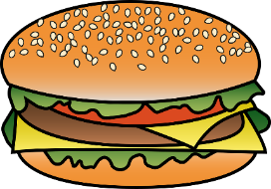
This burger has 100 grams of (fake) meat.
It weighs 220 grams.
What fraction of the burger is fake meat?
This burger has 100 grams of (fake) meat.
It has 150 grams of dressings.
What fraction of the burger is fake meat?
What is the difference between these two questions?
$$100$$
$$=\frac{5}{11}$$
$$100$$
$$=\frac{100}{250}$$
$$220$$
$$100+150$$
$$=\frac{2}{5}$$

Slide 19
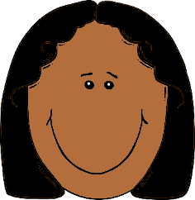
Jill mixes water with apple concentrate.
She wants to find the perfect mix!
If we mix these together,
the result will be $\frac{1}{7}$ concentrate.
700 ml
100 ml
Do you agree?
+
=

Slide 20
Jill mixes water with apple concentrate.
She wants to find the perfect mix!
What fraction of this mix is concentrate?
500 ml
100 ml
$$\frac{100}{500+100}$$
$$=\frac{100}{600}$$
+
=
$$=\frac{1}{6}$$

Slide 21
Jill mixes water with apple concentrate.
She wants to find the perfect mix!
What fraction of this mix is concentrate?
600 ml
200 ml
$$\frac{200}{600+200}$$
$$=\frac{200}{800}$$
+
=
$$=\frac{1}{4}$$

Slide 22
Which of these mixes is stronger?
700 ml
100 ml
$$\frac{100}{700+100}$$
$$=\frac{100}{800}$$
$$=\frac{1}{8}$$
+
=
600 ml
100 ml
$$\frac{100}{600+100}$$
$$=\frac{100}{700}$$
$$=\frac{1}{7}$$
+
=

Slide 23
Which of these mixes is the strongest?
240 ml
30 ml
a)
b)
c)
$$\frac{30}{240+30}$$
$$=\frac{30}{270}$$
$$=\frac{1}{9}$$
+
350 ml
50 ml
$$\frac{50}{350+50}$$
$$=\frac{50}{400}$$
$$=\frac{1}{8}$$
+
600 ml
120 ml
$$\frac{120}{700+50}$$
$$=\frac{120}{720}$$
$$=\frac{1}{6}$$
+

Slide 24
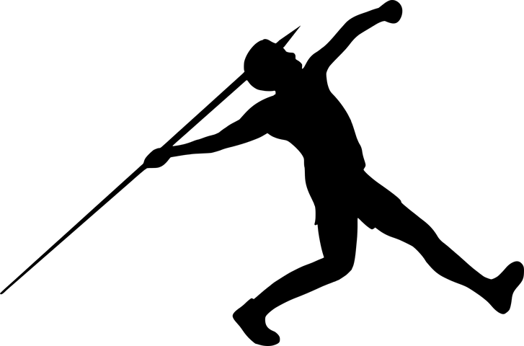
In a javelin competition…
Anne threw 24 m.
Bernice threw 8 m.
Carli threw 64 m.
Dani threw 58 m.
Express:
1) Bernice’s throw as a fraction of Anne’s throw.
$$\frac{8}{24}=\frac{1}{3}$$
2) Bernice’s throw as a fraction of Carli’s throw.
$$\frac{8}{64}=\frac{1}{8}$$
3) Anne’s throw as a fraction of Carli’s throw.
$$\frac{24}{64}=\frac{3}{8}$$
4) Anne’s throw as a fraction of Dani’s throw.
$$\frac{24}{58}=\frac{12}{29}$$

Slide 25
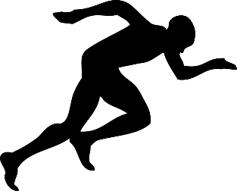
The individual times in a team 4 × 100 metre relay race:
Alex
Brin
Chris
Dan
12 seconds
13 seconds
11 seconds
10 seconds
Express:
$$\frac{11}{13}$$
1) Chris’ time as a fraction of Brin’s.
$$\frac{10}{12}=\frac{5}{6}$$
2) Dan’s time as a fraction of Alex’s.
$$\frac{12}{12+13+11+10}=\frac{12}{46}=\frac{6}{23}$$
3) Alex’s time as a fraction of the team’s time.

Slide 26
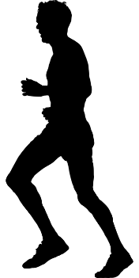
The individual times in a team 4 × 400 metre relay race:
Andi
Bert
Carl
Dave
55 seconds
1 m 05s
58 seconds
1 min 12 seconds
Express:
$$\frac{55}{250}=\frac{11}{50}$$
1) Andi’s time as a fraction of the team total.
$$\frac{120}{250}=\frac{12}{25}$$
2) Andi and Bert’s combined time as a fraction of the total.
$$\frac{55}{65}=\frac{11}{13}$$
3) Andi’s time as a fraction of Bert’s.

Slide 27
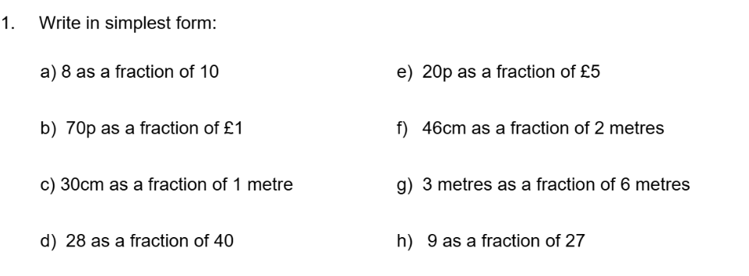

Slide 28
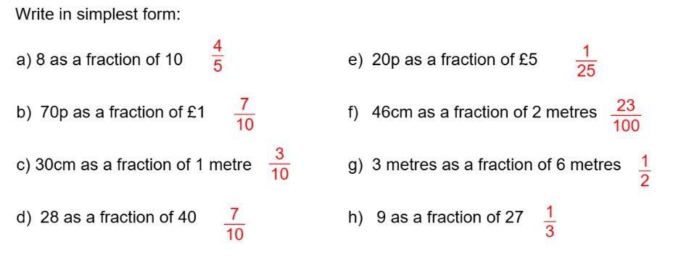

Slide 30
DIGIT Puzzle
How many ways can you complete this calculation?
$$15 \text{cm} of 60 \text{cm}=\frac{1}{4}$$
$$of$$
$$=$$
cm
cm
$$45 \text{cm} of 90 \text{cm}=\frac{1}{2}$$
Use any digits
What are the largest & smallest
fractions you can create?
Use digits only once
$$21 \text{cm} of 49 \text{cm}=\frac{3}{7}$$
$$08 \text{cm} of 72 \text{cm}=\frac{1}{9}$$
Some Answers
$$64 \text{cm} of 72 \text{cm}=\frac{8}{9}$$

