Slide 2
Reverse Percentages using Multipliers

Slide 3
Recap From Previous Lessons
Calculate 35% of 140
35% of a number is 140. What is the number?
100% | 140
35%
100%
35% | 140
x 0.35
x 0.35
x 0.35
What is the same and what is different about each question?
How is the method for working it out different?

Slide 4
I DO:
YOU DO:
A box contains red and yellow marbles.
40% of the marbles are yellow.
80 marbles are yellow.
How many marbles are in the box?
A bag contains pink and green counters.
30% of the counters are pink.
24 counters are pink.
How many counters are in the box?
100%
40% | 80
200
100%
30% | 24
80
x 0.4
$÷$ 0.4
x 0.3
$÷$ 0.3

Slide 5
Recap From Previous Lessons
Decrease 120 by 15%
In a sale, the price of a phone decreased by 15% to £120. What was the price before the sale?
100% | 120
85%
100%
85% | 120
x 0.85
x 0.85
x 0.85
What is the same and what is different about each question?
How is the method for working it out different?

Slide 6
A coat is reduced by 10% in a sale and now costs £90.
How much was the coat before it was reduced?
A student attempts to solve this problem as follows:
$$10\% of 90 = 9$$
The coat cost $10\%$more than the sale price.
$$90 + 9 = £99$$
This is incorrect.
How can we show this student that this is incorrect?

Slide 7
If the coat was £99 originally…
10% of 99 = 9.90
99 – 9.90 = £89.10
In the sale the coat would have cost £89.10

Slide 8
I DO:
YOU DO:
Tom collects stamps. This year he collected 528 which was 32% more stamps than last year. How many stamps did Tom collect last year?
Esah recently bought a phone. He sold it for £234 making a 17% profit. How much did he pay for the phone?
100%
132% | 528
400
100%
117% | £234
£200
x 1.32
$÷$ 1.32
x 1.17
$÷$ 1.17

Slide 9
I DO:
YOU DO:
Sarina just sold her car for £13,000. This was 35% less than she paid for the car 2 years ago. How much did Sarina pay for the car?
Chloe is selling her house. She has just reduced the price of her house by 8% to £193,200. What was the price of the house before the reduction?
100%
65% | £13,000
£20,000
100%
92% | £193,200
£210,000
x 0.65
$÷$ 0.65
x 0.92
$÷$ 0.92

Slide 10
On Whiteboards
1) The population of Nottingham is 300,000. The population of Nottingham is 6% of the population of the East Midlands. What is the population of the East Midlands? | 2) The price of a weekly bus ticket increased by 3% to £15.45. What was the price before the increase?
3) In a sale, the price of a shirt is reduced by 25% to £51. What was the price of the shirt before the sale? | 4) Jennifer now earns £28,000 per year after a 12% wage rise. How much did she earn before the wage rise?

Slide 11
On Whiteboards
1) The population of Nottingham is 300,000. The population of Nottingham is 6% of the population of the East Midlands. What is the population of the East Midlands?
5,000,000
100%
6% | 300,000
x 0.06
$÷$ 0.06

Slide 12
On Whiteboards
2) The price of a weekly bus ticket increased by 3% to £15.45. What was the price before the increase?
100%
103% | £15.45
£15
x 1.03
$÷$ 1.03

Slide 13
On Whiteboards
3) In a sale, the price of a shirt is reduced by 25% to £51. What was the price of the shirt before the sale?
100%
75% | £51
£68
x 0.75
$÷$ 0.75

Slide 14
On Whiteboards
4) Jennifer now earns £28,000 per year after a 12% wage rise. How much did she earn before the wage rise?
100%
112% | £28,000
£25,000
x 1.12
$÷$ 1.12

Slide 15
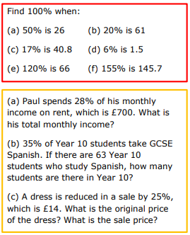
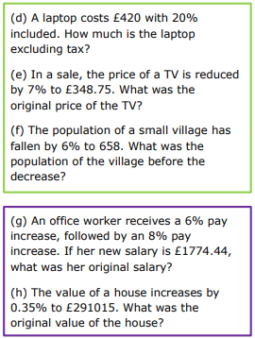
Independent Task – In Silence
tax
Notes:
Dr Austin - 7ac124_ea9543927a2f4fb7a88d39e15db7b53d.pdf

Slide 16
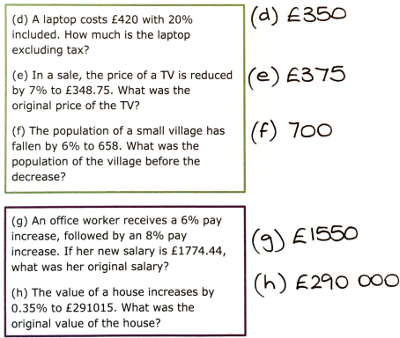
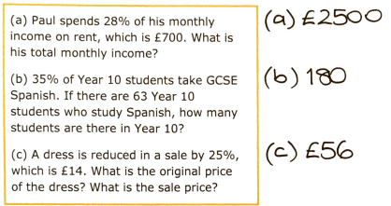
Independent Task – ANSWERS

Slide 17
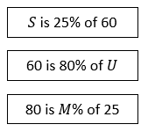
Dr Frost Maths – Challenge Questions
1
[OCR GCSE(9-1) Nov 2017 5H Q7]
Naomi is given a 10% pay decrease. Her new wage is £252 per week.
What would be her weekly wage if, instead, she had received a 10% pay increase?
$$\left(£252÷0.9\right)×1.1=£308$$
4
[TMC Regional 2013 Q7] A shopkeeper paid £30 (cost price) for a coat. She wishes to place a price tag on it so that she can offer a 10% discount on the price marked on the tag and still make a profit of 20% on the cost price. What price should she mark on the tag? Solution: £40
?
?
2
[IMC 2008 Q11] What is $S+U+M$?
410
[JMO 1996 A7] When a barrel is 30% empty it contains 30 litres more than when it is 30% full. How many litres does the barrel hold when full? Solution: 75
?
5
[JMO 2001 A6] ‘One third of the population now has access to the internet; this is 50% more than one year ago.’ What fraction of the population had access to the internet one year ago? Solution: $\frac{2}{9}$
?
3
?

Slide 18
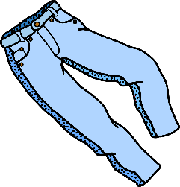
For each card, decide whether the information in the grey box is TRUE or FALSE. If it is FALSE, correct it!
A
B
C
D
20% off!
Now £48!
30% extra free!
Now 442 ml!
15% off!
Now £34!
25% extra free!
Now 650 g!
Was: £70
Was: 340 ml
Was: £45
Was: 500 g
E
F
G
H
Quarter off!
Now £12,750!
Shelly invested money &
gained 8% over the year.
She ended up with £270
Only £56!
(Includes 12% tax)
33% bigger!
Now 532 ml!
Shelly invested £240
Pre-Tax: £52
Was: 400 ml
Was: £17,000
I
J
K
L
Mike invested money &
lost 23% over the year.
He ended up with £346.50
Only £516!
(Includes 7.5% tax)
5% discount!
Now £61.75!
35% extra free!
Now 459 g!
Was: £65
Mike invested £400
Was: 340 g
Pre-Tax: £450
M
Max invested money &
gained 15% in the 1st year.
He then lost 20% in
the 2nd year.
He ended up with £3680
Trish invested money &
lost 40% in the 1st year.
She then gained 8% in
the 2nd year.
She ended up with £3564
N
O
P
Sal invested some money
& the amount increased by
10% every year for 3 years.
She withdrew £2662
Over the last 2 years a tree
grew 30% per year.
The plant is now 1.352m tall.
Sal invested £2047.
Max invested £4000
The tree was 70 cm tall.
Trish invested £5200
Notes:
Challenge – Could be printed as an extension to the SECURE task

Slide 19
For each card, decide whether the information in the grey box is TRUE or FALSE. If it is FALSE, correct it!
A
B
C
D
20% off!
Now £48!
30% extra free!
Now 442 ml!
15% off!
Now £34!
25% extra free!
Now 650 g!
£40
520 g
£60
Was: £70
Was: 340 ml
Was: £45
Was: 500 g
E
F
G
H
Quarter off!
Now £12,750!
Shelly invested money &
gained 8% over the year.
She ended up with £270
Only £56!
(Includes 12% tax)
33% bigger!
Now 532 ml!
£50
£250
Shelly invested £240
Pre-Tax: £52
Was: 400 ml
Was: £17,000
I
J
K
L
Mike invested money &
lost 23% over the year.
He ended up with £346.50
Only £516!
(Includes 7.5% tax)
5% discount!
Now £61.75!
35% extra free!
Now 459 g!
£480
£450
Was: £65
Mike invested £400
Was: 340 g
Pre-Tax: £450
M
Max invested money &
gained 15% in the 1st year.
He then lost 20% in
the 2nd year.
He ended up with £3680
Trish invested money &
lost 40% in the 1st year.
She then gained 8% in
the 2nd year.
She ended up with £3564
N
O
P
Sal invested some money
& the amount increased by
10% every year for 3 years.
She withdrew £2662
Over the last 2 years a tree
grew 30% per year.
The plant is now 1.352m tall.
£2000
80 cm
Sal invested £2047.
Max invested £4000
The tree was 70 cm tall.
Trish invested £5200
£5500
Notes:
Challenge - Answers

