Slide 1
TITLE: Substitution of negatives into harder expressions
Work out the value of -3b when b=-5
2. Work out $8^{2}$
3. Write down the definition for coefficient
4. Work out the value of the expression 4a – 9 when a = -3
5. Include your own question from sparx
Notes:
Populate the recent learning and long time learning with topics relevant to your class

Slide 2
TITLE: Substitution of negatives into harder expressions
Work out the value of -3b when b=-5
2. Work out $(−{8)}^{2}$
3. Write down the definition for coefficient
4. Work out the value of the expression 4a – 9 when a = -3
5. Include your own question from sparx
15
4(-3) – 9
= -12 – 9
= -21
64
Notes:
Populate the recent learning and long time learning with topics relevant to your class

Slide 3
Recap from last lesson
Substitute x=-3 into the expression
$$5x+4$$
5(-3) + 4
= -15 + 4
= -11

Slide 4
Recap from last lesson
Substitute x=-7into the expression
$$5x−\text{3}$$
5(-7) - 3
= -35 - 3
= -38

Slide 5
Recap from last lesson
Substitute x=-8 into the expression
$$3x+\text{2}$$
3(-9) + 2
= -24 + 2
= -22

Slide 6
Recap from last lesson
Substitute x=-3 into the expression
$$2−3x$$
2 – 3(-3)
= 2 - -9
= 11

Slide 7
Recap from last lesson
Substitute x=-3 into the expression
$$−3x+2$$
-3(-3) + 2
= 9 + 2
= 11

Slide 8
What are the missing functions?
Use your algebraic convention knowledge to write the function machine
$$a$$
$$square$$
$$a^{2}$$

Slide 9
What are the missing functions?
Use your algebraic convention knowledge to write the function machine
$$a$$
$$square$$
$+$ 1
$$a^{2}+1$$
?
?

Slide 10
What are the missing functions?
Use your algebraic convention knowledge to write the function machine
$$square$$
x4
$$a$$
?
?
$$4a^{2}$$

Slide 11
What are the missing functions?
Use your algebraic convention knowledge to write the function machine
$$+1$$
square
$$a$$
?
?
$${\left(a+1\right)}^{2}$$

Slide 12
Write the function machine for the expression $a^{2}$ then substitute $a = −3$into the function
$$−3$$
$$square$$
$$9$$
$$a$$
$${\left(−3\right)}^{2}$$

Slide 13
Write the function machine for the expression $a^{2}−1$ then substitute $a = −5$into the function
-5
$$square$$
$$−1$$
24
$$x$$
$${\left(−5\right)}^{2}−1=24$$

Slide 14
Write the function machine for the expression ${(a+2)}^{2}$ then substitute $a = −3$into the function
-3
$$+2$$
$$square$$
1
$$x$$
$${\left((−3)+2\right)}^{2}=1$$

Slide 15
What is the value of $5x^{2}$ when $x=4$?
Logan
Maria
$$5{\left(4\right)}^{2}=5×16$$
$$=80$$
$$5{\left(4\right)}^{2}={20}^{2}$$
$$=400$$
Why did you change the order? The question says to multiply by 5 first, and then square that answer!
I squared the $4$ first, and then multiplied that answer by 5.
Who is right?
Logan is correct.
We need to remember to use the order of operations! Exponents (powers) are calculated first, followed by multiplication.
Let’s use algebra tiles to convince ourselves.
Notes:
Teacher Notes
A slide to introduce the students to substituting into something like $3x^{2}$. Initially the students are faced with justifying who is correct out of Maria and Logan.
Ask the students to consider the question in the white box. Then …
Click to show the student’s working out. Ask the students who they agree with, and why? Hopefully you should get a split of students.
Click twice to show the student’s explanation. Ask the students if they want to change their mind.
Click to show the final explanation.

Slide 16
What is the value of $5x^{2}$ when $x=4$?
Remember: $5x^{2}≡5×x^{2}$
$${ x}^{2}$$
$${ x}^{2}$$
$${ x}^{2}$$
$${ x}^{2}$$
$${ x}^{2}$$
$$4^{2}$$
$$4^{2}$$
$$4^{2}$$
$$4^{2}$$
$$4^{2}$$
$$16$$
$$16$$
$$16$$
$$16$$
$$16$$
Here are five $x^{2}$ tiles. This represents $5x^{2}$.
If we substitute $x=4$ into this diagram, we can see the $16$ that appeared in Logan’s calculation.
Therefore, the calculation we need to do is $5×16=80$. This follows the order of operations.
Notes:
Teacher Notes
A slide to show the algebra tiles justification of $5x^{2}$.
Click to show the algebra tiles representing $5x^{2}$. Remind the students that $5x^{2}=5×x^{2}$, so we need $5$ $x^{2}$ tiles
Click to start an animation sequence showing the substitution. The 4 is substituted into the $x$ in each tile, leaving $4^{2}$. After 1.5 seconds, this is changed for 16. A link to Logan’s working out is made.
Click to show the final statement – the justification of $5×16$

Slide 17
What is the difference between $5x^{2}$ and ${\left(5x\right)}^{2}$?
Let’s use algebra tiles to have a look.
This is ${\left(5x\right)}^{2}$. $${\left(5x\right)}^{2}≡5x×5x≡25x^{2}$$
There are twenty-five $x^{2}$ tiles.
Remember:, this is $5x^{2}$, or $5×x^{2}$.
There are five $x^{2}$ tiles.
$$x$$
$$x$$
$$x$$
$$x$$
$$x$$
$${ x}^{2}$$
$${ x}^{2}$$
$${ x}^{2}$$
$${ x}^{2}$$
$${ x}^{2}$$
$$x$$
$${ x}^{2}$$
$${ x}^{2}$$
$${ x}^{2}$$
$${ x}^{2}$$
$${ x}^{2}$$
$$x$$
$${ x}^{2}$$
$${ x}^{2}$$
$${ x}^{2}$$
$${ x}^{2}$$
$${ x}^{2}$$
In $5x^{2}$, just the $x$ term is being squared.
$$x$$
$${ x}^{2}$$
$${ x}^{2}$$
$${ x}^{2}$$
$${ x}^{2}$$
$${ x}^{2}$$
$$x$$
$${ x}^{2}$$
$${ x}^{2}$$
$${ x}^{2}$$
$${ x}^{2}$$
$${ x}^{2}$$
In ${\left(5x\right)}^{2}$, the whole $5x$ term is being squared.
$$x$$
$${ x}^{2}$$
$${ x}^{2}$$
$${ x}^{2}$$
$${ x}^{2}$$
$${ x}^{2}$$
Notes:
Teacher Notes
Use of algebra tiles to show the difference between $5x^{2}$ and ${\left(5x\right)}^{2}$.
Click once to make the $5x^{2}$ tiles appear. Then, click to make a black box appear to reiterate the idea that just the $x$ term is being squared. This can be linked to the $5×x^{2}$ that appears above the tiles.
Click again to make the ${\left(5x\right)}^{2}$ tiles appear. First of all, the green edge lengths will appear, showing the $5x$ on each side – simulating the squaring. Then, after a second, the middle tiles will fill in. Link to the identity that is above the tiles. ${\left(5x\right)}^{2}=5x×5x$, which is why we get $25$ $x^{2}$ tiles. Finally, click one more time to make a black box appear to reiterate this.

Slide 18
Find the value of $3a^{2}$ when
$a=−5$
$$3{\left(−5\right)}^{2}=3×{\left(−5\right)}^{2}$$
$$=3×(25)$$
$$=75$$

Slide 19
What is the value of ${\left(3b\right)}^{2}$ given that $b=−5$
$${\left(3×(−5)\right)}^{2}$$
$$={(−15)}^{2}$$
$$=225$$

Slide 20
Calculate the value of $−2c^{4}$ when $c=−3$
$$−2{\left(−3\right)}^{4}$$
$$=−2×(81)$$
$$=−162$$

Slide 21
Work out the value of
$6d^{2}−{\left(3d\right)}^{3}$ when $d=−2$
$$6{\left(−2\right)}^{2}−{\left(3×(−2)\right)}^{3}$$
$$=\left(6×4\right)−{\left(−6\right)}^{3}$$
$$=24+216$$
$$=240$$

Slide 22
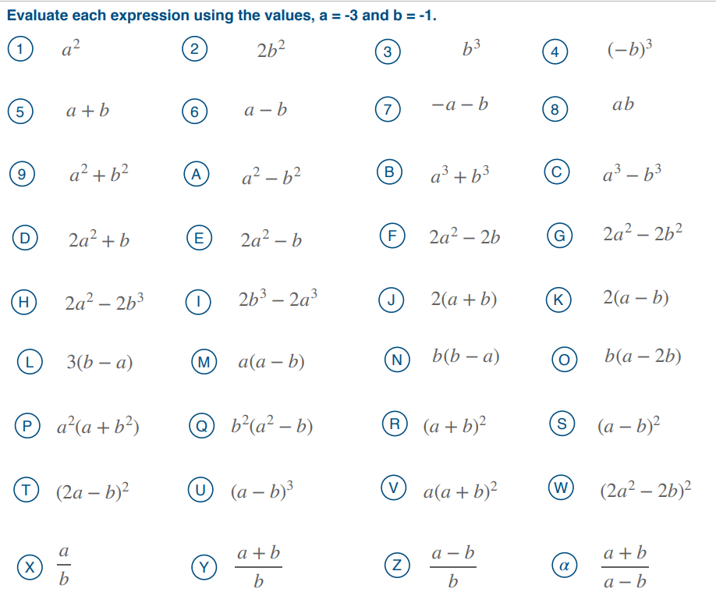
TITLE: Substituting negative values into harder expressions

Slide 23
=9
=-4
=4
=17
=20
=24
=2
=-2
=8
=19
=52
=6
=-1
= 4
=-28
=20
=-8
=-2
=-1
= 3
=-26
=16
=-4
=1

Slide 24
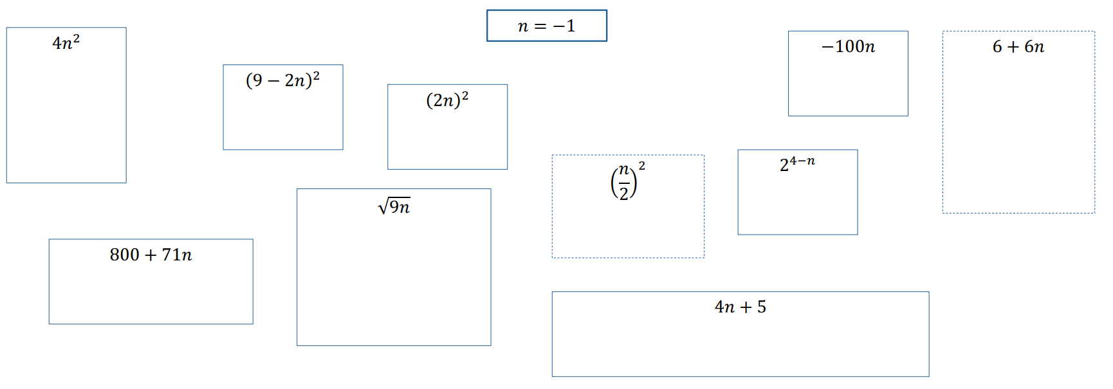
When n = -1, which of these expressions give you a square number

Slide 25
When n = -1, which of these expressions give you a square number
= 100
✓
= 4
✓
= 121
= 0
✓
✓
= 4
= 32
= ¼
= Math Error
= 871
= 1
✓

Slide 26
Further practice
Given that $a=−3$, calculate the following:
$6a$
$6a−2$
$2−6a$
$6a^{2}$
${ \left(6a\right)}^{2}$
$6+a^{2}$
${ \left(2−6a\right)}^{2}$
$2−6a^{2}$
$−6a^{2}+2$
$6b−2$
$$−18$$
$$−20$$
$$−16$$
$$54$$
$$324$$
?
1
?
6
$$15$$
$$400$$
$$−52$$
$$−22$$
?
2
?
7
?
3
?
8
?
4
?
9
?
5
?
10
?
What is the difference between questions 4 and 5? How do I know what to do first?
Question 10 isn’t possible! We don’t have a value for $b$, so we cannot calculate $6b−2$.
Notes:
Teacher Notes
A quick TYU check. Could be done on whiteboards or in books.
Using variation theory, we start with standard practice (Q1-4, 6, 8), introduce non-standard practice (Q5, 7, 9) and finally show student what substitution cannot do (Q10).
Q2/3 are linked (one is positive, one is negative), a nice opportunity to talk about why (subtraction is not commutative, the difference between the numbers has the same magnitude, but the direction of the difference has changed).
Q4/5 and Q6/7 highlight the importance of brackets.
After revealing the answer to Q5, a question box appears drawing attention to the notation differences. $6a^{2}$ has the exponent only on the $a$. ${\left(6a\right)}^{2}$ has the exponent on $6a$. The brackets must be calculated first, according to the order of operations.
Q8/9 give the same answer – a nice opportunity to talk about why.
Q10 – don’t highlight this to students until the end, see if they notice first!

Slide 27
Deeper Thinking
a
$$x^{2}+5x−8$$
b
$$2x^{2}−3x−2$$
?
?
$${\left(−5\right)}^{2}+5\left(−5\right)−8$$
$$=\left(25\right)+(−25)−8$$
$$=25−25−8$$
$$=−8$$
$${2\left(−5\right)}^{2}−3\left(−5\right)−2$$
$$=(2×25)−(−15)−2$$
$$=50+15−2$$
$$=63$$
What is the value of each of these expressions when $x=−5$?
c
$${\left(2x\right)}^{2}−3x−2$$
?
$${(2×−5)}^{2}−3\left(−5\right)−2$$
$$={\left(−10\right)}^{2}−\left(−15\right)−2$$
$$=100+15−2$$
$$=113$$
Notes:
Teacher Notes
Deeper understanding, this slide contains all of the skills we have covered so far.
Could be done using a mini-whiteboard.

