Slide 1
Title – Algebraic probability
26/02/2025
1
2
3
4

Slide 2
A bag contains red and black beads. The ratio of red to black beads is 1 : 2.
Roxy takes two beads from the bag at random without replacement.
The probability that both beads are red is $\frac{1}{15}$.
How many beads were in the bag at the beginning?
Which sort of probability is this?
Dependent events
What information can we take from the question?
“Two types of beads
$\frac{1}{3}$ are red, $\frac{2}{3}$ are black”
“Without replacement”
Why does the ratio make the question more difficult?
Not sure how many beads there are!

Slide 3
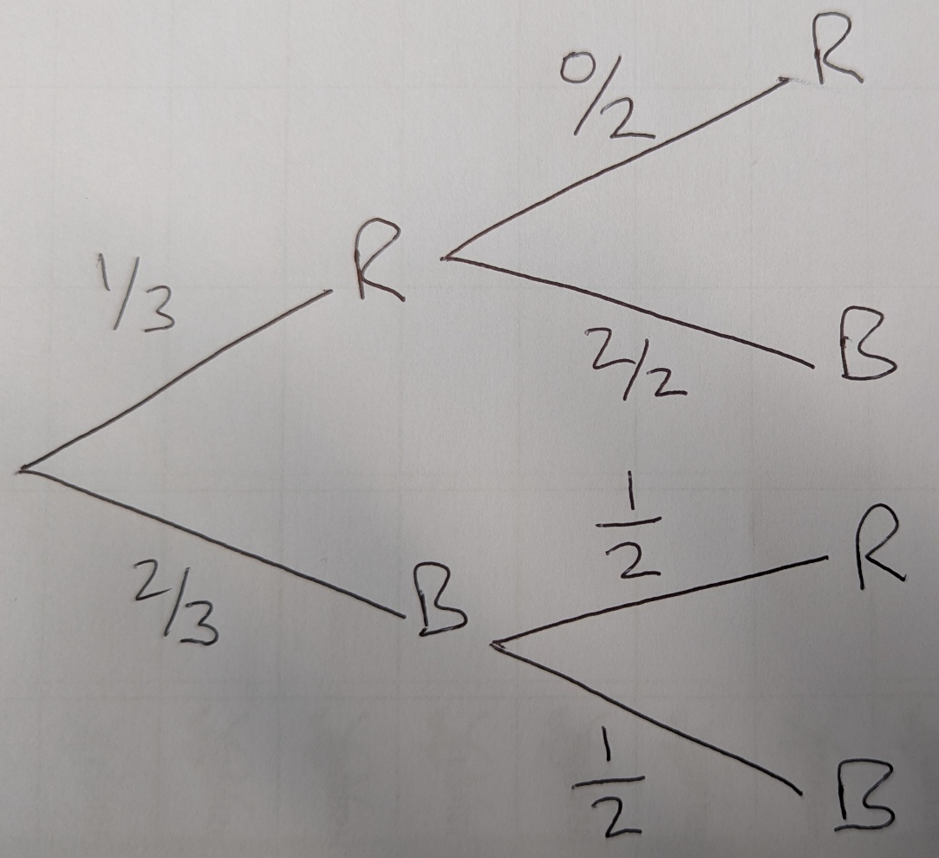
A bag contains red and black beads. The ratio of red to black beads is 1 : 2.
Roxy takes two beads from the bag at random without replacement.
The probability that both beads are red is $\frac{1}{15}$.
How many beads were in the bag at the beginning?
Here is one student’s attempt at this question. They didn’t manage to get any further.
Why is that? What went wrong?

Slide 4
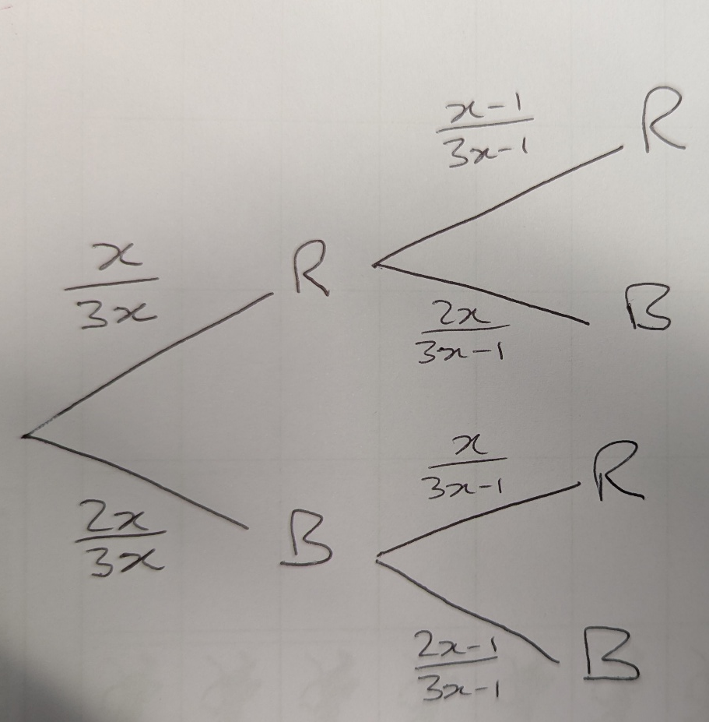
A bag contains red and black beads. The ratio of red to black beads is 1 : 2.
Roxy takes two beads from the bag at random without replacement.
The probability that both beads are red is $\frac{1}{15}$.
How many beads were in the bag at the beginning?
Why is $\frac{x}{3x}$ a better representation?
What would the other branches be?
?
?
?
?
?

Slide 5
A bag contains red and black beads. The ratio of red to black beads is 1 : 2.
Roxy takes two beads from the bag at random without replacement.
The probability that both beads are red is $\frac{1}{15}$.
How many beads were in the bag at the beginning?
$$\frac{x}{3x}×\frac{x−1}{3x−1}=\frac{1}{15}$$
$$\frac{1}{3}×\frac{x−1}{3x−1}=\frac{1}{15}$$
$$\frac{x−1}{3x−1}=\frac{1}{5}$$
$$5\left(x−1\right)=3x−1$$
$$5x−5=3x−1$$
$$2x=4$$
$$x=2$$
What is my final answer?
$$Total beads=3x=6$$

Slide 6
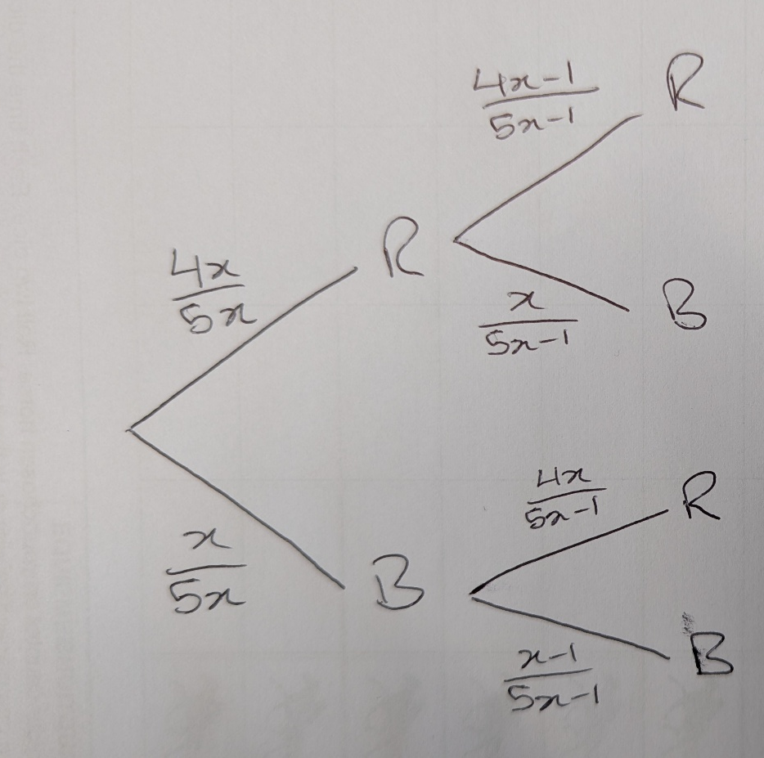
A bag contains red and black beads. The ratio of red to black beads is 4 : 1.
Roxy takes two beads from the bag at random without replacement.
The probability that both beads are red is $\frac{3}{5}$.
How many beads were in the bag at the beginning?
?
$$\frac{4x}{5x}×\frac{4x−1}{5x−1}=\frac{3}{5}$$
?
$$\frac{4}{5}×\frac{4x−1}{5x−1}=\frac{3}{5}$$
?
?
$$\frac{4x−1}{5x−1}=\frac{3}{4}$$
?
$$4\left(4x−1\right)=3(5x−1)$$
?
$$16x−4=15x−3$$
?
$$x=1$$
$$Total beads=5x=5$$

Slide 7
A box contains milk and dark chocolates. The ratio of milk to dark chocolates is 3 : 2.
One at a time, Peter takes two chocolates from the box at random and eats them.
The probability that the first chocolate is milk and the second is dark is $\frac{9}{35}$.
Find how many milk chocolates were in the box to begin with.

Slide 8
On your whiteboards…

Slide 9
On your whiteboards…

Slide 10
On your whiteboards…
A box contains milk and dark chocolates. The ratio of milk to dark chocolates is 4 : 3.
One at a time, Peter takes two chocolates from the box at random and eats them.
The probability that they are NOT both milk is $\frac{5}{7}$.
Find how many chocolates were in the box to begin with.
Method 1
Method 2

