Slide 1
Title – Probability Trees without replacement
17/03/2025
In a book club, the ratio of the number of members who wears glasses to those that do not wear glasses is 2 : 3
36 members of the book club wear glasses. How many members are there in total?
Here are two similar hexagons. Work out the missing information.
If 21.3 $×$ 0.45 $=$ 9.585
What is 213 $×$ 4.5?
What is the sum of the first three square numbers?
1
90
4
\\\\\\\\\\\\\\
2
4
?
1
12
3
958.5
4
1 $+$ 4 $+$ 9 $=$ 14
Vocabulary check: Sum

Slide 2
Title – Dependent Probability Events
17/03/2025
1
2
3
4

Slide 3
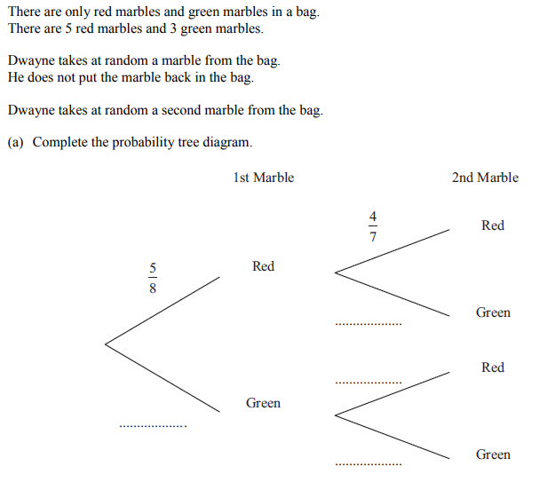
What is different about this question compared to our last lesson?

Slide 4
$$\frac{3}{8}$$
What fraction should go here

Slide 5
Why is this fraction $\frac{4}{7}$ ?

Slide 6
A red marble has been removed
$$\frac{3}{8}$$

Slide 7
So now there are 7 marbles, 4 of which are red
$$\frac{3}{8}$$

Slide 8
$$\frac{3}{7}$$
What fraction should go here?
Why?
$$\frac{3}{8}$$

Slide 9
This time, a green marble has been removed and not replaced
$$\frac{3}{7}$$
$$\frac{3}{8}$$

Slide 10
$$\frac{3}{7}$$
What should these two fractions be?
Why?
$$\frac{3}{8}$$

Slide 11
$$\frac{3}{7}$$
What should these two fractions be?
Why?
$$\frac{5}{7}$$
$$\frac{3}{8}$$
$$\frac{2}{7}$$

Slide 12
We can now answer questions using this tree diagram.
$$\frac{3}{7}$$
$$\frac{5}{7}$$
$$\frac{3}{8}$$
$$\frac{2}{7}$$

Slide 13
On your whiteboards:
What is the probability of picking two red marbles?
$$\frac{5}{8}×\frac{4}{7}$$
$$\frac{3}{7}$$
$$\frac{5}{7}$$
$$\frac{3}{8}$$
$$\frac{2}{7}$$

Slide 14
On your whiteboards:
What is the probability of picking two green marbles?
$$\frac{3}{7}$$
$$\frac{5}{7}$$
$$\frac{3}{8}$$
$$\frac{3}{8}×\frac{2}{7}$$
$$\frac{2}{7}$$

Slide 15
On your whiteboards:
What is the probability of picking marbles of different colours?
$$\frac{3}{7}$$
$$\frac{5}{8}×\frac{3}{7}$$
$$\frac{5}{7}$$
$$\frac{3}{8}$$
$$\frac{2}{7}$$

Slide 16
On your whiteboards:
What is the probability of picking marbles of different colours?
But we can also have…
$$\frac{3}{7}$$
$$\frac{5}{8}×\frac{3}{7}$$
$$\frac{5}{7}$$
$$\frac{3}{8}×\frac{5}{7}$$
$$\frac{3}{8}$$
$$\frac{2}{7}$$

Slide 17
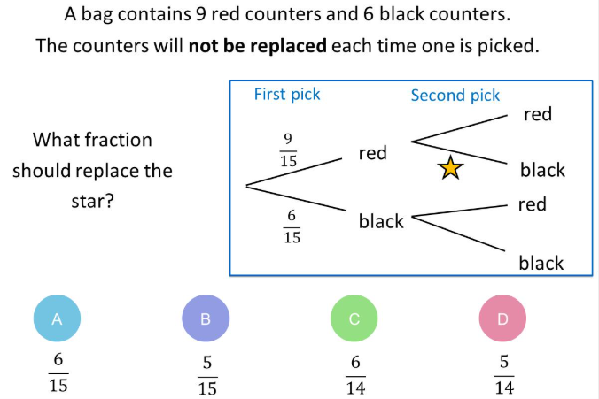

Slide 18
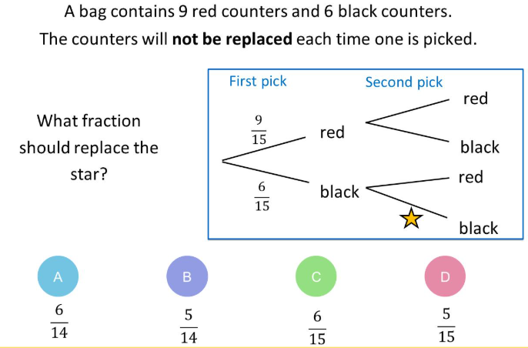

Slide 19
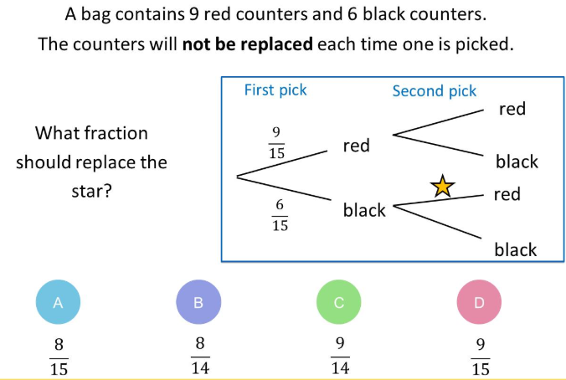

Slide 20
On your whiteboards…

Slide 21
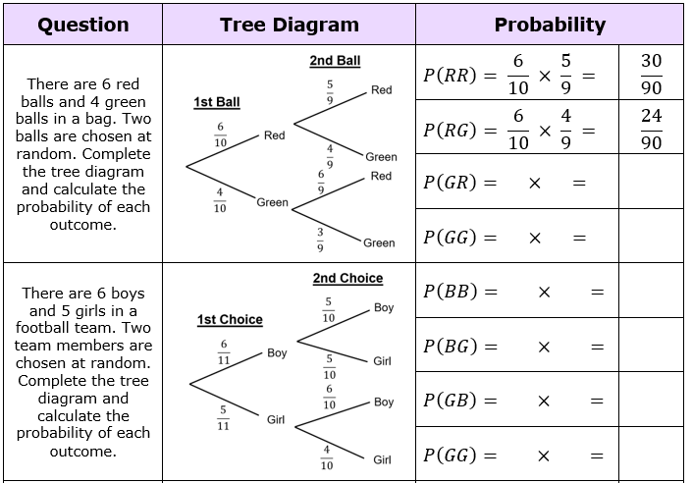

Slide 22
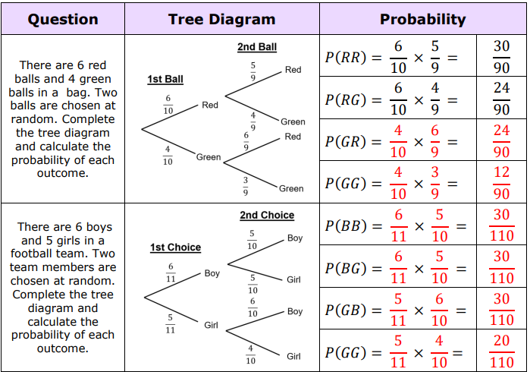

Slide 23
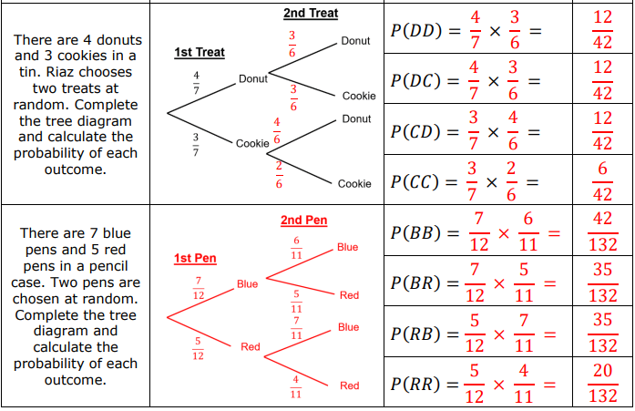

Slide 24
If a white disk is picked from this bag, 9 black shapes are added before another disc is picked.
Use a tree diagram to find P(two discs of different colours are picked).

Slide 25
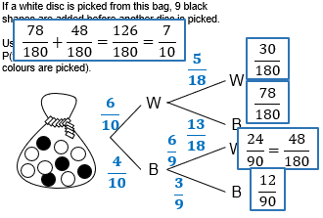

Slide 26
P(Tom is late to work) = 0.4 If Tom is late to work,
the probability of him being late the
next day increases by 50%.
What is the probability he is on time only
once out of 3 days.
$$=0.232$$

Slide 27
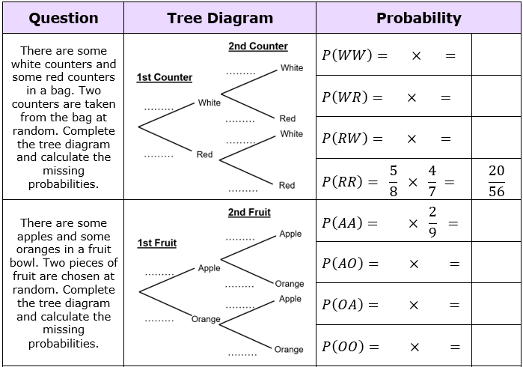

Slide 28
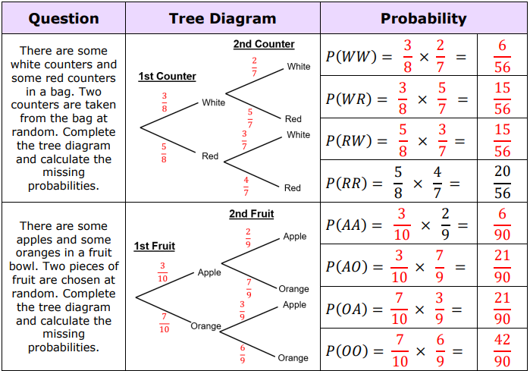

Slide 29
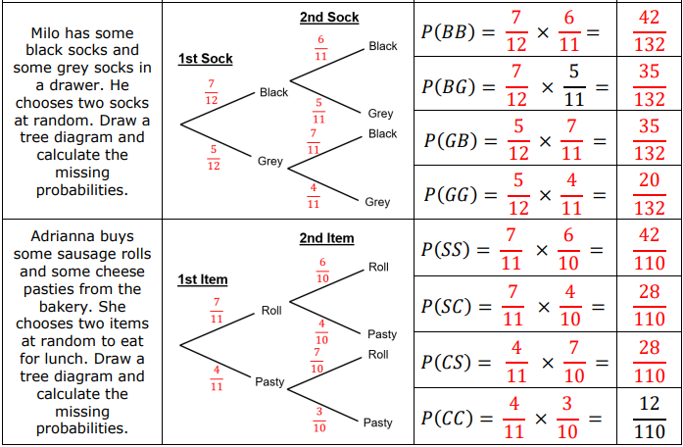

Slide 30
AQA Higher: May 2017 Paper 1, Q16
AQA Higher: November 2017 Paper 1, Q27
1
A fair spinner has 7 equal sections numbered 1, 2, 3, 4, 5, 6 and 7
A fair six-sided dice has 1 blue face and 5 red faces.
The spinner is spun.
If the spinner shows an odd number, the dice is thrown.
There are 12 cubes in a box.
7 are yellow and 5 are blue.
Two pens are taken out at random without replacement.
Work out the probability that the two pens are different colours.
1
1 (a)
Complete the tree diagram for the spinner and the dice.
[2 marks]
[4 marks]
Spinner
Dice
Even
Odd
1 (b)
Work out the probability of getting an odd number and the colour red.
[2 marks]
Answer
Answer

Slide 31
AQA Higher: May 2017 Paper 1, Q16
AQA Higher: November 2017 Paper 1, Q27
1
1
There are 12 cubes in a box.
7 are yellow and 5 are blue.
Two pens are taken out at random without replacement.
Work out the probability that the two pens are different colours.
A fair spinner has 7 equal sections numbered 1, 2, 3, 4, 5, 6 and 7
A fair six-sided dice has 1 blue face and 5 red faces.
The spinner is spun.
If the spinner shows an odd number, the dice is thrown.
1 (a)
Complete the tree diagram for the spinner and the dice.
[2 marks]
$$\frac{6}{11}$$
[4 marks]
Spinner
Dice
Y
$$\frac{3}{7}$$
Even
Y
$$\frac{5}{11}$$
$$\frac{7}{12}$$
$$\frac{7}{12}\text{×}\frac{5}{11}=\frac{35}{132}$$
B
$$\frac{4}{7}$$
$$\frac{1}{6}$$
$$\frac{7}{11}$$
$$\frac{5}{12}\text{×}\frac{7}{11}=\frac{35}{132}$$
blue
Y
$$\frac{5}{12}$$
Odd
$$\frac{5}{6}$$
red
B
$$\frac{4}{11}$$
B
1 (b)
Work out the probability of getting an odd number and the colour red.
$$\frac{4}{7}\text{×}\frac{5}{6}=\frac{20}{42} or\frac{10}{21}$$
[2 marks]
$$\frac{35}{132}+\frac{35}{132}=\frac{70}{132}$$
$\frac{70}{132}$ or $\frac{35}{66}$
Answer
Answer

