Slide 1
Fractions: Adding and subtracting worded questions

Slide 2
$$7\frac{1}{2} kg$$
$\frac{2}{3} l$
$$3\frac{17}{24}m$$

Slide 3
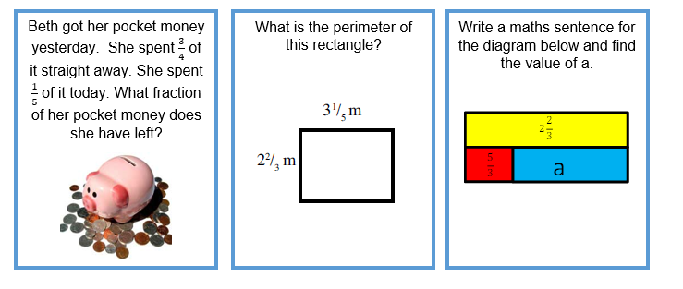
$$\frac{1}{20}$$
$$11\frac{11}{15} m$$
1

Slide 4
$$2\frac{7}{8}$$
$$\frac{5}{12}$$
$$5\frac{2}{3}$$

