Slide 2
TITLE: Add and Subtract algebraic fractions
Simplify the expression by collecting like terms.
Explain why the calculation is incorrect.
Simplify:
$2×p$
$3x×5$
$10y ÷2$
$$3x+x+2x−4x$$
$$=2x$$
$\frac{2}{3}+\frac{2}{5}=\frac{4}{8}$
$\frac{4}{8}=\frac{1}{2}$ and $\frac{2}{3}$ is already greater than $\frac{1}{2}$ before $\frac{2}{5}$ is added.
= 2p
= 15x
= 5y

Slide 3
Work out the calculation.
$\frac{\text{3}}{\text{7}}+\frac{\text{3}}{\text{7}}$
$\frac{\text{6}}{\text{7}}$
$\frac{x}{\text{7}}+\frac{x}{\text{7}}$
$\frac{\text{2}x}{\text{7}}$
Notes:
Get students to work out the question before showing the visual.

Slide 4
Work out
$\frac{x}{5}+\frac{2x}{5}$
$=\frac{3x}{5}$
Create a question where the answer is $\frac{4x}{9}$
Notes:
Get students to work out the question before showing the visual.

Slide 5
Work out the calculation.
$\frac{\text{1}}{\text{5}}+\frac{\text{1}}{\text{5}}$
$\frac{\text{2}}{\text{5}}$
Work out the calculation.
$\frac{\text{1}}{\text{g}}+\frac{\text{1}}{\text{g}}$
$\frac{\text{2}}{\text{g}}$
Notes:
Get students to work out the question before showing the visual.
Notice here the algebra is on the denominator

Slide 6
Work out
$\frac{1}{t}+\frac{2}{t}$
$=\frac{3}{t}$
Create a question where the answer is $\frac{7}{x}$
Notes:
Get students to work out the question before showing the visual.

Slide 7
Work out the calculation.
$\frac{\text{3}}{\text{5}}−\frac{\text{1}}{\text{5}}$
$\frac{\text{2}}{\text{5}}$
Work out the calculation.
$\frac{\text{3}}{x}−\frac{\text{1}}{x}$
$\frac{\text{2}}{x}$
Notes:
Subtraction with algebraic denominator

Slide 8
Work out
$\frac{6}{r}−\frac{4}{r}$
$=\frac{2}{r}$
Create a subtraction a question where the answer is $\frac{7}{x}$
Notes:
Get students to work out the question before showing the visual.

Slide 9
Work out
$\frac{9d}{2}−\frac{d}{2}$
$=\frac{8d}{2}$
*Can you simplify this answer by taking out common factors?
$4d$
Notes:
Get students to work out the question before showing the visual.

Slide 10
How is this question different?
Work out the calculation.
$\frac{\text{1}}{\text{5}}+\frac{\text{1}}{\text{10}}$
$\frac{\text{2}}{\text{10}}+\frac{\text{1}}{\text{10}}=\frac{\text{3}}{\text{10}}$

Slide 11
Express this calculation as a single fraction.
$$\frac{p}{5}+\frac{p}{10}$$
× 2
$$\frac{2p}{10}+\frac{p}{10}$$
$$=\frac{2p+p}{10}$$
$$=\frac{3p}{10}$$

Slide 12
Express this calculation as a single fraction.
$$\frac{t}{12}+\frac{t}{4}$$
× 3
$$\frac{t}{12}+\frac{3t}{12}$$
$$=\frac{t+3t}{12}$$
$$=\frac{4t}{12}$$
$$=\frac{t}{3}$$

Slide 13
Express this calculation as a single fraction.
$$\frac{2t}{5}+\frac{3t}{20}$$
× 4
$$\frac{8t}{20}+\frac{3t}{20}$$
$$=\frac{8t+3t}{20}$$
$$=\frac{11t}{20}$$

Slide 14
Express this calculation as a single fraction.
$$\frac{1}{3}+\frac{x}{6}$$
× 2
$$\frac{2}{6}+\frac{x}{6}$$
$$=\frac{2+x}{6}$$
$$=\frac{x+2}{6}$$

Slide 15
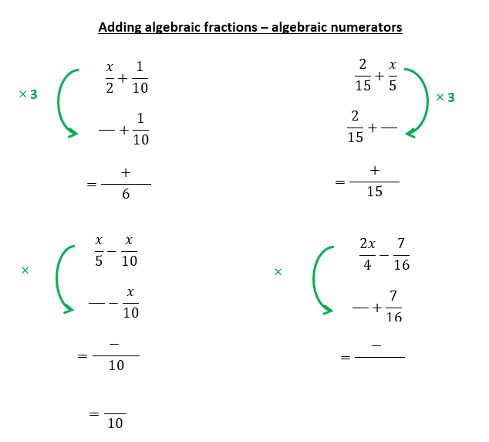
Independent practice – Task 1
Express these calculations as a single fraction.
$$\frac{x}{5}−\frac{x}{10}$$
$$\frac{2x}{4}−\frac{7}{16}$$
$$=\frac{8x−7}{16}$$
A
$$=\frac{x}{10}$$
D
$$\frac{2x}{3}+\frac{2x}{9}$$
$$=\frac{8x}{9}$$
$$\frac{2}{15}+\frac{x}{5}$$
B
E
$$=\frac{3x+2}{15}$$
$$\frac{x}{2}+\frac{1}{10}$$
$$=\frac{5x+1}{10}$$
$$\frac{5x}{2}−\frac{7x}{3}$$
C
F
$$=\frac{x}{6}$$
Notes:
Scaffolded sheet available

Slide 16
Work out the calculation.
$\frac{\text{1}}{\text{p}}+\frac{\text{1}}{\text{2}\text{p}}$
= $\frac{\text{2}}{\text{2}\text{p}}+\frac{\text{1}}{\text{2}\text{p}}$
$=\frac{\text{3}}{\text{2}\text{p}}$

Slide 17
What would happen in these cases?
$\frac{\text{1}}{\text{p}}+\frac{\text{1}}{\text{2}\text{p}}$
$\frac{\text{2}}{\text{2}\text{p}}+\frac{\text{1}}{\text{2}\text{p}}=\frac{\text{3}}{\text{2}\text{p}}$
$\frac{\text{1}}{\text{p}}+\frac{\text{1}}{\text{3}\text{p}}$
$\frac{\text{3}}{\text{3}\text{p}}+\frac{\text{1}}{\text{3}\text{p}}=\frac{\text{4}}{\text{3}\text{p}}$
$\frac{\text{1}}{\text{p}}+\frac{\text{1}}{\text{4}\text{p}}$
$\frac{\text{4}}{\text{4}\text{p}}+\frac{\text{1}}{\text{4}\text{p}}=\frac{\text{5}}{\text{4}\text{p}}$
How do these build?
What is the same/different?

Slide 18
Express this calculation as a single fraction.
$$\frac{1}{2a}+\frac{3}{4a}$$
× 2
$$\frac{2}{4a}+\frac{3}{4a}$$
$$=\frac{2+3}{4a}$$
$$=\frac{5}{4a}$$

Slide 19
Express this calculation as a single fraction.
$$\frac{5}{8t}−\frac{1}{2t}$$
× $4$
$$\frac{5}{8t}−\frac{4}{8t}$$
$$=\frac{5−4}{8t}$$
$$=\frac{1}{8t}$$

Slide 20
Express this calculation as a single fraction.
$$\frac{1}{3a}+\frac{1}{3}$$
× $a$
$$\frac{1}{3a}+\frac{a}{3a}$$
$$=\frac{1+a}{3a}$$
$$=\frac{a+1}{3a}$$

Slide 21
Express this calculation as a single fraction.
$$\frac{2}{5x}−\frac{1}{5}$$
× $x$
$$\frac{2}{5x}−\frac{x}{5x}$$
$$=\frac{2−x}{5x}$$

Slide 22
Spot the mistake
$$\frac{6}{7x}−\frac{2}{7}$$
× $x$
$$\frac{6}{7x}−\frac{2}{7x}$$
$$=\frac{4}{7x}$$

Slide 23
Independent practice – Task 2
Express these calculations as a single fraction.
$$\frac{1}{4a}+\frac{3}{a}$$
$$=\frac{13}{4a}$$
$$\frac{7}{4g}−\frac{1}{4}$$
$$=\frac{7−g}{4g}$$
A
D
$$\frac{1}{2a}−\frac{4}{10a}$$
$$\frac{1}{3}+\frac{2}{3x}$$
$$=\frac{x+2}{3x}$$
B
$$=\frac{1}{10a}$$
E
$$\frac{7}{6x}+\frac{2}{3x}$$
$$=\frac{11}{6x}$$
$$\frac{5}{8r}−\frac{1}{4}$$
$$=\frac{5−2r}{8r}$$
C
F

Slide 24
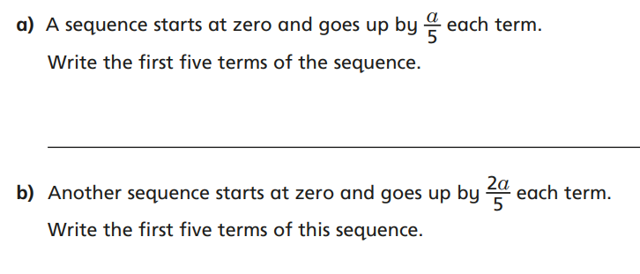
Problem solving

Slide 25
Problem solving
Express this calculation as a single fraction.
$$\frac{1}{t}+\frac{1}{2t}+\frac{1}{4t}$$

