Slide 1
Set Notation
$$\text{ξ}$$
The Universal Set
“Xi”
The elements of your set go in curly brackets
$$\text{ξ}\text{ = \{}\text{cats}\text{, }\text{dogs}\text{, }\text{rabbits}\text{, }\text{frogs}\text{\}}$$
$$\text{The} \text{set} \text{ξ} \text{contains} \text{cats}\text{, }\text{dogs}\text{, }\text{rabbits}\text{, }\text{frogs}$$

Slide 2
Are the two sets the same or different?
A $=\left\{\text{1, 3, 5, 7, 9}\right\}$
B $=\left\{\text{9, 7, 5, 3, 1}\right\}$
Can you write this set in another way?
$\left\{\text{1, 7, 5, 3, 9}\right\}$
$\left\{\text{odd} \text{numbers} \text{between}\text{ 1 }\text{and}\text{ 10 }\text{inclusive}\right\}$

Slide 3
On your whiteboards…
An element is a member of the set.
List the elements of each set.
Use correct set notation.
a) Set A: Days of the week
A $=\left\{\text{Monday}\text{, }\text{Tuesday}\text{, }\text{Wednesday}\text{, }\text{Thursday}\text{, }\text{Friday}\text{, }\text{Saturday}\text{, }\text{Sunday}\right\}$
b) Set B: Even factors of 36
B $=\left\{\text{2, 4, 6, 12, 18, 36}\right\}$

Slide 4
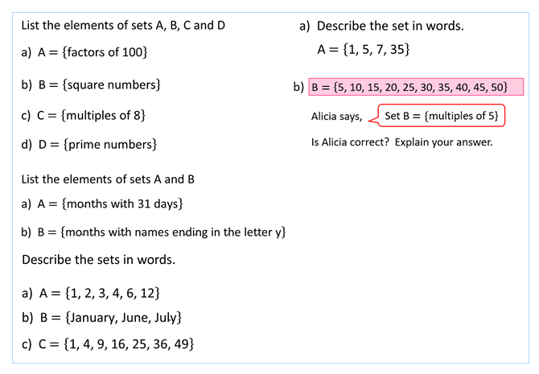
2. Combine your knowledge of set notation and Venn diagrams
Your turn
Create a Venn diagram for each group of sets:
$\text{ξ}=\left\{\text{Multiples} \text{of}\text{ 2 }\text{from}\text{ 0 }\text{to}\text{ 20 }\text{inclusive}\right\}$
A = {Prime numbers}
B = {Factors of 20}
$\text{ξ}=\left\{\text{Triangles}\right\}$
A = {Includes one obtuse angle}
B = {Isosceles}
C = {Has at least one 40⁰ angle}
$\text{ξ}=\left\{\text{Rectangles}\right\}$
A = {Height of 2cm}
B = {Perimeter > 20cm}
C = {Area > 20cm²}
1. Complete the worksheet
One triangle in each section!
One rectangle in each section!

Slide 5
Solutions
$$\text{ξ}=\left\{\text{10}\text{,} \text{20, }\text{30, }\text{40, }\text{50, }\text{60, }\text{70, }\text{80, }\text{90, }\text{100}\right\}$$
List the elements of sets A, B, C and D
a) A $=\left\{\text{factors} \text{of}\text{ 100}\right\}$
A $=\left\{\text{10, 20, 50, 100}\right\}$
b) B$=\left\{\text{square} \text{numbers}\right\}$
B $=\left\{\text{100}\right\}$
c) C$=\left\{\text{multiples} \text{of}\text{ 8}\right\}$
C $=\left\{\text{40, 80}\right\}$
d) D$=\left\{\text{prime} \text{numbers}\right\}$
D $=\left\{\right\}$

Slide 6
Solutions
$\text{ξ}=$ {Months of the year}
List the elements of sets A and B
a) A $=\left\{\text{months} \text{with}\text{ 31 }\text{days}\right\}$
A $=$ {January, March, May, July, August, October, December}
b) B$=\left\{\text{months} \text{with} \text{names} \text{ending} \text{in} \text{the} \text{letter} \text{y}\right\}$
B $=$ {January, February, May, July}

Slide 7
Solutions
Describe the sets in words.
a) A $=\left\{\text{1, 2, 3, 4, 6, 12}\right\}$
A $=\left\{\text{factors} \text{of}\text{ 12}\right\}$
b) B $=\left\{\text{January}\text{, }\text{June}\text{, }\text{July}\right\}$
B $=\left\{\text{months} \text{of} \text{the} \text{year} \text{starting} \text{with} \text{J}\right\}$
c) C $=\left\{\text{1, 4, 9, 16, 25, 36, 49}\right\}$
C $=\left\{\text{square} \text{numbers} \text{below}\text{ 50}\right\}$

Slide 8
Solutions
a) Describe the set in words.
A $=\left\{\text{1, 5, 7, 35}\right\}$
A $=\left\{\text{factors} \text{of}\text{ 35}\right\}$
b)
$$\text{B}=\left\{\text{5}\text{,}\text{ 1}\text{0, }\text{15, 2}\text{0, }\text{25, 3}\text{0, }\text{35, 4}\text{0, }\text{45, 5}\text{0}\right\}$$
Alicia says,
Set B $=\{$multiples of 5}
Is Alicia correct? Explain your answer.
No, Set B $=$ {multiples of 5 between 1 and 50 inclusive}

Slide 9
$$\text{ξ}$$
Blue Shapes
Triangles
What does the shaded section represent?
This is where the 2 sets intersect.
Blue shapes that are also triangles e.g.

Slide 10
$$\text{ξ}$$
A
B
What does the shaded section represent?
This is where the 2 sets intersect.
A $∩$ B
“A intersection B”

Slide 11
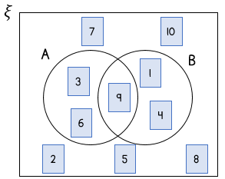
On your whiteboards…
$$\text{ξ}=\left\{\text{numbers} \text{from}\text{ 1 }\text{to}\text{ 10 }\text{inclusive}\right\}$$
How would you say these in words?
a) List the elements of A $∩$ B.
A $∩$ B $= \left\{\text{9}\right\}$
b) Describe set A, set B and A $∩$ B in words.
A $=${Multiples of 3}
B $=${Square Numbers}
A $∩$ B $=$multiples of 3 which are also square numbers

Slide 12
On your whiteboards…
$$\text{ξ}=\left\{\text{numbers}\text{ 1 }\text{to}\text{ 10 }\text{inclusive}\right\}$$
A $=$ $\left\{\text{odd} \text{numbers}\right\}$
B $=$ $\left\{\text{prime} \text{numbers}\right\}$
C $=\left\{\text{factors} \text{of}\text{ 12 }\right\}$
$$\text{ξ}$$
A
B
5
9
7
3
1
2
List the elements of
A $∩$ B
B $∩$ C
A $∩$ C
A $∩$B $∩$C
$$= \left\{\text{5, 7, 3}\right\}$$
4
10
8
6
$$= \left\{\text{3, 2}\right\}$$
$$= \left\{\text{1, 3}\right\}$$
C
$$=\left\{\text{3}\right\}$$

Slide 13
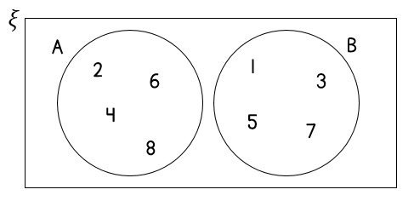
List the elements of A $∩$ B
9
A $∩$ B$=\left\{\right\}$
Explain why there are no elements in A $∩$ B
A $=$ {even numbers between 1 and 10 inclusive}
B $=$ {odd numbers between 1 and 10 inclusive}
There are no even numbers that are also odd.

Slide 14
50 people were asked whether they liked dark chocolate and milk chocolate.
The results are shown in the two-way table.
 | Like | Do not like
Dark Chocolate | 23 | 27
Milk Chocolate | 41 | 9
15 people like both dark and milk chocolate.
Draw a Venn diagram to represent this information
$$\text{ξ}$$
Dark
Milk
8 $+$ 15 $+$ 26 $=$ 49
23 $−$ 15
15
50 $−$ 49 $=$ 1
8
26
41 $−$ 15
1

Slide 15
Blue Shapes
Triangles
What does the shaded section represent?
All the shapes that are blue or triangles.
It is the union of the two sets.
A $∪$ B
“A union B”

Slide 16
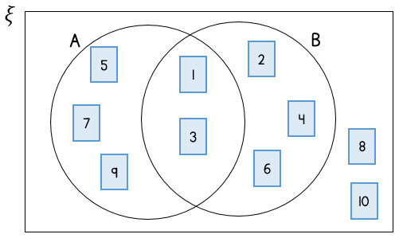
On your whiteboards…
List the elements of A $∪$ B.
A $∪$ B $=\left\{\text{5, 7, 9, 1, 3, 2, 4, 6}\right\}$

Slide 17
On your whiteboards…
$$\text{ξ}$$
A
B
5
$$\text{ξ}=\left\{\text{numbers}\text{ 1 }\text{to}\text{ 10 }\text{inclusive}\right\}$$
A $=$ $\left\{\text{odd} \text{numbers}\right\}$
B $=$ $\left\{\text{prime} \text{numbers}\right\}$
C $=\left\{\text{factors} \text{of}\text{ 12 }\right\}$
9
7
3
1
2
4
10
8
6
C
List the elements of
A $∪$ B
B $∪$ C
A $∪$ C
A $∪$B $∪$C
$$= \left\{\text{1, 9, 5, 7, 3, 2}\right\}$$
$$= \left\{\text{5, 7, 3, 2, 1, 4, 6}\right\}$$
$$= \left\{\text{1, 9, 5, 7, 3, 2, 4, 6}\right\}$$
$$=\left\{\text{1, 2, 3, 4, 5, 6, 7, 9}\right\}$$

Slide 18
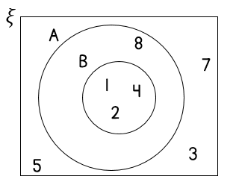
On your whiteboards…
For each Venn diagram, list the elements of A $∪$B
9
A $∪$ B$=\left\{\text{1, 2, 3, 4, 5, 6, 7, 8, 9}\right\}$
A $∪$ B$=\left\{\text{1, 2, 4, 8}\right\}$

Slide 19
On your whiteboards…
A $=\{$M, A, T, H, S}
B $=$ {E, N, G, L, I, S, H}
A
E
B
M
H
N
A
G
S
L
T
I
List the elements of
A $∩$B
A$∪$ B
$=${H, S}
$=${M, A, T, H, S, E, N, G, L, I}

Slide 20
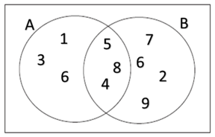
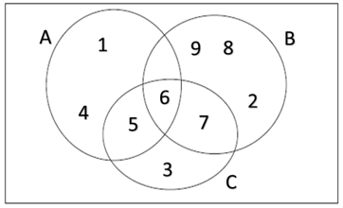
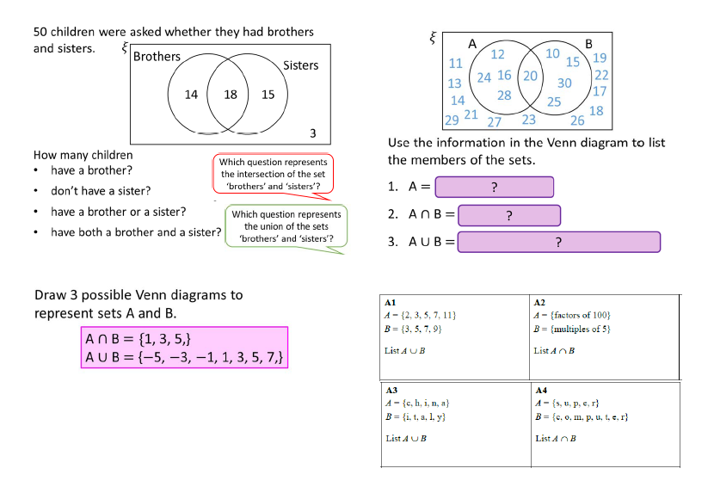
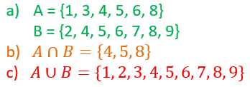
2. Write down the universal set, the intersection and union for each Venn diagram
Your turn
1. Complete the worksheet

Slide 21
Solutions
50 children were asked whether they had brothers and sisters.
$$\text{ξ}$$
Brothers
Sisters
14
18
15
3
How many children
have a brother?
don’t have a sister?
have a brother or a sister?
have both a brother and a sister?

Slide 22
Solutions
50 children were asked whether they had brothers and sisters.
$$\text{ξ}$$
Brothers
Sisters
14
18
15
3
How many children
have a brother?
don’t have a sister?
have a brother or a sister?
have both a brother and a sister?
Which question represents the intersection of the set ‘brothers’ and ‘sisters’?
32
17
47
18

Slide 23
Solutions
$$\text{ξ}$$
Brothers
Sisters
14
18
15
3
Which question represents the union of the sets ‘brothers’ and ‘sisters’?
How many children
have a brother?
don’t have a sister?
have a brother or a sister?
have both a brother and a sister?
32
17
47
18

Slide 24
Solutions
Draw 3 possible Venn diagrams to represent sets A and B.
A$∩$B $=\{$1, 3, 5,}
A$∪$ B $=$ {$−$5, $−$3, $−$1, 1, 3, 5, 7,}
$$\text{ξ}$$
A
B
1
$−$5
$−$3
3
$−$1
5
7

Slide 25
Solutions
Draw a possible Venn diagram to represent sets A and B.
A$∩$B $=\{$1, 3, 5,}
A$∪$ B $=$ {$−$5, $−$3, $−$1, 1, 3, 5, 7,}
$$\text{ξ}$$
A
B
$−$5
1
$−$3
3
$−$1
5
7

Slide 26
Solutions
Draw a possible Venn diagram to represent sets A and B.
A$∩$B $=\{$1, 3, 5,}
A$∪$ B $=$ {$−$5, $−$3, $−$1, 1, 3, 5, 7,}
$$\text{ξ}$$
A
B
$−$5
1
$−$1
3
$−$3
7
5

Slide 27
Solutions
Use the information in the Venn diagram to list the members of the sets.
A $=\{12, 16, 20, 24, 28\}$
A $∩$ B $=\{20\}$
A $∪$ B $=\{10, 12, 15, 16, 20, 24, 25, 28, 30\}$
$$ξ$$
A
B
12
10
19
11
15
24
16
20
22
13
30
28
17
14
25
21
18
29
27
23
26
?
?
?

Slide 28
Solutions

Slide 29
To finish…
Spot the mistakes

