Slide 1
Title – Venn Diagram Notation
10/03/2025
Outcome | 1 | 2 | 3 | 4 | 5 | 6
Frequency | 3 | 5 | 2 | 2 | 4 | 4
A six-sided die is rolled 20 times.
The same die is rolled 300 times. Estimate the number of times it lands on 2
The UK bee population reduces by 10% each year. A hive contains an estimated 2,000 bees. Approximately how many bees are in the hive after 1 year?
Share £21 in the ratio 3 : 4
The point (5, $m$) lies on the line $x+y=$ 3
Work out the value of $m$.
1
75
2
1,800
3
£9 and £12
4
$−$2

Slide 2
Mary is only friends with people that like classical music.
M
Annie, Burt, Derek, Felicity
A, B, D, F
These are sets: a collection of elements
Peter is only friends with people that like electronic dance music.
P
Annie, Charlie, Derek, Emma, Greg
A, C, D, E, G
Annie, Burt, Charlie, Derek, Emma, Felicity, Greg
Who is friends with Mary or Peter or both?
A, B, C, D, E, F, G
M ∪ P
This is the union: the combination of sets
Annie, Derek
Who is friends with both Mary and Peter?
A, D
M ∩ P
This is the intersection: the overlap of sets

Slide 3
Set Notation
Sets of Data
Universal Set
ξ = {Numbers 1 to 20 inclusive}
Elements
A = {Square Numbers}
= {1, 4, 9, 16}
B = {Multiples of 4}
= {4, 8, 12, 16, 20}
What is…
A ∪ B
Union: the combination of A and B.
A ∪ B = {1, 4, 8, 9, 12, 16, 20}
A ∩ B
Intersection: The overlap of A and B.
A ∩ B = {4, 16}
A’
Complement: Not in A.
A’ = {2, 3, 5, 6, 7, 8, 10, 11, 12, 13, 14, 15, 17, 18, 19, 20}

Slide 4
Venn Diagrams & Set Notation
ξ = {Numbers 1 to 9 inclusive}
A = {1, 3, 4, 7, 9}
B = {1, 2, 7, 8}
Union
ξ
A
B
A ∪ B
3
2
= {1, 2, 3, 4, 7, 8, 9}
1
4
9
7
8
The combination
of A and B.
5
6
ξ
Intersection
A
B
3
2
A ∩ B
= {1, 7}
1
4
9
7
8
The overlap
of A and B.
5
6
ξ
Complement
A
B
3
2
A’
= {2, 5, 6, 8}
1
4
9
7
8
Not in A.
6
5

Slide 5
Union
Intersection
Complement
A ∪ B
A ∩ B
A’
The combination
of A and B.
The overlap
of A and B.
Not in A.
Describe & total the shaded area
ξ
A
B
ξ
C
D
ξ
E
F
3
3
3
5
8
5
8
5
8
6
6
6
B
= 11
C’
= 14
E ∩ F
= 3
ξ
G
H
ξ
I
J
ξ
K
L
3
3
3
5
8
5
8
5
8
6
6
6
G ∪ H
= 16
I ∪ J’
= 14
K’ ∩ L’
= 6

Slide 6
Using totals in a Venn Diagram…
Union
Intersection
Complement
A ∪ B
A ∩ B
A’
The combination
of A and B.
The overlap
of A and B.
Not in A.
ξ
A
B
3
5
8
6
Describe & total the shaded area
A’
= 14

Slide 7
Using totals in a Venn Diagram…
Union
Intersection
Complement
A ∪ B
A ∩ B
A’
The combination
of A and B.
The overlap
of A and B.
Not in A.
ξ
A
B
3
5
8
6
Describe & total the shaded area
A ∪ B
= 16

Slide 8
Using totals in a Venn Diagram…
Union
Intersection
Complement
A ∪ B
A ∩ B
A’
The combination
of A and B.
The overlap
of A and B.
Not in A.
ξ
A
B
3
5
8
6
Describe & total the shaded area
B’
= 11

Slide 9
Using totals in a Venn Diagram…
Union
Intersection
Complement
A ∪ B
A ∩ B
A’
The combination
of A and B.
The overlap
of A and B.
Not in A.
ξ
A
B
3
5
8
6
Describe & total the shaded area
A ∩ B
= 3

Slide 10
Using totals in a Venn Diagram…
Union
Intersection
Complement
A ∪ B
A ∩ B
A’
The combination
of A and B.
The overlap
of A and B.
Not in A.
ξ
A
B
3
5
8
6
Describe & total the shaded area
A ∪ B’
= 14

Slide 11
Using totals in a Venn Diagram…
Union
Intersection
Complement
A ∪ B
A ∩ B
A’
The combination
of A and B.
The overlap
of A and B.
Not in A.
ξ
A
B
3
5
8
6
Describe & total the shaded area
A’ ∩ B
= 8

Slide 12
Using totals in a Venn Diagram…
Union
Intersection
Complement
A ∪ B
A ∩ B
A’
The combination
of A and B.
The overlap
of A and B.
Not in A.
ξ
A
B
3
5
8
6
Describe & total the shaded area
A’∩B’
= 6

Slide 13
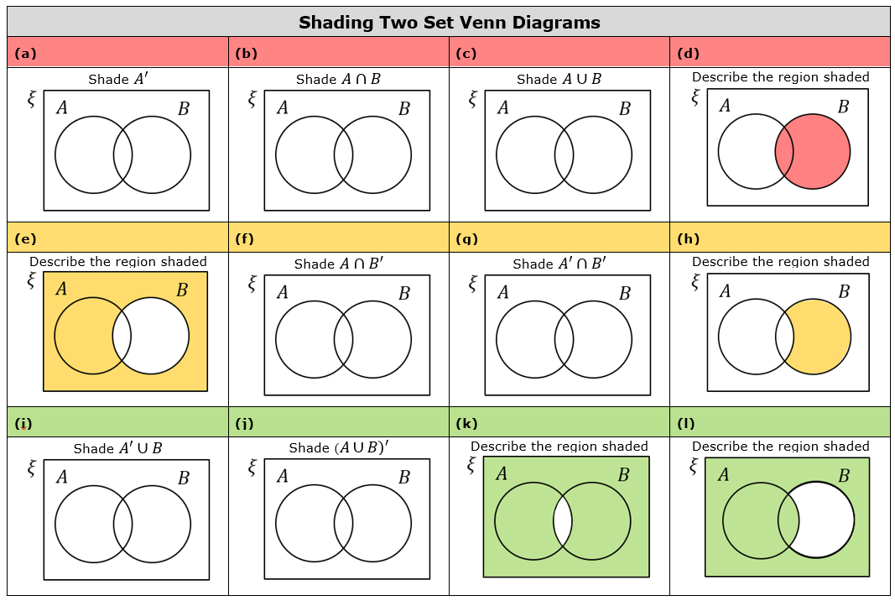

Slide 14
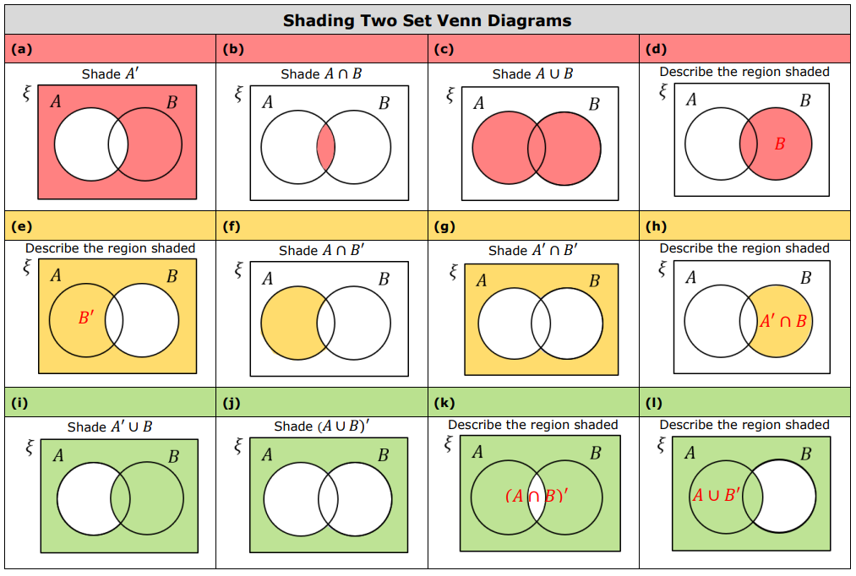

Slide 15
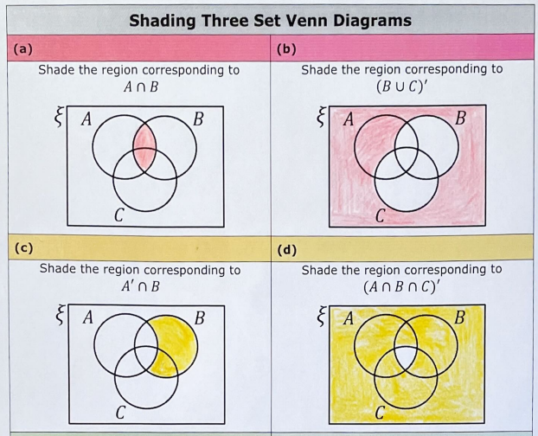

Slide 16
