Slide 1
Fill in the missing numbers – you can use the numbers 1 – 9 only once

Slide 2
Example 1 BIDMAS
$−2+3×−4$
Key words: operation, calculate, evaluate, index/indices

Slide 3
Example 2 BIDMAS
$2+−3×4÷−2$

Slide 4
Example 3 BIDMAS
$4− {\left(−3\right)}^{2}×−2$

Slide 5
Example 4 BIDMAS
$(4− {−3)}^{2}×−2$

Slide 6
TOrder of Operations with negative numbers
Copy and complete the calculations into your book
$−10×2−(−7)^{2}$ | f) $6×5+({−4)}^{2}$
b) $−8×−6−(−5)^{2}$ | g) $8 −5×4^{2}$
c) $2^{2}×−9−9$ | h) $3×(9+−8)^{2}$
d) $5−−4×{(−3)}^{2}$ | i) $10 ×−5+{(−6)}^{2}$
e) $(7−8)×2^{2}$ | j) $−7×−4+2^{3}$

Slide 7
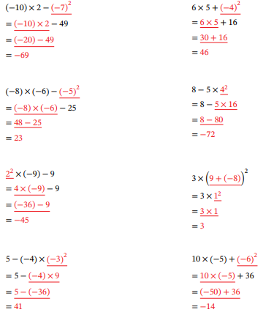
Mark and correct your work

Slide 8
Challenge
Make the target given, you must use all four numbers and any of $−, +, ×, ÷$
Target = $−3$ using $2, −2, −3, 4$
Target = $−5$ using $−2, 3, −6, 7$
Target = $−5$using $−2, −3, 4, 6$
Find two solutions to each question

