Slide 1
Title – Probability Trees
14/02/2025
1) Brown paint is made using red and green paint in the ratio 7 : 3 How many litres of red paint are needed to make 40 litres of brown paint?
2) Here are two similar triangles. Work out the length of the side marked $a$.
3) A rectangle has length 4 cm and width 5 cm. Write the dimension of rectangle that is similar.
4) State the order of rotational symmetry of a rhombus.
1
28 litres
2
8
24
3
$$a$$
9
3
e.g. length 8 cm width 10 cm
4
2
Vocabulary check: Parallel

Slide 2
Title – Independent Probability Events
14/02/2025
1
2
3
4

Slide 3
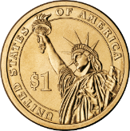
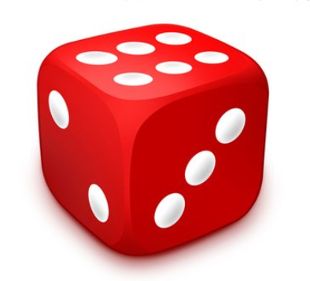
John flips a coin and Jane rolls a dice.
These are independent events.
What is the probability the result is tails and a 6?
What diagram could we draw to help us solve this problem?
Think, pair, share… 30 seconds!
 | 1 | 2 | 3 | 4 | 5 | 6
Heads | H1 | H2 | H3 | H4 | H5 | H6
Tails | T1 | T2 | T3 | T4 | T5 | T6
T6 is 1 outcome out of twelve so… P(T6) = $\frac{1}{12}$

Slide 4
John flips a coin and Jane rolls a dice.
These are independent events.
What is the probability the result is tails and a 6?
Coin Flip
Dice Roll
Results
$$\frac{1}{6}$$
$\frac{1}{2}$ × $\frac{1}{6}$ =
$$\frac{1}{12}$$
6
H6
Heads AND a 6
$$\frac{1}{2}$$
H
$$\frac{5}{6}$$
$\frac{1}{2}$ × $\frac{5}{6}$ =
$$\frac{5}{12}$$
1-5
H1-5
$$\frac{1}{6}$$
$\frac{1}{2}$ × $\frac{1}{6}$ =
$$\frac{1}{12}$$
6
T6
$$\frac{1}{2}$$
T
$$\frac{5}{6}$$
$\frac{1}{2}$ × $\frac{5}{6}$ =
$$\frac{5}{12}$$
1-5
T1-5

Slide 5
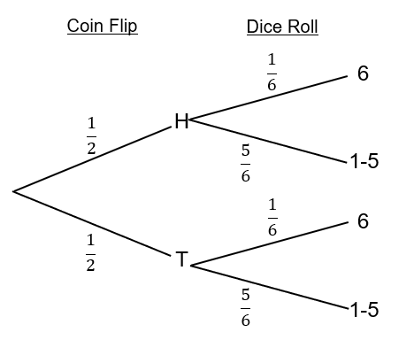
 | 1 | 2 | 3 | 4 | 5 | 6
Heads | H1 | H2 | H3 | H4 | H5 | H6
Tails | T1 | T2 | T3 | T4 | T5 | T6
What’s the same?
What’s different?
Think, pair, share…

Slide 9
To win the league, Burham United need to win against
Wedly Wanderers & then Rexham Rovers.
①
Unconditional Tree Diagrams
The probability of winning again Wedly is $\frac{2}{3}$
P(WW) = $\frac{6}{12}$
The probability of winning again Rexham is $\frac{3}{4}$
What is the probability Burham win the league (win both matches)?
Vs. Wedley
Vs. Rexham
Result
$$\frac{3}{4}$$
$$\frac{2}{3} × \frac{3}{4}=\frac{6}{12}$$
Win
WW
$$\frac{2}{3}$$
Win
$$\frac{2}{3} × \frac{1}{4}=\frac{2}{12}$$
$$\frac{1}{4}$$
Lose
WL
$$\frac{3}{4}$$
$$\frac{1}{3} × \frac{3}{4}=\frac{3}{12}$$
Win
LW
$$\frac{1}{3}$$
Lose
$$\frac{1}{4}$$
$$\frac{1}{3} × \frac{1}{4}=\frac{1}{12}$$
Lose
LL

Slide 10
The probability it is sunny on Saturday is $\frac{3}{7}$
②
The probability it is sunny on Sunday is $\frac{2}{5}$
P(NN) = $\frac{12}{35}$
What is P(not sunny all weekend)?
Saturday
Sunday
Result
$$\frac{2}{5}$$
$$\frac{3}{7} × \frac{2}{5}=\frac{6}{35}$$
Sunny
SS
$$\frac{3}{7}$$
Sunny
$$\frac{3}{7} × \frac{3}{5}=\frac{9}{35}$$
$$\frac{3}{5}$$
Not
Sunny
SN
$$\frac{2}{5}$$
$$\frac{4}{7} × \frac{2}{5}=\frac{8}{35}$$
Sunny
NS
$$\frac{4}{7}$$
Not
Sunny
Not
Sunny
$$\frac{4}{7} × \frac{3}{5}=\frac{12}{35}$$
$$\frac{3}{5}$$
NN

Slide 12
Box & Marbles
③
There are black and white marbles in the box.
One is picked – and replaced – then another is picked.
What is the probability both picks are the same colour?
How do the words in bold affect how we answer this question?
P (BB or WW) = $\frac{9}{100}+ \frac{49}{100}=\frac{58}{100}$
1st Pick
2nd Pick
Result
$$\frac{3}{10}$$
$$\frac{3}{10} × \frac{3}{10}=\frac{9}{100}$$
Black
BB
$$\frac{3}{10}$$
Black
$$\frac{7}{10}$$
$$\frac{3}{10} × \frac{7}{10}=\frac{21}{100}$$
White
BW
$$\frac{3}{10}$$
$$\frac{7}{10} × \frac{3}{10}=\frac{21}{100}$$
Black
WB
$$\frac{7}{10}$$
White
$$\frac{7}{10}$$
$$\frac{7}{10} × \frac{7}{10}=\frac{49}{100}$$
White
WW

Slide 15
The probability Jill passes her Geography test is 0.8
The probability Jill passes her Science test is 0.4
What is the probability she passes only one of the tests?
④
How is this question different to the previous?
P(PF or FP) = $0.48+0.08$= $0.56$
Geography Test
Science Test
Result
$$0.4$$
Pass
PP
$$0.8 ×0.4=0.32$$
$$0.8$$
Pass
$$0.6$$
Fail
PF
$$0.8 ×0.6=0.48$$
$$0.4$$
Pass
FP
$$0.2 ×0.4=0.08$$
$$0.2$$
Fail
$$0.6$$
Fail
FF
$$0.2 ×0.6=0.12$$

Slide 18
A coin and a dice were thrown.
What is the possibility of getting
a Tails and a 6?
What did Mary do wrong?
1st Event
2nd Event
Results
$$\frac{1}{6}$$
$\frac{1}{2}$ x $\frac{1}{6}$ =
$$\frac{1}{12}$$
1-5
T1-5
$$\frac{1}{2}$$
T
$$\frac{1}{6}$$
$\frac{1}{2}$ x $\frac{1}{6}$ =
$$\frac{2}{12}$$
6
T6
$$\frac{5}{6}$$
$\frac{1}{2}$ x $\frac{5}{6}$ =
$$\frac{6}{12}$$
1-5
H1-5
$$\frac{1}{2}$$
H
$$\frac{5}{6}$$
$\frac{1}{2}$ x $\frac{5}{6}$ =
$$\frac{5}{12}$$
6
H6

Slide 19
A coin and a dice were thrown.
What is the possibility of getting
a Tails and a 6?
What did Mary do wrong?
1st Event
2nd Event
Results
$$\frac{1}{6}$$
$\frac{1}{2}$ x $\frac{1}{6}$ =
$$\frac{1}{12}$$
1-5
T1-5
$$\frac{1}{2}$$
T
$$\frac{1}{6}$$
$\frac{1}{2}$ x $\frac{1}{6}$ =
$$\frac{2}{12}$$
6
T6
$$\frac{5}{6}$$
$\frac{1}{2}$ x $\frac{5}{6}$ =
$$\frac{6}{12}$$
1-5
H1-5
$$\frac{1}{2}$$
H
$$\frac{5}{6}$$
$\frac{1}{2}$ x $\frac{5}{6}$ =
$$\frac{5}{12}$$
6
H6

Slide 20
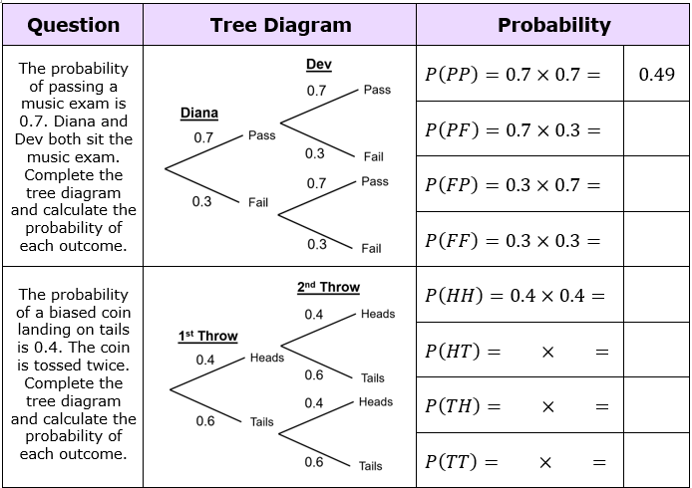

Slide 21
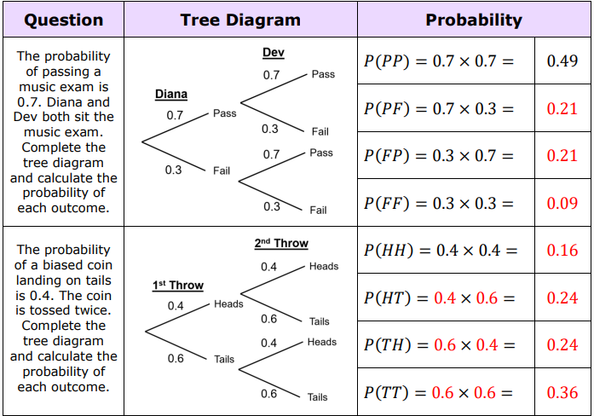

Slide 22
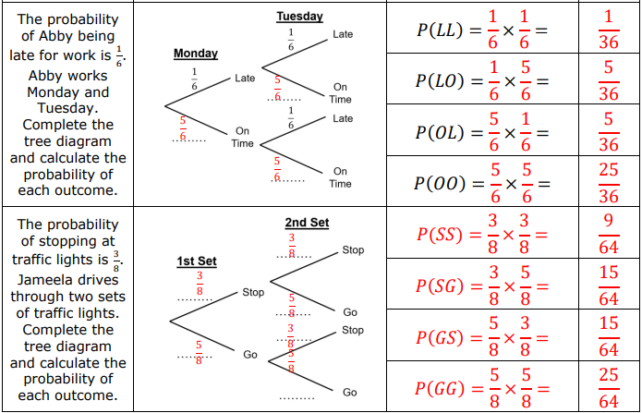

Slide 23
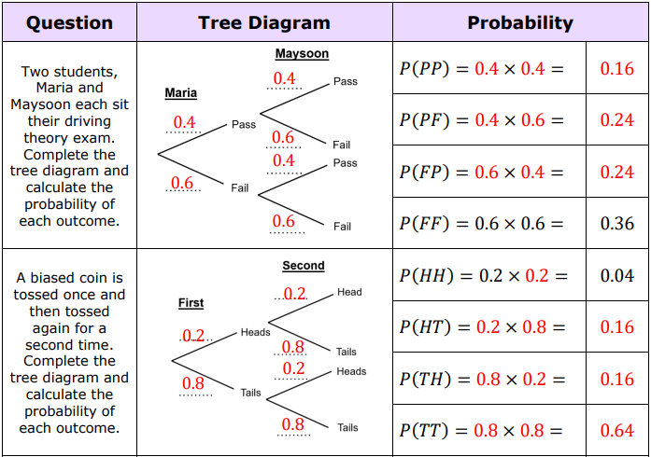

Slide 24
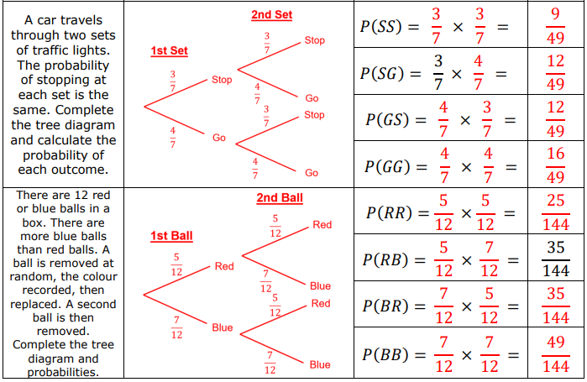

Slide 25
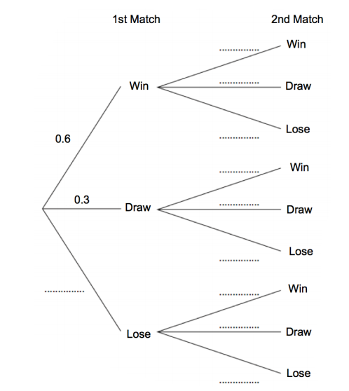
Here is a partially filled tree diagram
What is different about this tree diagram?

Slide 26
Here is a partially filled tree diagram
What do you think this tree diagram is about?

Slide 27
Here is a partially filled tree diagram
What questions could be asked about this tree diagram?
Think of as many as you can and write them on your whiteboards.
Notes:
Choose some questions from around the room and ask students to find the answers on their whiteboards.

Slide 28
