Slide 1
Calculator emulator You can use this website to sign up for a calculator emulator: https://classpad.net/note/#/tools/math The model we have given to all students at NES for the year 2024/45 is a CASIO fx-83GT - CW When you register, it will generate a code for you to input when you register here: https://classpad.net/intl/ To access the emulator thereafter, you can use this link: https://classpad.net/note/#/mypage/ex-tool

Slide 2
Complete in silence
Title: Retrieval 28/02/2025
Recent Learning
Long-Term Learning
Vocabulary Check
Complete the table with different numbers less than 10
Define or draw the words
integer
A positive or negative whole number
Calculate
20 - 2² $×4$
20 - 4$×4$
20 – 16
= 4
 | Factor of 18 | Prime number
Even number | 6 | 2
Square number | 1 or 9 | NOT POSSIBLE

Slide 3
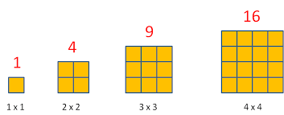
Prior Learning
Square numbers
How many squares?
These are square numbers
1st | 2nd | 3rd | 4th | 5th | 6th | 7th | 8th | 9th | 10th
1 | 4 | 9 | 16 | 25 | 36 | 49 | 64 | 81 | 100
1² | 2² | 3² | 4² | 5² | 6² | 7² | 8² | 9² | 10²
How can we describe each square number using shorthand?

Slide 4
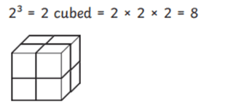
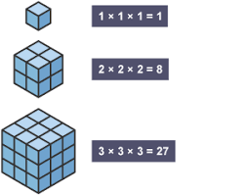
Cube numbers
How many cubes?
These are cube numbers
1st | 2nd | 3rd | 4th | 5th
1 | 8 | 27 | 64 | 125
¹³ | ²³ | ³³ | ⁴³ | ⁵³
How can we describe each cube number using shorthand?

Slide 5
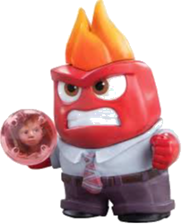
Riley wants to square -3
3 squared means -3 x -3 so -3 squared will be +9
3 squared is 9 so -3 squared will be -9
Who is correct?
-3² = -9
(-3)² = 9
-3 x -3 = +9

Slide 6
Tick or Trash ✘
What should the answers be?
In words | Question | Answer | Tick or Trash
Negative five squared | -5² | -25 | ✘
Negative two squared | (-2)² | 4 | 
Negative one cubed | (-1)³ | 1 | ✘
Negative two cubed | -2³ | 8 | ✘
Negative nine squared | (-9)² | 81 | 
(-5)²
25
-1
-8

Slide 7
Riley wants to cube -2
-2 cubed means
-2 x -2 x -2 so -2 cubed will be -8
2 cubed is 8.
-2 cubed is -8
Why are these both true?
-2³= -8
(-2)³ = -8
Why does this work for cubing numbers but not squaring?

Slide 8
Which statement is false?
When we square a positive number the result is always positive.
When we square a negative number the result is always positive.
When we cube a positive number the result is always positive.
When we cube a negative number the result is always positive.
When we cube a negative number the result is always negative.
Can you explain why?

Slide 9
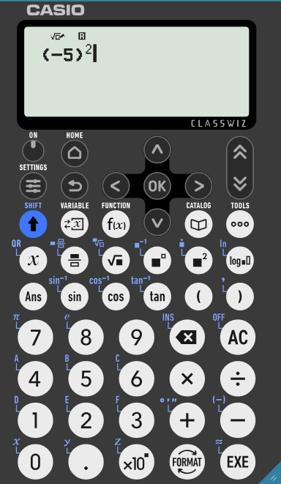
Calculator Practice
How would you input these questions into your calculator?
Negative five squared
Write your answer on your whiteboard ready to show me

Slide 10
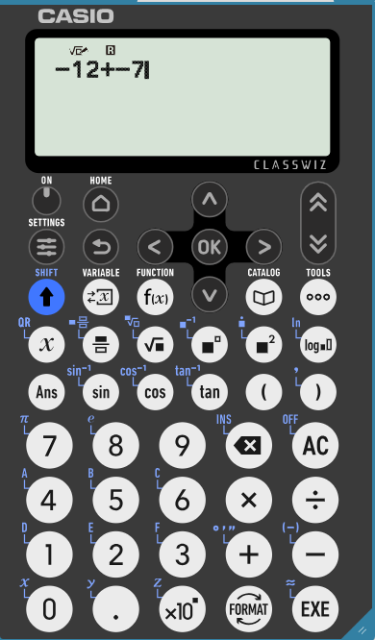
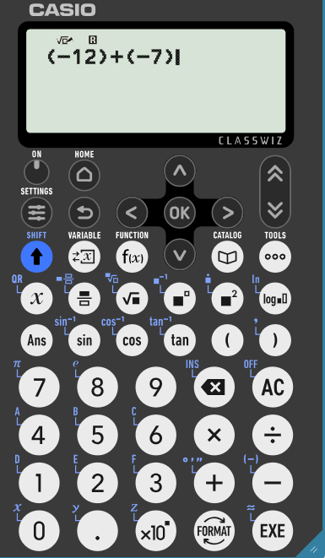
Calculator Practice
How would you input these questions into your calculator?
Find the sum of negative twelve and negative seven
Brackets help us to identify whether the – indicates a negative number, or if we are using the subtraction operation
sum
total
Write your answer on your whiteboard ready to show me
addition

Slide 11
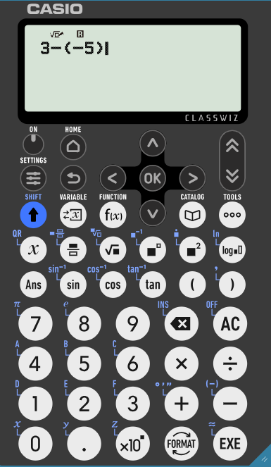
Calculator Practice
How would you input these questions into your calculator?
Brackets help us to identify whether the – indicates a negative number, or if we are using the subtraction operation
Subtract negative five from three
Subtract
take away
Write your answer on your whiteboard ready to show me

Slide 12
Calculator Practice
How would you input these questions into your calculator?
Find the product of negative two and negative six
product
Write your answer on your whiteboard ready to show me

Slide 13
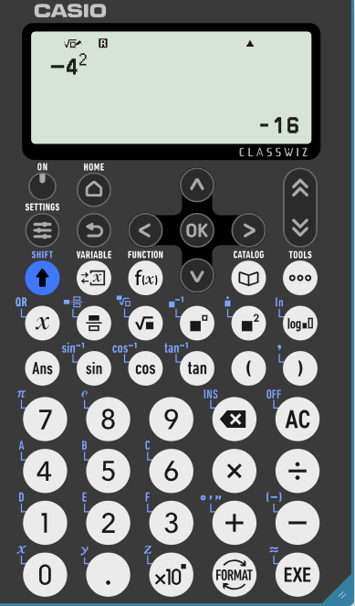
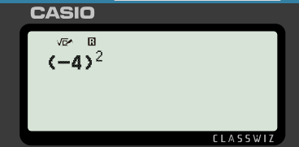
Spot the Mistake
What error has been made here?
Negative four squared
Missing brackets

Slide 14
Secure
Title: Negative Number Calculations
What is the result of -5 + 7?
Calculate -3 × 4.
Find -2 subtracted from -8.
What is -15 ÷ 3?
Find the value of negative three squared.
Subtract -9 from 5. What is the answer?
Multiply -7 by -2.
Divide -12 by -3.
What is the sum of -11, 3, and -5?
Calculate the product of -4, -1, and 2.
What is -3 - (-7)?
What is (5 - 11)²?
If the temperature is -2˚C and it drops by 5˚C , what is the new temperature?
2
-12
-6
-5
9
14
14
4
-13
8
4
36
-7 ˚C

