Slide 1
Notes:
Discuss that all previous learning has been separated into these two sections.
This lesson we will be working on recognising what we are looking for and applying to solve problems.

Slide 2
What are we learning in this lesson?
How to find missing lengths on any right-angled triangle without being told whether you are finding the hypotenuse or shorter side. Learning Outcomes: Recall how to find the missing hypotenuse and how to find a missing shorter side. Recognise which a question is looking for you to find. Apply this recognition to being able to find missing lengths and solve problems with a mix of hypotenuse and shorter sides.
Why are we learning about this?
We are now very confident with finding missing lengths on a right-angled triangle when we are told in the title that we are finding the hypotenuse or shorter side. However, in real life or in exams, we won’t have a title saying which one we are looking for.

Slide 3
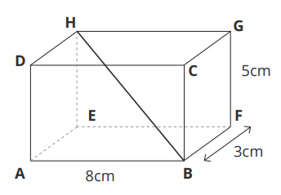
I DO:
WE DO:
The diagram shows a cuboid. Calculate the length of the diagonal AG, giving your answer correct to 2 decimal places.
The diagram shows a cuboid. Calculate the length of the diagonal BH, giving your answer correct to 2 decimal places.
RETRIEVE
INSTRUCT
PRACTISE
REVIEW

Slide 4
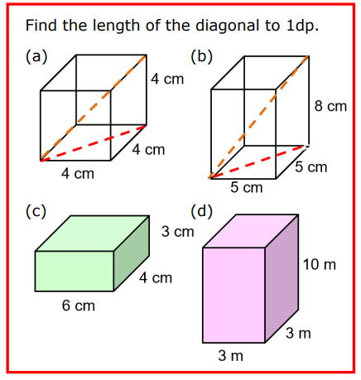

Slide 5
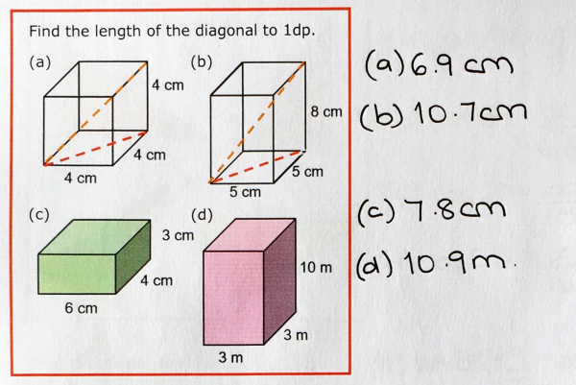

Slide 6
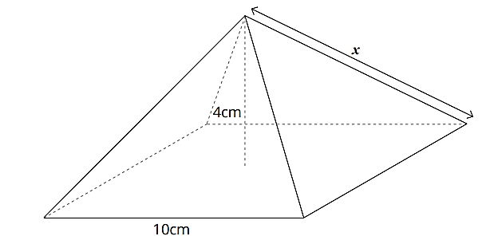
I DO:
WE DO:
RETRIEVE
INSTRUCT
PRACTISE
REVIEW

Slide 7
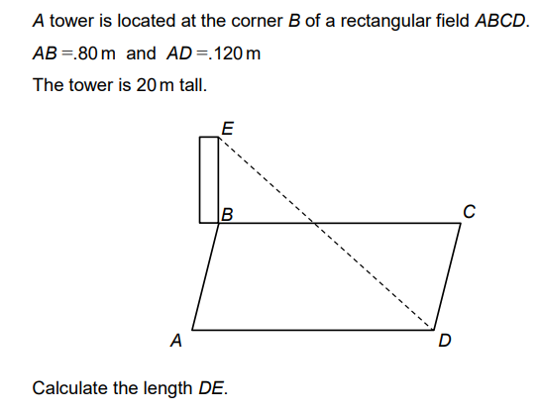

Slide 8
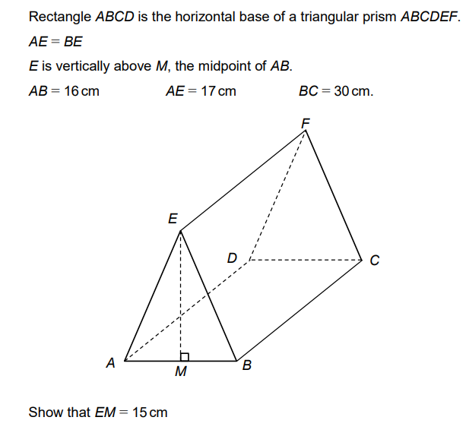

Slide 9
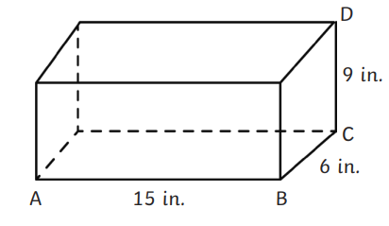
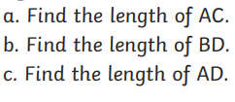
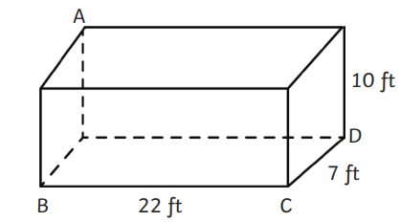
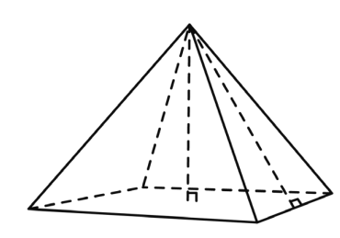
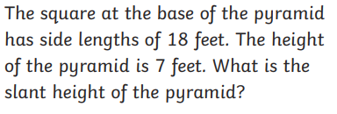

Slide 10
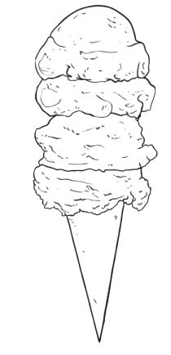
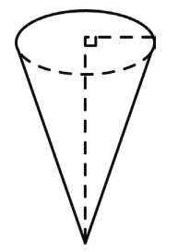
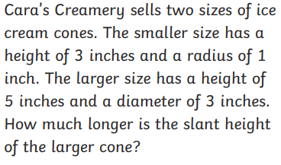

Slide 11
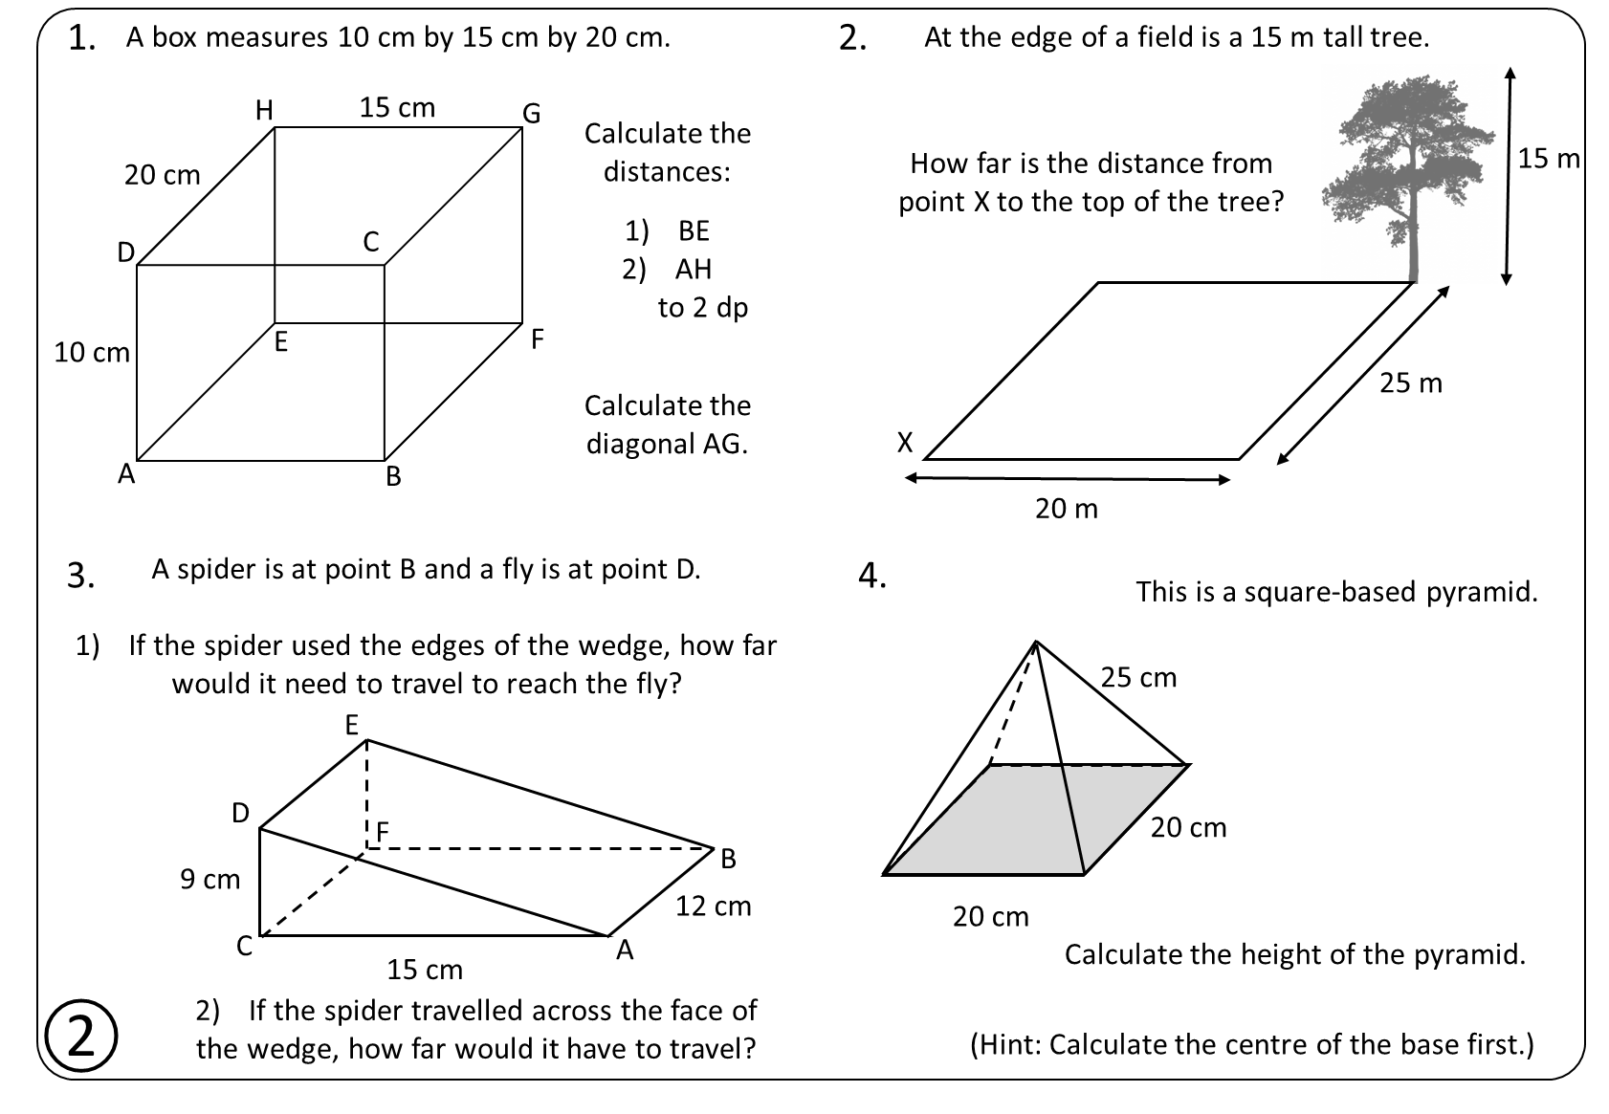

Slide 12
1.
A box measures 10 cm by 15 cm by 20 cm.
2.
At the edge of a field is a 15 m tall tree.
H
15 cm
G
Calculate the distances:
20 cm
How far is the distance from
point X to the top of the tree?
15 m
C
BE
AH
to 2 dp
D
1) 25 cm
E
F
35.36 m
10 cm
2) 26.93 cm
25 m
Calculate the diagonal AG.
X
Answers
A
B
A spider is at point B and a fly is at point D.
If the spider used the edges of the wedge, how far
would it need to travel to reach the fly?
20 m
3.
4.
This is a square-based pyramid.
1) 29.49 cm
25 cm
2) 21.21 cm
20.62 cm
E
D
14.14 cm
F
20 cm
9 cm
B
12 cm
20 cm
C
A
Calculate the height of the pyramid.
15 cm
If the spider travelled across the face of
the wedge, how far would it have to travel?
②
(Hint: Calculate the centre of the base first.)

Slide 14
Your Do – Find the missing lengths correct to 1 decimal place.

