Slide 1
Use a calculator to find the answers.
Give your answers to 2 dp
4² =
2.85² =
3.5² =
5.3² + 5.1² =
2² + 5² =
$\sqrt{27}$ =
$\sqrt{47}$ =
5² + 2.3² =
$\sqrt{(42+52)}$ =
$\sqrt{50}$ =
$\sqrt{39}$ =
$\sqrt{(62−102)}$ =
$\sqrt{10}$ =

Slide 2
Answers
Use a calculator to find the answers.
Give your answers to 2 dp
4² = 16
2.85² = 8.12
3.5² = 12.25
5.3² + 5.1² = 54.1
2² + 5² = 29
$\sqrt{27}$ = 5.20
5² + 2.3² = 30.29
$\sqrt{47}$ = 6.86
$\sqrt{(42+52)}$ = 6.40
$\sqrt{50}$ = 7.07
$\sqrt{39}$ = 6.24
$\sqrt{(62−102)}$ =
$\sqrt{−64}$
$\sqrt{10}$ = 3.16
But! You cannot have a
square root of a negative number!

Slide 3
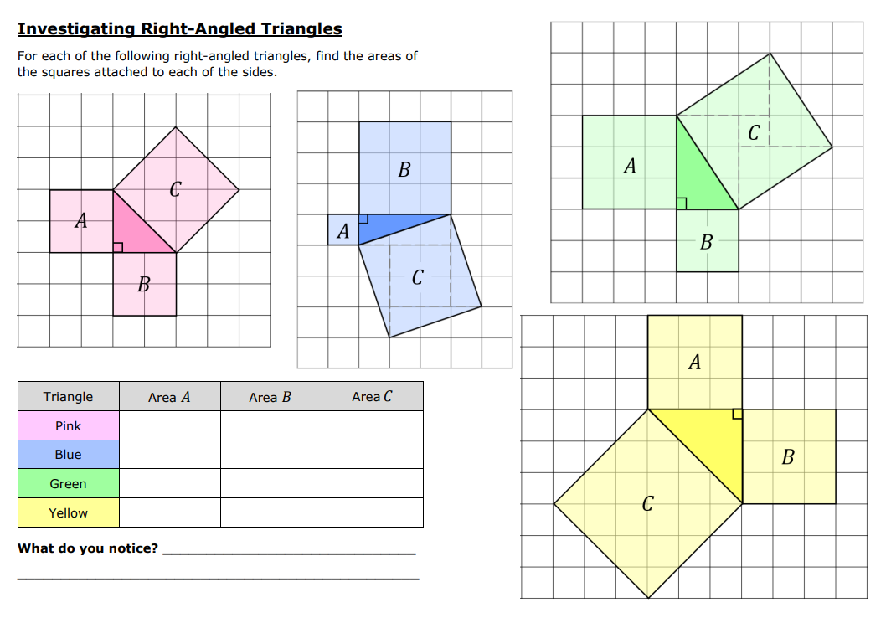
Notes:
Print 1 copy each
Could be scaffolded under the visualiser

Slide 4
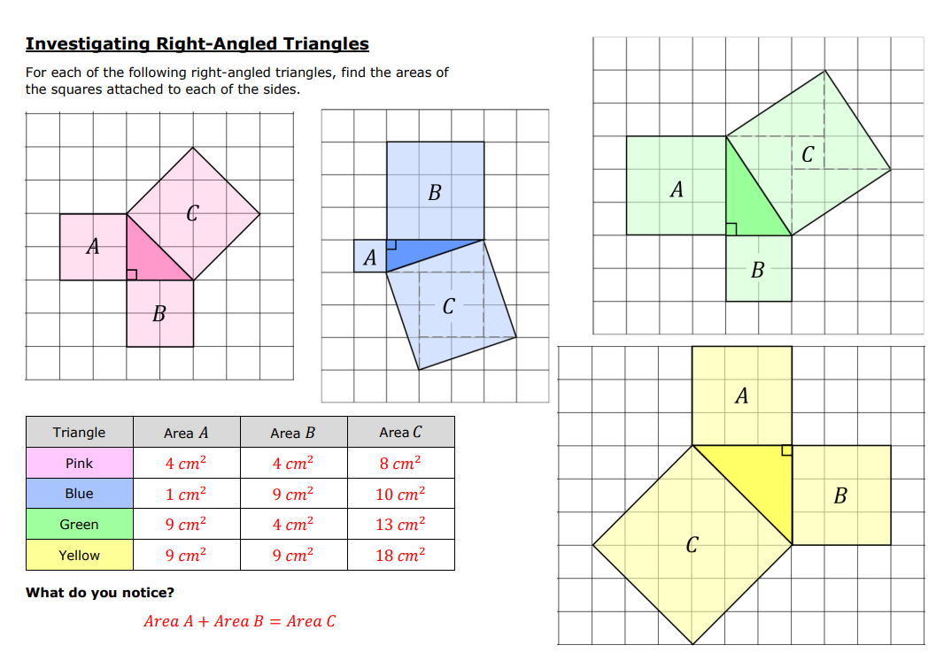

Slide 5
Let’s watch this video…
While you watch, think: how would a mathematician describe what we see?
Write down your answer on your whiteboards
(What mathematical words can you use?)

Slide 6
What have we found?
The square of the longest side is equal to the sum of the squares of the two shorter sides

Slide 7
Copy the formula and diagram into your books
Pythagoras’ Theorem
(only for right-angled triangles)
c
a
a²
+ b²
= c²
a & b are the shorter sides.
b
c is always the longest side.
(the hypotenuse)

Slide 8
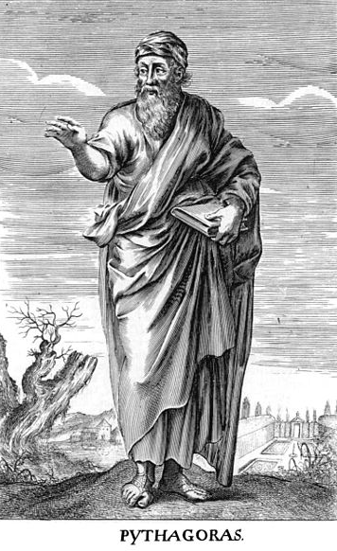
Pythagoras of Samos
c. 570 – c. 495 BC
A Greek philosopher who taught
students about religion and politics,
and made mathematical discoveries.

Slide 9
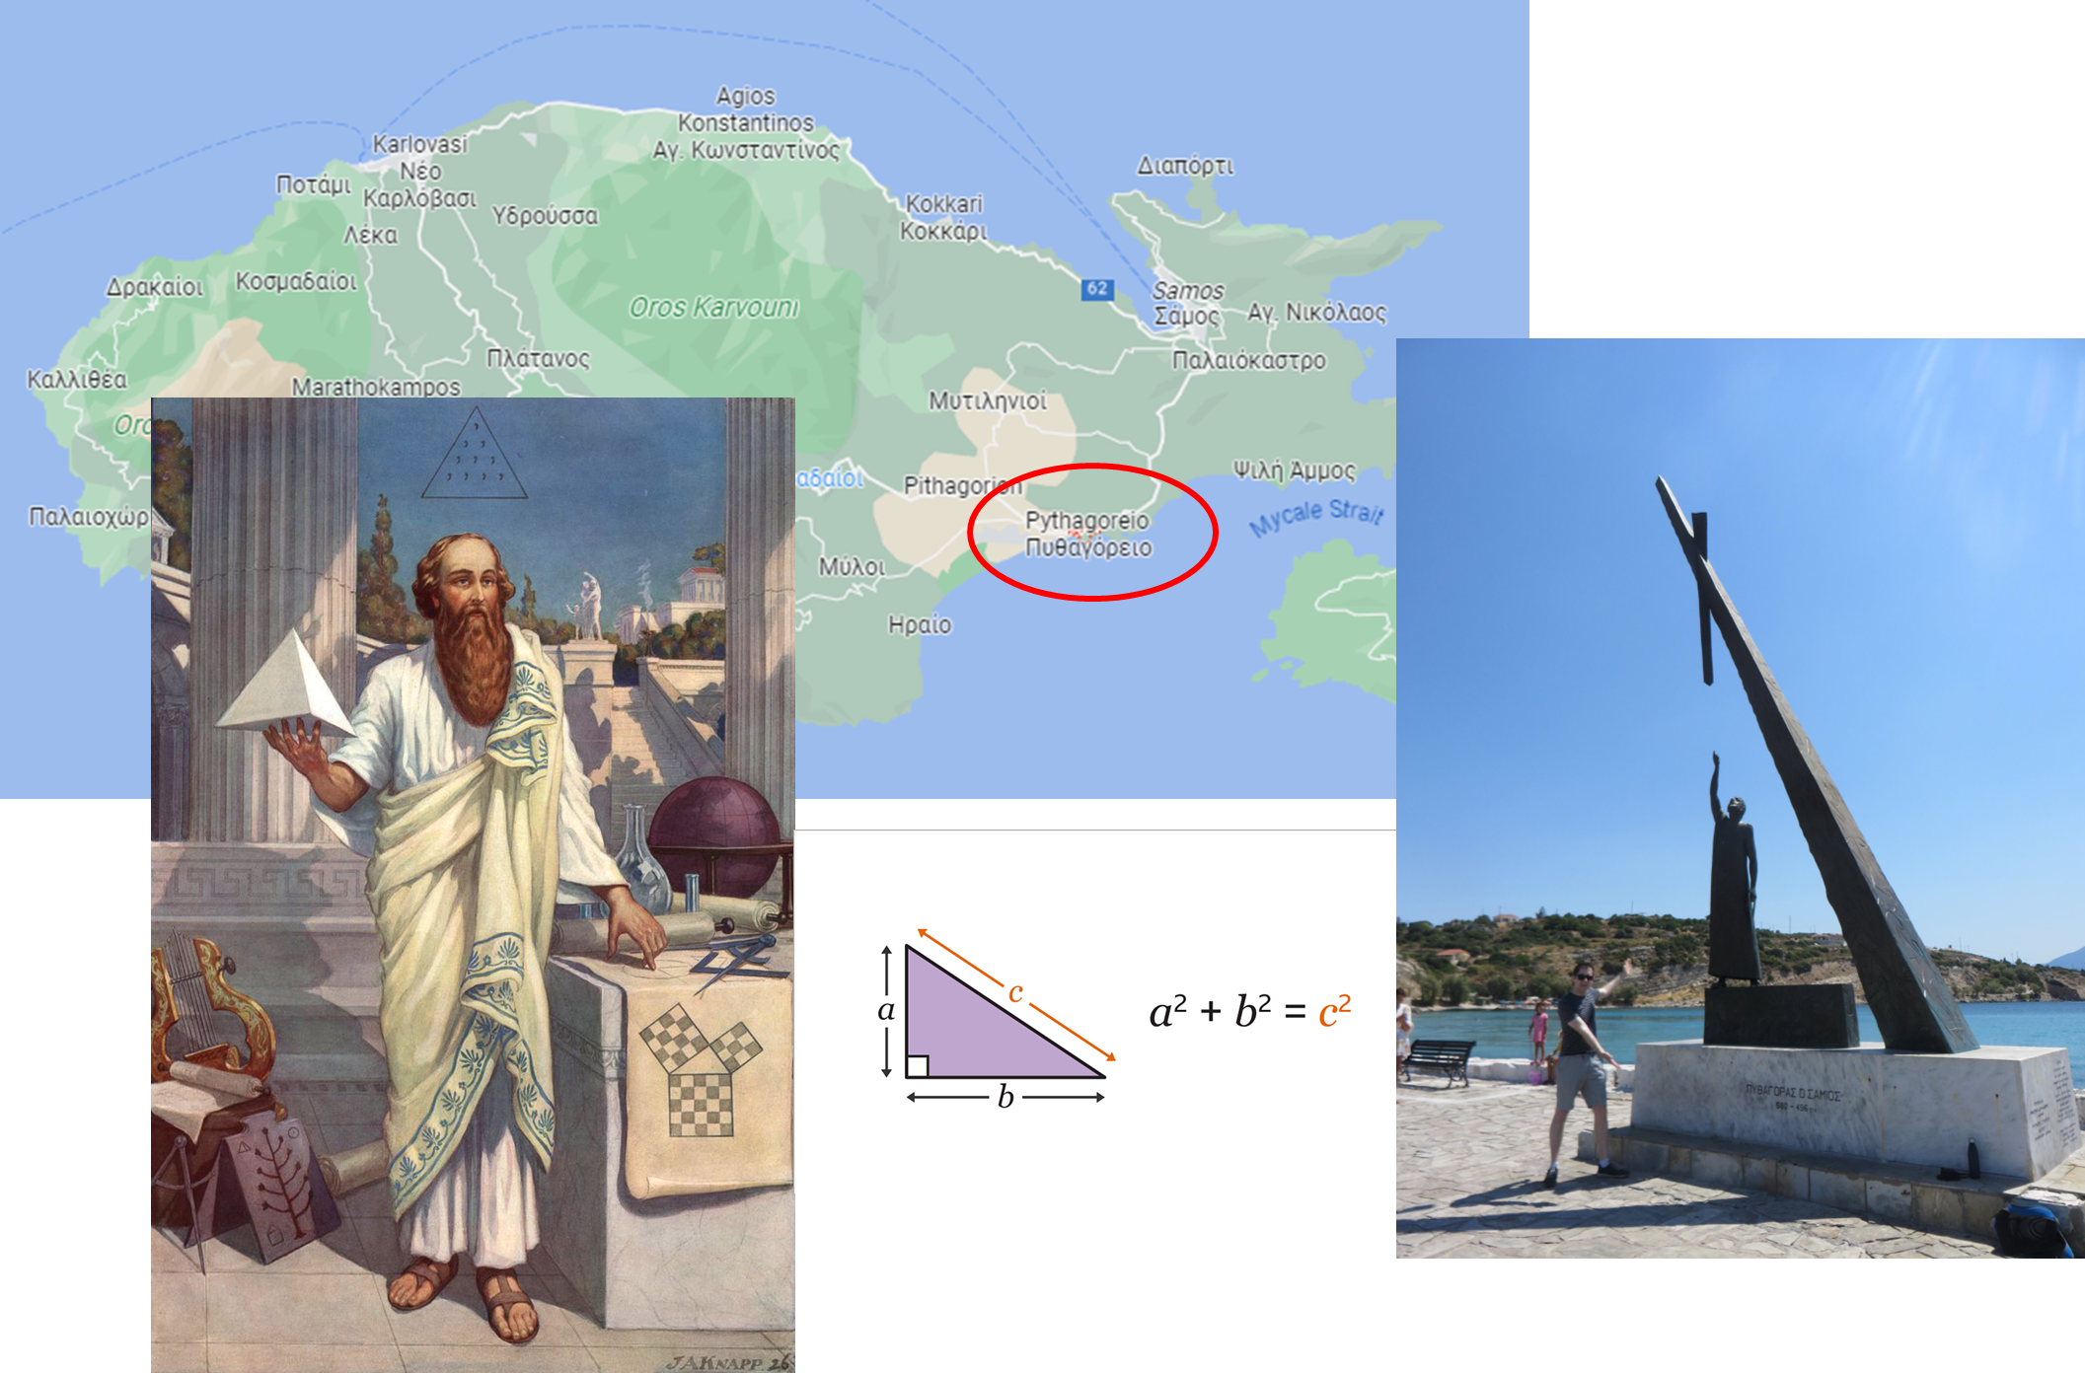

Slide 10
Copy the formula and diagram into your books
Pythagoras’ Theorem
(only for right-angled triangles)
c
a
a²
+ b²
= c²
a & b are the shorter sides.
b
c is always the longest side.
(the hypotenuse)

Slide 12
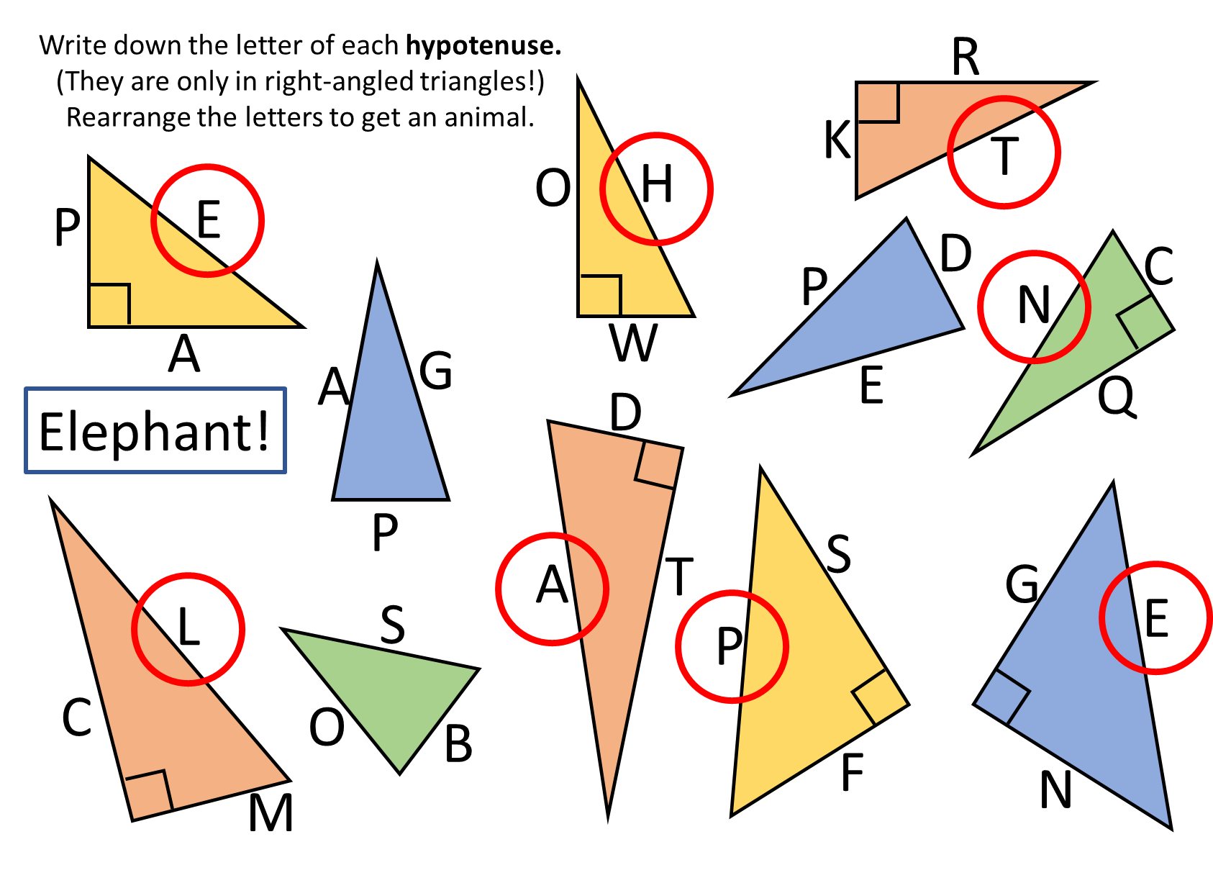

Slide 13
Here is Triangle 1.
It is a right-angled triangle with
sides: 3 cm, 4 cm and 5 cm.
(not to scale)
Pythagoras’ Theorem
We can draw a square on each
side of the triangle.
5 cm
3 cm
C
4 cm
A
What is the area of square A? ___________
What is the area of square B? ___________
What is the area of square C? ___________
B
Continue the investigation…
Triangle 2
 | Area (cm²)
Triangle | Square A | Square B | Square C
1
2
3
4
5
5 cm
13 cm
12 cm
8 cm
Triangle 3
15 cm
17 cm
Triangle 5: sides of 12 cm, 35 cm and 37 cm.
Triangle 4
Conclusion:
What is the relationship
between the length of the sides
of a right-angled triangle?
25 cm
7 cm
24 cm
Notes:
Could be modelled under visualiser

Slide 14
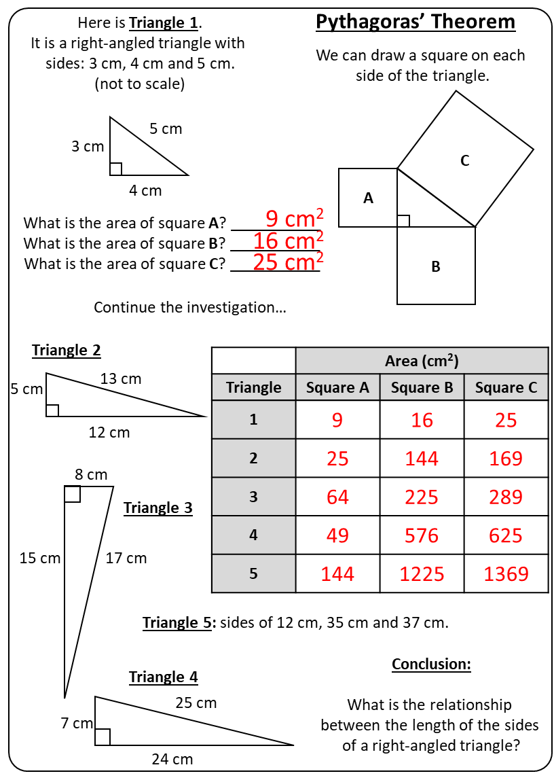
Answers
Notes:
Work through this on the visualiser

Slide 15
Here is Triangle 1.
It is a right-angled triangle with
sides: 3 cm, 4 cm and 5 cm.
(not to scale)
Pythagoras’ Theorem
Here is Triangle 1.
It is a right-angled triangle with
sides: 3 cm, 4 cm and 5 cm.
(not to scale)
Pythagoras’ Theorem
We can draw a square on each
side of the triangle.
We can draw a square on each
side of the triangle.
5 cm
5 cm
3 cm
C
3 cm
C
4 cm
A
4 cm
A
What is the area of square A? ___________
What is the area of square B? ___________
What is the area of square C? ___________
What is the area of square A? ___________
What is the area of square B? ___________
What is the area of square C? ___________
B
B
Continue the investigation…
Continue the investigation…
Triangle 2
 | Area (cm²)
Triangle | Square A | Square B | Square C
1
2
3
4
5
Triangle 2
 | Area (cm²)
Triangle | Square A | Square B | Square C
1
2
3
4
5
5 cm
13 cm
5 cm
13 cm
12 cm
12 cm
8 cm
8 cm
Triangle 3
Triangle 3
15 cm
17 cm
15 cm
17 cm
Triangle 5: sides of 12 cm, 35 cm and 37 cm.
Triangle 5: sides of 12 cm, 35 cm and 37 cm.
Triangle 4
Conclusion:
What is the relationship
between the length of the sides
of a right-angled triangle?
Triangle 4
Conclusion:
What is the relationship
between the length of the sides
of a right-angled triangle?
25 cm
25 cm
7 cm
7 cm
24 cm
24 cm
Notes:
Printout option 1

Slide 16
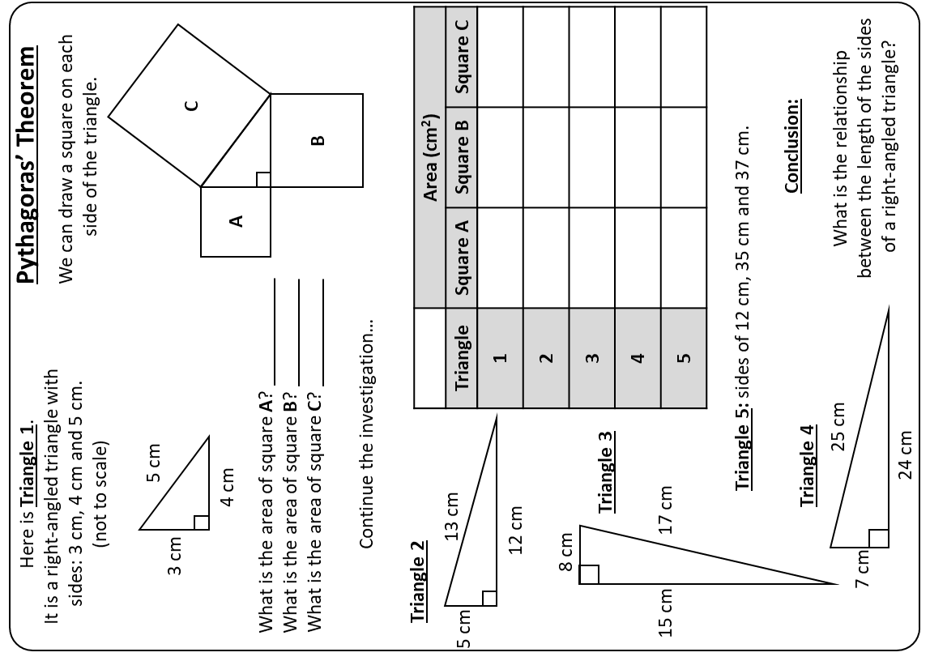
Notes:
Printout option 2

