Slide 1
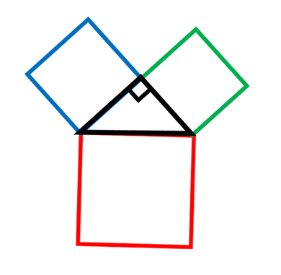
Find three possible areas that will satisfy Pythagoras’ Theorem.
… and another
…and another
Find three possible side lengths that will satisfy Pythagoras’ Theorem.
Notes:
Can they find three that will work? How do they know it works?

Slide 2
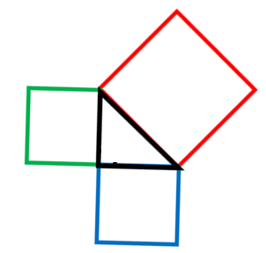
36
64
100
64
49
25
What’s the same?
What’s different?

Slide 3
36
64
100
64
49
25
Only one of these is right-angled, which one?
How do you know?

Slide 4
Pythagoras’ Theorem only works for right angled triangles…
For a right-angled triangle, the area of the square on the longest side is equal to the sum of the squares on the shorter sides.
36
64
100
64
-Pythagoras’ Theorem
49
25
$$36+64=100$$
$$25+49≠64$$
$$Right−angled$$
$$Not right−angled$$

Slide 5
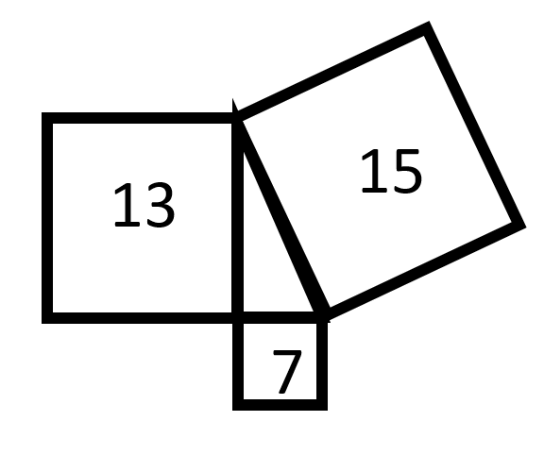
So, Pythagoras’ Theorem only works for right angled triangles…
Is this triangle right-angled?
On whiteboards…

Slide 6
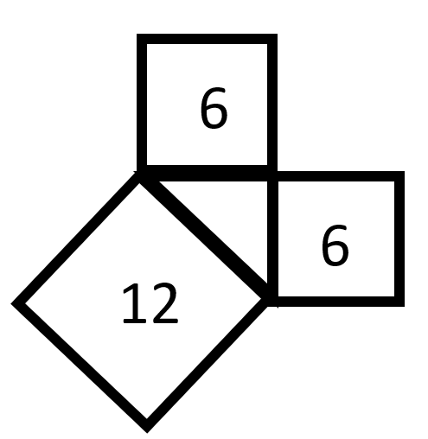
So, Pythagoras’ Theorem only works for right angled triangles…
Is this triangle right-angled?
On whiteboards…

Slide 7
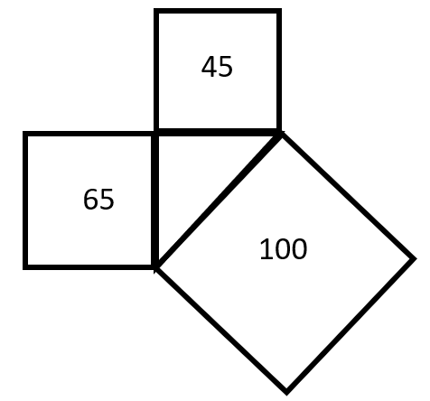
So, Pythagoras’ Theorem only works for right angled triangles…
Is this triangle right-angled?
On whiteboards…

Slide 8
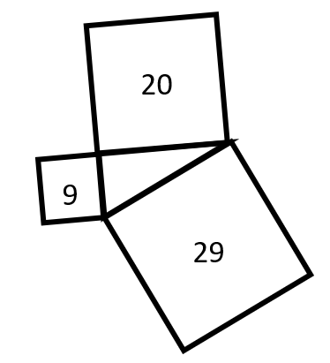
So, Pythagoras’ Theorem only works for right angled triangles…
Is this triangle right-angled?
On whiteboards…

Slide 9
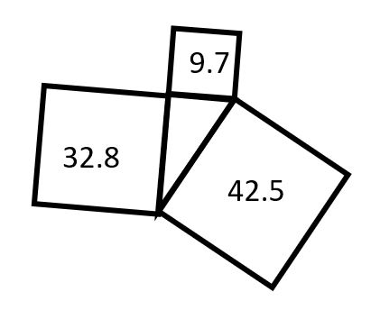
So, Pythagoras’ Theorem only works for right angled triangles…
Is this triangle right-angled?
On whiteboards…

Slide 10
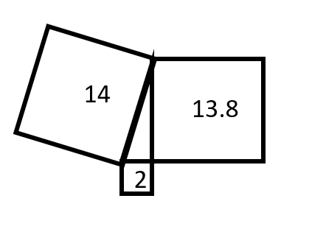
So, Pythagoras’ Theorem only works for right angled triangles…
Is this triangle right-angled?
On whiteboards…

Slide 11
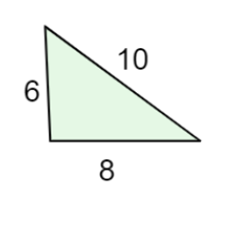
So, Pythagoras’ Theorem only works for right angled triangles…
Is this triangle right-angled?
On whiteboards…
What is the same?
What is different?

Slide 12
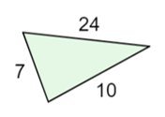
So, Pythagoras’ Theorem only works for right angled triangles…
Is this triangle right-angled?
On whiteboards…

Slide 13
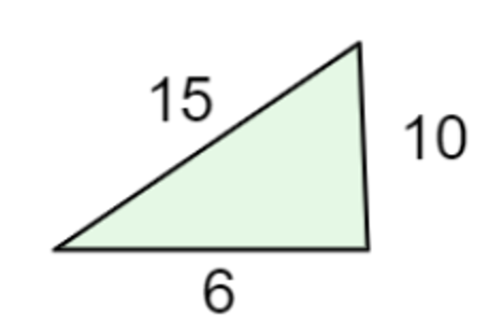
So, Pythagoras’ Theorem only works for right angled triangles…
Is this triangle right-angled?
On whiteboards…

Slide 14
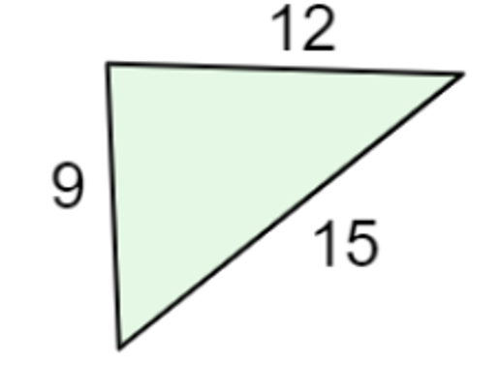
So, Pythagoras’ Theorem only works for right angled triangles…
Is this triangle right-angled?
On whiteboards…

Slide 15
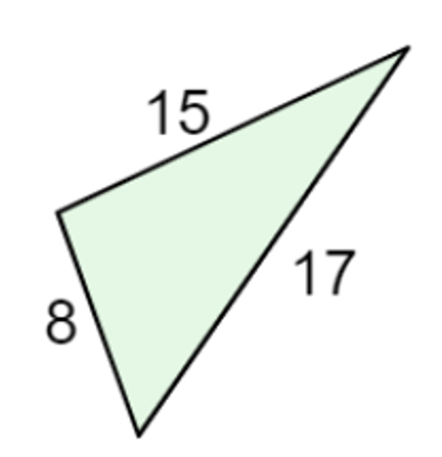
So, Pythagoras’ Theorem only works for right angled triangles…
Is this triangle right-angled?
On whiteboards…

Slide 16
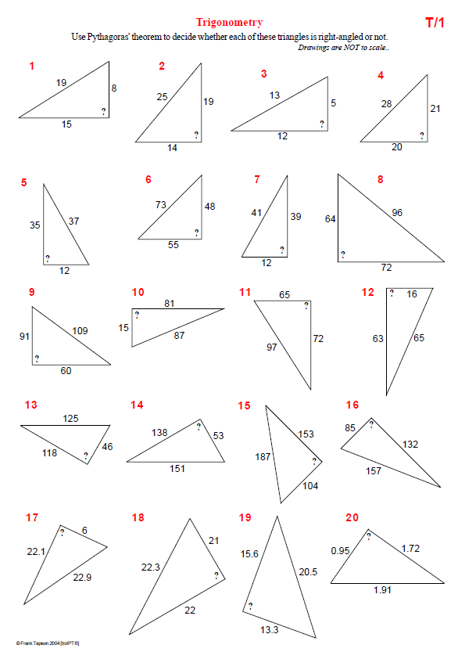
Have a go at the worksheet:

Slide 17
Notes:
Additional Practice

Slide 18
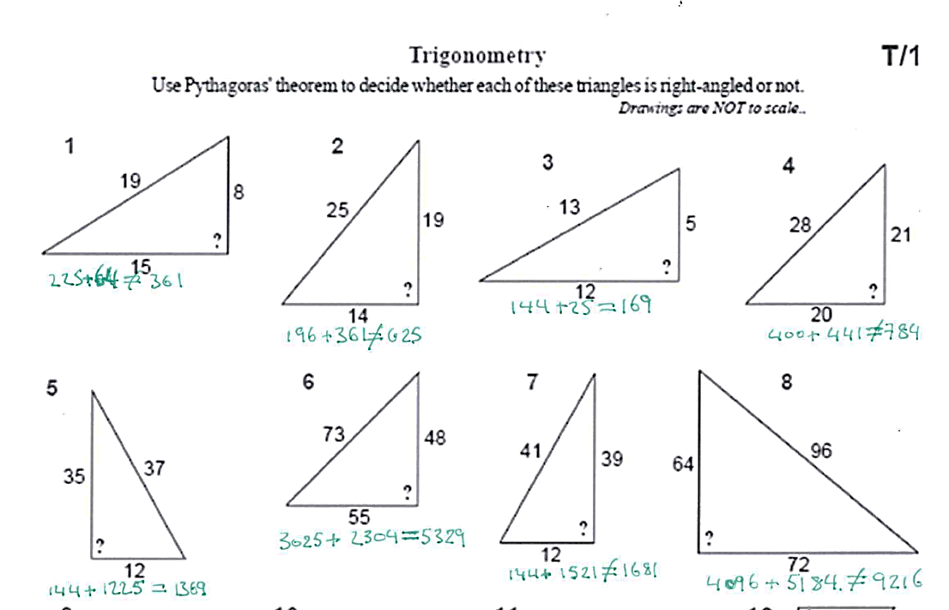
ANSWERS

Slide 19
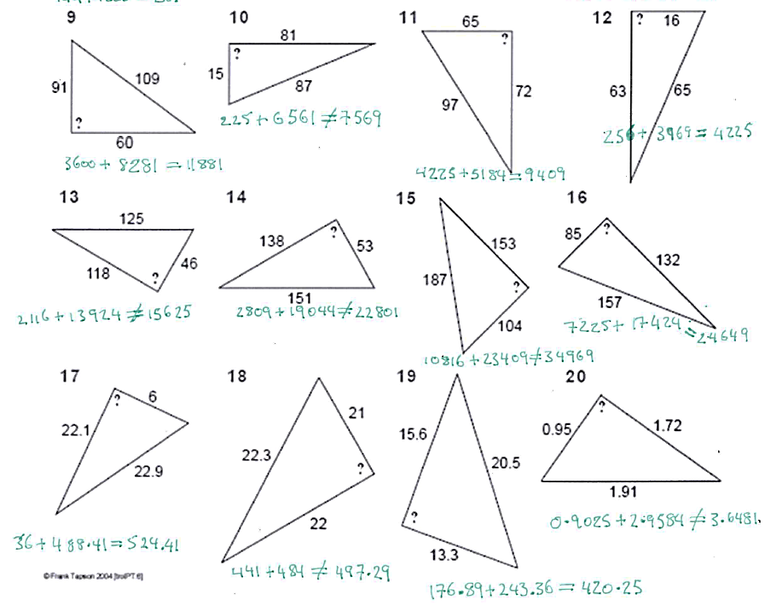
ANSWERS

Slide 20
On whiteboards, split this shape into triangles.

Slide 21
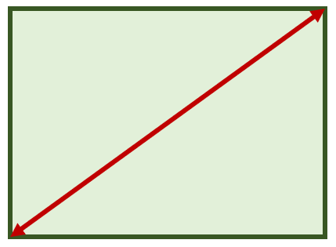
13cm
5cm
12cm
Is this a rectangle?
How do you know?

Slide 22
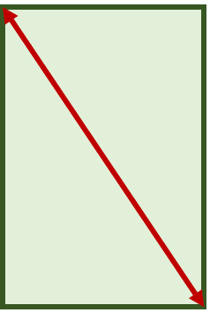
10cm
8m
5m
Is this a rectangle?
How do you know?

Slide 23
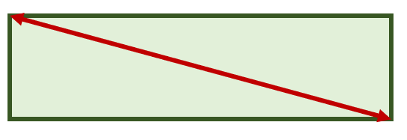
0.6m
1.34m
1.2m
Is this a rectangle?
How do you know?

Slide 24
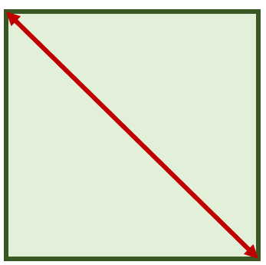
1000cm
7.07m
7.07m
Is this a rectangle?
How do you know?
Notes:
Real life applications – is it close enough to right angled?

