Slide 1
Round these numbers to 1 decimal place (d.p)
5.42
3.73
7.59
19.887
0.453
0.97
101.06
99.95
Example: 3.76

Slide 2
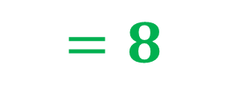
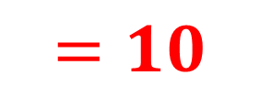
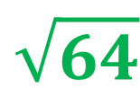
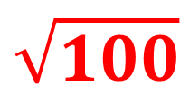
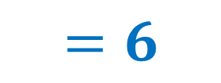
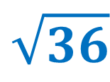
What is the side length?
100
64
$$\sqrt{100}$$
$$=10$$
$$\sqrt{64}$$
$$=8$$
36
$$\sqrt{36}$$
$$=6$$

Slide 3
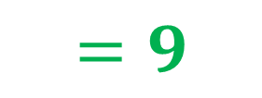
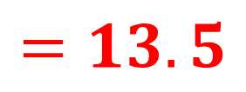
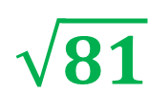
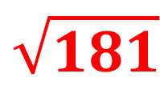
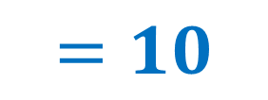
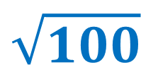
What is the side length?
181
81
$$\sqrt{181}$$
$$=13.5$$
$$\sqrt{81}$$
$$=9$$
100
$$\sqrt{100}$$
$$=10$$

Slide 4
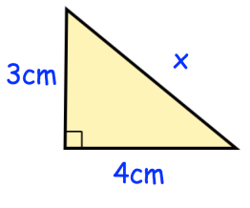
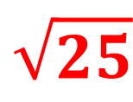
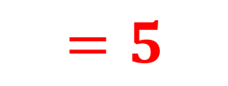
Find the missing area
25
9
$$\sqrt{25}$$
$$=5$$
Now find the missing side
16

Slide 5
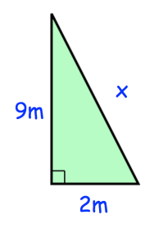
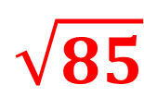
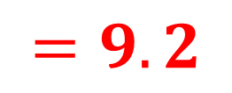
Find the missing area
85
81
Now find the missing side
4
$$\sqrt{85}$$
$$=9.2$$

Slide 6
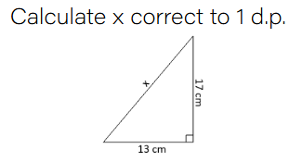
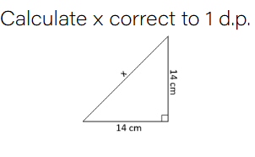
I do:
We do:

Slide 7
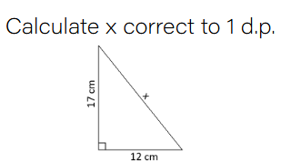
On your whiteboards…

Slide 8
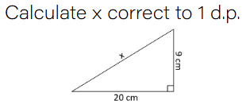
On your whiteboards…

Slide 9
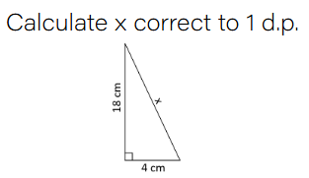
On your whiteboards…

Slide 10
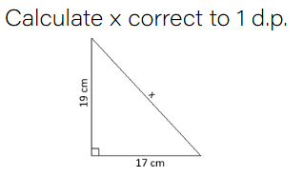
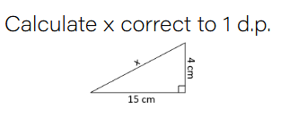
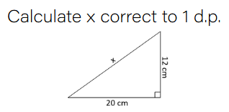
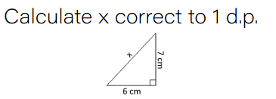
15.5cm
25.5cm
9.2cm
23.3cm

Slide 11
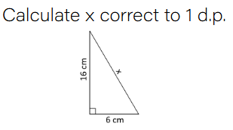
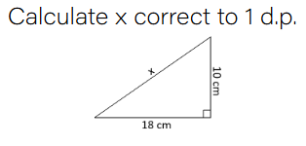
Let’s try to be more efficient!
I do:
We do:
Notes:
Link to $a^{2}+b^{2}=c^{2}$
Also doing it in calculator
One side of the room does it in multiple steps (finding individual squares) other does it in one step

Slide 12
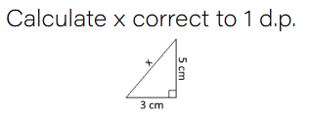
On your whiteboards…

Slide 13
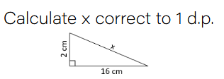
On your whiteboards…

Slide 14
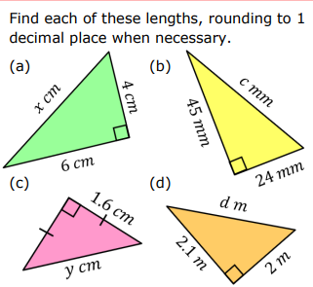

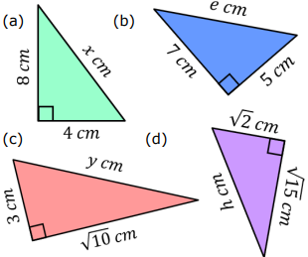

Challenge:

Slide 15
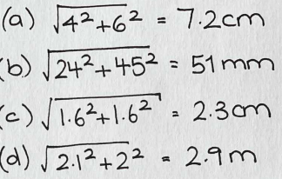
8.9cm
8.6cm
4.4cm
4.1cm
Challenge:
21.5cm

Slide 16
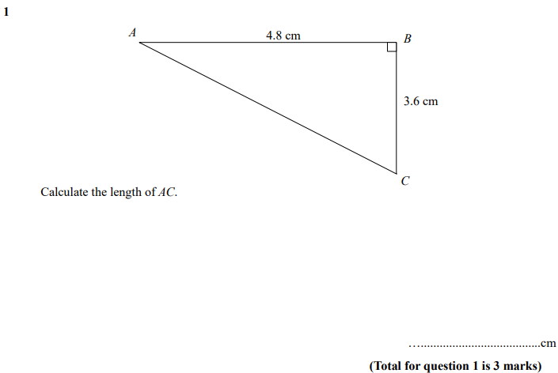

Slide 17
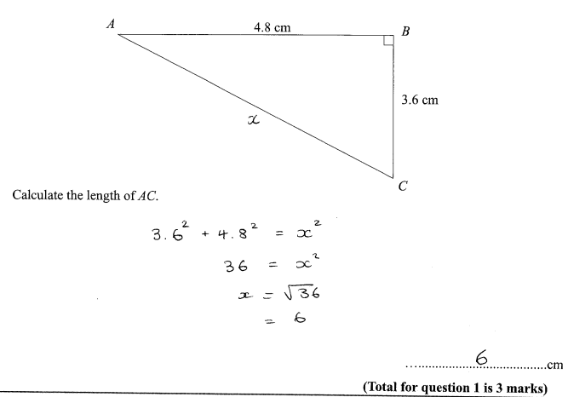

Slide 18
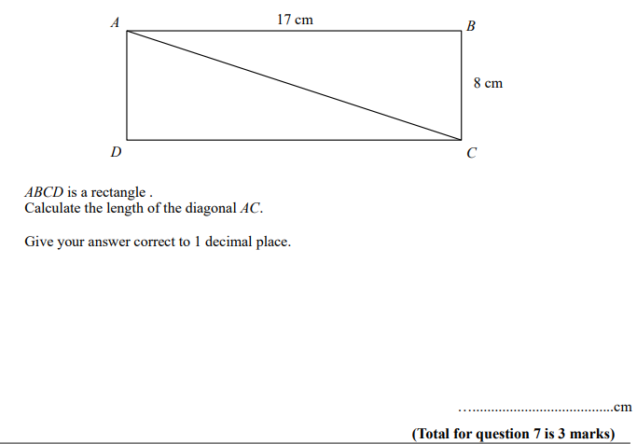

Slide 19
