Slide 1
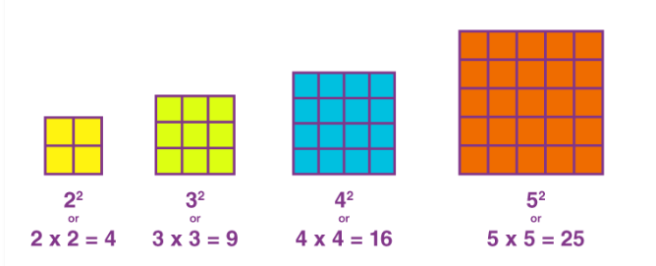
Write the square numbers up to ${15}^{2}$
$$12=1$$
$$22=4$$
$$32=9$$
$$42=16$$
$$52=25$$
$$62=36$$
$$72=49$$
$$82=64$$
$$92=81$$
$$102=100$$
$$112=121$$
$$122=144$$
$$132=169$$
$$142=196$$
$$152=225$$

Slide 2
Work out the following without a calculator
$$\sqrt{144}$$
$$\sqrt{4}+\sqrt{9}$$
$$\sqrt{36}−\sqrt{9}$$
$$\sqrt{100}+\sqrt{100}$$
$$=12$$
$$\sqrt{25}×\sqrt{4}$$
$$\sqrt{36}÷\sqrt{9}$$
$$\sqrt{100}×\sqrt{100}$$
$${(\sqrt{64})}^{2}$$
$$=10$$
$$=5$$
$$=2$$
$$=3$$
$$=100$$
$$=20$$
$$=64$$

Slide 3
What is the side length of each square?
$$2 cm$$
$$4 {cm}^{2}$$
$$? cm$$
$$2 {cm}^{2}$$
$$1 cm$$
$$2 cm$$
$$1 {cm}^{2}$$
$$? cm$$
$$1 cm$$

Slide 4
The area of these shaded squares is $2 cm2$
$$1.41 cm$$
$$1.41 cm$$
$$1.41 cm$$
$$2 cm2$$
$$2 cm2$$
How could these diagrams be made
more accurate?
$$1.41 cm$$
Mohammed says the side lengths are $1.41 cm$.
Do you agree?
Notes:
The aim here is for pupils to realise that the rounded answer is not accurate enough (1.41). They may simply square root 2 and come up with a more accurate solution for the length(1.4142 … ect). If so the following slides could be skipped and the principal of leaving it as root 2 instead could be generated from discussion around this point. If they don’t prompt with questioning about the degree of accuracy using the next slides.
Pupils are expected to calculate 1.41 x 1.41 and see that the solution is not 2.
Pythagoras is not encouraged at this stage, though if it is used, don’t shoot it down. They may get a longer decimal ans on their calculator and offer this as a suggestion. If they do, run with it, let them try again with that. Again, if this happens you may not need the next few slides.

Slide 5
What about now?
Is it more accurate?
1.414213 cm
1.414213 cm
1.414213 cm
$$2 cm2$$
$$2 cm2$$
1.414213 cm
What could we write so that the area is exactly $2 cm2$?
Notes:
Still not 2 but it is closer
Yes – closer to 2. The longer decimal gives us a more accurate answer but it isn’t perfect

Slide 6
What could we write so that the area is exactly $2 cm2$?
$$? cm$$
$$? cm$$
$?$ $cm$
$$2 cm2$$
$$2 cm2$$
$?$ $cm$

Slide 7
What could we write so that the area is exactly $2 cm2$?
$\sqrt{2}$ $cm$
$\sqrt{2}$ $cm$
$\sqrt{2}$ $cm$
$$2 cm2$$
$$2 cm2$$
$\sqrt{2}$ $cm$

Slide 8
What does this picture tell us about $\sqrt{2}$?
$\sqrt{2}$ $cm$
$\sqrt{2}$ $cm$
$\sqrt{2}$ $cm$
$$2 cm2$$
$$2 cm2$$
$\sqrt{2}$ $cm$
Notes:
Root 2 is a number that carries on forever (has a lot of decimal places) no need to be too explicit here. It is approx. the same value as 1.41 … however root 2 tells us the number EXACTLY

Slide 9
What does this picture tell us about $\sqrt{2}×\sqrt{2}$?
$\sqrt{2}$ $cm$
$\sqrt{2}$ $cm$
$\sqrt{2}$ $cm$
$$2 cm2$$
$$2 cm2$$
$\sqrt{2}$ $cm$
Notes:
Draw the conclusion of multiplying 2 identical surds

Slide 10
On your whiteboards…
What would the area of this square be?
$\sqrt{5}$ $cm$
$$5 cm2$$
$\sqrt{5}$ $cm$

Slide 11
On your whiteboards…
What would the area of this square be?
$\sqrt{13}$ $cm$
$$13 cm2$$
$\sqrt{13}$ $cm$

Slide 12
On your whiteboards…
What would the area of this square be?
$\sqrt{7}$ $cm$
$$7 cm2$$
$\sqrt{7}$ $cm$

Slide 13
On your whiteboards…
What would the area of this square be?
$\sqrt{41}$ $cm$
$$41 cm2$$
$\sqrt{41}$ $cm$

Slide 14
Surds Friday, 14 February 2025
$$\sqrt{a}×\sqrt{a}=a$$
Choose three of your own numerical examples to write into your book

Slide 15
$$\sqrt{\text{18}}$$
This just represents a number.
Discuss:
What number do you think it represents?
Why?
Notes:
Which two whole numbers is root 18 between?

Slide 16
$\sqrt{\text{18}},\sqrt{\text{2}}$ and $\sqrt{\text{5}}$ are all surds
Discuss:
What do you think that means?

Slide 17
$\sqrt{\text{18}},\sqrt{\text{2}}$ and $\sqrt{\text{5}}$ are all surds

A surd is a root that cannot be written as a fraction or a decimal exactly
This means it is an irrational number
$\sqrt{\text{18}}$ = 4.242640687119286 …
Can you think of any other irrational numbers that you know?
$$π$$
$$e$$
Notes:
Pupils may think of pi. Some may have seen e. Make it clear these are not surds.

Slide 18
Is $\sqrt{2}$ a surd?
Is $\sqrt{8}$ a surd?
Is $\sqrt{4}$ a surd?
✓
✓
✗

Slide 19
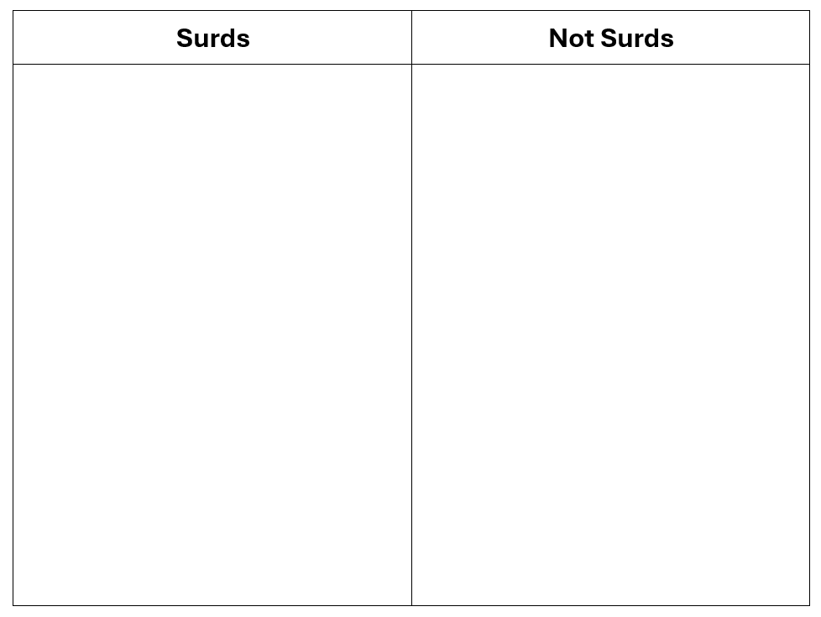
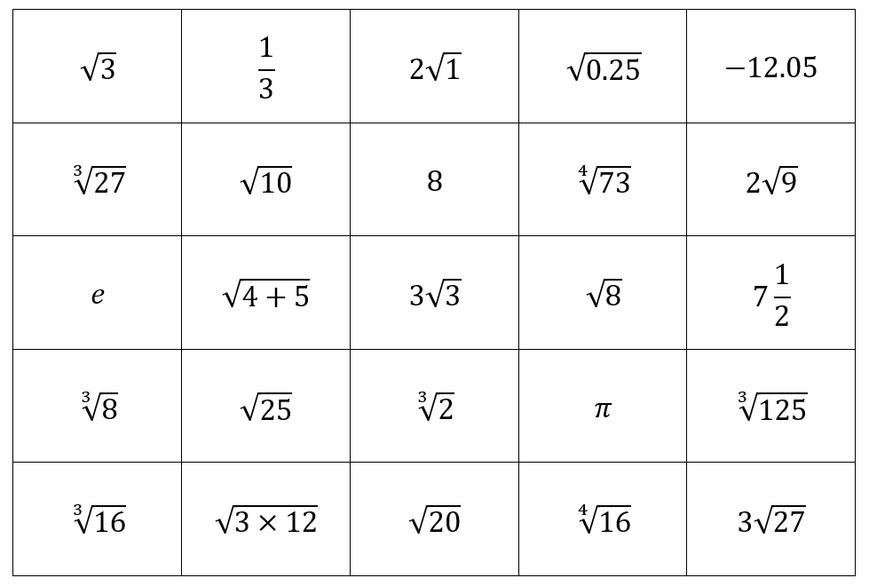
Working in pairs: Take it in turns to pick a number and convince your partner that it is a surd (or not). Once you are both happy and agree, write it in the table.

Slide 20
Working in pairs: Take it in turns to pick a number and convince your partner that it is a surd (or not). Once you are both happy and agree, write it in the table.

Slide 21
Challenge Problems
Notes:
Most students will not get this far – that is fine!

Slide 22
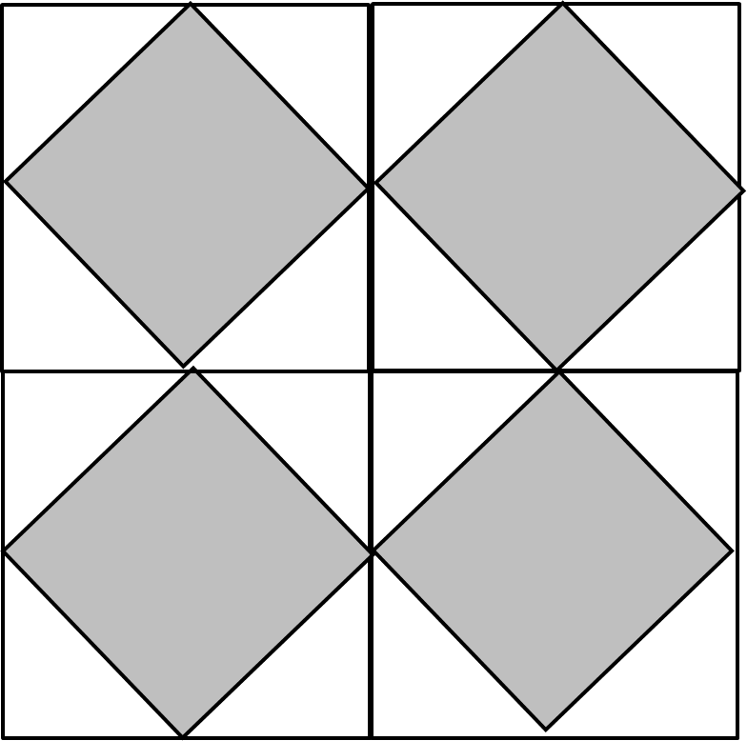
18cm²
18cm²
18cm²
18cm²
What do the little lines mean?

Slide 23
18cm²
18cm²
18cm²
18cm²
What is the side length of the shaded square?

Slide 24
18cm²
18cm²
18cm²
18cm²
What is the perimeter of the centre square?

Slide 25
18cm²
18cm²
18cm²
18cm²
What is total area of the combined white shapes?
Can you find another method?

