Slide 1
Simplify these expression by collecting like terms

Slide 2
Simplify these expression by collecting like terms

Slide 3
What is the perimeter of the square?
5 cm
5 cm

Slide 4
What is the perimeter of the square?
5 cm
Perimeter = 5 + 5 + 5 +5
^{= 4 x 5}
^{= 20cm}
5 cm

Slide 5
What is the perimeter of the square?
2 cm²
+
+
+
$$\sqrt{2}+\sqrt{2}+\sqrt{2}+\sqrt{2}=4\sqrt{2}$$

Slide 6
What is the perimeter of the square?
$$\sqrt{3}$$
$$\sqrt{3}$$

Slide 7
What is the perimeter of the square?
$$\sqrt{3}$$
Perimeter = $\sqrt{3}$ ⁺ $\sqrt{3}$ ⁺ $\sqrt{3}$ ⁺ $\sqrt{3}$
⁼ $4 ×\sqrt{3}$
⁼ $4 \sqrt{3}$
$$\sqrt{3}$$

Slide 8
On mini whiteboards, work out the perimeter of the square
$$\sqrt{7}$$
$$\sqrt{7}$$

Slide 9
On mini whiteboards, work out the perimeter of the square
$$\sqrt{5}$$

Slide 10
On mini whiteboards, work out the perimeter of the square
$$\sqrt{14}$$

Slide 11
On mini whiteboards, work out the perimeter of the regular hexagon
$$\sqrt{11}$$

Slide 12
On mini whiteboards, work out the perimeter of the rectangle
$$\sqrt{5}$$
$$\sqrt{3}$$

Slide 13
On mini whiteboards, draw a square that has a perimeter of 4 $\sqrt{6}$
Show the lengths of each side

Slide 14
On mini whiteboards, draw a square that has a perimeter of 4 $\sqrt{6}$
Show the lengths of each side
And another different shape

Slide 15
On mini whiteboards, draw a quadrilateral that has a perimeter of 4$\sqrt{10}$
Show the lengths of each side

Slide 16
On mini whiteboards, draw a quadrilateral that has a perimeter of 4$\sqrt{10}$
Show the lengths of each side
And a different shape

Slide 17
On mini whiteboards, draw a shape that has a perimeter of 3 $\sqrt{2}$
Show the lengths of each side

Slide 18
On mini whiteboards, draw a shape that has a perimeter of 2$\sqrt{3}$ + 3 $\sqrt{7}$
Show the lengths of each side

Slide 19
$$\sqrt{a}+\sqrt{a}=2\sqrt{a}$$
Adding and subtracting Surds
$$\sqrt{b}+\sqrt{b}+\sqrt{b}+\sqrt{b}=4\sqrt{b}$$
Choose three of your own numerical examples to write into your book

Slide 20
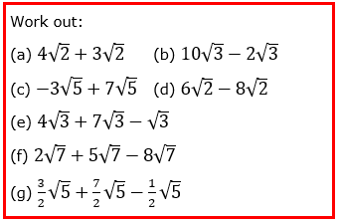
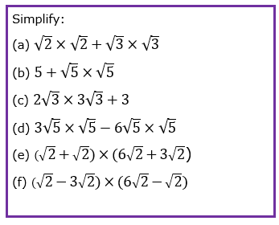
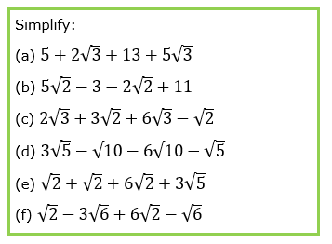
Notes:
Modified from Dr Austin Maths to meet learning point

Slide 21
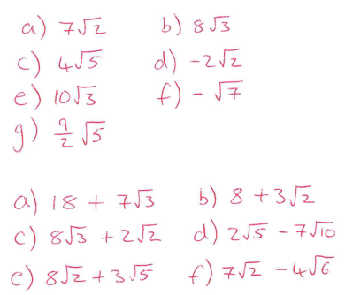
Notes:
Modified from Dr Austin Maths to meet learning point

Slide 22
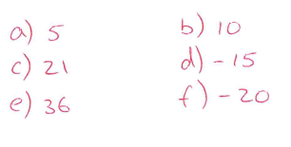
Notes:
Modified from Dr Austin Maths to meet learning point

Slide 23
Challenge Problems
Notes:
Most students will not get this far – that is fine!

Slide 24
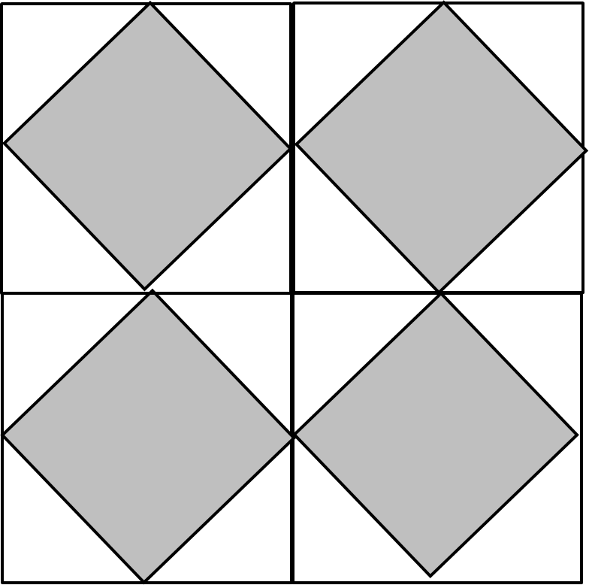
18cm²
18cm²
18cm²
18cm²
What do the little lines mean?

Slide 25
18cm²
18cm²
18cm²
18cm²
What is the side length of the shaded square?

Slide 26
18cm²
18cm²
18cm²
18cm²
What is the perimeter of the centre square?

Slide 27
18cm²
18cm²
18cm²
18cm²
What is total area of the combined white shapes?
Can you find another method?

