Slide 1
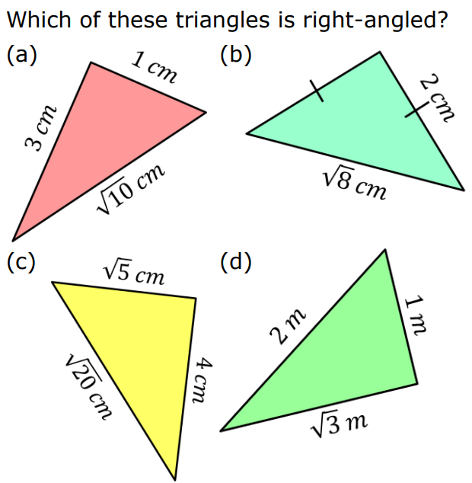
How do you know?
Notes:
Can they find three that will work? How do they know it works?

Slide 2
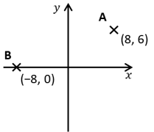
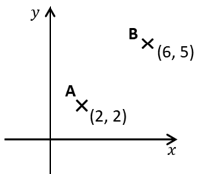
I do:
We do:
Find the distance AB
Find the distance AB

Slide 3
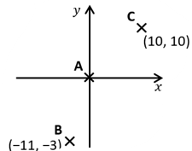
I do:
We do:
Find the distance AC
Find the distance BC
CH: Find the distance ABC

Slide 4
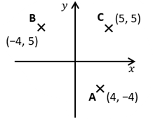
I do:
We do:
Find the distance BC
Find the distance AC
CH: Find the perimeter of ABC

Slide 5
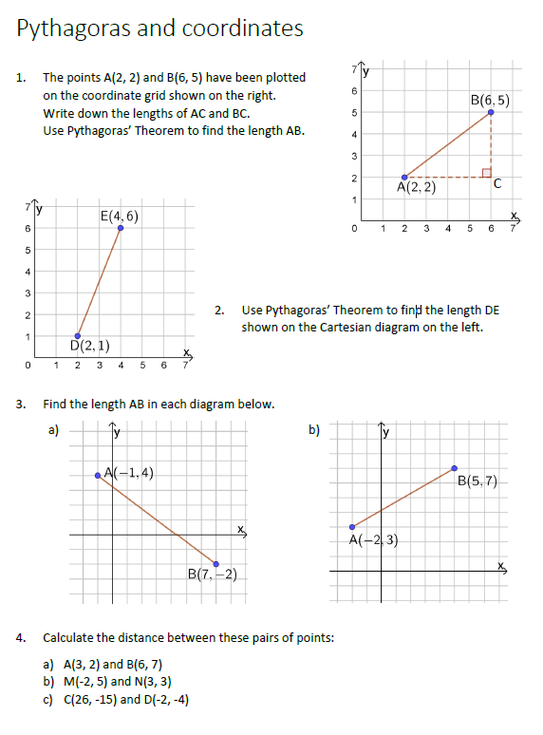
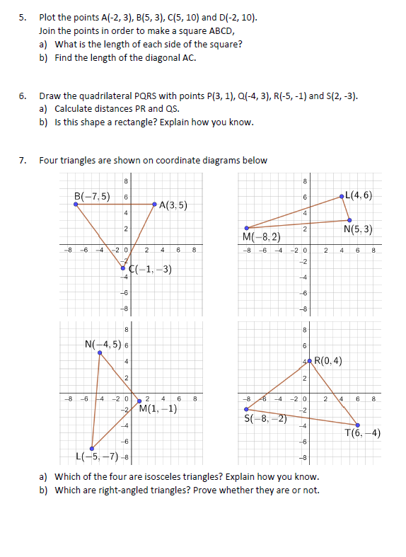
Have a go at the worksheet!

Slide 7
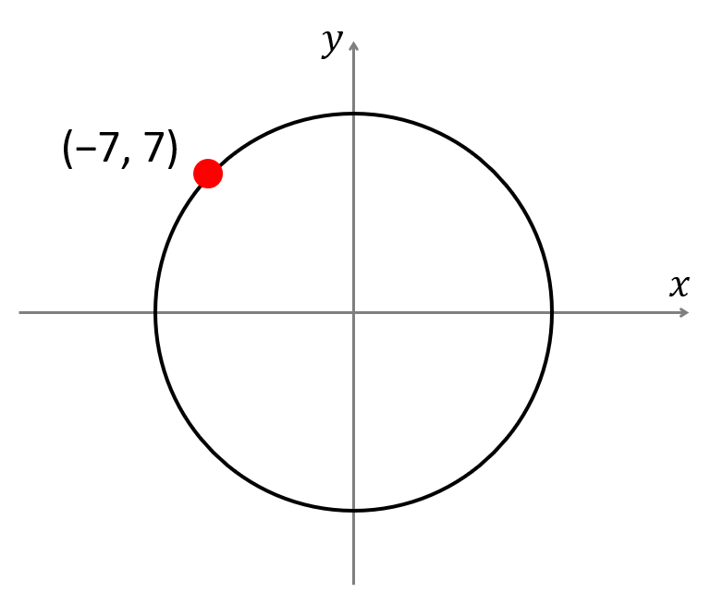
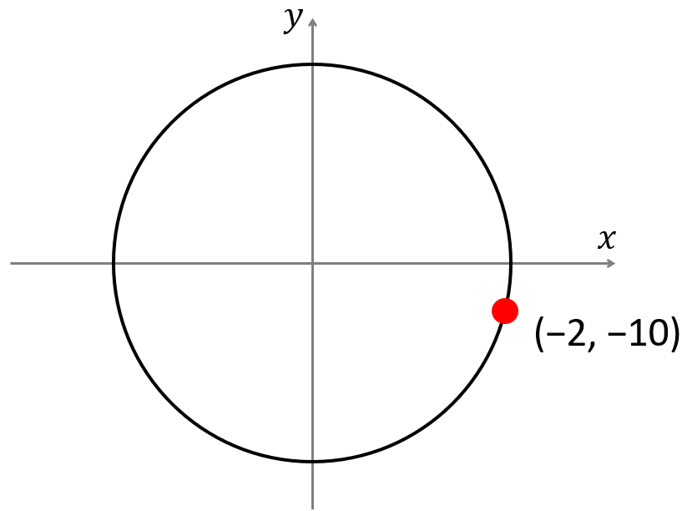
I do:
We do:
Find the radius of the circle
Find the radius of the circle
CH: Find the diameter of the circle

Slide 8
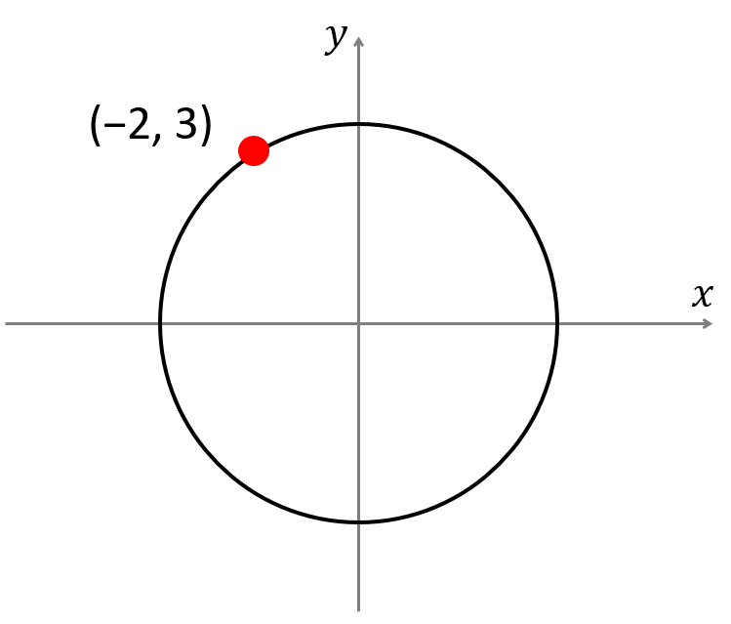
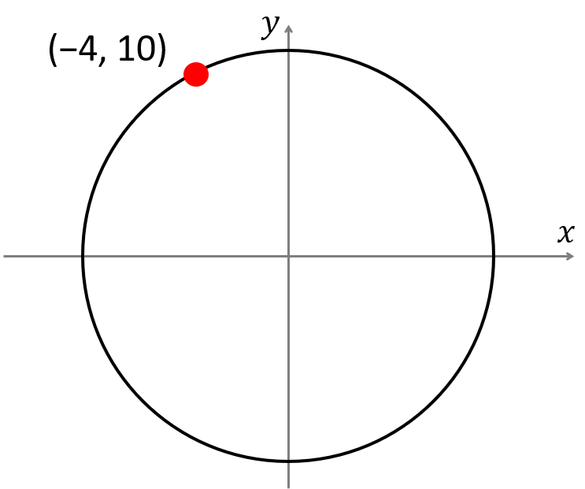
I do:
We do:
Find the radius of the circle
Find the radius of the circle
CH: Find the circumference of the circle

Slide 9
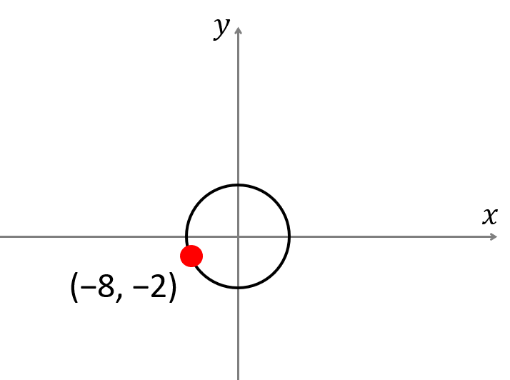
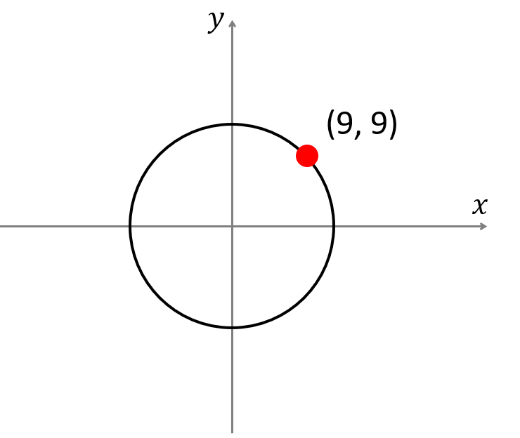
I do:
We do:
Find the radius of the circle
Find the radius of the circle
CH: Find the area of the circle

Slide 10
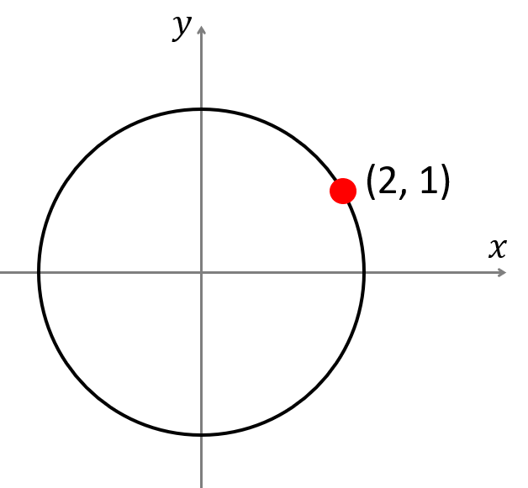
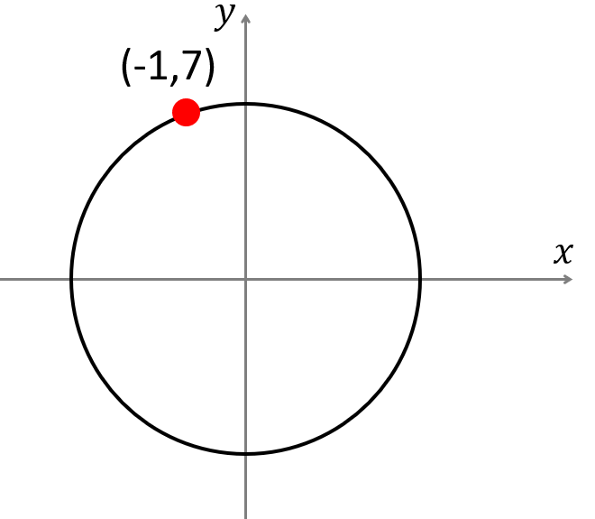
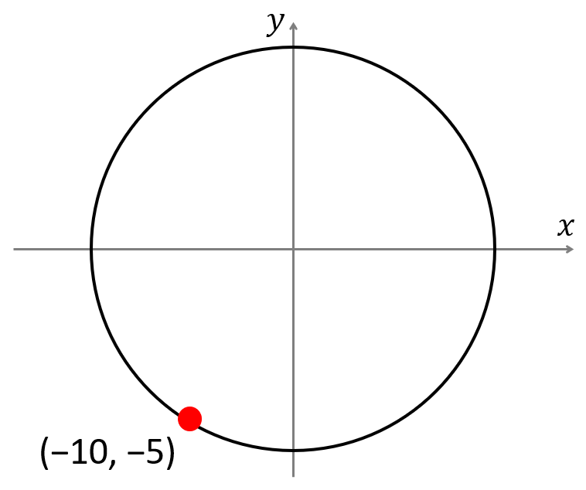
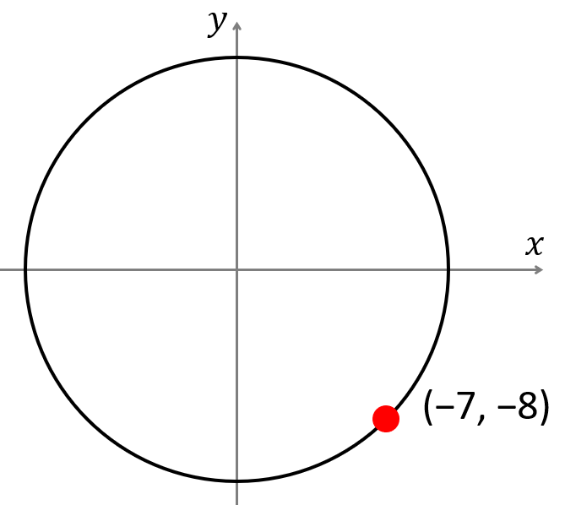
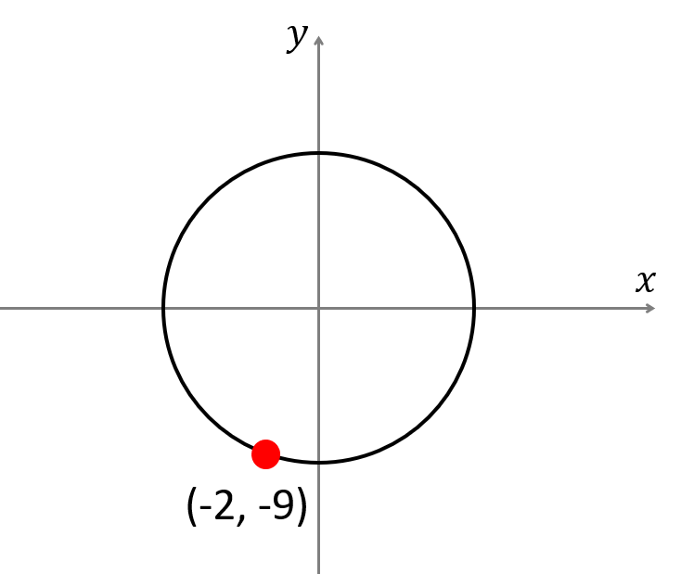
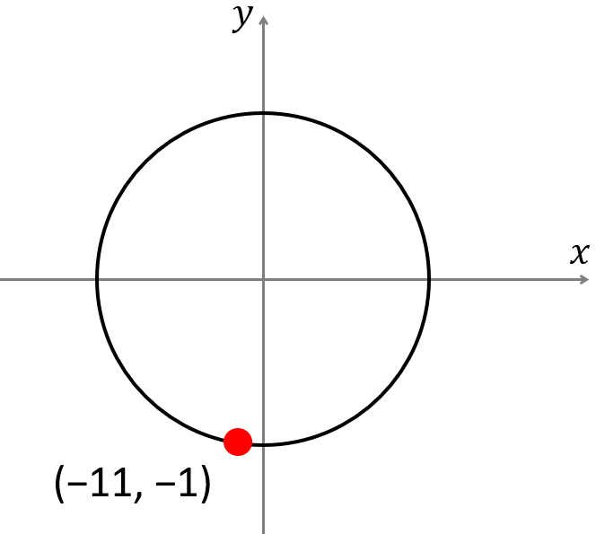
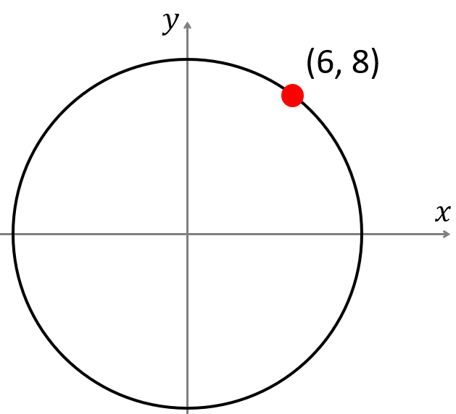
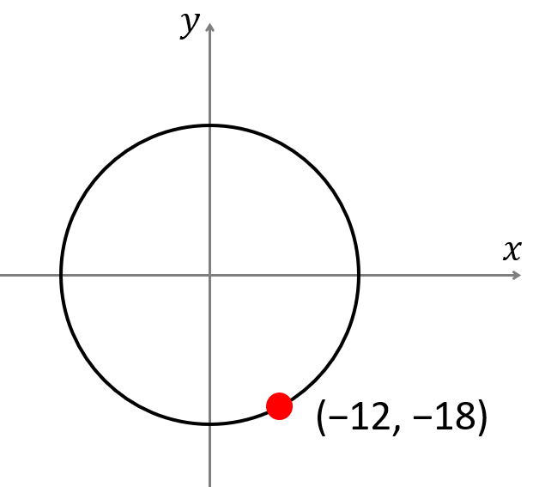
Worksheet:
1) | 2) | 3) | 4)
Radius= | Radius= | Radius= | Radius=
Area= | Area= | Area= | Area=
Circumference= | Circumference= | Circumference= | Circumference=
5) | 6) | 7) | 8)
Radius= | Radius= | Radius= | Radius=
Area= | Area= | Area= | Area=
Circumference= | Circumference= | Circumference= | Circumference=

Slide 11
I do:
We do:
Find the diagonal length
Find the radius of the circle
3 cm
6 cm
5 cm
7 cm
6 cm
4 cm

Slide 12
I do:
We do:
Find the diagonal length
Calculate the distance AB
9.7 m
B
A
6 cm
3.8 m
5 m
4 cm
$$a$$

Slide 13
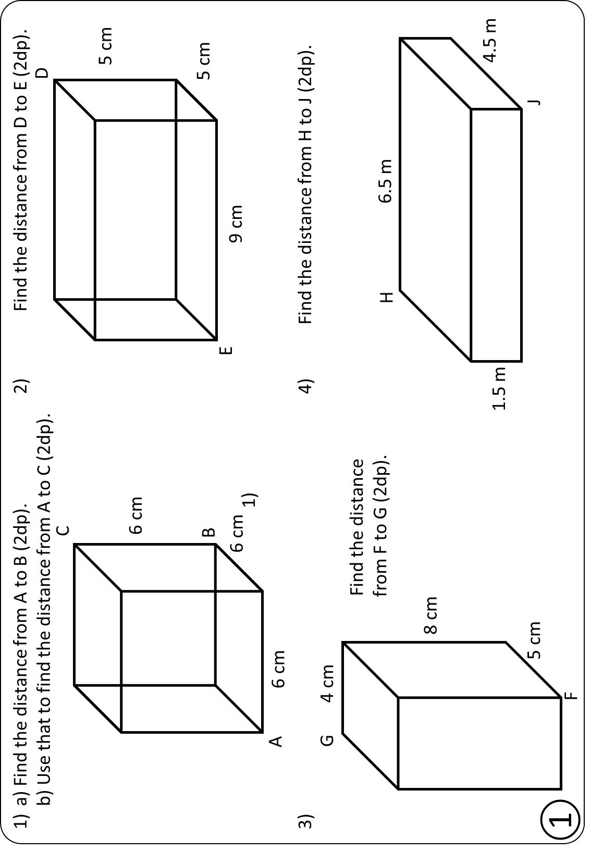
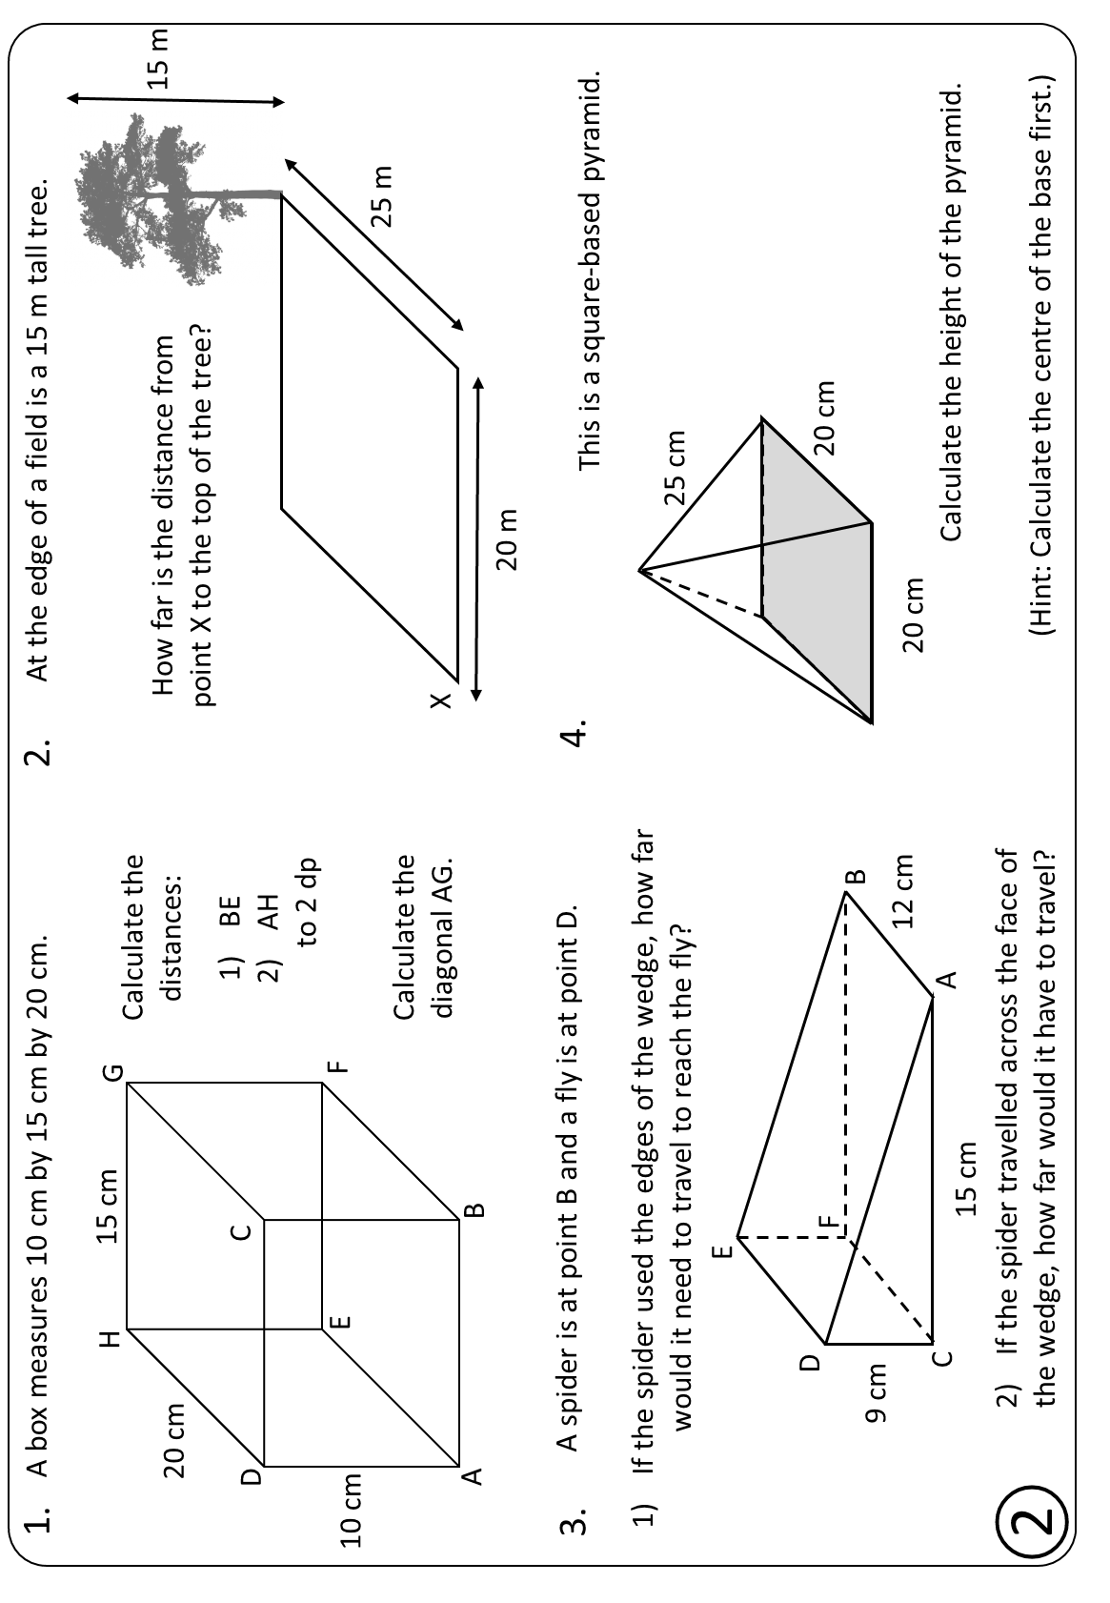
Have a go at the worksheet!

Slide 14
1)
a) Find the distance from A to B (2dp).
b) Use that to find the distance from A to C (2dp).
2)
Find the distance from D to E (2dp).
D
C
5 cm
10.39 cm
6 cm
B
5 cm
6 cm
E
9 cm
11.45 cm
1)
A
Answers
6 cm
3)
4)
Find the distance from H to J (2dp).
G
4 cm
Find the distance
from F to G (2dp).
H
6.5 m
8 cm
1.5 m
4.5 m
5 cm
10.25 cm
8.05 cm
J
①
F

Slide 15
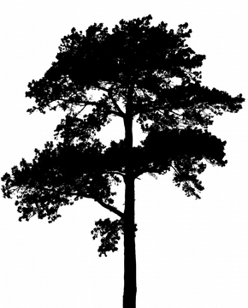
1.
A box measures 10 cm by 15 cm by 20 cm.
2.
At the edge of a field is a 15 m tall tree.
H
15 cm
G
Calculate the distances:
20 cm
How far is the distance from
point X to the top of the tree?
15 m
C
BE
AH
to 2 dp
D
1) 25 cm
E
F
35.36 m
10 cm
2) 26.93 cm
25 m
Calculate the diagonal AG.
X
A
B
Answers
20 m
A spider is at point B and a fly is at point D.
If the spider used the edges of the wedge, how far
would it need to travel to reach the fly?
3.
4.
This is a square-based pyramid.
1) 29.49 cm
25 cm
2) 21.21 cm
20.62 cm
E
D
14.14 cm
F
20 cm
9 cm
B
12 cm
20 cm
C
A
Calculate the height of the pyramid.
15 cm
If the spider travelled across the face of
the wedge, how far would it have to travel?
②
(Hint: Calculate the centre of the base first.)

