Slide 1
Work out the following without a calculator
$$\sqrt{25}×\sqrt{4}$$
$$\sqrt{36}÷\sqrt{9}$$
$$\sqrt{100}×\sqrt{100}$$
$${(\sqrt{64})}^{2}$$
$$\sqrt{6} ×\sqrt{6}$$
$$\sqrt{144}$$
$$\sqrt{4}+\sqrt{9}$$
$$\sqrt{36}−\sqrt{9}$$
$$\sqrt{100}+\sqrt{100}$$
$$\sqrt{4} ×\sqrt{4}$$
$$6 ×\sqrt{6}$$
$$\sqrt{6}+\sqrt{6}$$

Slide 2
Example
$$\sqrt{9}×\sqrt{4}$$
How else could this be calculated?

Slide 3
Work out without a calculator
$$\sqrt{25}×\sqrt{4}$$
Show at least two methods

Slide 4
Work out without a calculator
$$\sqrt{100}×\sqrt{9}$$
Show at least two methods

Slide 5
Work out without a calculator
$$\sqrt{9}×\sqrt{9}$$
Show at least two methods

Slide 6
Work out without a calculator
$${(\sqrt{121})}^{2}$$
Show at least two methods

Slide 7
What could the question have been?
$$\sqrt{12}$$
Notes:
Think-Pair-Share

Slide 8
Simplifying a surd
$$\sqrt{12}=\sqrt{4}×\sqrt{3}$$
$$=2\sqrt{3}$$

Slide 9
Simplifying a surd
$$\sqrt{12}=\sqrt{6}×\sqrt{2}$$
This is not fully simplified.

Slide 10
Title: Simplifying Surds

Slide 11
Although $\sqrt{8}$ is a surd, it can still be simplified
Example: Simplify $\sqrt{8}$
$$\sqrt{8}=\sqrt{4×2}$$
$$\sqrt{8}=\sqrt{4}×\sqrt{2}$$
$$\sqrt{8}=2×\sqrt{2}$$
$$\sqrt{8}=2\sqrt{2}$$

Slide 12
What is the key step in simplifying surds?
Find a factor of the surd that is a square number
Write the first 15 numbers on your whiteboards.
1, 4, 9, 16, 15, 36, 49, 64, 81, 100, 121, 169, 196, 225 …
What if the surd doesn’t have a factor that is a square number?

Slide 13
Simplify
$$\sqrt{18}$$
$$3\sqrt{2}$$

Slide 14
Simplify
$$\sqrt{27}$$
$$3\sqrt{3}$$

Slide 15
Simplify
$$\sqrt{75}$$
$$5\sqrt{3}$$

Slide 16
Simplify
$$\sqrt{72}$$
Notes:
Emphasis largest square factor

Slide 17
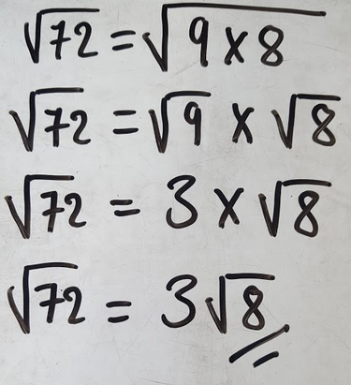
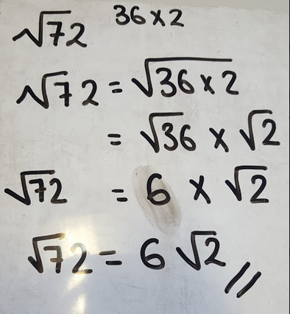
Isobel and Emily are simplifying $\sqrt{72}$
Discuss:
Who has simplified correctly?
Why?

Slide 18
Simplifying Surds
Simplify:
1. $\sqrt{12}$ 6. $\sqrt{20}$ 10. $\sqrt{24}$
2. $\sqrt{27}$ 7. $\sqrt{45}$ 11. $\sqrt{54}$
3. $\sqrt{48}$ 8. $\sqrt{80}$ 12. $\sqrt{96}$
4. $\sqrt{75}$ 9. $\sqrt{125}$ 13. $\sqrt{150}$
Why are the answers $2\sqrt{4}, 3\sqrt{4}$ etc. not there?

Slide 19
Simplifying Surds ANSWERS
Simplify:
1. $2\sqrt{3}$ 6. $2\sqrt{5}$ 10. $2\sqrt{6}$
2. $3\sqrt{3}$ 7. $3\sqrt{5}$ 11. $3\sqrt{6}$
3. $4\sqrt{3}$ 8. $4\sqrt{5}$ 12. $4\sqrt{6}$
4. $5\sqrt{3}$ 9. $5\sqrt{5}$ 13. $5\sqrt{6}$
Because $\sqrt{4}$ can be simplified further to 2

Slide 20
How would you simplify $2\sqrt{20}$?

Slide 21
We Do
You Do
$$3\sqrt{50}$$
$2\sqrt{8}$
$10\sqrt{32}$
$3\sqrt{75}$
$3\sqrt{98}$

Slide 22
We Do
You Do
$$3\sqrt{50}$$
$2\sqrt{8}$
$10\sqrt{32}$
$3\sqrt{75}$
$3\sqrt{98}$
$$4\sqrt{2}$$
$$40\sqrt{2}$$
$$15\sqrt{3}$$
$$21\sqrt{2}$$

Slide 23
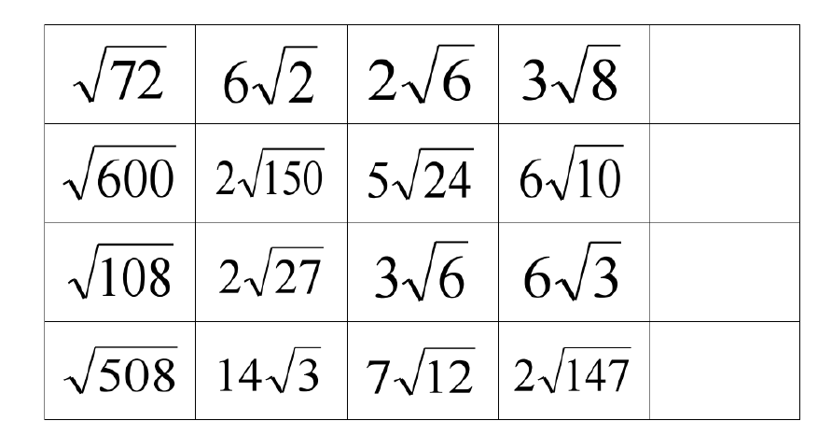
Find the odd one out on each row:
Challenge:
Add another surd, in the empty box, that is equivalent to the odd one out

Slide 24
Challenge:
Write the ratio in its simplest form
$$\sqrt{8} : \sqrt{50 } : \sqrt{128}$$

