Slide 3
RECAP
What is the side length?
100
64
$$\sqrt{100}$$
$$=10$$
$$\sqrt{64}$$
$$=8$$
36
$$\sqrt{36}$$
$$=6$$

Slide 4
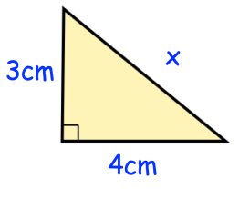
RECAP
Find the missing area
25
9
$$\sqrt{25}$$
$$=5$$
Now find the missing side
16

Slide 5
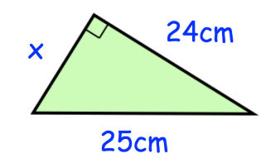
Find the missing area
576
49
Now find the missing side
$$\sqrt{49}$$
$$=7$$
625

Slide 6
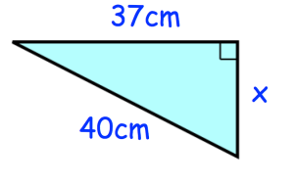
Find the missing area
1369
231
Now find the missing side
1600
$$\sqrt{231}$$
$$=15.2$$

Slide 7
5cm
13cm
5cm
4cm
x cm
x cm

Slide 8
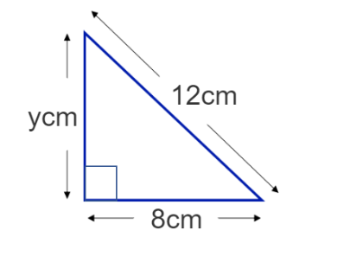
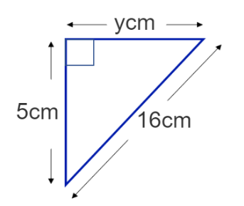
Find the exact value of y
Find the exact value of y

Slide 9
Find y to 1 decimal place
Find y to 1 decimal place

Slide 10
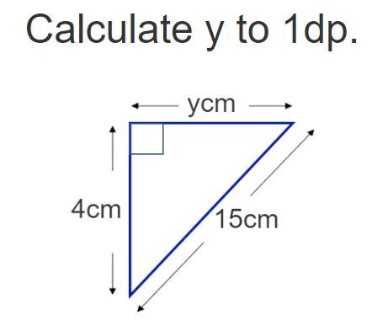
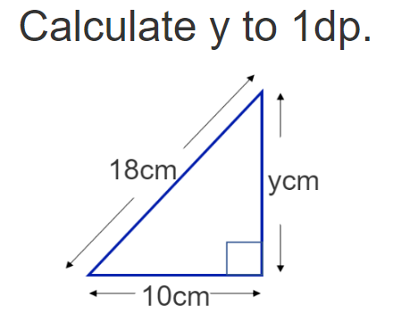

Slide 11
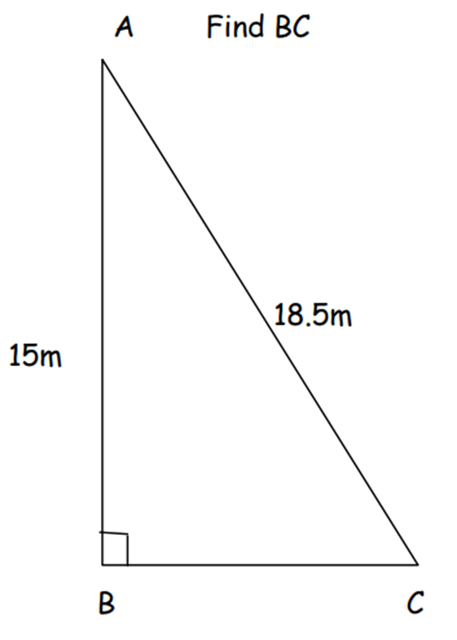
Can you spot the mistake

Slide 12
What is the length of $x$?
Give your answer to 2 d.p.
b
10 cm
a
c
$$x$$
12 cm
Not to scale

Slide 13
What is the length of $x$?
Give your answer to 2 d.p.
a
b
$$x$$
9 cm
13 cm
c
Not to scale

Slide 14
What is the length of $x$?
Give your answer to 2 d.p.
$$x$$
12 cm
13 cm
Not to scale

Slide 15
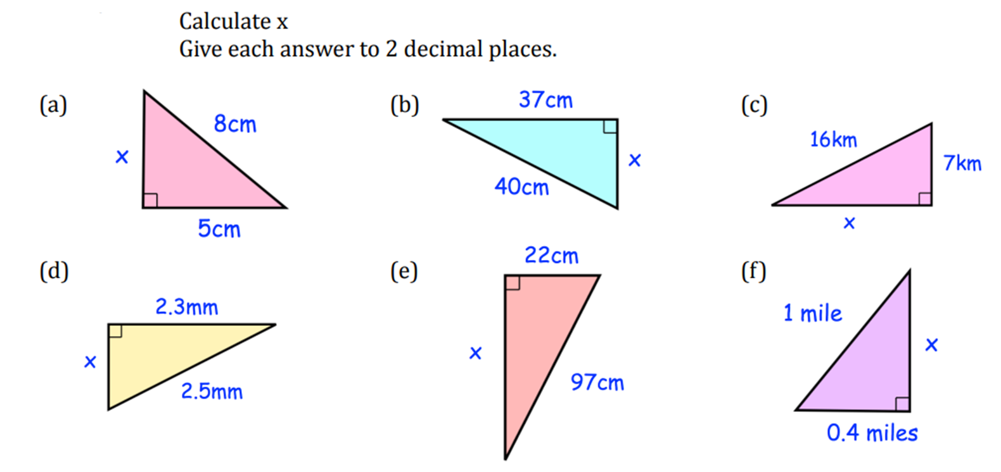
Calculate x for each diagram

Slide 16
Calculate x for each diagram

Slide 17
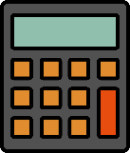
1)
12 cm
1)
7 cm
$$x$$
1)
36 cm
5 cm
22 cm
a
10 cm
Calculate length a.
Express the
exact value of $x$.
Find the area of
this triangle.
2)
8 m
b
2)
2)
Calculate the area of a right-angled triangle with a hypotenuse of 40 cm & a height of 20 cm.
9 cm
$$z$$
7 m
Calculate length b.
Find length $z$.
3)
36 cm
3)
3)
20 cm
32 cm
4 mm
16 cm
5 mm
c
22 cm
2 mm
Calculate the perimeter
of this triangle.
Find length c.
Find the perimeter of this shape.

Slide 18
1)
12 cm
1)
7 cm
$$x$$
1)
36 cm
5 cm
22 cm
a
10 cm
$\sqrt{51}$ cm
10.9 cm
Calculate length a.
Express the
exact value of $x$.
Find the area of
this triangle.
626.9 cm²
2)
8 m
b
2)
2)
Calculate the area of a right-angled triangle with a hypotenuse of 40 cm & a height of 20 cm.
9 cm
$$z$$
7 m
3.9 m
6.4 cm
Calculate length b.
Find length $z$.
3)
36 cm
3)
3)
346.4 cm²
20 cm
32 cm
4 mm
16 cm
48 cm
5 mm
c
22 cm
2 mm
Calculate the perimeter
of this triangle.
14.6 mm
Find length c.
42.8 cm
Find the perimeter of this shape.

Slide 19
