Slide 1
Express the following as a product of prime factors
24
48
96
100
200
600

Slide 2
Simplify
$$\sqrt{126}$$
For some larger surds it can be more challenging to identify a factor that is a square number.
It can be useful to consider prime factors in these cases.

Slide 3
$$\sqrt{126}$$
$$=\sqrt{2}×\sqrt{2}×\sqrt{2}×\sqrt{2}×\sqrt{7}$$
$$\sqrt{2}×\sqrt{56}$$
$$=2×2×\sqrt{7}$$
$$=4\sqrt{7}$$
$$\sqrt{2}×\sqrt{28}$$
$$\sqrt{2}×\sqrt{14}$$
$$\sqrt{2}×\sqrt{7}$$

Slide 4
We Do
You Do
Simplify
Simplify
$$\sqrt{240}$$
$$\sqrt{245}$$
$$7\sqrt{5}$$

Slide 5
What method do you prefer?
Why?
$$\sqrt{9×14}$$
$$\sqrt{126}$$
$$\sqrt{9}×\sqrt{14}$$
Lucy
Just look for square factors.
Full Prime Factorisation!
Factorise until I can spot a square factor.
Mark
$$\sqrt{2×3×3×7}$$
Pete
$$\sqrt{2×63}$$
$\sqrt{2}×\sqrt{3}$ $×\sqrt{3}×\sqrt{7}$
$$\sqrt{2×9×7}$$
$$\sqrt{2}×3×\sqrt{7}$$

Slide 6
Simplify
$$\sqrt{756}$$
$$6\sqrt{21}$$

Slide 7
Simplify
$$\sqrt{210}$$
Notes:
Can’t be simplified further

Slide 8
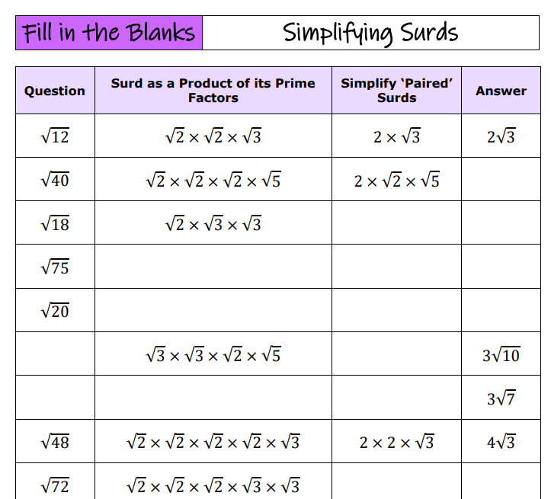
Notes:
7ac124_cab253893ff748cdba3cdd4a0e0e7cb8.pdf

Slide 9
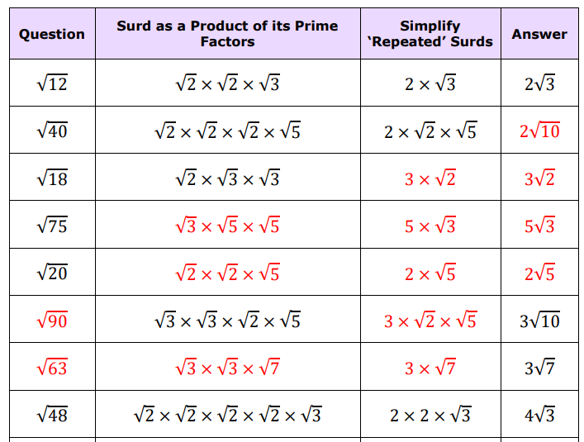

Slide 10
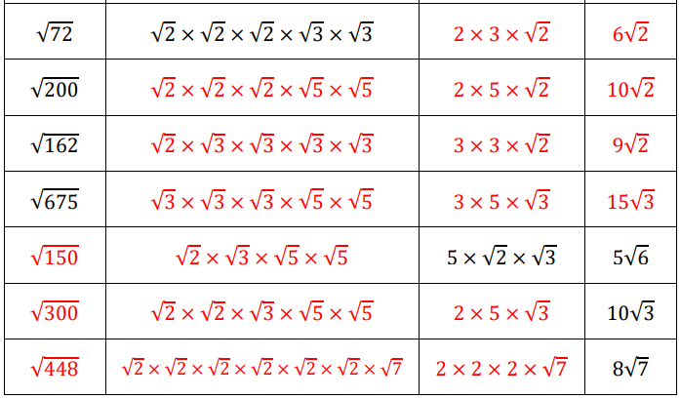

Slide 11
Simplify:
Simplify:
Simplify:
1)
$$\sqrt{12}$$
1)
$$\sqrt{50}$$
1)
$$2\sqrt{27}$$
2)
$$\sqrt{40}$$
2)
$$\sqrt{63}$$
2)
$$3\sqrt{96}$$
3)
$$\sqrt{24}$$
3)
$$\sqrt{75}$$
$$2\sqrt{343}$$
3)
4)
$$\sqrt{18}$$
4)
$$\sqrt{98}$$
$$\frac{\sqrt{360}}{2}$$
4)
5)
$$\sqrt{8}$$
5)
$$\sqrt{112}$$
5)
$$\frac{2}{3}\sqrt{243}$$
6)
$$\sqrt{28}$$
6)
$$\sqrt{147}$$
7)
$$\sqrt{80}$$
7)
$$\sqrt{216}$$
6)
$$\sqrt{216}×\sqrt{50}$$

Slide 12
Simplify:
Simplify:
Simplify:
1)
$$\sqrt{12}$$
$$2\sqrt{3}$$
1)
$$\sqrt{50}$$
$$5\sqrt{2}$$
1)
$$2\sqrt{27}$$
$$6\sqrt{3}$$
2)
$$\sqrt{40}$$
$$2\sqrt{10}$$
2)
$$\sqrt{63}$$
$$3\sqrt{7}$$
2)
$$3\sqrt{96}$$
$$12\sqrt{6}$$
3)
$$\sqrt{24}$$
$$2\sqrt{6}$$
3)
$$\sqrt{75}$$
$$5\sqrt{3}$$
$$2\sqrt{343}$$
$$14\sqrt{7}$$
3)
4)
$$\sqrt{18}$$
$$3\sqrt{2}$$
4)
$$\sqrt{98}$$
$$7\sqrt{2}$$
$$\frac{\sqrt{360}}{2}$$
$$3\sqrt{10}$$
4)
5)
$$\sqrt{8}$$
$$2\sqrt{2}$$
5)
$$\sqrt{112}$$
$$4\sqrt{7}$$
5)
$$\frac{2}{3}\sqrt{243}$$
$$6\sqrt{3}$$
6)
$$\sqrt{28}$$
$$2\sqrt{7}$$
6)
$$\sqrt{147}$$
$$7\sqrt{3}$$
7)
$$\sqrt{80}$$
$$4\sqrt{5}$$
7)
$$\sqrt{216}$$
$$6\sqrt{6}$$
6)
$$\sqrt{216}×\sqrt{50}$$
$$60\sqrt{3}$$

Slide 13
Simplify:
Simplify:
a)
$$\sqrt{80}$$
$$=4\sqrt{5}$$
$$\sqrt{75}$$
b)
$$\sqrt{99}$$
$$=3\sqrt{11}$$
$$\sqrt{3×5×5}$$
c)
$$\sqrt{128}$$
$$=8\sqrt{2}$$
d)
$$\sqrt{250}$$
$$=5\sqrt{10}$$
$$\sqrt{3}×\sqrt{5}×\sqrt{5}$$
e)
$$\sqrt{108}$$
$$=6\sqrt{3}$$
f)
$$\sqrt{162}$$
$$=9\sqrt{2}$$
$$\sqrt{3}×5$$
g)
$$\sqrt{252}$$
$$=6\sqrt{7}$$
$$5\sqrt{3}$$
h)
$$\sqrt{432}$$
$$=12\sqrt{3}$$
Notes:
Extra Practice if needed

Slide 14
Problem 1
Problem 2
Problem 3

