Slide 3
Find the area of the triangle:
Area = ½ x base x height
5
a
Base = 6
Height = a
6

Slide 4
Find the area of the triangle:
Isosceles triangle:
5
Make 2 right angled triangles:
3
6

Slide 5
Find the area of the triangle:
Isosceles triangle:
Make 2 right angled triangles:
5
Use Pythagoras’ Theorem:
a
5² = 3² + a²
a² = 5² - 3²
3
a² = 25 - 9
a² = 16
a = √16
a = 4

Slide 6
The original problem:
Find the area of the triangle:
Area = ½ x base x height
5
4
base = 6
height = 4
Area = ½ x 6 x 4
Area = ½ x 24
6
Area = 12

Slide 7
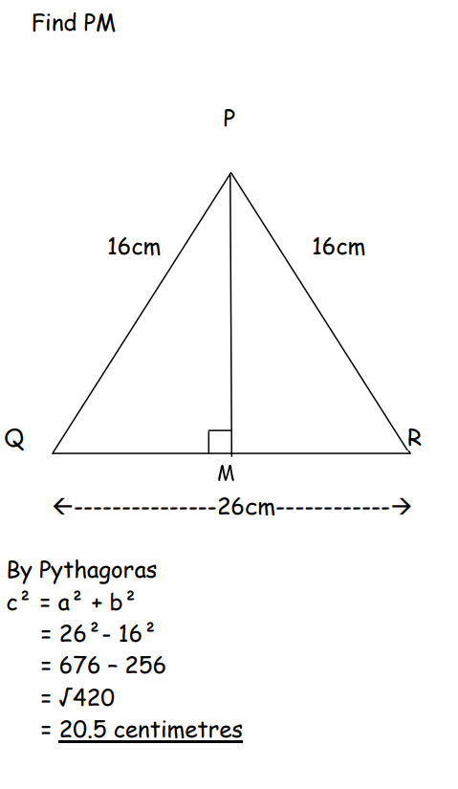
What is the mistake?

Slide 8
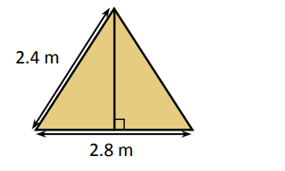
A tent is 2.8 metres wide. Its sloping sides are 2.4 metres long. Calculate the height of the tent correct to 2 decimal places.

Slide 9
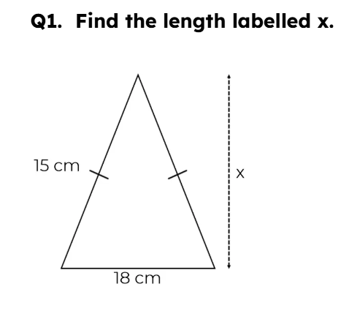
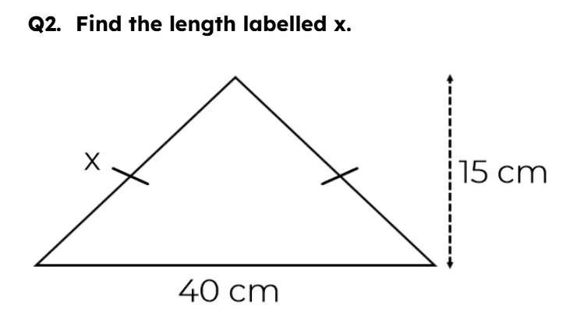
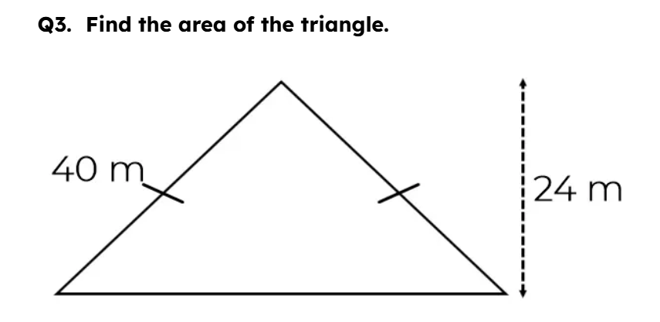

Slide 10
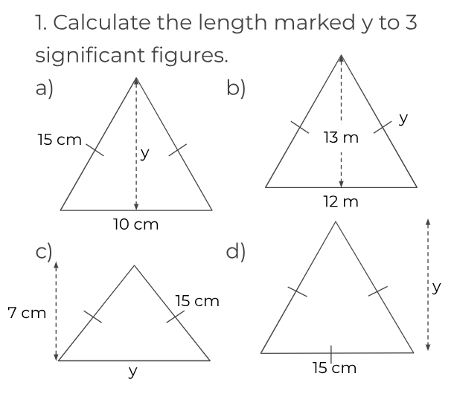

Slide 11
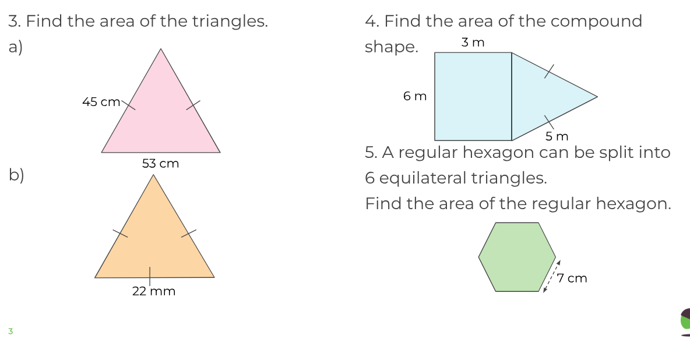

Slide 12
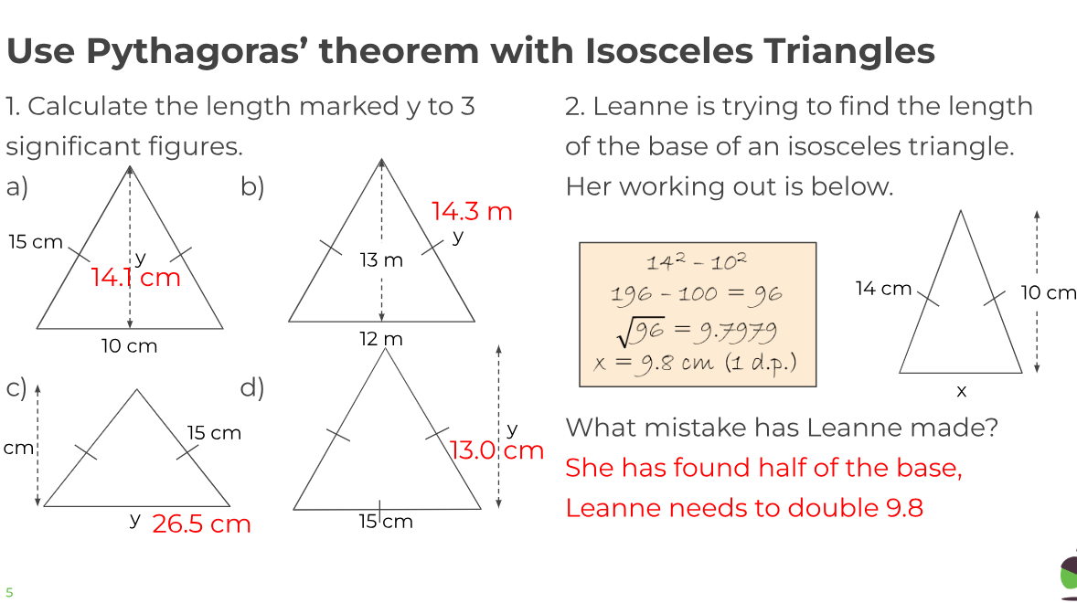

Slide 13
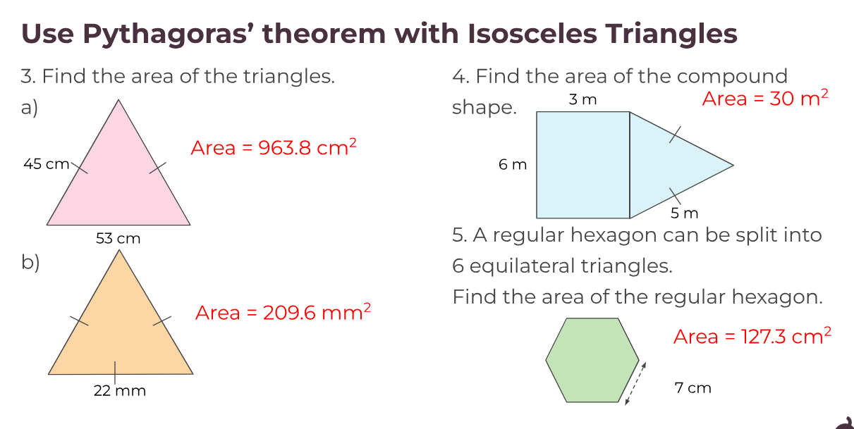

Slide 14
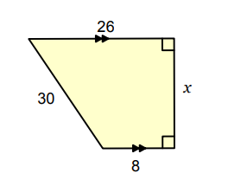
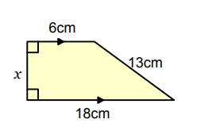
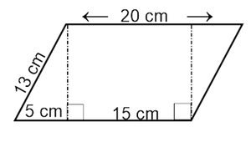

Slide 15
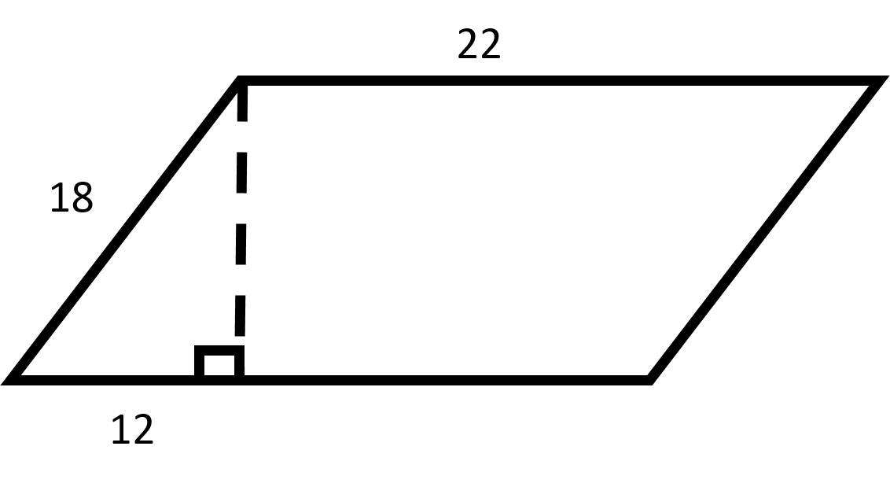
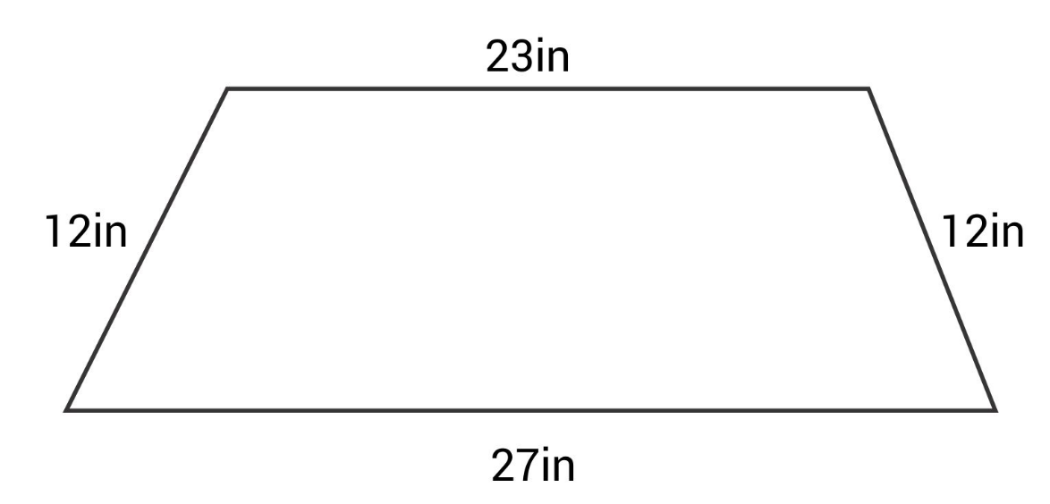
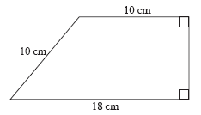
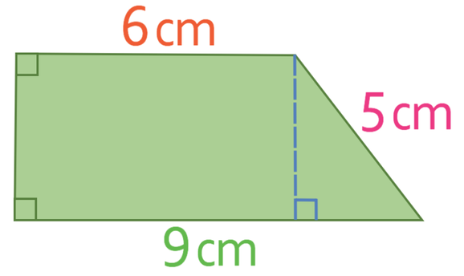
Find the missing height of each shape

Slide 16
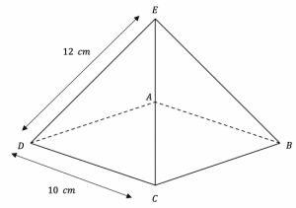
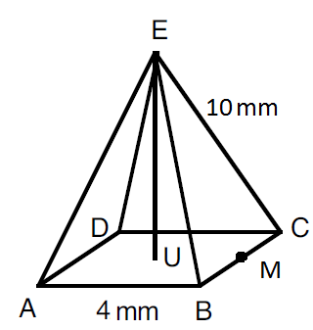

Slide 17
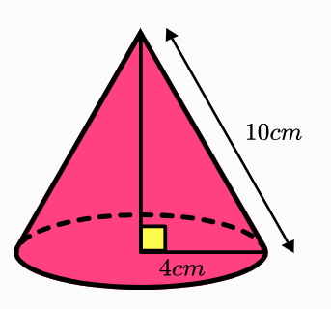
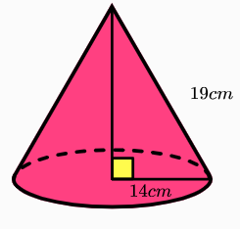
Calculate the perpendicular height of the cone
Calculate the perpendicular height of the cone

Slide 18
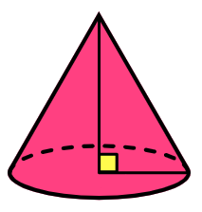
Calculate the radius of the cone
Calculate the radius of the cone
36cm
40cm
15
cm
25
cm

Slide 19

Calculate the perpendicular height of the cone
29 cm
h cm
12 cm

Slide 20
Calculate the perpendicular height of the cone
88 cm
w cm
32 cm

Slide 21
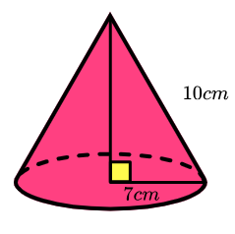
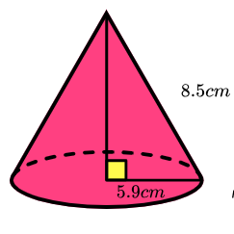
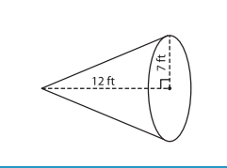
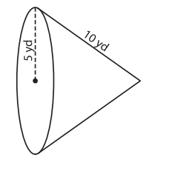
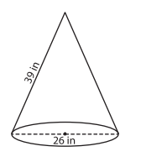
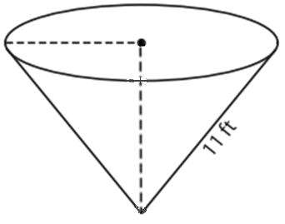
Where possible find the missing perpendicular height or radius of each cone
10m
14ft
20m

Slide 22
Where possible find the missing perpendicular height or radius of each cone
7.1
6.1
Already done
8.7
10m
14ft
20m
36.8
17.3
Not possible

Slide 23
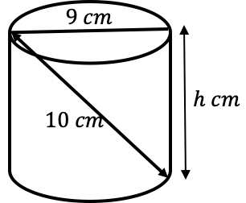
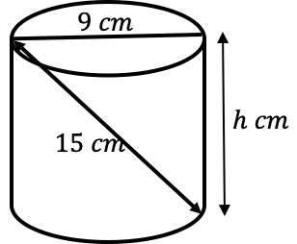
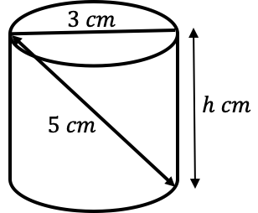
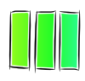
Don’t forget to | Reflect | Expect | Check | Explain | for each question
I DO
Calculate the volume of the cylinder below.
WE DO
Calculate the volume of the cylinder below.
YOU DO
Calculate the volume of the cylinder below.

Slide 24
Don’t forget to | Reflect | Expect | Check | Explain | for each question
I DO
Calculate the volume of the cylinder below.
WE DO
Calculate the volume of the cylinder below.
YOU DO
Calculate the volume of the cylinder below.
Draw the triangle
9
h
10
h²+9²=10²
h²+81=100
h=√19
d=9cm so r=4.5cm
Volume of Cylinder=πr²h
V=π x 4.5² x √19
V=277.3cm³ (1dp)

